Slide 1
MATH 1051H - S61 - Lecture 10

Slide 2
Inference for other estimators

Slide 3
Inference for other estimators
The sample mean is not the only point estimate for which the sampling distribution is nearly normal. For example, the sampling distribution of sample proportions is also nearly normal when $n$ is sufficiently large (more on this later)

Slide 4
Inference for other estimators
The sample mean is not the only point estimate for which the sampling distribution is nearly normal. For example, the sampling distribution of sample proportions is also nearly normal when $n$ is sufficiently large (more on this later)
An important assumption about point estimates is that they are unbiased, i.e., the sampling distribution of the estimate is centered at the true population parameter it estimates.

Slide 5
Inference for other estimators
The sample mean is not the only point estimate for which the sampling distribution is nearly normal. For example, the sampling distribution of sample proportions is also nearly normal when $n$ is sufficiently large (more on this later)
An important assumption about point estimates is that they are unbiased, i.e. the sampling distribution of the estimate is centered at the true population parameter it estimates.
An unbiased estimate does not naturally over or underestimate the parameter. Rather, it tends to provide a “good” estimate.
The sample mean is an example of an unbiased point estimate, as are each of the examples we introduce in this section.

Slide 6
Inference for other estimators
The sample mean is not the only point estimate for which the sampling distribution is nearly normal. For example, the sampling distribution of sample proportions is also nearly normal when $n$ is sufficiently large (we’ll talk about this in detail in two weeks).
An important assumption about point estimates is that they are unbiased, i.e. the sampling distribution of the estimate is centered at the true population parameter it estimates.
That is, an unbiased estimate does not naturally over or underestimate the parameter. Rather, it tends to provide a “good” estimate.
The sample mean is an example of an unbiased point estimate, as are each of the examples we introduce in this section.
Some point estimates follow distributions other than the normal distribution, and some scenarios require statistical techniques that we haven’t covered yet - we will discuss most of these in the next course (1052H)

Slide 7
Non-normal point estimates
We may apply the ideas of hypothesis testing to cases where the point estimate or test statistic is not necessarily normal. There are many reasons why such a situation may arise:
the sample size is too small for the normal approximation to be valid;
the standard error estimate may be poor; or
the point estimate tends towards some distribution that is not the normal distribution.

Slide 8
Non-normal point estimates
We may apply the ideas of hypothesis testing to cases where the point estimate or test statistic is not necessarily normal. There are many reasons why such a situation may arise:
the sample size is too small for the normal approximation to be valid;
the standard error estimate may be poor; or
the point estimate tends towards some distribution that is not the normal distribution.
For each case where the normal approximation is not valid, our first task is always to understand and characterize the sampling distribution of the point estimate or test statistic. Next, we can apply the general frameworks for hypothesis testing to these alternative distributions.

Slide 9
When to retreat
Statistical tools rely on the following two main conditions:
Independence: A random sample from less than 10% of the population ensures independence of observations. In experiments, this is ensured by random assignment. If independence fails, then advanced techniques must be used, and in some such cases, inference may not be possible.
Sample size and skew: For example, if the sample size is too small, the skew too strong, or extreme outliers are present, then the normal model for the sample mean will fail.
Whenever conditions are not satisfied for a statistical technique:
Learn new methods that are appropriate for the data.
Consult a statistician.
Ignore the failure of conditions. This last option effectively invalidates any analysis and may discredit novel and interesting findings.

Slide 10
Practice
All else held equal, will the p-value be lower if $n=100$ or $n=10000$?
$n=100$
$n=10000$

Slide 11
Practice
All else held equal, will the p-value be lower if $n=100$ or $n=10,000$?
$n=100$
$n=10,000$
Suppose $\overline{x}=50$, $s=2$, $H_{0}:μ=49.5$, and $H_{A}:μ>49.5$.
$$\begin{matrix}Z_{n=100} & = & \frac{50−49.5}{\frac{2}{\sqrt{100}}}=\frac{50−49.5}{\frac{2}{10}}=\frac{0.5}{0.2}=2.5, p-value=0.0062 \\ Z_{n=10000} & = & \frac{50−49.5}{\frac{2}{\sqrt{10000}}}=\frac{50−49.5}{\frac{2}{100}}=\frac{0.5}{0.02}=25, p-value≈0\end{matrix}$$
As $n$ increases - $SE$ $↓$, $Z$ $↑$, p-value $↓$

Slide 12
Demonstration
Imagine we test the hypothesis $H_{0}:μ=10$ vs. $H_{A}:μ>10$ for the following 8 samples. Assume $σ=2$.

Slide 13
$\overline{x}$ | $10.05$ | $10.10$ | $10.2$
$n=30$ | p = 0.45 | p = 0.39 | p = 0.29
$n=5000$

Slide 14
Demonstration
Imagine we test the hypothesis $H_{0}:μ=10$ vs. $H_{A}:μ>10$ for the following 8 samples. Assume $σ=2$.

Slide 15
$\overline{x}$ | $10.05$ | $10.10$ | $10.2$
$n=30$ | p = 0.45 | p = 0.39 | p = 0.29
$n=5000$ | p = 0.04 | p = 0.0002 | p $≈0$

Slide 16
Demonstration
Imagine we test the hypothesis $H_{0}:μ=10$ vs. $H_{A}:μ>10$ for the following 8 samples. Assume $σ=2$.

Slide 17
$\overline{x}$ | $10.05$ | $10.10$ | $10.2$
$n=30$ | p = 0.45 | p = 0.39 | p = 0.29
$n=5000$ | p = 0.04 | p = 0.0002 | p $≈0$

Slide 18
When $n$ is large, even small deviations from the null (small effect sizes), which may be considered practically insignificant, can yield statistically significant results.

Slide 19
Statistical vs. practical significance
Real differences between the point estimate and null value are easier to detect with larger samples.
However, very large samples will result in statistical significance even for tiny differences between the sample mean and the null value (effect size), even when the difference is not practically significant.
This is especially important to research: if we conduct a study, we want to focus on finding meaningful results (we want observed differences to be real, but also large enough to matter).
The role of a statistician is not just in the analysis of data, but also in planning and design of a study.

Slide 20
Aphorism
“To call in the statistician after the experiment is done may be no more than asking him to perform a postmortem examination: he may be able to say what the experiment died of.” - Sir Ronald Aylmer Fisher, Address to Indian Statistical Congress (1938)
It’s ok to need help: you’re not statisticians, and you won’t be at the end of this class!

Slide 21
The t Distribution

Slide 22
A Specific Example of Non-Normal
In the last discussion, we talked about how we might approach certain problems where the normal assumption does not hold. We’re now going to start looking at a specific, famous example of this kind of problem - the t distribution.

Slide 23
Example
Mercury in seafood due to pollution is a known problem, especially in heavy industrial areas, although mercury has spread a long way from explicit polluters. Japan as a country consumes a large amount of seafood, and researches were interested in the average mercury content in Rossi’s dolphins from the Taiji area. They analyzed 19 dolphins’ muscles for mercury content.

Slide 24
n | $\overline{x}$ | s | minimum | maximum
19 | 4.4 | 2.3 | 1.7 | 9.2

Slide 25
Measurements are in micrograms of mercury per wet gram of muscle ($μ$g/wet g).
So, a “begged question”: could we do a hypothesis test on this data using what we know so far (e.g., a Z distribution)?

Slide 26
Review: Purpose of Large Sample
As long as observations are independent, and the population distribution is not extremely skewed, a large sample would ensure that:
the sampling distribution of the mean is nearly normal
the estimate of the standard error (SE), as $\frac{s}{\sqrt{n}}$, is reliable

Slide 27
The normality condition
The CLT, which states that sampling distributions will be nearly normal, holds true for any sample size as long as the population distribution is nearly normal.
While this is a helpful special case, it’s inherently difficult to verify normality in small data sets.
We should exercise caution when verifying the normality condition for small samples. It is important to not only examine the data but also think about where the data come from.
For example, ask: would I expect this distribution to be symmetric, and am I confident that outliers are rare?

Slide 28
In Context (Dolphins)
How big is our sample? And, given the summary, how symmetric is our data?
only 19 samples
no population $σ$
data seems mostly symmetric

Slide 29
The $t$ Distribution
When working with small samples, and the population standard deviation is unknown (almost always), the uncertainty of the standard error estimate is addressed by using a new distribution: the $t$ distribution.
This distribution also has a bell shape, but its tails are thicker than the normal model’s.
Therefore observations are more likely to fall beyond two SDs from the mean than under the normal distribution.
These extra thick tails are helpful for resolving our problem with a less reliable estimate the standard error (since $n$ is small)

Slide 30
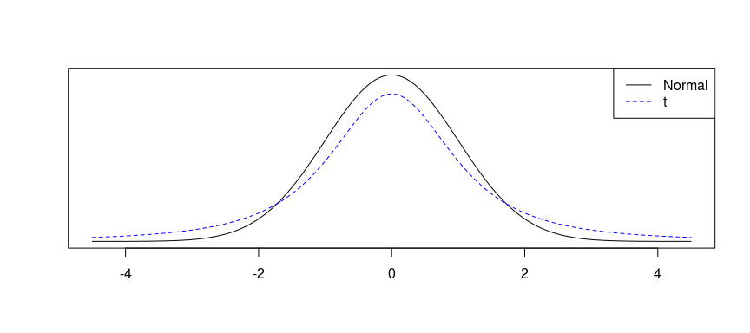
A plot of $t$ versus $N$

Slide 31
The $t$ Distribution (ctd.)
Always centered at zero, like the standard normal ($z$) distribution.
Has a single parameter: degrees of freedom ($df$) – like $χ^{2}$.
What happens to the shape of the $t$ distribution as $df$ increases?

Slide 32
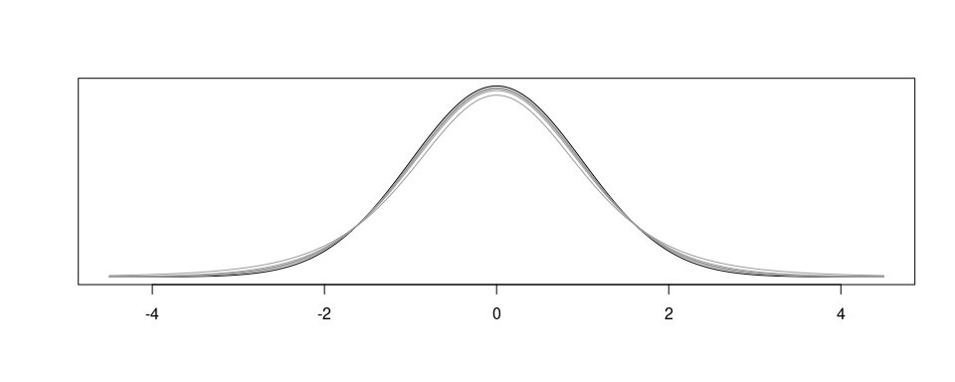
The $t$ Distribution (ctd.)

Slide 33
As $df→∞$, the $t$ distribution approaches the normal!

Slide 34
Asymptotic
What $df$ is required to give arbitrary decimal agreement between the $t$ and $z$ curves? (on a restricted domain)
2 decimals: $df=14$
3 decimals: $df=136$
4 decimals: $df=1370$
What do we usually ask for? 30 $df$ corresponds to 3 decimals for the $[−3,3]$ domain, which is good enough. So once $df>30$, people often just use a $z$ instead.

Slide 35
Recap: Inference using a small sample mean
If $n<30$, sample means follow a $t$ distribution with $SE=\frac{s}{\sqrt{n}}$, unless you are positive you know the population standard deviation $σ$.
Conditions:
independence of observations (often verified by a random sample, and if sampling without replacement, $n<10\%$ of population)
$n<30$ and no extreme skew
Hypothesis Testing:
$$t_{df}=\frac{point estimate−null value}{SE}, where df=n−1.$$

Slide 36
Back to the Dolphins
Researchers want to know if the average mercury content in these dolphins exceeds 4 $μg$/wet g. Perform a hypothesis test to answer this question.

Slide 37
n | $\overline{x}$ | s | minimum | maximum
19 | 4.4 | 2.3 | 1.7 | 9.2

Slide 38
Hypothesis Test
$H_{0}:μ≤4 versus H_{A}:μ>4$
Conditions:
we assume independence of observations
$n<30$
don’t know $σ$
So we need to use the t!

Slide 39
Test Statistic
The test statistic doesn’t change: it’s a test statistic on the mean, so the statistic stays the same! The only difference is that the random variable we get is no longer assumed to be a Z … instead, it’s a t.
$$t=\frac{\overline{x}−μ_{0}}{{SE}_{\overline{x}}}=\frac{4.4−4}{\frac{2.3}{\sqrt{19}}}=0.7581.$$

Slide 40
Computing the p-value
Our alternative is $μ>4$, so our p-value goes up …

Slide 41
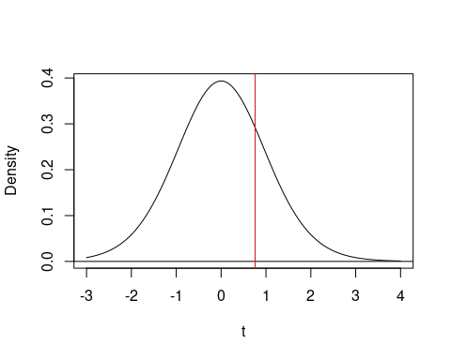

Slide 42
p-value
But there’s a trick … when you specify a t distribution, you don’t specify mean/SD … you have to specify the degrees-of-freedom (df). Our rule for the mean is that df is n-1: one less than the number of samples you have.
pt(q = 0.7581, df = 19 - 1, lower.tail = FALSE)
## [1] 0.2291013
Thus our p-value is 0.229, which is “big”, so we would fail to reject the null hypothesis, meaning we cannot conclude that the mean is greater than 4 $μg$/wet g.

Slide 43
Summary of Tests on Means for t Distributions
Similar assumptions to the Z
Same test statistic
Notice the df argument (n-1)
Same way of computing p-value, except use pt() not pnorm()
Same interpretation

Slide 44
Linear Regression and Hypothesis

Slide 45
Linear Regression
$$\hat{y}=β_{0}+β_{1}x$$
Notation:
Intercept:
Parameter: $β_{0}$
Point estimate: $b_{0}$
Slope:
Parameter: $β_{1}$
Point estimate: $b_{1}$

Slide 46
Note
Both parameters have point estimates … these are statistics! That means we can do hypothesis tests on them!

Slide 47
Hypothesis Tests for Linear Regression
Most of the time, we only do hypothesis tests for linear regression on the slope - specifically, on $β_{1}$ as the parameter.
So what is the hypothesis?
What do we say about the null … default, base, nothing going on, nothing to see, do not pass go …

Slide 48
Null Hypothesis for Slopes
Remember what a slope is: it’s actually a representation of the relationship between two variables (like correlation). So our default is that there is no relationship. What does this correspond to? If there’s no relationship, that corresponds to correlation 0 … which is also slope 0!
Thus
$H_{0}$: $β_{1}=0$
is our null hypothesis.

Slide 49
Alternative Hypothesis for Slopes
So what is the alternative hypothesis? We only ever care about one:
$H_{A}$: $β_{1}≠0$.
So now we can perform hypothesis tests inside linear regressions!

Slide 50
Let’s Return to our Previous Example
USA states (and DC), with percent of population in poverty, and percent of population that graduated from high school.

Slide 51
Poverty - HS Grads
So what is our hypothesis in this problem? Let’s start with words:
Null Hypothesis: there is no relationship between the percentage of the population that graduate from high school, and the percentage of the population living in poverty.
Alternative Hypothesis: there is a relationship between these two variables.

Slide 52
Poverty - HS Grads
Now, translate this to symbols:
$$H_{0}:β_{1}=0 versus H_{A}:β_{1}≠0.$$
Now, how do we do this? We can’t do the test statistic like we normally do … but we don’t have to!

Slide 53
Poverty - HS Grads - Doing the Test
Take a close look at the row starting with Graduates: what do you see?
mod <- lm(Poverty ~ Graduates, data = poverty) summary(mod)
## ## Call: ## lm(formula = Poverty ~ Graduates, data = poverty) ## ## Residuals: ## Min 1Q Median 3Q Max ## -4.1624 -1.2593 -0.2184 0.9611 5.4437 ## ## Coefficients: ## Estimate Std. Error t value Pr(>|t|) ## (Intercept) 64.78097 6.80260 9.523 9.94e-13 *** ## Graduates -0.62122 0.07902 -7.862 3.11e-10 *** ## --- ## Signif. codes: 0 '***' 0.001 '**' 0.01 '*' 0.05 '.' 0.1 ' ' 1 ## ## Residual standard error: 2.082 on 49 degrees of freedom ## Multiple R-squared: 0.5578, Adjusted R-squared: 0.5488 ## F-statistic: 61.81 on 1 and 49 DF, p-value: 3.109e-10

Slide 54
Poverty - HS Grads - Doing the Test
Variable | Estimate | Std. Error | t value | Pr(>|t|)
Graduates | -0.62122 | 0.07902 | -7.862 | 3.11e-10 ***

Slide 55
So we have:
point estimate: $−0.62122$
SE: $0.07902$
test statistic: $t=−7.862$
p-value: $p=3.11e−10$ (very, very small!)
So what’s our conclusion?

Slide 56
Poverty - Conclusions
Since we find an extremely small p-value (smaller than $α=0.05$ for sure), we reject the null hypothesis, and conclude that there is a relationship between the percentage of the population graduating from high school, and the percentage of the population living in poverty. We estimate $b_{1}=−0.621$.

Slide 57
So … Hypotheses on Linear Models
So we can estimate slopes, then do hypothesis tests on them, which lets us determine if we believe there are associations (or “relationships”) between them. And we don’t have to do much … just fit a model in R, and then read the answer.

Slide 58
Connections between t-tests and Linear Regression

Slide 59
Why are they the same thing?
So why are t-tests and linear regression the same thing?
t-test: we’re comparing a set of data to some value $μ_{0}$
regression: we have a row we haven’t considered, labeled (Intercept)
So, this actually means that
$$H_{0}:μ=μ_{0} (t-test on mean)$$
is equivalent to
$$H_{0}:β_{0}=μ_{0} (t-test on intercept - mean!)$$
In other words, a t-test it’s our linear model $y=β_{0}+β_{1}x$ where the slope term is gone since there is no x.

Slide 60
Let’s Try an Example
Consider the dolphin example from before, with some specific data (not exactly the same). We are interested in $H_{0}:μ=4.0$.
dat <- c(2.56, 3.86, 5.66, 5.95, 7.67, 1.92, 10.01, 6.00, 4.47, 6.83, 1.47, 1.02, 8.36, 3.36, 5.34, 1.75, 4.55, 4.78, 4.91) mod_a <- t.test(x = dat, alternative = "two.sided", mu = 4) mod_b <- lm((dat - 4) ~ 1)

Slide 61
Fitting using the t.test() function
mod_a
## ## One Sample t-test ## ## data: dat ## t = 1.3611, df = 18, p-value = 0.1903 ## alternative hypothesis: true mean is not equal to 4 ## 95 percent confidence interval: ## 3.586035 5.937123 ## sample estimates: ## mean of x ## 4.761579

Slide 62
Fitting using the Linear Model
summary(mod_b)
## ## Call: ## lm(formula = (dat - 4) ~ 1) ## ## Residuals: ## Min 1Q Median 3Q Max ## -3.7416 -1.8016 0.0184 1.2134 5.2484 ## ## Coefficients: ## Estimate Std. Error t value Pr(>|t|) ## (Intercept) 0.7616 0.5595 1.361 0.19 ## ## Residual standard error: 2.439 on 18 degrees of freedom

Slide 63
So …
That (Intercept) piece we ignored from our previous section turns out to be a t-test on the mean, when considered without a slope! Neat!

Slide 64
Coming Up Next
In our coming lectures, we will explore one additional test (on proportions), and then discuss a very important idea called “confidence intervals” that are related to hypothesis tests, and used for describing estimates!

