Slide 1
MATH 1051H-A: Lecture #04

Slide 2
Considering Categorical Data

Slide 3
A Couple of Wrap-up Ideas
In the last lecture, we discussed numerical data, and several summary plots (histogram, boxplot). In this little warm-up / wrap-up, we’ll finish talking about data a bit more, including contingency tables, which have at least one example used on the second WeBWorK Assignment.

Slide 4
Contingency Tables
A table that summarizes data for two categorical variables is called a contingency table.
The contingency table below shows the distribution of students’ genders and whether or not they are looking for a spouse while in college.
looking for spouse
No
Yes
Total
gender
Female
86
51
137
Male
52
18
70
Total
138
69
207

Slide 5
Bar Plots
A bar plot is a common way to display a single categorical variable. A bar plot where proportions instead of frequencies are shown is called a relative frequency bar plot.

Slide 6
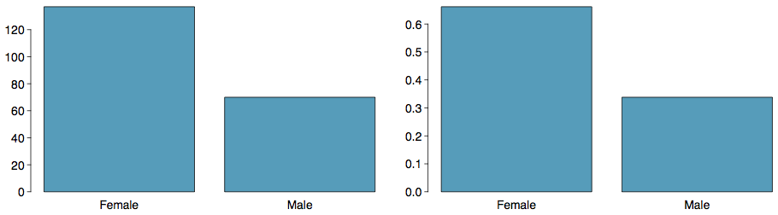

Slide 7
How are bar plots different than histograms? Bar plots are used for displaying distributions of categorical variables, while histograms are used for numerical variables. The x-axis in a histogram is a number line, hence the order of the bars cannot be changed, while in a bar plot the categories can be listed in any order (though some orderings make more sense than others, especially for ordinal variables.)

Slide 8
Choosing the Appropriate Proportion
Does there appear to be a relationship between gender and whether the student is looking for a spouse in college?
looking for spouse
No
Yes
Total
gender
Female
86
51
137
Male
52
18
70
Total
138
69
207
To answer this question we examine the row proportions:
% Females looking for a spouse: 51 / 137 ~ 0.37
% Males looking for a spouse: 18 / 70 ~ 0.26

Slide 9
Segmented Bar and Mosaic Plots
What are the differences between the three visualizations shown below?

Slide 10
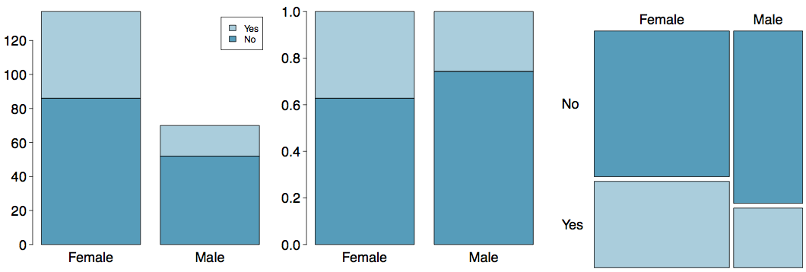

Slide 11
Pie Charts
Can you tell which order encompasses the lowest percentage of mammal species?
http://www.bucknell.edu/msw3

Slide 12
Comparing Numerical Data Across Groups
Does there appear to be a relationship between class year and the number of clubs students are in?

Slide 13
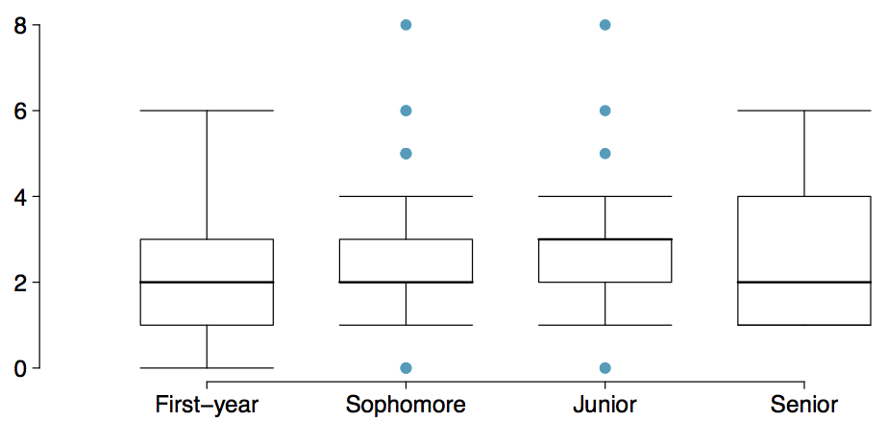

Slide 14
Defining Probability

Slide 15
Note
We are now starting a brand new set of ideas: probability! Some of the material will be covered quite quickly, because it’s not actually terribly relevant to our course. Our objective is to get to continuous probability so we can understand the tools that are used for statistics: the rest is just context.

Slide 16
Random processes
A random process is a situation in which we know what outcomes could happen, but we don’t know which particular outcome will happen.
Examples: coin tosses, die rolls, iTunes shuffle, whether the stock market goes up or down tomorrow, etc.
It can be helpful to model a process as random even if it is not truly random.
http://www.cnet.com.au/itunes-just-how-random-is-random-339274094.htm

Slide 17
Probability
There are several possible interpretations of probability but they (almost) completely agree on the mathematical rules probability must follow.
$P(A)$ = Probability of event A
$0≤P(A)≤1$

Slide 18
Probability: Frequentist
Frequentist interpretation:
The probability of an outcome is the proportion of times the outcome would occur if we observed the random process an infinite number of times.
relies on a “multiverse” concept for most problems, “if”

Slide 19
Probability: Bayesian
Bayesian interpretation:
A Bayesian interprets probability as a subjective degree of belief: For the same event, two separate people could have different viewpoints and so assign different probabilities.
Largely popularized by revolutionary advance in computational technology and methods during the last twenty years.

Slide 20
Practice
Which of the following events would you be most surprised by?
exactly 3 heads in 10 coin flips
exactly 3 heads in 100 coin flips
exactly 3 heads in 1000 coin flips

Slide 21
Practice
Which of the following events would you be most surprised by?
exactly 3 heads in 10 coin flips
exactly 3 heads in 100 coin flips
exactly 3 heads in 1000 coin flips

Slide 22
Law of large numbers
The Law of large numbers states that as more observations are collected, the proportion of occurrences with a particular outcome, ${\hat{p}}_{n}$, converges to the probability of that outcome, $p$.

Slide 23
Law of large numbers (cont.)
When tossing a fair coin, if heads comes up on each of the first 10 tosses, what do you think the chance is that another head will come up on the next toss? 0.5, less than 0.5, or more than 0.5?

Slide 25
Law of large numbers (cont.)
When tossing a fair coin, if heads comes up on each of the first 10 tosses, what do you think the chance is that another head will come up on the next toss? 0.5, less than 0.5, or more than 0.5?

Slide 27
Law of large numbers (cont.)

Slide 29
The probability is still 0.5, or there is still a 50% chance that another head will come up on the next toss.
$$P(H{ on 11}^{th} toss)=P(T{ on 11}^{th} toss)=0.5$$
The coin is not “due” for a tail.
The common misunderstanding of the LLN is that random processes are supposed to compensate for whatever happened in the past; this is just not true and is also called the gambler’s fallacy (or law of averages).

Slide 30
Disjoint and non-disjoint outcomes
Disjoint (mutually exclusive) outcomes: Cannot happen at the same time.
The outcome of a single coin toss cannot be a head and a tail.
A student both cannot fail and pass a class.
A single card drawn from a deck cannot be an ace and a queen.

Slide 31
Disjoint and non-disjoint outcomes
Disjoint (mutually exclusive) outcomes: Cannot happen at the same time.
The outcome of a single coin toss cannot be a head and a tail.
A student both cannot fail and pass a class.
A single card drawn from a deck cannot be an ace and a queen.
Non-disjoint outcomes: Can happen at the same time.
A student can get an A in Stats and A in Econ in the same semester.

Slide 32
Probability distributions
A probability distribution lists all possible events and the probabilities with which they occur.
The probability distribution for the gender of one child:

Slide 33
Event | Male | Female
Probability | 0.5 | 0.5

Slide 34
Probability distributions
A probability distribution lists all possible events and the probabilities with which they occur.
Rules for probability distributions:
The events listed must be disjoint
Each probability must be between 0 and 1
The probabilities must total 1

Slide 35
Probability distributions
A probability distribution lists all possible events and the probabilities with which they occur.
The probability distribution for the genders of two children:

Slide 36
Event | MM | FF | MF | FM
Probability | 0.25 | 0.25 | 0.25 | 0.25

Slide 37
Practice
In a survey, 52% of respondents said they like pizza. What is the probability that a randomly selected respondent from this sample is a pizza hater.
0.48
more than 0.48
less than 0.48
cannot calculate using only the information given

Slide 38
Practice
In a survey, 52% of respondents said they like pizza. What is the probability that a randomly selected respondent from this sample is a pizza hater.
0.48
more than 0.48
less than 0.48
cannot calculate using only the information given
More: If the only two states people can be in are pizza likers and pizza haters, then the first option (1) is possible. However, it is also possible there are people who are ambivalent about pizza, or love pizza (more than like?), or who have never eaten pizza! The only answer we can eliminate is (b), because it is impossible by the rules of probability.

Slide 39
Sample space and complements
The sample space is the collection of all possible outcomes of a trial (or experiment).
A couple has one child, what is the sample space for the gender of this child? $S=\{M,F\}$
A couple has two children, what is the sample space for the gender of these children? $S=$

Slide 40
Sample space and complements
The sample space is the collection of all possible outcomes of a trial (or experiment).
A couple has one child, what is the sample space for the gender of this child? $S=\{M,F\}$
A couple has two children, what is the sample space for the gender of these children? $S=\{MM,FF,FM,MF\}$

Slide 41
Sample space and complements
Complementary events are two mutually exclusive events whose probabilities that add up to 1.
A couple has one child. If we know that the child is not a boy, what is gender of this child? $\{M,F\}$. Male and female are complementary outcomes.
A couple has two children, if we know that they are not both female, what are the possible gender combinations for these children? $\{MM,FF,FM,MF\}$

Slide 42
Independence
Two processes are said to be independent of one another if knowing the outcome of one provides no useful information about the outcome of the other.
Knowing that the coin landed on a head on the first toss does not provide any useful information for determining what the coin will land on in the second toss. $→$ Outcomes of two tosses of a coin are independent.

Slide 43
Independence
Two processes are said to be independent of one another if knowing the outcome of one provides no useful information about the outcome of the other.
Knowing that the coin landed on a head on the first toss does not provide any useful information for determining what the coin will land on in the second toss. $→$ Outcomes of two tosses of a coin are independent.
Knowing that the first card drawn from a deck is an ace does provide useful information for determining the probability of drawing an ace in the second draw. $→$ Outcomes of two draws from a deck of cards (without replacement) are dependent.

Slide 44
Practice
Between January 9-12, 2013, SurveyUSA interviewed a random sample of 500 North Carolina residents asking them whether they think widespread gun ownership protects law abiding citizens from crime, or makes society more dangerous. 58% of all respondents said it protects citizens. 67% of White respondents, 28% of Black respondents, and 64% of Hispanic respondents shared this view. Which of the below is true?
Opinions on gun ownership and race ethnicity are most likely
complementary
mutually exclusive
independent
dependent
disjoint
http://www.surveyusa.com/client/PollReport.aspx?g=a5f460ef-bba9-484b-8579-1101ea26421b

Slide 45
Practice
Between January 9-12, 2013, SurveyUSA interviewed a random sample of 500 North Carolina residents asking them whether they think widespread gun ownership protects law abiding citizens from crime, or makes society more dangerous. 58% of all respondents said it protects citizens. 67% of White respondents, 28% of Black respondents, and 64% of Hispanic respondents shared this view. Which of the below is true?
Opinions on gun ownership and race ethnicity are most likely
complementary
mutually exclusive
independent
dependent
disjoint
http://www.surveyusa.com/client/PollReport.aspx?g=a5f460ef-bba9-484b-8579-1101ea26421b

Slide 46
Checking for independence:
If P(A occurs, given that B is true) = $P(A | B)=P(A)$, then A and B are independent.

Slide 47
The Gun Ownership Question
P(protects citizens) = 0.58
P(randomly selected NC resident says gun ownership protects citizens, given that the resident is white) = P(protects citizens $|$ White) = 0.67
P(protects citizens $|$ Black) = 0.28
P(protects citizens $|$ Hispanic) = 0.64
P(protects citizens) varies by race/ethnicity, therefore opinion on gun ownership and race ethnicity are most likely dependent.

Slide 48
Determining dependence based on sample data
If conditional probabilities calculated based on sample data suggest dependence between two variables, the next step is to conduct a hypothesis test to determine if the observed difference between the probabilities is likely or unlikely to have happened by chance.
If the observed difference between the conditional probabilities is large, then there is stronger evidence that the difference is real.
If a sample is large, then even a small difference can provide strong evidence of a real difference.

Slide 49
More on dependence
We saw that P(protects citizens $|$ White) = 0.67 and P(protects citizens $|$ Hispanic) = 0.64. Under which condition would you be more convinced of a real difference between the proportions of Whites and Hispanics who think gun widespread gun ownership protects citizens? $n=500$ or $n=50,000$

Slide 50
Disjoint vs. complementary
Do the sum of probabilities of two disjoint events always add up to 1?

Slide 51
Disjoint vs. complementary
Do the sum of probabilities of two disjoint events always add up to 1?
Not necessarily, there may be more than 2 events in the sample space, e.g. party affiliation.

Slide 52
Disjoint vs. complementary
Do the sum of probabilities of two disjoint events always add up to 1?
Not necessarily, there may be more than 2 events in the sample space, e.g. party affiliation.
Do the sum of probabilities of two complementary events always add up to 1?

Slide 53
Disjoint vs. complementary
Do the sum of probabilities of two disjoint events always add up to 1?
Not necessarily, there may be more than 2 events in the sample space, e.g. party affiliation.
Do the sum of probabilities of two complementary events always add up to 1?
Yes, that’s the definition of complementary, e.g. heads and tails.

Slide 54
Note
If you took a version of this course before, or a similar course, you may be expecting that we would do a lot of discrete probability questions: conditional probability, Bayes Rule, tree diagrams and so on. I have completely removed that from this course, as it really doesn’t do anything useful for the rest of the material. We’re now moving on to random variables and continuous probability (in the next lecture).

