Slide 1
MATH 1051H S61: Lecture 07

Slide 2
Statistics

Slide 3
Transition
In the first few lectures, we discussed some aspects of statistics (data, variable types, sampling concerns, and experimental design). We also touched on some aspects of plotting, which we then used in workshops.
Then we went off on a seeming tangent, and talked about probability for a while!
Now, we’re back to statistics, and will stay with it for the rest of the semester.

Slide 4
Data and Modeling
In science, we often obtain data from experiments or observational studies, and then are interested in modeling it. How we model it varies from field to field, but underlying many of the models used in science are statistical models. In this lecture, we will be examining one of the foundational models used all through every scientific field.
The material for this lecture comes from Chapters 2.1.1 and 8.

Slide 5
Line fitting, residuals, and correlation

Slide 6
Modeling numerical variables
We will begin by quantifying the relationship between two numerical variables, as well as modeling numerical response variables using a numerical or categorical explanatory variable. The model is therefore “find the relationship between two variables”.

Slide 7
Poverty vs. HS graduate rate
This scatterplot shows the relationship between HS graduate rate in all 50 US states and DC and the % of residents who live below the poverty line (income below $23,050 for a family of 4 in 2012).

Slide 8
Poverty vs. HS graduate rate (code)
par(mar=c(4,4,1,1), las=1, mgp=c(2.5,0.7,0), cex.lab = 1.5, cex.axis = 1.5) plot(poverty$Poverty ~ poverty$Graduates, ylab = "% in poverty", xlab = "% HS grad", pch = 19, col = COL[1,2])

Slide 9
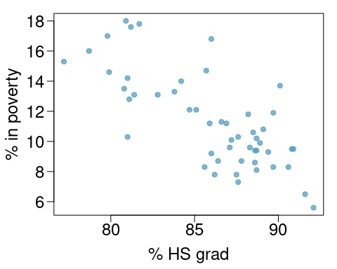

Slide 10
Poverty vs. HS graduate rate
Response variable?
Explanatory variable?
Relationship?

Slide 11
Poverty vs. HS graduate rate
Response variable? % in poverty
Explanatory variable? % HS grad
Relationship? linear, negative, moderately strong

Slide 12
Quantifying the relationship
Correlation describes the strength of the linear association between two variables.
It takes values between -1 (perfect negative) and +1 (perfect positive).
A value of 0 indicates no linear association.

Slide 13
Guessing the correlation
Which of the following is the best guess for the correlation between % in poverty and % HS grad?
0.6 -0.75 -0.1 0.02 -1.5

Slide 14
Guessing the correlation
# scatterplot, %poverty vs.%no husband par(mar=c(4,4,1,1), las=1, mgp=c(2.5,0.7,0), cex.lab = 1.5, cex.axis = 1.5) plot(poverty$Poverty ~ poverty$PercentFemaleHouseholderNoHusbandPresent, ylab = "% in poverty", xlab = "% female householder, no husband present", pch=19, col=COL[1,2])
Which of the following is the best guess for the correlation between % in poverty and % female householder (no husband present)?
0.1 -0.6 -0.4 0.9 0.5

Slide 15
Assessing the correlation
Which of the given plots has the strongest correlation, i.e., correlation coefficient closest to +1 or -1?

Slide 16
Answer
Correlation means linear association, and the strongest linear association is Figure (b). We can actually compute the correlations, and they are:
0.834 (a)
0.966 (b)
0.357 (c)
-0.852 (d)
We’ll show you how to do this in workshop!

Slide 17
Fitting a line by least squares regression

Slide 18
Eyeballing the line
Which of the lines on the figure appears to be the line that best fits the linear relationship between % in poverty and % HS grad? Choose one.

Slide 19
Residuals
Residuals are the leftovers from the model fit: Data = Fit + Residual

Slide 20
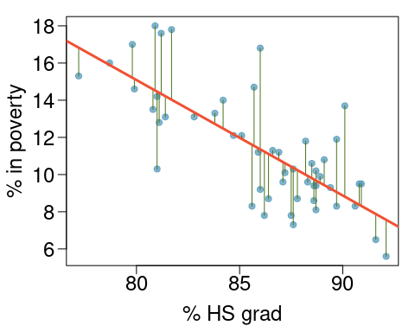

Slide 21
Residuals (cont.)
Formally, residuals are the difference between the observed ($y_{i}$) and predicted ${\hat{y}}_{i}$.
$$e_{i}=y_{i}−{\hat{y}}_{i}$$

Slide 22
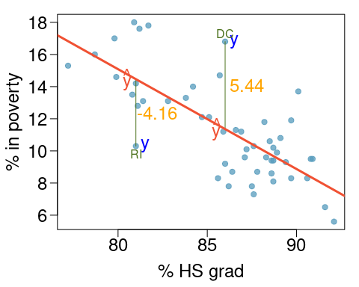
Specific Residuals

Slide 23
% living in poverty in DC is 5.44% more than predicted.
% living in poverty in RI is 4.16% less than predicted.

Slide 24
A measure for the best line
We want a line that has small residuals:
Option 1: Minimize the sum of magnitudes (absolute values) of residuals
$$|e_{1}|+|e_{2}|+⋯+|e_{n}|$$
Option 2: Minimize the sum of squared residuals – least squares
$$e_{1}^{2}+e_{2}^{2}+⋯+e_{n}^{2}$$
Option 3 … 100: actual topics of research!
Why least squares?
Most commonly used
Easier to compute by hand and using software
In many applications, a residual twice as large as another is usually more than twice as bad

Slide 25
The least squares line
$$\hat{y}=β_{0}+β_{1}x$$
Notation:
Intercept:
Parameter: $β_{0}$
Point estimate: $b_{0}$
Slope:
Parameter: $β_{1}$
Point estimate: $b_{1}$

Slide 26
The least squares line
mod <- lm(Poverty ~ Graduates, data = poverty) summary(mod)
## ## Call: ## lm(formula = Poverty ~ Graduates, data = poverty) ## ## Residuals: ## Min 1Q Median 3Q Max ## -4.1624 -1.2593 -0.2184 0.9611 5.4437 ## ## Coefficients: ## Estimate Std. Error t value Pr(>|t|) ## (Intercept) 64.78097 6.80260 9.523 9.94e-13 *** ## Graduates -0.62122 0.07902 -7.862 3.11e-10 *** ## --- ## Signif. codes: 0 '***' 0.001 '**' 0.01 '*' 0.05 '.' 0.1 ' ' 1 ## ## Residual standard error: 2.082 on 49 degrees of freedom ## Multiple R-squared: 0.5578, Adjusted R-squared: 0.5488 ## F-statistic: 61.81 on 1 and 49 DF, p-value: 3.109e-10

Slide 27
Slope
The slope of the regression can be calculated as
$$b_{1}=\frac{s_{y}}{s_{x}}R$$
but we will just use R, and identify it from the summary table:
mod$coefficients
## (Intercept) Graduates ## 64.7809658 -0.6212167
(so $b_{1}=−0.62$)
Interpretation For each additional % point in HS graduate rate, we would expect the % living in poverty to be lower on average by 0.62% points.

Slide 28
Intercept
The intercept is where the regression line intersects the $y$-axis. The calculation of the intercept uses the fact the a regression line always passes through $(\overline{x},\overline{y})$:
$$b_{0}=\overline{y}−b_{1}\overline{x},$$
but again, we will just use R and identify it:
mod$coefficients
## (Intercept) Graduates ## 64.7809658 -0.6212167
(so $b_{0}=64.78$).

Slide 29
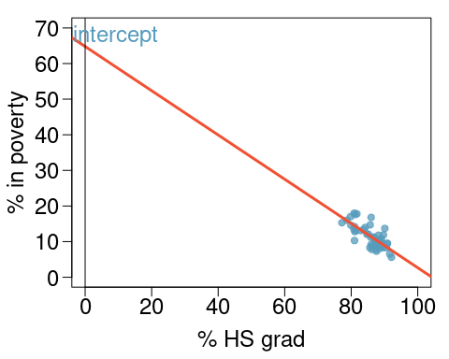
Intercept

Slide 30
Which of the following is the correct interpretation of the intercept?
For each % point increase in HS graduate rate, % living in poverty is expected to increase on average by 64.68%.
For each % point decrease in HS graduate rate, % living in poverty is expected to increase on average by 64.68%.
Having no HS graduates leads to 64.68% of residents living below the poverty line.
States with no HS graduates are expected on average to have 64.68% of residents living below the poverty line.
In states with no HS graduates % living in poverty is expected to increase on average by 64.68%.

Slide 31
More on the intercept
Since there are no states in the dataset with no HS graduates, the intercept is of no interest, not very useful, and also not reliable since the predicted value of the intercept is so far from the bulk of the data.
(see previous figure)

Slide 32
Regression line
$$\hat{\% in poverty}=64.68−0.62 \% HS grad$$
par(mar=c(4,4,1,1), las=1, mgp=c(2.5,0.7,0), cex.lab = 1.5, cex.axis = 1.5) plot(poverty$Poverty ~ poverty$Graduates, ylab = "% in poverty", xlab = "% HS grad", pch=19, col=COL[1,2]) lm_pov_grad = lm(Poverty ~ Graduates, data = poverty) abline(lm_pov_grad, col = COL[4], lwd = 3)

Slide 33
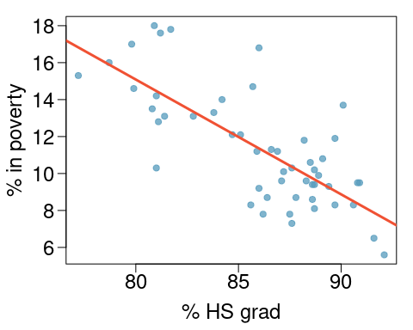

Slide 34
Interpretation of slope and intercept
Intercept: When $x=0$, $y$ is expected to equal the intercept.
Slope: For each unit in $x$, $y$ is expected to increase / decrease on average by the slope.

Slide 35
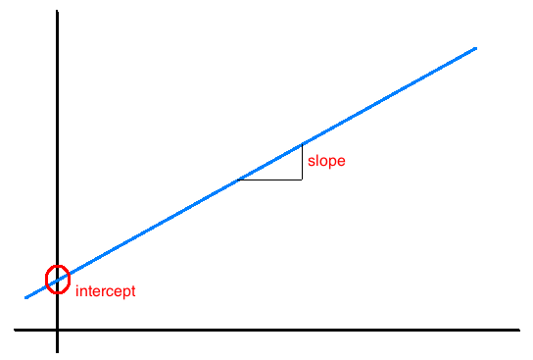

Slide 36
These statements are not causal, unless the study is a randomized controlled experiment.

Slide 37
Prediction & extrapolation

Slide 38
Prediction
Using the linear model to predict the value of the response variable for a given value of the explanatory variable is called prediction, simply by plugging in the value of $x$ in the linear model equation.
There will be some uncertainty associated with the predicted value.

Slide 39


Slide 40
Extrapolation
Applying a model estimate to values outside of the realm of the original data is called extrapolation.
Sometimes the intercept might be an extrapolation.

Slide 41
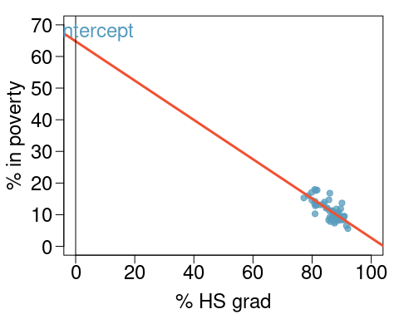

Slide 42
Examples of extrapolation

Slide 43
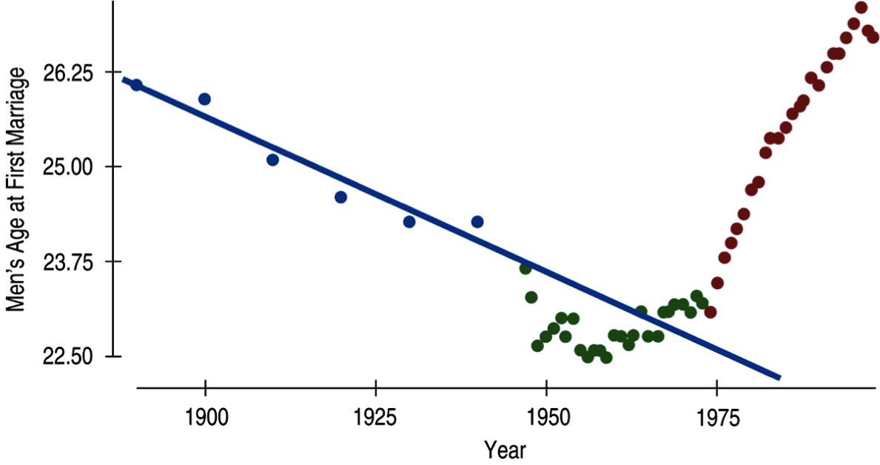

Slide 44
Examples of extrapolation

Slide 45
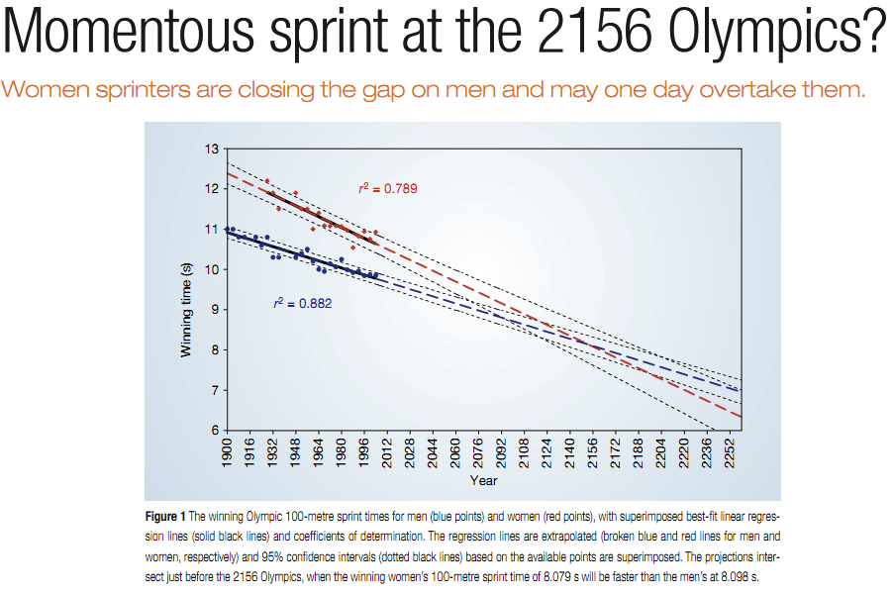

Slide 47
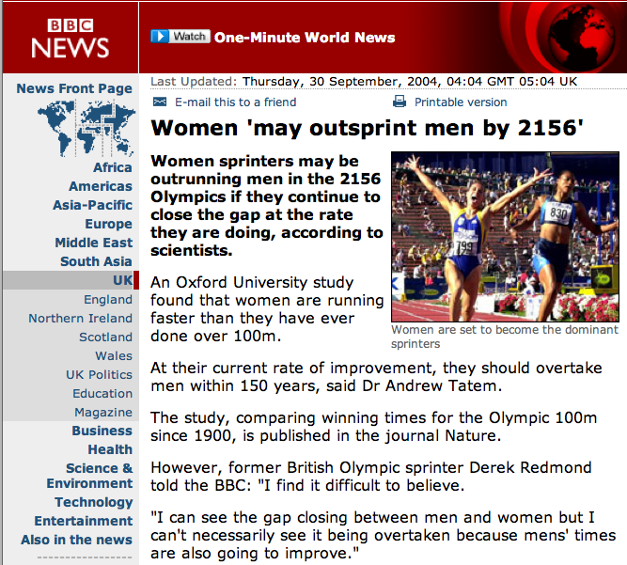

Slide 48
Conditions for the least squares line
Linearity
Nearly normal residuals
Constant variability

Slide 49
Conditions: (1) Linearity
The relationship between the explanatory and the response variable should be linear.
Methods for fitting a model to non-linear relationships exist, but are beyond the scope of this class. One such method will be discussed in MATH 1052H.
Check using a scatterplot of the data, or a residuals plot.

Slide 50
Conditions: (1) Linearity (Examples)

Slide 51
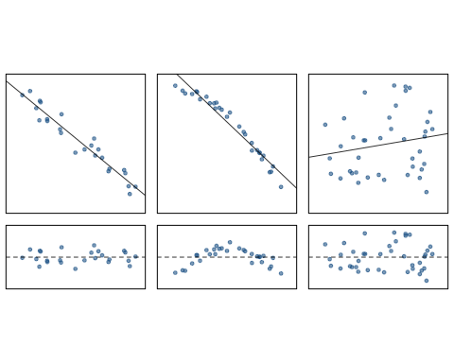

Slide 52
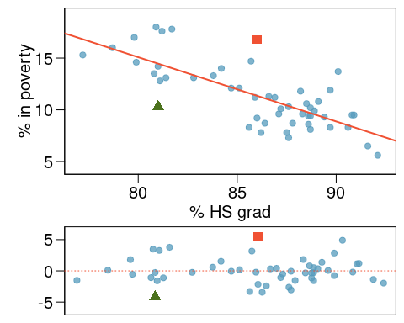
Anatomy of a residuals plot

Slide 53
RI: % HS grade (81), % poverty (10.3)
$$ \widehat{\%~in~poverty} = 64.68 - 0.62 * 81 = 14.46\\ e = \%~in~poverty - \widehat{\%~in~poverty} \\ e = 10.3 - 14.46 = -4.16 \\ $$

Slide 54
Conditions: (2) Nearly normal residuals
The residuals should be nearly normal.
This condition may not be satisfied when there are unusual observations that don’t follow the trend of the rest of the data.
Check using a histogram or normal probability plot of residuals.

Slide 55
Conditions: (2) Nearly normal residuals
par(mfrow=c(1,2)) histPlot(lm_pov_grad$residuals, col = COL[1], xlab = "residuals") qqnorm(lm_pov_grad$residuals, pch = 19, col = COL[1,2]) qqline(lm_pov_grad$residuals, pch = 19, col = COL[1])

Slide 56
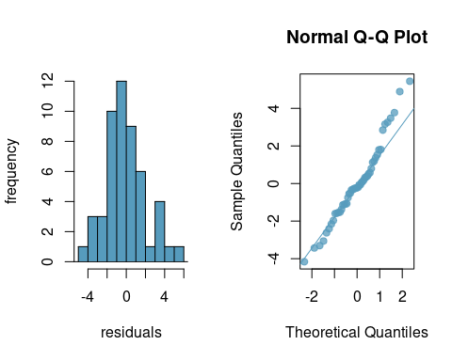

Slide 57
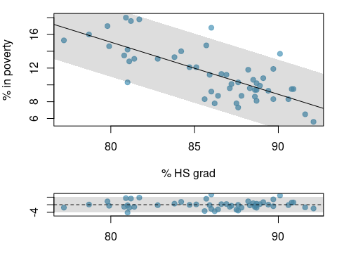
Conditions: (3) Constant variability

Slide 58
The variability of points around the least squares line should be roughly constant.
This implies that the variability of residuals around the 0 line should be roughly constant as well.
Also called homoscedasticity.
Check using a histogram or normal probability plot of residuals.

Slide 59
Checking conditions
What condition is this linear model obviously violating?
Constant variability
Linear relationship
Normal residuals
No extreme outliers

Slide 60
Checking conditions
What condition is this linear model obviously violating?
Constant variability
Linear relationship
Normal residuals
No extreme outliers

Slide 61
$R^{2}$
The strength of the fit of a linear model is most commonly evaluated using $R^{2}$
$R^{2}$ is calculated as the square of the correlation coefficient.
It tells us what percent of variability in the response variable is explained by the model.
The remainder of the variability is explained by variables not included in the model or by inherent randomness in the data.
For the model we’ve been working with, $R^{2}=−{0.62}^{2}=0.38$.

Slide 62
Interpretation of $R^{2}$
Which of the below is the correct interpretation of $R=−0.62$, $R^{2}=0.38$?
38% of the variability in the % of HG graduates among the 51 states is explained by the model.
38% of the variability in the % of residents living in poverty among the 51 states is explained by the model.
38% of the time % HS graduates predict % living in poverty correctly.
62% of the variability in the % of residents living in poverty among the 51 states is explained by the model.

Slide 64
To Come
We now have our first statistical model. In the coming lectures, we will talk about what this model means, how we use it, and how we can determine uncertainty in the model (since it is statistical, after all!).

