Slide 1
MATH 1052H - S62 - Lecture 09

Slide 2
Reminder: How to Complete a Regression Analysis
begin with a scatterplot, ensure that the pattern is approximately a straight line
look for outliers, try to determine if the outliers are errors
estimate the regression
construct a residual plot, verify no pattern or thicker/thinner
histogram and/or normal quantile plot for residuals: is it approximately normal?

Slide 3
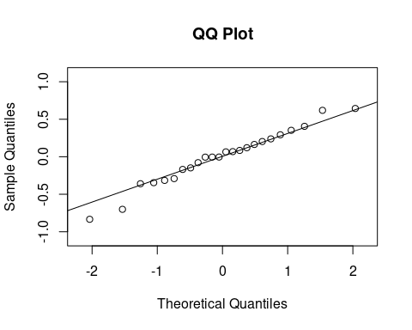
Example of a “Good” Regression

Slide 4
A note on prediction
If we have a good model, then using $\hat{y}$ as the prediction makes sense: take your $x$, substitute it into $b_{0}+b_{1}x$, and you’re done.
If you do not have a good model, then this makes no sense! In this case, the best prediction we can do is to use $\overline{y}$: just predict the average value, and call it a day!

Slide 5
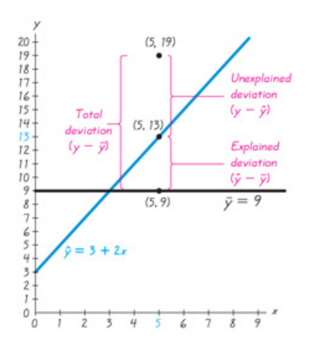
Deviation

Slide 6
Deviation
So we can divide deviation into three parts:
deviation around the mean (total deviation)
explained deviation around the mean (from regression)
unexplained deviation around the mean (the leftovers)

Slide 7
Formally
Assume we have a collection of $(x,y)$ data, and a regression equation that gives predicted values of $y$ called $\hat{y}$, and the mean of the $y$ values is $\overline{y}$.
Total deviation: $y−\overline{y}$
Explained deviation: $\hat{y}−\overline{y}$
Unexplained deviation: $y−\hat{y}$

Slide 8
This gives …
$$y−\overline{y}=(\hat{y}−\overline{y})+(y−\hat{y})$$
So total deviation is the sum of explained and unexplained.

Slide 9
Variation
Same relationship as deviation, just with each element squared.
$$∑(y−\overline{y})^{2}=∑(\hat{y}−\overline{y})^{2}+∑(y−\hat{y})^{2}$$

Slide 10
Coefficient of Determination
Remember $r^{2}$? Lets formally define it twice over:
$r^{2}$ is the square of the correlation coefficient (easy, no interpretation …)
$r^{2}$ is the ratio of the explained variation to the total variation
So, another name for $r^{2}$ is the coefficient of determination, and it is defined as the proportion of the variation in $y$ that is explained by the linear relationship between $x$ and $y$.

Slide 11
Confidence Intervals
In previous lectures, we have discussed confidence intervals. Remember: estimators are actually just educated guesses about a parameter of interest. We’re guessing! So confidence intervals are a way to quantify our uncertainty: to say “it’s probably in this region here”.

Slide 12
Prediction Intervals
A prediction interval is a similar thing: it provides an interval estimate of a predicted value of $y$, from a regression equation or similar.
To create one of these, we require an E term, just like in confidence intervals.

Slide 13
Standard Error of Estimate $s_{e}$
The standard error of estimate is a measure of the differences between the observed (data) $y$ values and the predicted $\hat{y}$ values from the regression equation.
$$s_{e}=\sqrt{\frac{∑(y−\hat{y})^{2}}{n−2}}$$

Slide 14
Sometimes Easier Formula
An alternative representation is
$$s_{e}=\sqrt{\frac{∑y^{2}−b_{0}∑y−b_{1}∑xy}{n−2}}$$
This formula has the advantage that it uses standard pieces that you might easily have access to.

Slide 15
Prediction Interval
Given a particular value $x_{0}$, the prediction interval for the single $y$ associated with that $x_{0}$ is
$$\hat{y}−E<y<\hat{y}+E$$
where
$$E=t_{α/2}s_{e}\sqrt{1+\frac{1}{n}+\frac{n(x_{0}−\overline{x})^{2}}{n(∑x^{2})−(∑x)^{2}}}$$

Slide 16
Confidence Intervals
Recall that we use confidence intervals when we are estimating things (that is, computing estimators). Prediction intervals are not quite the same thing, as we are not estimating parameters.
However, in a regression problem, we are estimating parameters: $b_{0}$ and $b_{1}$ are parameters! So we can: a) compute confidence intervals for them, and b) define hypothesis tests for them! This we’ve seen before …

Slide 17
Hypothesis Tests for parameters $β_{0}$ and $β_{1}$
The test we already know, for the correlation coefficient $ρ$:
$$H_{0}:ρ=0 \text{versus} H_{A}:ρ≠0$$
is equivalent to a test on $β_{1}$, the slope of the linear regression:
$$H_{0}:β_{1}=0 \text{versus} H_{A}:β_{1}≠0.$$

Slide 18
Confidence Interval for $β_{1}$
Since we can perform a hypothesis test for $β_{1}$, we can use the confidence interval method for $β_{1}$:
$${\hat{β}}_{1}−E<β_{1}<{\hat{β}}_{1}+E$$
with
$$E=t_{α/2}\frac{s_{e}}{\sqrt{∑x^{2}−\frac{(∑x)^{2}}{n}}}$$

Slide 19
Confidence Interval for $β_{0}$
Similarly,
$${\hat{β}}_{0}−E<β_{0}<{\hat{β}}_{0}+E$$
with
$$E=t_{α/2}s_{e}\sqrt{\frac{1}{n}+\frac{{\overline{x}}^{2}}{∑x^{2}−\frac{(∑x)^{2}}{n}}}$$

Slide 20
From Computer Output: $p$-values
summary(lm(subway ~ pizza))
## ## Call: ## lm(formula = subway ~ pizza) ## ## Residuals: ## 1 2 3 4 5 6 ## -0.02631 -0.01532 0.02042 0.13416 -0.18835 0.07540 ## ## Coefficients: ## Estimate Std. Error t value Pr(>|t|) ## (Intercept) 0.03456 0.09501 0.364 0.734461 ## pizza 0.94502 0.07446 12.692 0.000222 *** ## --- ## Signif. codes: 0 '***' 0.001 '**' 0.01 '*' 0.05 '.' 0.1 ' ' 1 ## ## Residual standard error: 0.123 on 4 degrees of freedom ## Multiple R-squared: 0.9758, Adjusted R-squared: 0.9697 ## F-statistic: 161.1 on 1 and 4 DF, p-value: 0.000222

Slide 21
A New Example: Diamond Prices
The table on the next slide lists weights (carats) and prices (dollars) of randomly selected diamonds. Find the explained variation, and determine the regression equation which best fits the data. Find a confidence interval for $β_{1}$. Find the prediction interval at $95\%$ level for a diamond that weighs 0.8 carats.

Slide 22
Data
Weight | Price
0.3 | 510
0.4 | 1151
0.5 | 1343
0.5 | 1410
1.0 | 5669
0.7 | 2277

Slide 23
What do we do first?

Slide 24
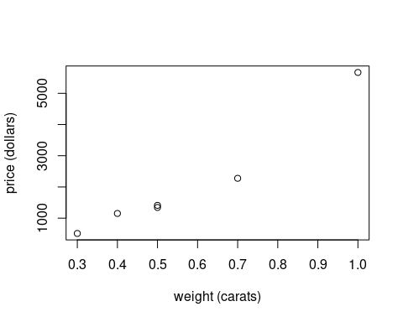
Scatterplot

Slide 25
Do we think this is linear? Are there outliers?

Slide 26
Compute Correlation in R
cor.test(weight, price)
## ## Pearson's product-moment correlation ## ## data: weight and price ## t = 7.6691, df = 4, p-value = 0.001554 ## alternative hypothesis: true correlation is not equal to 0 ## 95 percent confidence interval: ## 0.7269359 0.9965841 ## sample estimates: ## cor ## 0.9676369

Slide 27
Explained Variation
We have $r$, so simply square it:
$$r^{2}={0.967637}^{2}=0.936$$
Thus, a linear relationship between the size (in carats) and price (in dollars) of randomly selected diamonds explains $93.6\%$ of the variation in price.

Slide 28
Do this in R
summary(lm(price ~ weight))
## ## Call: ## lm(formula = price ~ weight) ## ## Residuals: ## 1 2 3 4 5 6 ## 363.9 287.2 -238.5 -171.5 499.0 -739.9 ## ## Coefficients: ## Estimate Std. Error t value Pr(>|t|) ## (Intercept) -2007.0 571.8 -3.510 0.02467 * ## weight 7177.0 935.8 7.669 0.00155 ** ## --- ## Signif. codes: 0 '***' 0.001 '**' 0.01 '*' 0.05 '.' 0.1 ' ' 1 ## ## Residual standard error: 523.8 on 4 degrees of freedom ## Multiple R-squared: 0.9363, Adjusted R-squared: 0.9204 ## F-statistic: 58.82 on 1 and 4 DF, p-value: 0.001554

Slide 29
Confidence Intervals
Find the confidence interval for $β_{1}$:
$${\hat{β}}_{1}−E<β_{1}<{\hat{β}}_{1}+E$$
with
$$E=t_{α/2}\frac{s_{e}}{\sqrt{∑x^{2}−\frac{(∑x)^{2}}{n}}}$$
qt(0.975, 4)
## [1] 2.776445

Slide 30
Find $s_{e}$
$$\begin{matrix}s_{e} & =\sqrt{\frac{∑y^{2}−b_{0}∑y−b_{1}∑xy}{n−2}} \\ & =\sqrt{\frac{42,698,940+2006.979⋅12,360−7177.021⋅9252.8}{6−2}} \\ & =\sqrt{\frac{1,097,661}{4}} \\ & =523.847\end{matrix}$$
Or …

Slide 31
Use R again …
mod <- lm(price ~ weight) summary(mod)
## ## Call: ## lm(formula = price ~ weight) ## ## Residuals: ## 1 2 3 4 5 6 ## 363.9 287.2 -238.5 -171.5 499.0 -739.9 ## ## Coefficients: ## Estimate Std. Error t value Pr(>|t|) ## (Intercept) -2007.0 571.8 -3.510 0.02467 * ## weight 7177.0 935.8 7.669 0.00155 ** ## --- ## Signif. codes: 0 '***' 0.001 '**' 0.01 '*' 0.05 '.' 0.1 ' ' 1 ## ## Residual standard error: 523.8 on 4 degrees of freedom ## Multiple R-squared: 0.9363, Adjusted R-squared: 0.9204 ## F-statistic: 58.82 on 1 and 4 DF, p-value: 0.001554

Slide 32
So
$$E=2.776⋅\frac{523.847}{\sqrt{2.24−\frac{{3.4}^{2}}{6}}}=2597.9.$$

Slide 33
Put it together
$$\begin{matrix}7177.021−2597.9< & β_{1}<7177.021+2597.9 \\ 4579.1< & β_{1}<9775.0\end{matrix}$$
This is our 95% confidence interval for $β_{1}$. Since this confidence interval does not overlap with $0$, we do have evidence at level $α=0.05$ to conclude that there is a linear relationship between the weight and price of diamonds.

Slide 34
Or Use R
confint(mod)
## 2.5 % 97.5 % ## (Intercept) -3594.564 -419.3936 ## weight 4578.725 9775.3174
Which one do you think is easier … ?

Slide 35
Finally, Prediction Interval
$$\hat{y}−E<y<\hat{y}+E$$
where
$$E=t_{α/2}s_{e}\sqrt{1+\frac{1}{n}+\frac{n(x_{0}−\overline{x})^{2}}{n(∑x^{2})−(∑x)^{2}}}$$

Slide 36
Fill in Values
$$\begin{matrix}E & =t_{α/2}s_{e}\sqrt{1+\frac{1}{n}+\frac{n(x_{0}−\overline{x})^{2}}{n(∑x^{2})−(∑x)^{2}}} \\ & =2.776(523.847)\sqrt{1+\frac{1}{6}+\frac{6(0.8−0.5667)^{2}}{6(2.24)−(3.4)^{2}}} \\ & =1484.735⋅\sqrt{1.3404} \\ & =1718.979≈1719.\end{matrix}$$

Slide 37
So, prediction interval …
$$\begin{matrix}(−2007)+7177⋅0.8−1719< & y<(−2007)+7177⋅0.8+1719 \\ 2015.6< & y<5453.6.\end{matrix}$$
Thus, our 95% prediction interval for the value of a 0.8 carat diamond is $(\$2015.60,\$5453.60)$.

Slide 38
Or Use R
We need a special object to represent the input for X.
newdata <- data.frame(weight = 0.8) predict(mod, newdata, interval="predict")
## fit lwr upr ## 1 3734.638 2050.75 5418.527
The difference is just rounding.

Slide 39
Chapter 9: Multiple Regression
Everything we’ve considered so far has been two variables, and examining the correlation (linear relationship) between them. In this section, we expand this to consider linear relationships with more than two variables.

Slide 40
Equation
A multiple regression equation describes a linear relationship between a response variable $y$ and two or more predictor variables $(x_{1},x_{2},⋯)$. The general form is then
$$\hat{y}=b_{0}+b_{1}x_{1}+b_{2}x_{2}+⋯+b_{k}x_{k}.$$

Slide 41
Notation
The coefficients we obtain, $b_{0},⋯,b_{k}$ are sample statistics: educated guesses! We are trying to estimate the underlying population parameters $β_{0},⋯,β_{k}$.
Alternative Notation:
$b_{0}≡\hat{β_{0}}$
$⋯$
$b_{k}≡\hat{β_{k}}$

Slide 42
Manual Computation?
Even more so than the case of simple linear regression, multiple regression problems progress fully beyond any reasonable level of manual computation. This entire section will be creation, interpretation and discussion of outputs from R (and the material of Workshops 9, 10 and 11 will be used).

Slide 43
Example 1: Regression in Heights
The origin of the term regression is in the idea of regressing (reverting) toward a mean. If two parents have a child, the aspects of that child tend, on average, to regress (revert) toward the mean of the two parents, and, in fact, the mean of the population. So a very tall man and a short woman who have a child will tend to have an average-height child.
This is not true for all cases, but is a general statement that seems to hold true.

Slide 44
Some height data (inches)
Mother | Father | Daughter
63 | 64 | 58.6
67 | 65 | 64.7
64 | 67 | 65.3
60 | 72 | 61.0
65 | 72 | 65.4
67 | 72 | 67.4
59 | 67 | 60.9

Slide 45
(total of 20)

Slide 46
Computer Output
summary(lm(daughter ~ father + mother))

Slide 47
Pulling out critical things
We see a number of things. The first is the regression equation:
$$\text{daughter}=7.4543+0.1636⋅\text{father}+0.7072⋅\text{mother},$$
while the second is the $R^{2}$ value, $R^{2}=67.5\%$. We also see that the adjusted $R^{2}$ is listed as $63.7\%$, and that the $p−$value (overall) is $7.06×{10}^{−5}$, a small number.

Slide 48
What do these mean?
We will spend the next lecture exploring what these items mean, and working through the process of actually doing a multiple regression in practice.

