Slide 1
MATH 1052H - S62 - Lecture 10

Slide 2
One further thing, simple linear regression
We did confidence intervals for $β_{0}$ and $β_{1}$, which is enough to let us perform hypothesis tests. We could also compute the test t-statistic, and use the p-value from the computer output, or from the t-statistic. Any of the methods we reviewed already will work just fine!

Slide 3
Formulae
For a hypothesis of
$$H_{0}:β_{1}=β H_{A}:β_{1}≠β$$
we compute
$$t_{\text{test}}=\frac{b_{1}−β}{se(β_{1})}=\frac{b_{1}−β}{\frac{s_{e}}{\sqrt{∑x^{2}−\frac{(∑x)^{2}}{n}}}}$$
where, once again,
$$s_{e}=\sqrt{\frac{∑y^{2}−b_{0}∑y−b_{1}∑xy}{n−2}}.$$

Slide 4
Usual Test Steps
Once you’ve computed your $t_{\text{test}}$, just do everything like normal, remembering that you only have $n−2$ degrees of freedom instead of the usual $n−1$.
… or just use the outputs from R, with p-values!

Slide 5
Multiple Regression Example 1: Regression in Heights
Mother | Father | Daughter
63 | 64 | 58.6
67 | 65 | 64.7
64 | 67 | 65.3
60 | 72 | 61.0
65 | 72 | 65.4

Slide 6
(total of 20)

Slide 7
Doing a Simple Regression
summary(lm(daughter ~ mother))

Slide 8
Checking the Results
Lets compute the standard error of $β_{1}$ (the mother coefficient) to verify what we see.
$$\begin{matrix}se(β_{1}) & =\frac{\sqrt{\frac{∑y^{2}−b_{0}∑y−b_{1}∑xy}{n−2}}}{\sqrt{∑x^{2}−\frac{(∑x)^{2}}{n}}} \\ & =\frac{\sqrt{\frac{81,554.74−16.8436⋅1275.6−0.7363⋅81,491.6}{20−2}}}{\sqrt{81,515−\frac{(1275)^{2}}{20}}} \\ & =\frac{1.975717}{15.28888}=0.1292258\end{matrix}$$

Slide 9
This is exactly what we saw from the computer:
Then our $t_{\text{test}}$ statistic is:
$$t_{\text{test}}=\frac{0.7363−0}{0.1292}=5.698916≈5.697.$$
So the output from the computer is exactly this, minus the work!

Slide 10
Multiple Regression: Computer Output
summary(lm(daughter ~ father + mother))

Slide 11
Pulling out critical things
We see a number of things. The first is the regression equation:
$$\text{daughter}=7.4543+0.1636⋅\text{father}+0.7072⋅\text{mother},$$
while the second is the $R^{2}$ value, $R^{2}=67.5\%$. We also see that the adjusted $R^{2}$ is listed as $63.7\%$, and that the $p−$value (overall) is $7.06×{10}^{−5}$, a small number.

Slide 12
Definitions
$b_{0}$ in a multiple regression problem is the predicted value of $y$ when all predictor variables are zero. This doesn’t always make sense!
$b_{1}$ represents the change in $y$ when the first variable ($x_{1}$) changes by one unit; everything else stays fixed
$b_{2}$ represents the change in $y$ when the second variable ($x_{2}$) changes by one unit; everything else stays fixed
and so on!

Slide 13
Overall $p$-value
The overall $p$-value of the model ($7.057e−05=0.00007057$) is a measure of the overall significance of the multiple regression equation. The test it is associated with is:
$$ H_0: \text{all parameters are zero} \qquad \text{versus} \\\qquad H_A: \text{at least one parameter is non-zero}. $$
(this is actually an ANOVA - it’s all connected)

Slide 14
Interpreting the $p$-value
A $p$-value which is less than $α$ means “reject the null”: this means at least one parameter is non-zero, and that the model can be used for prediction. There is something useful in the model.
A $p$-value which is greater than $α$ means “fail to reject the null”: we do not have evidence to conclude that any of the parameters are non-zero. This means the model should not be used for prediction: there’s nothing useful in the model!

Slide 15
The Height Model
Our overall $p$-value was quite small: $0.00007057$. This is much smaller than $α=0.01$ or $α=0.05$, so we see that there is useful information in this model, and we can use it to predict the heights of daughters from the heights of their parents.

Slide 16
Definition
The adjusted coefficient of determination is a variant of the coefficient of determination, $R^{2}$, that we talked about previously. The formula is
$$R_{adj}^{2}=1−\frac{n−1}{n−(k+1)}(1−R^{2})$$
where $n$ is the number of data points and $k$ is the number of predictor ($x$) variables.
Why do we do this?
in multiple regression, $R^{2}$ increases for every variable you add, even if it’s useless
$R^{2}$ is supposed to be a measure of how well multiple regression fits the data
So we adjust the $R^{2}$ so the newly added predictors need to be useful

Slide 17
Height Results
The results from the daughter/mother/father height regression are:
$R^{2}=0.6752$
Adjusted $R^{2}=0.637$
So the naive viewpoint says that $67.5\%$ of the variation in daughter heights is explained by the heights of the father and mother. The adjusted (more sensible) viewpoint says that only $63.7\%$ of the variation is explained.
When you compare regression models, you should use the adjusted $R^{2}$ value from each.

Slide 18
Variable Selection
The trickiest part of multiple regression is not interpreting the results of a model, or even comparing two models. Since we use computers, it’s also not the actual computation of the coefficients.
The trickiest part: deciding what variables go into the model in the first place!
The topic of variable selection can be very complicated, and we won’t cover all of the ways that exist to evaluate variables (many of which are too complex or mathematical for this course!).

Slide 19
Method 1: Common Sense
When trying to setup the model, and choosing the variables, you need some minimal amount of rationale for including a variable. We wouldn’t try to use the daughter’s favourite colour, for example: what would that have to do with her health?
We could, though, use the family’s ethnicity, socioeconomic status or geographic location as predictors, because there are plausible links between these things and someone’s height. Remember our Netherlands example: some countries have people who are taller than others! Genetics is a real thing.

Slide 20
Method 2: Overall $p$-value
We can use the overall model $p$-value of the resulting model fit(s), and compare them. The lower the $p$-value, the more “significant” the model fit is.

Slide 21
Method 3: Adjusted $R^{2}$
We can compare models by looking at their Adjusted $R^{2}$, and assuming all input variables are sensible (Method 1), higher Adjusted $R^{2}$ should imply a better fit / more predictive power.

Slide 22
Method 4: Standard Error
We can examine the standard error, $s_{e}$, for each of the models, and attempt to find one which has the smallest standard error. This leads to models which have more precise prediction intervals, so they do a good job at prediction $\hat{y}$ for a given $x_{0}$.

Slide 23
Method 5: Significant Variable $p$-values
Rather than looking at the overall model $p$-value, we could instead examine the specific coefficients in a given model, and look for ones which are not significant. We can then streamline our model, eliminating pieces which aren’t significant, until we find a parsimonious model.

Slide 24
Definition
The classical “science” definition of parsimony is:
In statistics, we use parsimony to mean:
So a parsimonious model is one which has all the terms significant (possibly excepting the intercept / $b_{0}$ term), but which still has maximized Adjusted $R^{2}$ (or minimized overall $p$-value; or minimum $s_{e}$) for the given set of predictors.

Slide 25
A Tiny Bit of Combinatorics
Combinatorics is an area of mathematics that deals with counting things. You might have been introduced to a tiny bit of this area in high school if you ever discussed the “choose notation”:
$$\left(\begin{matrix}y \\ x\end{matrix}\right)$$
which we read as “$y$ choose $x$”.
What this lets us do is say “how many different ways can be pick $x$ items out from a set of size $y$”.

Slide 26
Example: how many different 5-card hands are there from a standard 52-card deck?
$$\left(\begin{matrix}52 \\ 5\end{matrix}\right)=2,598,960.$$
Regression Example: how many different regression models are there if we have 4 possible predictors which we can use?
$$\left(\begin{matrix}4 \\ 1\end{matrix}\right)+\left(\begin{matrix}4 \\ 2\end{matrix}\right)+\left(\begin{matrix}4 \\ 3\end{matrix}\right)+\left(\begin{matrix}4 \\ 4\end{matrix}\right)=15.$$

Slide 27
Slightly Easier
If we just say “well, each variable can be included, or not included”, then we have four possible decisions to make: variable 1, variable 2, etc. Each decision has two outcomes: we either include or don’t include. That becomes:
$$2×2×2×2=16$$
different variations. But among those variations is one which has us rejecting all four variables … in that case, are we still doing regression?? So we have $16−1=15$ different possible models.

Slide 28
How to Build Models
So, we have 15 different variations. How can we possibly choose among them? Logically:
First, make sure all the variables are actually correlated with the thing you want to predict. If something isn’t correlated, throw it out immediately. (a bunch of $r$ values)
Second, check to see if the variables are correlated with each other. If two variables are highly correlated, then they will predict the same thing, so we only include the one that is most correlated with the response (throw one out).
Third, build a complete model: include everything that’s correlated and doesn’t duplicate.
Once we’ve done this, we perform backward elimination: we start from this full model, and we start deleting things that aren’t as useful until we reach parsimony.

Slide 29
One more note on $t$-tests
When we were doing simple linear regression earlier, we used $n−2$ degrees of freedom for the critical values for the confidence intervals and comparison tests for our coefficient $β_{1}$. When we move to multiple regression, this isn’t true anymore!
For a multiple regression model, the degrees-of-freedom of a $t$ distribution for testing individual coefficients is $n−(k+1)$, where $n$ is the total number of observations, and $k$ is the number of predictors $x_{i}$ being used.
(so for a simple model, we have one prediction $x_{1}$, so $n−(1+1)=n−2$).

Slide 30
Back to Height
Our model was
$$\text{daughter}=7.4543+0.1636⋅\text{father}+0.7072⋅\text{mother},$$
and the output from the model was

Slide 31
In this case, we used all available predictors: mother and father. We see that the overall model is a good one ($p$-value of $0.00007057$). We could use this model for prediction. The Adjusted $R^{2}$ is $0.637$.
However, scanning the list of coefficients, we see that the father variable has a non-significant $p$-value. We might be able to eliminate the father variable, by the principle of parsimony, and make a simpler, but equally effective, model.

Slide 32
Simpler Model
summary(lm(daughter ~ mother))

Slide 33
Results
Adjusted $R^{2}$ went from $0.637$ to $0.6235$ (decrease)
Overall $p$-value went from $7e−5$ to $2e−5$ (decrease)
Residual standard error went from $1.94$ to $1.976$ (increase)
Conclusion? Adjusted $R^{2}$ decreased and residual standard error increased. While the significance of the simpler model is better (since $p$-value decreased), the other two metrics are poorer for the simpler model. Thus, even though removing the father variable from the model simplified things, it did not improve our predictive power, or our fit.
So we leave father in, and our “best model” from this data is to use both father and mother to predict the height of the daughter.

Slide 34
The Stepwise Algorithm
Run the model with all sensible variables included
Look at the $t$ statistic and $p$-value of each term included. Find the variable that has the largest $p$-value which is still greater than $α$. Eliminate this variable.
Re-run the model with the variable eliminated.
Repeat until all remaining $p$-values are less than $α$.
As we saw in the height example above, while we can do this, sometimes it is worth leaving a variable in the model even if it has a $p$-value greater than $α$, if it contributes both increased Adjusted $R^{2}$ and reduced standard error. It’s quite tricky!

Slide 35
Dummy Variables
So far, all of the predictor and response variables we have considered have been continuous in nature. However, we can easily come up with examples where we would want to use a dichotomous variable (also known as a binary variable, or a TRUE/FALSE variable) in our regression.
From the ANOVA unit, you know that we can have lots of variables of interest that are not numeric: yes/no, true/false, red/green! Not numeric, categorical!
To use these variables (which aren’t numbers!) in a numerical regression problem, we convert them to something known as dummy variables. Assign each of the cases to a numerical value 0 or 1; it doesn’t matter which is which, so long as you are consistent. Then include the 0/1 variable as part of the regression.

Slide 36
Height Data: More Complicated
Let’s go back in time to 1888, and look at Galton’s original height data.
galton <- read_table2("galton.csv")
## # A tibble: 6 x 6 ## Family Father Mother Gender Height Kids ## <chr> <dbl> <dbl> <chr> <dbl> <dbl> ## 1 1 78.5 67 M 73.2 4 ## 2 1 78.5 67 F 69.2 4 ## 3 1 78.5 67 F 69 4 ## 4 1 78.5 67 F 69 4 ## 5 2 75.5 66.5 M 73.5 4 ## 6 2 75.5 66.5 M 72.5 4

Slide 37
Scatterplots for Multiple Regression?
One problem with multiple regression is that the actual fit is not a line anymore: it’s actually something known as a hyperplane: basically, a line in 3D or 4D. It’s much, much harder to visualize!
One way to work around this for the initial screening part of the regression is to do scatterplots of each variable against each other variable, two at a time. So we do scatterplots of the response against each predictor, and also do scatterplots of the predictors pair-wise (done two at a time).

Slide 38
Galton’s Data, Scatterplots
pairs(Height ~ Father + Mother, data = galton, main = "Pairwise Scatterplots")

Slide 39
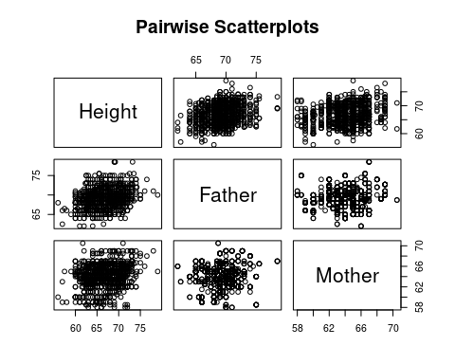

Slide 40
So what do we see?
positive linear relationships between all pairwise variables
height of child is positively linearly correlated with height of father
height of child is positively linearly correlated with height of mother
height of father is positively linearly correlated with height of mother

Slide 41
Lets Compute
cor.test(galton$Height, galton$Father)
## ## Pearson's product-moment correlation ## ## data: galton$Height and galton$Father ## t = 8.5737, df = 896, p-value < 2.2e-16 ## alternative hypothesis: true correlation is not equal to 0 ## 95 percent confidence interval: ## 0.2137851 0.3347455 ## sample estimates: ## cor ## 0.2753548

Slide 42
cor.test(galton$Height, galton$Mother)
## ## Pearson's product-moment correlation ## ## data: galton$Height and galton$Mother ## t = 6.1628, df = 896, p-value = 1.079e-09 ## alternative hypothesis: true correlation is not equal to 0 ## 95 percent confidence interval: ## 0.1380554 0.2635982 ## sample estimates: ## cor ## 0.2016549

Slide 43
cor.test(galton$Father, galton$Mother)
## ## Pearson's product-moment correlation ## ## data: galton$Father and galton$Mother ## t = 2.211, df = 896, p-value = 0.02729 ## alternative hypothesis: true correlation is not equal to 0 ## 95 percent confidence interval: ## 0.008283733 0.138418345 ## sample estimates: ## cor ## 0.07366461

Slide 44
Same Model
We try the same model as before:
summary(lm(Height ~ Father + Mother, data = galton))

Slide 45
Is this a good model?
all individual coefficients are significant (very low $p$-values)
overall model $p$-value is very small
There’s no real path for backwards elimination here.
However: we did not include the final variable – gender!

Slide 46
New, Larger Model
summary(lm(Height ~ Father + Mother + as.factor(Gender), data = galton))

Slide 47
Even Better!
This reduces the standard error (good!), increases the Adjusted $R^{2}$ (good!), and even reduces all of the individual coefficient $p$-values (great!).
So this is our model: nothing to remove!

Slide 48
Another Example: Bears
Consider a data set with variables about bears.
head(bears)
## AGE MONTH SEX HEADLEN HEADWTH NECK LENGTH CHEST WEIGHT ## 1 19 7 1 11.0 5.5 16.0 53.0 26 80 ## 2 55 7 1 16.5 9.0 28.0 67.5 45 344 ## 3 81 9 1 15.5 8.0 31.0 72.0 54 416 ## 4 115 7 1 17.0 10.0 31.5 72.0 49 348 ## 5 104 8 2 15.5 6.5 22.0 62.0 35 166 ## 6 100 4 2 13.0 7.0 21.0 70.0 41 220
Lets predict the weight of the bears by using the other variables, including Age. We will start by considering all the reasonable predictors: AGE, SEX, NECK, LENGTH, and CHEST.

Slide 49
pairs(WEIGHT ~ AGE + NECK + LENGTH + CHEST, data = bears)

Slide 50
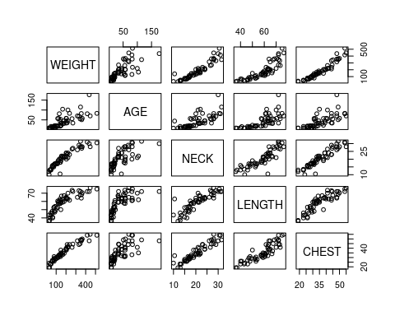

Slide 51
Compute a Full Model
summary(lm(WEIGHT ~ as.factor(SEX) + AGE + NECK + LENGTH + CHEST, data = bears))

Slide 52
Eliminate
First, we eliminate variable LENGTH, which has the highest $p$-value:
summary(lm(WEIGHT ~ as.factor(SEX) + AGE + NECK + CHEST, data = bears))

Slide 53
Eliminate
Next, we eliminate the gender (SEX) of the bears:
summary(lm(WEIGHT ~ AGE + NECK + CHEST, data = bears))

Slide 54
Conclusion
Our final model has Adjusted $R^{2}$ of $0.9383$, with standard error $30.26$ and significant $p$-values for every term in the regression. The previous model (which included gender) had Adjusted $R^{2}$ of $0.9386$ and standard error of $30.17$, but both NECK and SEX were not significant terms in the model.
This suggests to us that perhaps NECK and SEX were more correlated than average, and were interfering with each other.

Slide 55
Scatterplot
plot(bears$NECK, as.factor(bears$SEX), xlab = "NECK (inches)", ylab = "SEX")

Slide 56
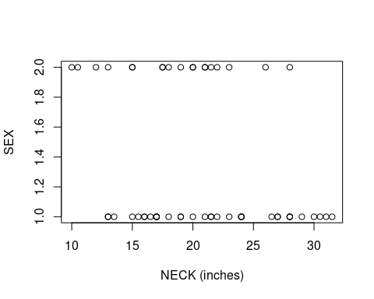

Slide 57
Correlation
cor.test(bears$NECK, as.numeric(as.factor(bears$SEX)))
## ## Pearson's product-moment correlation ## ## data: bears$NECK and as.numeric(as.factor(bears$SEX)) ## t = -2.1149, df = 52, p-value = 0.03925 ## alternative hypothesis: true correlation is not equal to 0 ## 95 percent confidence interval: ## -0.51070292 -0.01477946 ## sample estimates: ## cor ## -0.2814263

Slide 58
Conclusion
The neck size of bears is correlated with their sex in a way which causes the two to interact when included in the model together. In general, it is always better to remove interacting terms unless you really know how they interact (remember: domain-specific knowledge).

Slide 59
Final Idea: Interaction
As we saw in the previous example, sometimes variables can interact in ways which interfere with the regression. One of the assumptions in regression (often violated!) is that all of the predictor variables are independent! When two variables are clearly related, as the SEX and NECK variables seemed to be, problems can happen.
If two variables are said to interact, or to have an interaction, one way of understanding what is going on is to assume that:
there is a relationship between Variable 1 and the Response
there is a relationship between Variable 2 and the Response
the relationship between Variable 1 and the Response changes based on the value of Variable 2 (or vice versa)

Slide 60
We can include interactions in the model
summary(lm(WEIGHT ~ AGE + NECK + CHEST + as.factor(SEX) + as.factor(SEX) * NECK, data = bears))

Slide 61
Even Better!
This is a better fit than what we had before. All but one term is significant at $α=0.05$, the standard error has been reduced, and the Adjusted $R^{2}$ has been increased. All because we realized that NECK and SEX were related, and added a term to the model which accounted for that interaction.
This concludes the example.

Slide 62
Non-linear Regressions
The final sections of Chapter 9 are quite light on material, and largely serve as an introduction to an advanced topic: what happens if the data is related, but not in a linear fashion?
This happens all the time in real world data!

Slide 63
Poisson Response Variables
One of the compound assumptions that is required for linear regression is that the relationship between predictor and response is linear (straight lines!) and also that the errors (and hence, residuals) are normally distributed.
However, one of the more common response variable types we want to use is not like this at all!
Definition: many forms of count data (that is, data which is recorded as the number of events occurring in a fixed amount of time) follow a Poisson random variable distribution. These count data will not meet the requirements of linear regression.
Examples: daily numbers of deaths in Toronto, Ontario; daily number of visitors to Disney World in Orlando, Florida; hourly number of customers at a local CIBC bank; hourly number of visitors to a Tim Horton’s drive-through.

Slide 64
Building a Model
We want the normality requirements of linear regression to be met. But our response variable has issues. How do we fix this?
Logarithmic Transformation: (log-transform for short) We can transform a variable in a regression model by applying a transformation; that is, by plugging the values into a function and using the results of that function output rather than the original values.
Reminder: the logarithm is a function family that you likely learned about in Grade 11. It is the functional inverse of the exponential function. The natural logarithm is one using base $e$: the number $2.71828$, and is often written as $\text{ln}(x)$ or $\text{log}(x)$ if context is clear.
$$e^{x}↔\text{ln}(x)$$

Slide 65
When to use the transform
If
the response variable is counts-per-time
there is an exponential relationship visible on a scatterplot
then it may be appropriate to take the natural logarithm of the appropriate variable.

Slide 66
Example 1: Response
If our scatterplot looks like
then we appear to have an exponential relationship.

Slide 67
Naive Model
summary(mod1 <- lm(y ~ x))

Slide 68
Improved Model
summary(mod2 <- lm(log(y) ~ x))

Slide 69
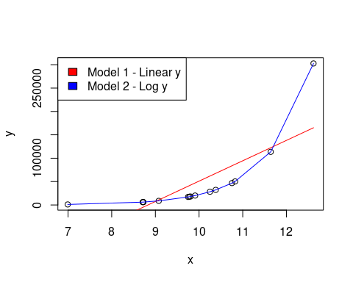
Can we tell the difference?

Slide 70
Always Plot!
If possible, we always want to plot the data. The two previous examples were both “good” regressions (from $p$-values, although not from $s_{e}$, which is the big hint), but clearly one of them is far superior to the other one!

Slide 71
Using Residuals to Detect Needed Transforms
One of the best ways to find a needed transformation in our data is to look at the residuals. If linear is a “bad” choice for the data, the residuals will almost always have a pattern: this pattern can suggest an appropriate transformation.

Slide 72
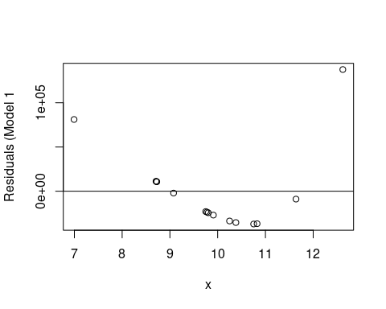
Residuals from Linear Model (previous)

Slide 73
These residuals look exponential. Clearly they are not random!

Slide 74
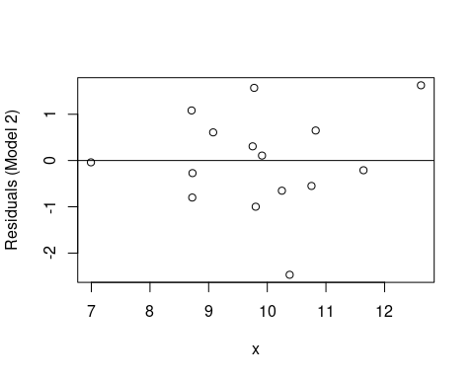
Residuals from Log-Transformed Model (previous)

Slide 75
These residuals are random looking. Better model!

Slide 76
Note
There are no questions testing you on nonlinear regression - it’s an optional topic, which I’ve included because it’s really good for you to be exposed to it. If we were doing the in-person 1052H, we’d have a lot more time to breathe, and we’d have done an assignment on that topic. But for the summer … that’s it!

Slide 77
Lecture 11
There will be a Lecture 11 posted next week going quickly through some optional topics, just for fun and for your personal exposure. If you ever encounter the ideas from Lecture 11, at least you’ll know what they’re called, so you can look them up (or talk to a statistician!)

