Slide 1
MATH 1052H - S62 - Lecture 05

Slide 2
Inference for Paired Means

Slide 3
Our New Case
In our previous lectures, we’re reviewed hypothesis tests on a single sample and its mean ($\overline{x}$), and hypothesis tests on two samples and the difference of their means (${\overline{x}}_{1}−{\overline{x}}_{2}$).
In this lecture, we’re going to talk about one more example of this kind of test: differences of means, from two samples, but with a special twist - the data is paired.

Slide 4
What does Pairing Mean?
Paired data occurs when we have two samples, and the samples somehow have a link so that each element of one sample has a natural pair in another sample. Here are some examples:
Daily total sales from a convenience store in June of 2019 and June of 2020
Hourly traffic from Highway 115 for June 24th and July 1st of 2020
Final grades for fourth-year high school students in English and Math
Can you see what the pairing unit is across these sets?

Slide 5
The Rule
We normally compare two sets by taking the average of each, and then comparing those averages. However, when the data are paired, that no longer makes sense, because the sets are not independent.
So, when the data is naturally paired, we can’t use our previous test, and need a new one!

Slide 6
Parameter and Point Estimation
Parameter of Interest: Mean Difference of all [whatever your data is]
$μ$: the population-level mean difference (paired)
Point Estimate: Average difference of sampled [whatever your data is]
$\overline{x}$: a sample mean difference (paired)

Slide 7
Case Study: Friday the 13th
Between 1990 - 1992 researchers in the UK collected data on traffic flow, accidents, and hospital admissions on Friday 13th and the previous Friday, Friday 6th. Below is an excerpt from this data set on traffic flow. We can assume that traffic flow on a given day at locations 1 and 2 are independent.

Slide 8
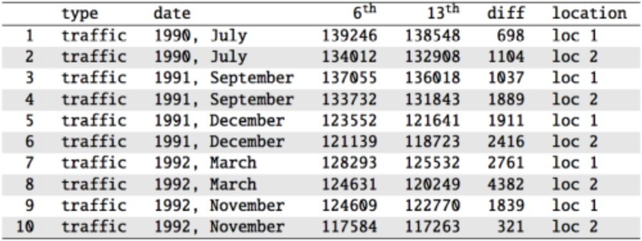

Slide 9
Scanlon, T.J., Luben, R.N., Scanlon, F.L., Singleton, N. (1993), “Is Friday the 13th Bad For Your Health?” BMJ, 307, 1584-1586.

Slide 10
Friday the 13th
We want to investigate if people’s behavior is different on Friday 13th compared to Friday 6th. One approach is to compare the traffic flow on these two days.
$H_{0}$: Average traffic flow on Friday 6th and 13th are equal.
$H_{A}$: Average traffic flow on Friday 6th and 13th are different.
Each case in the data set represents traffic flow recorded at the same location in the same month of the same year: one count from Friday 6th and the other Friday 13th. Are these two counts independent?

Slide 11
Friday the 13th
We want to investigate if people’s behavior is different on Friday 13th compared to Friday 6th. One approach is to compare the traffic flow on these two days.
$H_{0}$: Average traffic flow on Friday 6th and 13th are equal.
$H_{A}$: Average traffic flow on Friday 6th and 13th are different.
Each case in the data set represents traffic flow recorded at the same location in the same month of the same year: one count from Friday 6th and the other Friday 13th. Are these two counts independent?
No

Slide 12
Hypotheses
What are the hypotheses for testing for a difference between the average traffic flow between Friday 6th and 13th?
$H_{0}:μ_{\text{6th}}=μ_{\text{13th}} \text{versus} H_{A}:μ_{\text{6th}}≠μ_{\text{13th}}$
$H_{0}:p_{\text{6th}}=p_{\text{13th}} \text{versus} H_{A}:p_{\text{6th}}≠p_{\text{13th}}$
$H_{0}:μ_{\text{diff}}=0 \text{versus} H_{A}:μ_{\text{diff}}≠0$
$H_{0}:{\overline{x}}_{\text{diff}}=0 \text{versus} H_{A}:{\overline{x}}_{\text{diff}}≠0$

Slide 13
Hypotheses
What are the hypotheses for testing for a difference between the average traffic flow between Friday 6th and 13th?
$H_{0}:μ_{\text{6th}}=μ_{\text{13th}} \text{versus} H_{A}:μ_{\text{6th}}≠μ_{\text{13th}}$
$H_{0}:p_{\text{6th}}=p_{\text{13th}} \text{versus} H_{A}:p_{\text{6th}}≠p_{\text{13th}}$
$H_{0}:μ_{\text{diff}}=0 \text{versus} H_{A}:μ_{\text{diff}}≠0$
$H_{0}:{\overline{x}}_{\text{diff}}=0 \text{versus} H_{A}:{\overline{x}}_{\text{diff}}≠0$

Slide 14
A Plot of the Data

Slide 15
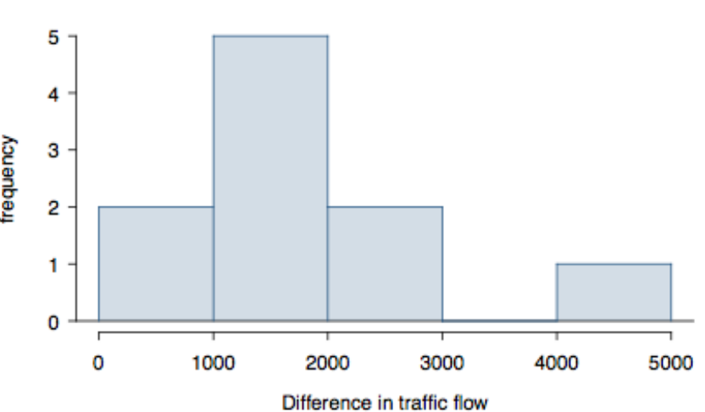

Slide 16
Conditions
Independence: we are told to assume that the cases (rows in the table) are independent
Sample size/skew: the sample distribution, shown on the last slide, does not seem to be extremely skewed, but it’s very difficult to assess with such a small sample size. We might want to think about whether we would expect the population distribution to be skewed or not – probably not, as it should be equally likely to have days with lower than average traffic and higher than average traffic.
Note: $n<30$!
So what do we do when the sample size is small? Use a t!

Slide 17
Computing the Statistics

Slide 19
We have, from this table:
${\overline{x}}_{\text{diff}}=1836$
$s_{\text{diff}}=1176$
$n=10$

Slide 20
Finding the test statistic
The test statistic for inference on a small-sample mean ($n<50$) is the $t$ statistic with $df=n−1$.
$$t_{\text{df}}=\frac{\text{point estimate}−\text{null value}}{SE}$$
In this context, these become:
Point Estimate: ${\overline{x}}_{\text{diff}}=1836$
SE: $SE=\frac{s_{\text{diff}}}{\sqrt{n}}=\frac{1176}{\sqrt{10}}=371.88$
$t$: $t=\frac{1836−0}{371.88}=4.937$
$df$: $df=10−1=9$
Note: the null value is $0$ here because the null hypothesis we set at the start of the lecture is $μ_{\text{diff}}=0$.

Slide 21
Finding the p-value
The p-value of this test statistic is, again, the tail area under the null (t) distribution.
2 * pt(4.937, df = 9, lower.tail = FALSE)
## [1] 0.0008055524
Since this p-value is smaller than an arbitrary $α=0.05$, we would conclude at a 95% level of significance that our mean difference is not 0. Thus, the data provide convincing evidence of a difference between traffic flow on Friday the 6th and Friday the 13th.

Slide 22
What is the difference?
We concluded that there is a difference in the traffic flow between Friday 6th and 13th.
But it would be more interesting to find out what exactly this difference is.
We can use a confidence interval to estimate this difference.

Slide 23
Confidence intervals for a small-sample mean
Confidence intervals are always of the form
$$\text{point estimate}±\text{ME}$$
ME is always calculated as the product of a critical value (remember: $z^{*}$) and SE.
Since small-sample means follow a $t$ distribution (and not a $z$ distribution), the critical value is a $t^{*}$ (as opposed to a $z^{*}$).
$$\text{point estimate}±t^{*}×\text{SE}$$

Slide 24
Finding the critical $t^{*}$
Since $n=10$, we have $df=10−1=9$.
qt(0.025, df = 9)
## [1] -2.262157
qt(0.975, df = 9)
## [1] 2.262157

Slide 25
Practice
Which of the following is the correct calculation of a 95% confidence interval for the difference between the traffic flow between Friday 6th and 13th?
${\overline{x}}_{\text{diff}}=1836$, $s_{\text{diff}}=1176$ and $n=10$, with $SE=371.88$.
$1836±1.96×372$
$1836±2.26×372$
$1836±2.26×1176$

Slide 26
Practice
Which of the following is the correct calculation of a 95% confidence interval for the difference between the traffic flow between Friday 6th and 13th?
${\overline{x}}_{\text{diff}}=1836$, $s_{\text{diff}}=1176$ and $n=10$, with $SE=371.88$.
$1836±1.96×372$
$1836±2.26×372→(995,2677)$
$1836±2.26×1176$

Slide 27
Interpreting the CI
Which of the following is the best interpretation for the confidence interval we just calculated?
$$μ_{\text{diff: 6th - 13th}}=(995,2677)$$
We are 95% confident that …
the difference between the average number of cars on the road on Friday 6th and 13th is between 995 and 2,677.
on Friday 6th there are 995 to 2,677 fewer cars on the road than on the Friday 13th, on average.
on Friday 6th there are 995 fewer to 2,677 more cars on the road than on the Friday 13th, on average.
on Friday 13th there are 995 to 2,677 fewer cars on the road than on the Friday 6th, on average.

Slide 28
Interpreting the CI
Which of the following is the best interpretation for the confidence interval we just calculated?
$$μ_{\text{diff: 6th - 13th}}=(995,2677)$$
We are 95% confident that …
the difference between the average number of cars on the road on Friday 6th and 13th is between 995 and 2,677.
on Friday 6th there are 995 to 2,677 fewer cars on the road than on the Friday 13th, on average.
on Friday 6th there are 995 fewer to 2,677 more cars on the road than on the Friday 13th, on average.
on Friday 13th there are 995 to 2,677 fewer cars on the road than on the Friday 6th, on average.

Slide 29
One Final Note
Note: The example we used was for paired means (difference between dependent groups). We took the difference between the observations and used only these differences (one sample) in our analysis, therefore the mechanics are the same as when we are working with just one sample.

Slide 30
Case Study 2: High School Grades
200 observations were randomly sampled from the High School and Beyond survey. The same students took a reading and writing test and their scores are shown below. At a first glance, does there appear to be a difference between the average reading and writing test score?

Slide 31
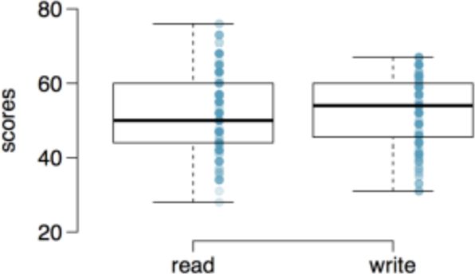

Slide 32
Paired Observations
The same students took a reading and writing test and their scores are shown below. Are the reading and writing scores of each student independent of each other?

Slide 33
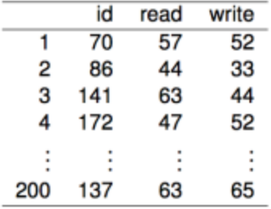

Slide 34
Yes (b) No

Slide 35
Paired Observations
The same students took a reading and writing test and their scores are shown below. Are the reading and writing scores of each student independent of each other?

Slide 37
Yes (b) No

Slide 38
Analyzing Paired Data
As we mentioned earlier, when two sets of observations have this special correspondence (not independent), they are said to be paired.
To analyze paired data, it is often useful to look at the difference in outcomes of each pair of observations.
$$\text{diff}=\text{read - write}$$
It is important that we always subtract using a consistent order, from student to student or patient to patient, or whatever our operational unit is.

Slide 39
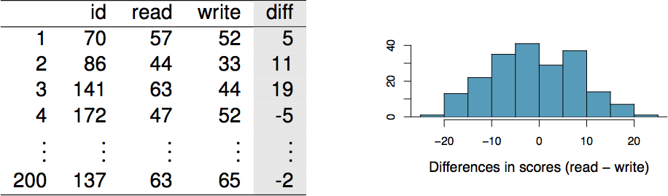

Slide 40
Parameter and Point Estimate
Parameter of interest: Average difference between the reading and writing scores of all high school students.
$$μ_{\text{diff}}$$
Point estimate: Average difference between the reading and writing scores of sampled high school students.
$${\overline{x}}_{\text{diff}}$$

Slide 41
Setting the Hypotheses
If in fact there was no difference between the scores on the reading and writing exams, what would you expect the average difference to be?
$$0$$
What are the hypotheses for testing if there is a difference between the average reading and writing scores?
$$ H_0: \text{There is no difference between the}\\ \text{average reading and writing score,} \mu_\text{diff} = 0 $$
versus
$$ H_A: \text{There is a difference between the}\\ \text{average reading and writing score,} \mu_\text{diff} \neq 0 $$

Slide 42
Checking assumptions and conditions
Which of the following is true?
Since students are sampled randomly and are less than 10% of all high school students, we can assume that the difference between the reading and writing scores of one student in the sample is independent of another.
The distribution of differences is bimodal, therefore we cannot continue with the hypothesis test.
In order for differences to be random we should have sampled with replacement.
Since students are sampled randomly and are less than 10% of all students, we can assume that the sampling distribution of the average difference will be nearly normal.

Slide 43
Checking assumptions and conditions
Which of the following is true?
Since students are sampled randomly and are less than 10% of all high school students, we can assume that the difference between the reading and writing scores of one student in the sample is independent of another.
The distribution of differences is bimodal, therefore we cannot continue with the hypothesis test.
In order for differences to be random we should have sampled with replacement.
Since students are sampled randomly and are less than 10% of all students, we can assume that the sampling distribution of the average difference will be nearly normal.

Slide 44
Calculating the test statistic and the p-value
The observed average difference between the two scores is -0.545 points and the standard deviation of the difference is 8.887 points. Do these data provide convincing evidence of a difference between the average scores on the two exams? Use $α=0.05$.

Slide 45
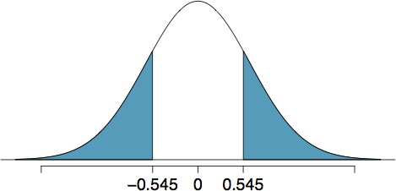

Slide 46
$$\begin{matrix}Z & =\frac{−0.545−0}{\frac{8.887}{\sqrt{200}}}=\frac{−0.545}{0.626} \\ & =−0.87\end{matrix}$$
with p-value of $0.1949×2=0.3898$.

Slide 47
Conclusion
How did we get this p-value?
2 * pt(-0.87, df = 199, lower.tail = TRUE)
## [1] 0.3853486
Since p-value > 0.05, we fail to reject, and the data do not provide convincing evidence of a difference between the average reading and writing scores.

Slide 48
Interpretation of p-value
Which of the following is the correct interpretation of the p-value?
Probability that the average scores on the reading and writing exams are equal.
Probability that the average scores on the reading and writing exams are different.
Probability of obtaining a random sample of 200 students where the average difference between the reading and writing scores is at least 0.545 (in either direction), if in fact the true average difference between the scores is 0.
Probability of incorrectly rejecting the null hypothesis if in fact the null hypothesis is true.

Slide 49
Interpretation of p-value
Which of the following is the correct interpretation of the p-value?
Probability that the average scores on the reading and writing exams are equal.
Probability that the average scores on the reading and writing exams are different.
Probability of obtaining a random sample of 200 students where the average difference between the reading and writing scores is at least 0.545 (in either direction), if in fact the true average difference between the scores is 0.
Probability of incorrectly rejecting the null hypothesis if in fact the null hypothesis is true.

Slide 50
Hypothesis Test $⇔$ Confidence Interval
Suppose we were to construct a 95% confidence interval for the average difference between the reading and writing scores. Would you expect this interval to include 0?
yes
no
cannot tell from the information given

Slide 51
Hypothesis Test $⇔$ Confidence Interval
Suppose we were to construct a 95% confidence interval for the average difference between the reading and writing scores. Would you expect this interval to include 0?
yes
no
cannot tell from the information given
$$−0.545±1.96\frac{8.887}{\sqrt{200}}=−0.545±1.96×0.626=(−1.775,0.685)$$

Slide 52
General Hypothesis Test Conclusion
There are actually three separate ways we can finish a NHST scenario.
compute the p-value, compare it to $α$
compute a critical value of a statistic, compare it to the test statistic (we don’t cover this in MATH 1051H/1052H)
compute the confidence interval, check if it contains the null hypothesis
Any one of these is sufficient: they will always agree.

Slide 53
Recap / Conclusion
We now have a few ways of analyzing means: single sample means, paired sample means (that turn into the same test as single samples!), and independent sample means.
A logical question you might think to ask is … what happens if we have more than two sets of data? And that’s our next topic!

