Slide 1
MATH 1052H - S62 - Lecture 06

Slide 2
More than Two Means

Slide 3
Some Context
In our previous lectures, we’ve discussed single sample means, paired sample means (two means), and independent sample means (two means). We hinted that something we might be interested in was more-than-two samples. In this lecture, we will start the discussion of that idea.

Slide 4
Case Study: Aldrin in the Wolf River

Slide 5
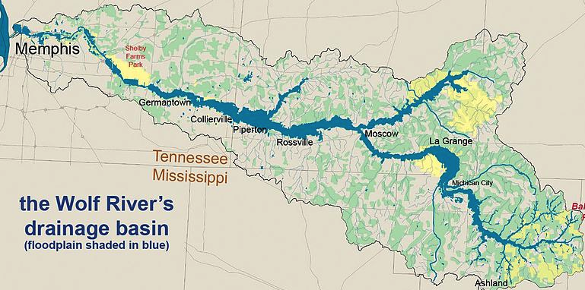

Slide 6
The Wolf River in Tennessee flows past an abandoned site once used by the pesticide industry for dumping wastes, including chlordane (pesticide), aldrin, and dieldrin (both insecticides).
These highly toxic organic compounds can cause various cancers and birth defects.

Slide 7
Case Study: Aldrin - Study Methods
The standard methods to test whether these substances are present in a river is to take samples at six-tenths depth.
But since these compounds are denser than water and their molecules tend to stick to particles of sediment, they are more likely to be found in higher concentrations near the bottom than near mid-depth.

Slide 8
Data
Aldrin concentration (nanograms per liter) at three levels of depth.
## aldrin depth ## 1 3.8 bottom ## 2 4.8 bottom ## 3 4.9 bottom ## 4 5.3 bottom ## 10 8.8 bottom ## 11 3.2 middepth ## 12 3.8 middepth ## 13 4.3 middepth ## 20 6.6 middepth ## 21 3.1 surface ## 22 3.6 surface ## 23 3.7 surface

Slide 9
Exploratory analysis
Aldrin concentration (nanograms per liter) at three levels of depth.

Slide 10
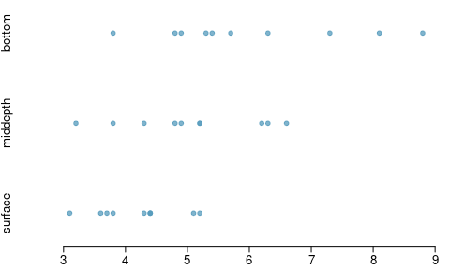

Slide 11
## n mean sd ## 1 bottom 10 6.04 1.58 ## 2 middepth 10 5.05 1.10 ## 3 surface 10 4.20 0.66

Slide 12
Research question
Is there a difference between the mean aldrin concentrations among the three levels?
To compare means of 2 groups we use a Z or a T statistic.
To compare means of 3+ groups we use a new test called ANOVA and a new statistic called F.

Slide 13
ANOVA
ANOVA is used to assess whether the mean of the outcome variable is different for different levels of a categorical variable.
$H_{0}:$ The mean outcome is the same across all categories,
$$μ_{1}=μ_{2}=⋯=μ_{k},$$
where $μ_{i}$ represents the mean of the outcome for observations in category $i$.
$H_{A}:$ At least one mean is different than others.

Slide 14
Conditions
The observations should be independent within and between groups
If the data are a simple random sample from less than 10% of the population, this condition is satisfied.
Carefully consider whether the data may be independent (e.g. no pairing).
Always important, but sometimes difficult to check.
The observations within each group should be nearly normal.
Especially important when the sample sizes are small.
How do we check for normality?
The variability across the groups should be about equal.
Especially important when the sample sizes differ between groups.
How can we check this condition?

Slide 15
$z$/$t$ test vs. ANOVA - Purpose
$z$/$t$ test
Compare means from two groups to see whether they are so far apart that the observed difference cannot reasonably be attributed to sampling variability.
$$H_{0}:μ_{1}=μ_{2}$$
ANOVA
Compare the means from two or more groups to see whether they are so far apart that the observed differences cannot all reasonably be attributed to sampling variability.
$$H_{0}:μ_{1}=μ_{2}=⋯=μ_{k}$$

Slide 16
$z$/$t$ test vs. ANOVA - Method
$z$/$t$ test
Compute a test statistic (a ratio).
$$z/t=\frac{({\overline{x}}_{1}−{\overline{x}}_{2})−(μ_{1}−μ_{2})}{SE_{{\overline{x}}_{1}−{\overline{x}}_{2}}}$$
ANOVA
Compute a test statistic (a ratio).
$$F=\frac{\text{variability between groups}}{\text{variability within groups}}$$

Slide 17
$z$/$t$ test vs. ANOVA
For both:
Large test statistics lead to small p-values.
If the p-value is small enough $H_{0}$ is rejected, we conclude that the population means are not equal.
In general:
With only two groups t-test and ANOVA are equivalent, but only if we use a pooled standard variance in the denominator of the test statistic.
With more than two groups, ANOVA compares the sample means to an overall grand mean.

Slide 18
Hypotheses (back to our Case Study)
What are the correct hypotheses for testing for a difference between the mean aldrin concentrations among the three levels?
$H_{0}:μ_{B}=μ_{M}=μ_{S}\text{ versus }H_{A}:μ_{B}≠μ_{M}≠μ_{S}$
$H_{0}:μ_{B}≠μ_{M}≠μ_{S}\text{ versus }H_{A}:μ_{B}=μ_{M}=μ_{S}$
$H_{0}:μ_{B}=μ_{M}=μ_{S}\text{ versus }H_{A}:$ At least one mean is different.
$H_{0}:μ_{B}=μ_{M}=μ_{S}=0\text{ versus }H_{A}:$ At least one mean is different.
$H_{0}:μ_{B}=μ_{M}=μ_{S}\text{ versus }H_{A}:μ_{B}>μ_{M}>μ_{S}$

Slide 19
Hypotheses
What are the correct hypotheses for testing for a difference between the mean aldrin concentrations among the three levels?
$H_{0}:μ_{B}=μ_{M}=μ_{S}\text{ versus }H_{A}:μ_{B}≠μ_{M}≠μ_{S}$
$H_{0}:μ_{B}≠μ_{M}≠μ_{S}\text{ versus }H_{A}:μ_{B}=μ_{M}=μ_{S}$
$H_{0}:μ_{B}=μ_{M}=μ_{S}\text{ versus }H_{A}:$ At least one mean is different.
$H_{0}:μ_{B}=μ_{M}=μ_{S}=0\text{ versus }H_{A}:$ At least one mean is different.
$H_{0}:μ_{B}=μ_{M}=μ_{S}\text{ versus }H_{A}:μ_{B}>μ_{M}>μ_{S}$

Slide 20
ANOVA and the F test

Slide 21
Test statistic
Does there appear to be a lot of variability within groups? How about between groups?
$$F=\frac{\text{variability between groups}}{\text{variability within groups}}$$

Slide 22
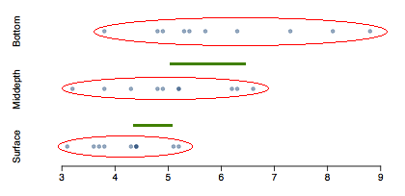

Slide 23
Test statistic (cont.)
$$F=\frac{\text{variability between groups}}{\text{variability within groups}}=\frac{MSG}{MSE}$$
MSG is Mean Square between Groups
$$df_{G}=k−1$$
where $k$ is number of groups
MSE is Mean Square Error - variability in residuals
$$df_{E}=n−k$$
where $n$ is number of observations.

Slide 24
$F$ distribution and p-value
$$F=\frac{\text{variability between groups}}{\text{variability within groups}}$$

Slide 25
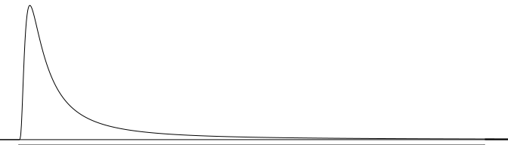

Slide 26
In order to be able to reject $H_{0}$, we need a small p-value, which requires a large F statistic.
In order to obtain a large F statistic, variability between sample means needs to be greater than variability within sample means.

Slide 27
ANOVA output, deconstructed

Slide 28
# our data is stored as a data.frame called aldrin our_model <- lm(aldrin ~ depth, data = aldrin) summary( aov( our_model ) )
## Df Sum Sq Mean Sq F value Pr(>F) ## depth 2 16.96 8.480 6.134 0.00637 ** ## Residuals 27 37.33 1.383 ## --- ## Signif. codes: 0 '***' 0.001 '**' 0.01 '*' 0.05 '.' 0.1 ' ' 1
Degrees of freedom associated with ANOVA
groups: $df_{G}=k−1$, where $k$ is the number of groups
total: $df_{T}=n−1$, where $n$ is the total sample size
error: $df_{E}=df_{T}−df_{G}$

Slide 29
## Df Sum Sq Mean Sq F value Pr(>F) ## depth 2 16.96 8.480 6.134 0.00637 ** ## Residuals 27 37.33 1.383 ## --- ## Signif. codes: 0 '***' 0.001 '**' 0.01 '*' 0.05 '.' 0.1 ' ' 1
$df_{G}=k−1=3−1=2$
$df_{T}=n−1=30−1=29$
$df_{E}=29−2=27$

Slide 30
## Df Sum Sq Mean Sq F value Pr(>F) ## depth 2 16.96 8.480 6.134 0.00637 ** ## Residuals 27 37.33 1.383 ## --- ## Signif. codes: 0 '***' 0.001 '**' 0.01 '*' 0.05 '.' 0.1 ' ' 1
Sum of squares between groups, SSG
Measures the variability between groups
$$SSG=\sum_{i=1}^{k}{n_{i}}({\overline{x}}_{i}−\overline{x})^{2}$$
where $n_{i}$ is each group size, ${\overline{x}}_{i}$ is the average for each group, $\overline{x}$ is the overall (grand) mean.
I will never make you compute this by hand!

Slide 31
## Df Sum Sq Mean Sq F value Pr(>F) ## depth 2 16.96 8.480 6.134 0.00637 ** ## Residuals 27 37.33 1.383 ## --- ## Signif. codes: 0 '***' 0.001 '**' 0.01 '*' 0.05 '.' 0.1 ' ' 1
Sum of squares total, SST
Measures the variability between groups
$$SST=\sum_{i=1}^{n}{(}x_{i}−\overline{x})$$
where $x_{i}$ represent each observation in the dataset.
Again, not something we do by hand!

Slide 32
## Df Sum Sq Mean Sq F value Pr(>F) ## depth 2 16.96 8.480 6.134 0.00637 ** ## Residuals 27 37.33 1.383 ## --- ## Signif. codes: 0 '***' 0.001 '**' 0.01 '*' 0.05 '.' 0.1 ' ' 1
Sum of squares error, SSE
Measures the variability within groups:
$$SSE=SST−SSG$$
(might make you do this one by hand, because it’s easy - so long as you have SST and SSG already!)

Slide 33
## Df Sum Sq Mean Sq F value Pr(>F) ## depth 2 16.96 8.480 6.134 0.00637 ** ## Residuals 27 37.33 1.383 ## --- ## Signif. codes: 0 '***' 0.001 '**' 0.01 '*' 0.05 '.' 0.1 ' ' 1
Mean square error
Mean square error is calculated as sum of squares divided by the degrees of freedom.
(also easy, also may be asked!)
$$ MSG = 16.96 / 2 = 8.480 \\ MSE = 37.33 / 27 = 1.383 $$

Slide 34
## Df Sum Sq Mean Sq F value Pr(>F) ## depth 2 16.96 8.480 6.134 0.00637 ** ## Residuals 27 37.33 1.383 ## --- ## Signif. codes: 0 '***' 0.001 '**' 0.01 '*' 0.05 '.' 0.1 ' ' 1
Test statistic, F value
As we discussed before, the F statistic is the ratio of the between group and within group variability:
$$F=\frac{MSG}{MSE}$$
$$F=\frac{8.480}{1.383}=6.134$$

Slide 35
## Df Sum Sq Mean Sq F value Pr(>F) ## depth 2 16.96 8.480 6.134 0.00637 ** ## Residuals 27 37.33 1.383 ## --- ## Signif. codes: 0 '***' 0.001 '**' 0.01 '*' 0.05 '.' 0.1 ' ' 1
p-value
p-value is the probability of at least as large a ratio between the between group and within group variability, if in fact the means of all groups are equal. It’s calculated as the area under the F curve, with degrees of freedom $df_{G}$ and $df_{E}$, above the observed F statistic.

Slide 36
## Df Sum Sq Mean Sq F value Pr(>F) ## depth 2 16.96 8.480 6.134 0.00637 ** ## Residuals 27 37.33 1.383 ## --- ## Signif. codes: 0 '***' 0.001 '**' 0.01 '*' 0.05 '.' 0.1 ' ' 1

Slide 37
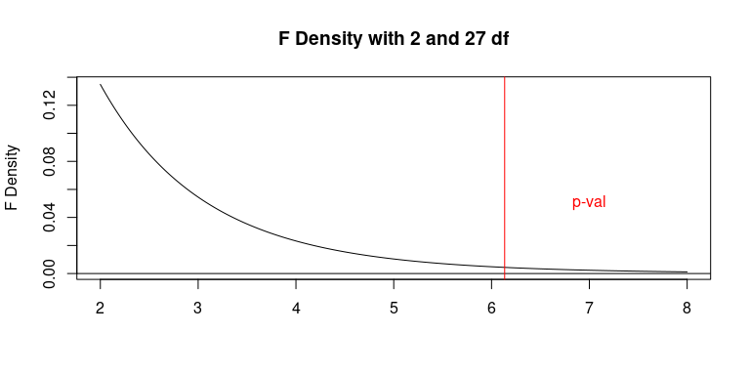

Slide 38
## Df Sum Sq Mean Sq F value Pr(>F) ## depth 2 16.96 8.480 6.134 0.00637 ** ## Residuals 27 37.33 1.383 ## --- ## Signif. codes: 0 '***' 0.001 '**' 0.01 '*' 0.05 '.' 0.1 ' ' 1
pf(q = 6.134, df1 = 2, df2 = 27, lower.tail = FALSE)
## [1] 0.006366302

Slide 39
Conclusion - in context
What is the conclusion of the hypothesis test?
The data provide convincing evidence that the average aldrin concentration
is different for all groups.
on the surface is lower than the other levels.
is different for at least one group.
is the same for all groups.

Slide 40
Conclusion - in context
What is the conclusion of the hypothesis test?
The data provide convincing evidence that the average aldrin concentration
is different for all groups.
on the surface is lower than the other levels.
is different for at least one group.
is the same for all groups.

Slide 41
Conclusion
If p-value is small (less than $α$), reject $H_{0}$. The data provide convincing evidence that at least one mean is different from (but we can’t tell which one).
If p-value is large, fail to reject $H_{0}$. The data do not provide convincing evidence that at least one pair of means are different from each other, the observed differences in sample means are attributable to sampling variability (or chance).

Slide 42
Checking conditions

Slide 43
(1) independence
Does this condition appear to be satisfied?
In this study the we have no reason to believe that the aldrin concentration won’t be independent of each other.

Slide 44
(2) approximately normal
Does this condition appear to be satisfied?

Slide 45
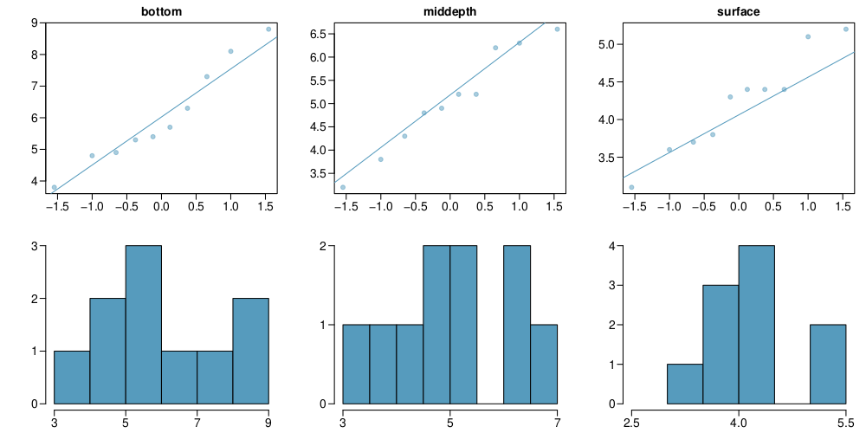

Slide 46
(3) constant variance
Does this condition appear to be satisfied?

Slide 47
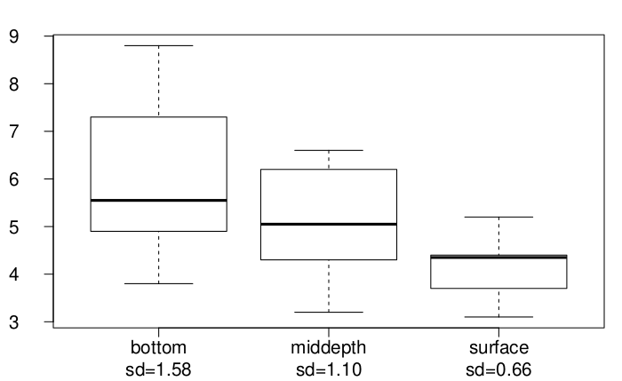

Slide 48
Multiple comparisons & Type 1 error rate

Slide 49
Which means differ?
Earlier we concluded that at least one pair of means differ. The natural question that follows is which ones?
We can do two sample $t$ tests for differences in each possible pair of groups.
Can you see any pitfalls with this approach?

Slide 50
Pitfalls
When we run too many tests, the Type 1 Error rate increases.
This issue is resolved by using a modified significance level.

Slide 51
Multiple comparisons
The scenario of testing many pairs of groups is called multiple comparisons.
The Bonferroni correction suggests that a more stringent significance level is more appropriate for these tests:
$$α^{⋆}=α/K$$
where $K$ is the number of comparisons being considered.
If there are $k$ groups, then usually all possible pairs are compared and $K=\frac{k(k−1)}{2}$.

Slide 52
Determining the modified $α$
In the aldrin data set depth has 3 levels: bottom, mid-depth, and surface. If $α=0.05$, what should be the modified significance level for two sample $t$ tests for determining which pairs of groups have significantly different means?
$α^{*}=0.05$
$α^{*}=0.05/2=0.025$
$α^{*}=0.05/3=0.0167$
$α^{*}=0.05/6=0.0083$

Slide 53
Determining the modified $α$
In the aldrin data set depth has 3 levels: bottom, mid-depth, and surface. If $α=0.05$, what should be the modified significance level for two sample $t$ tests for determining which pairs of groups have significantly different means?
$α^{*}=0.05$
$α^{*}=0.05/2=0.025$
$α^{*}=0.05/3=0.0167$
$α^{*}=0.05/6=0.0083$

Slide 54
Which means differ?
Based on the box plots below, which means would you expect to be significantly different?

Slide 56
bottom and surface? bottom and mid-depth? mid-depth and surface? bottom and mid-depth plus mid-depth and surface? bottom and mid-depth plus bottom and surface plus mid-depth and surface?

Slide 57
Which means differ? (cont.)
If the ANOVA assumption of equal variability across groups is satisfied, we can use the data from all groups to estimate variability:
Estimate any within-group standard deviation with $\sqrt{MSE}$, which is $s_{pooled}$
Use the error degrees of freedom, $n−k$, for $t$-distributions
Difference in two means: after ANOVA
$$SE=\sqrt{\frac{σ_{1}^{2}}{n_{1}}+\frac{σ_{2}^{2}}{n_{2}}}≈\sqrt{\frac{MSE}{n_{1}}+\frac{MSE}{n_{2}}}$$

Slide 58
Is there a difference between the average aldrin concentration at the bottom and at mid depth?
From the original summary table, mean of bottom is 6.04, mean of middepth is 5.05
From the ANOVA table, the Residuals have df 27 and Mean Sq 1.38
$$ T_{df_E} = \frac{(\bar{x}_{bottom} - \bar{x}_{middepth})}{\sqrt{ \frac{MSE}{n_{bottom}} + \frac{MSE}{n_{middepth}} }} \qquad \; \qquad T_{27} = \frac{( 6.04 - 5.05 )}{\sqrt{ \frac{1.38}{10} + \frac{1.38}{10} }} = \frac{0.99}{0.53} =1.87 \\ \alpha^\star = 0.05 / 3 = 0.0167 $$

Slide 59
Finish
Find the p-value:
pt(q = 1.87, df = 27, lower.tail = FALSE) * 2
## [1] 0.0723635
Then since the test has $α^{⋆}=0.0167$: fail to reject $H_{0}$, the data do not provide convincing evidence of a difference between the average aldrin concentrations at bottom and mid depth.

Slide 60
Pairwise: Bottom and Surface
Is there a difference between the average aldrin concentration at the bottom and at surface?
$$ T_{df_E} = \frac{(\bar{x}_{bottom} - \bar{x}_{surface})}{\sqrt{ \frac{MSE}{n_{bottom}} + \frac{MSE}{n_{surface}} }} \qquad \; \qquad T_{27} = \frac{( 6.04 - 4.02 )}{\sqrt{ \frac{1.38}{10} + \frac{1.38}{10} }} = \frac{2.02}{0.53} =3.81 \\ \alpha^\star = 0.05 / 3 = 0.0167 $$
pt(q = 3.81, df = 27, lower.tail = FALSE)
## [1] 0.0003650144
Conclusion: reject $H_{0}$, the data provide convincing evidence of a difference between the average aldrin concentrations at bottom and surface.

Slide 61
Conclusion, Notes
What we have described in this lecture is known in the literature as “one-way ANOVA”. There is only one factor variable across the data, and any data source you use will be stored in a data.frame with two columns only.
This data is the natural output of experiments (remember Chapter 1 of our text from 1051H?), and we will discuss more complicated examples of this later in the term. This topic plus linear regression are the two most useful and common models used in science, so pay attention to them - you’ll definitely encounter them again!

