Slide 1
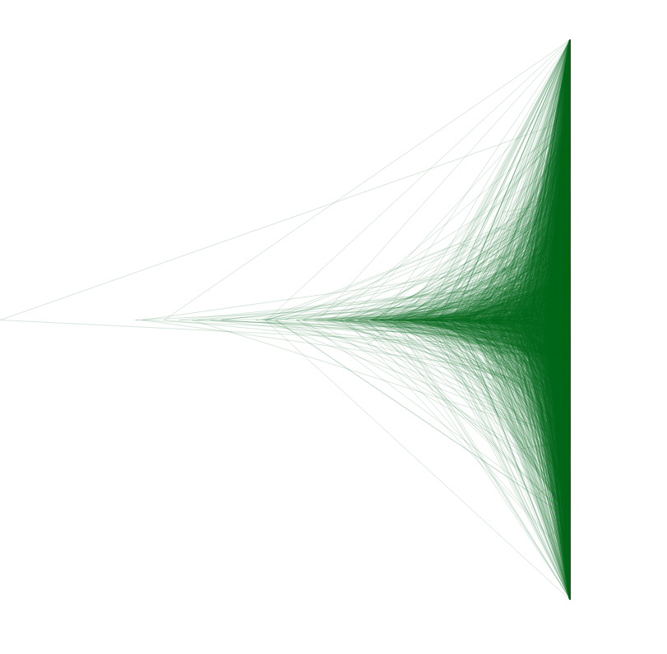
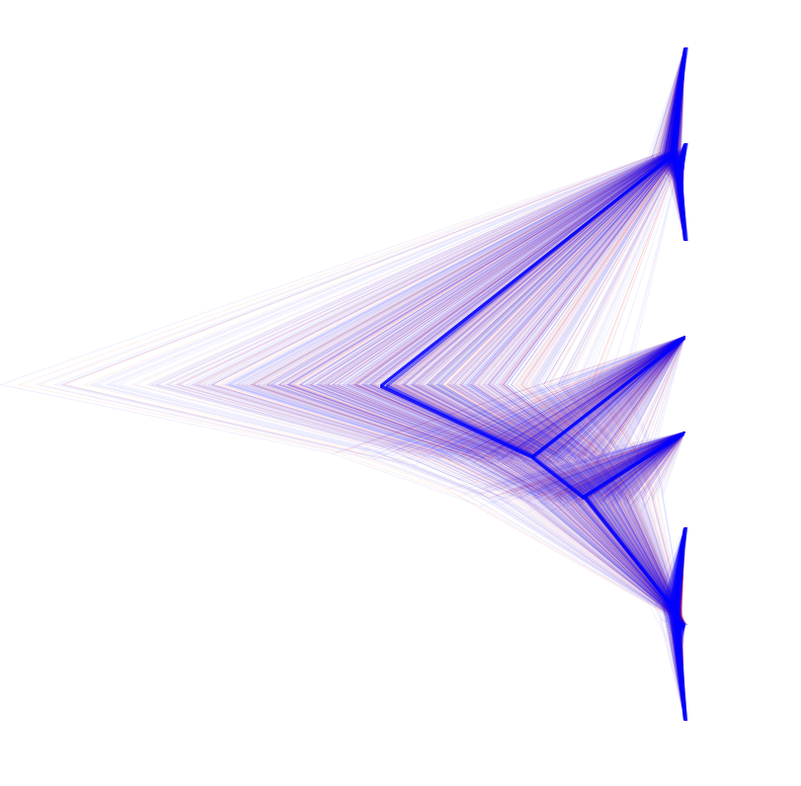
Samples of Trees
Coalescent
MCV Locus
A
B
D
E
G
D
F
G
C
F
B
C
H
H
E
A

