Slide 1
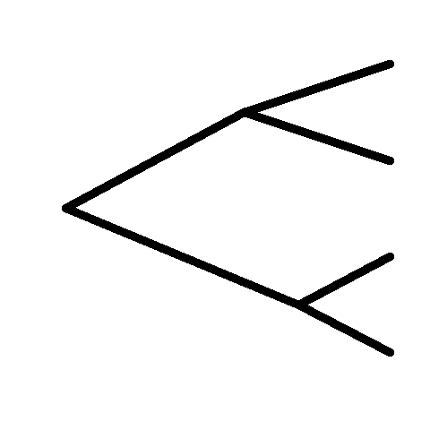
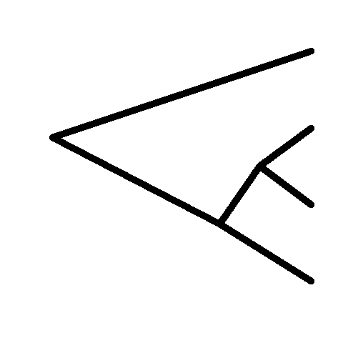
Allelic Series as Functional Mutations on Trees
i.
ii.
iii.
D
D
B
A
A
A
B
B
C
C
C
D

