Slide 1
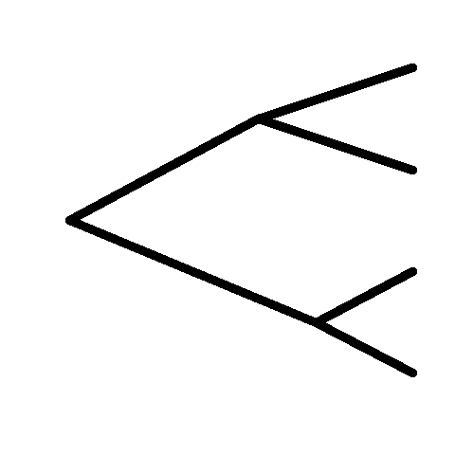
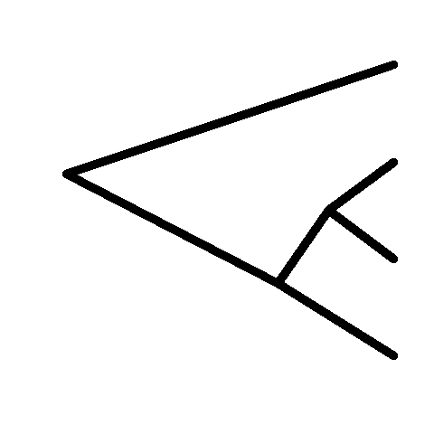
i.
ii.
iii.
D
D
B
A
A
A
B
B
C
C
C
D

