Slide 1
From Bootstrap to
Asymptotic Inference
Standard errors, the CLT, and confidence intervals

Slide 2
Where we are/where we are going
We're going to show how you can approximate non-parametric bootstrap inference by using the Normal distribution
Some of this will be review from two weeks ago
Some/all will be review if you have a background in stats (leave now or forever hold your peace!)
Our goal today is build up the pieces we’ve been learning into an inference routine that you can use anytime you need to understand the uncertainty of an estimator
Our running example will be hedonic pricing: predicting the value of housing based on its amenities (square feet, bathrooms, total rooms, area, age)

Slide 3
Roadmap for today
1. Review: the sampling distribution and the standard error
2. Bootstrapping a regression
3. Why the bell curve keeps showing up: the CLT
4. Confidence intervals and tests
When it breaks
Our inference routine
every interval today is: estimate ± c × SE

Slide 4
The sampling distribution and standard error

Slide 5
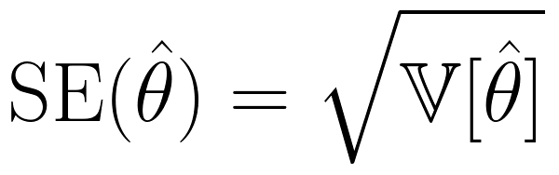
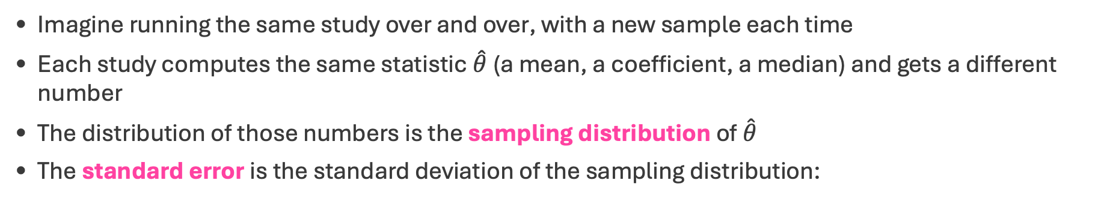
Review: The Sampling Distribution
Imagine running the same study over and over, with a new sample each time
Each study computes the same statistic $\hat{θ}$(a mean, a coefficient, a median) and gets a different number
The distribution of those numbers is the sampling distribution of $\hat{θ}$
The standard error is the standard deviation of the sampling distribution:
It is not the standard deviation of the data. It is the standard deviation of the estimate

Slide 6
The standard error is the standard deviation of the sampling distribution

Slide 7
The standard error is the standard deviation of the sampling distribution!

Slide 8
The standard error is the standard deviation of the sampling distribution!!

Slide 9
The standard error is the standard deviation of the sampling distribution!!!

Slide 10
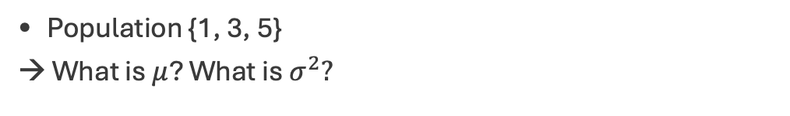
Let’s work out an example with a very small population
Population {1, 3, 5}
→ What is $μ$? What is $σ^{2}?$
Draw n = 2 with replacement. Calculate the mean for 9 possible samples:
sample | (1,1) | (1,3) | (1,5) | (3,1) | (3,3) | (3,5) | (5,1) | (5,3) | (5,5)
x̄ | 1 | 2 | 3 | 2 | 3 | 4 | 3 | 4 | 5
→ What is E[x̄]? What is V[x̄]?
→ What is the standard error of the mean?
This is the whole sampling distribution. Usually, we don’t get to see it. How do we calculate SE when we don’t see the whole sampling distribution?

Slide 11
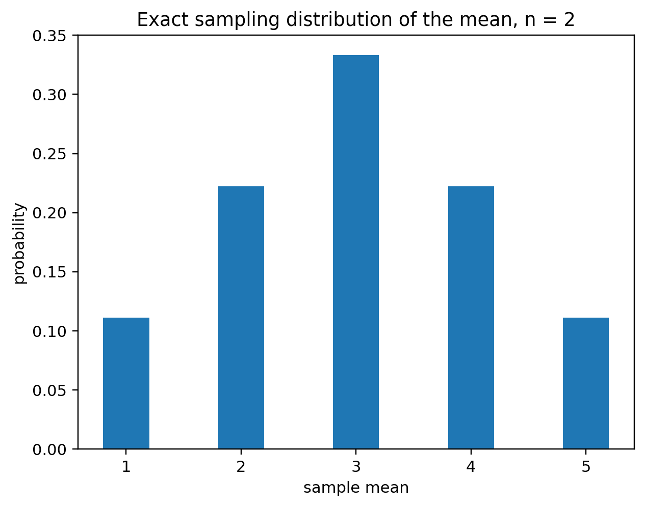
Let’s work out an example with a very small population
Population {1, 3, 5}
μ (population mean) = (1 + 3 + 5)/3 = 3
σ² (population variance) = (4 + 0 + 4)/3 = 8/3
Draw n = 2 with replacement: 9 possible samples
sample | (1,1) | (1,3) | (1,5) | (3,1) | (3,3) | (3,5) | (5,1) | (5,3) | (5,5)
x̄ | 1 | 2 | 3 | 2 | 3 | 4 | 3 | 4 | 5
E[x̄] = (1 + 2 + 3 + 2 + 3 + 4 + 3 + 4 + 5)/9 = 27/9 = 3 = μ
V[x̄] (sampling distribution variance) = average squared distance from 3 = (4 + 1 + 0 + 1 + 0 + 1 + 0 + 1 + 4)/9 = 4/3
SE (sampling distribution SD) = √V[x̄] = √(4/3) = 1.15. Same as the formula: V[x̄] = σ²/n = (8/3)/2 = 4/3 ✓
This is the whole sampling distribution. When we can't list every sample, we use SE = σ/√n and plug in s for σ (next slides)

Slide 12
Two Ways to Get the Standard Error
1. Know the whole sampling distribution. List every possible sample, compute x̄ for each, and take the variance of the x̄'s. For {1, 3, 5}: V[x̄] (sampling distribution variance) = 4/3, SE = √V[x̄] = 1.15. Only possible for tiny populations or simulations
  With real data: the bootstrap is this done on our sample instead of the population
2. Use the formula. The sampling distribution's variance comes from the population's: V[x̄] = σ²/n, so SE = σ/√n. No list needed, but it needs σ, the population SD
  se(x̄) = σ/√n is exact but useless as written: σ is unknown. Every practical SE fills that gap the same way
  With real data: we know neither the sampling distribution nor σ. So we plug in s, the SD of our one sample: estimated SE = s/√n
For {1, 3, 5}: population σ² = 8/3, so σ = 1.63 and SE = σ/√2 = 1.15 ✓, the same answer as route 1
real data: estimated SE = s/√n, or the bootstrap

Slide 13
Estimating the Standard Error
Route 2 needs σ, which we don't know. We estimate it from our one sample with s
From one sample, say (3, 5): x̄ = 4 and
Why n − 1 when calculating s², our estimate of σ² that comes from the sample? The deviations are measured from x̄, which was fit to the same data and sits closer to them than μ does. From μ = 3 the squares would sum to 4, not 2:
1. Split each deviation:
2. Square and add up:
Cross term is 0 (deviations from x̄ sum to 0). Spread around μ = spread around x̄ + a penalty. For (3, 5): 4 = 2 + 2
3. Rearrange step 2:
Average each piece:
Two denominators, two jobs: n − 1 estimates σ²; the n in σ²/n comes from averaging

Slide 14
But the Estimated SE Is Still Biased Low
s² is unbiased for σ², but √s² is not unbiased for σ
On the 9 samples, the estimated SE is |x₁ − x₂| / 2:
|x₁ − x₂| | 0 | 2 | 4 | average
samples (of 9) | 3 | 4 | 2
s² | 0 | 2 | 8 | 8/3 (unbiased)
estimated SE | 0 | 1 | 2 | 8/9 = 0.89, not 1.15
Why? The square root shrinks big numbers more than small ones. Average 0 and 16: the average is 8, and √8 = 2.83. Take roots first: √0 = 0 and √16 = 4, average 2. The root of the average is bigger than the average of the roots
Here: the average estimated SE is 0.89, but √(average of s²/n) = √(4/3) = 1.15
How do we fix it? For the SE itself, usually we don't: the bias fades fast as n grows. For normal data, s averages 0.80σ at n = 2, 0.94σ at n = 5, 0.97σ at n = 10, 0.99σ at n = 30
What we fix is the interval: the t-distribution (critical value 2.78 instead of 1.96 at n = 5) is built to account for the SE being estimated from the same small sample
n − 1 fixes the variance; the t-distribution fixes the interval

Slide 15
Exercise
Data: {2, 4, 5, 6, 8}
Compute x̄, the sum of squared deviations, s², and the estimated SE of x̄
What do you get if you divide by n instead of n − 1?
Which one answers: "how spread out are these five numbers?" and which answers "how spread out is the population?"
Notes:
Answer: x̄ = 5; deviations −3, −1, 0, 1, 3; sum of squares 20. Divide by n: 4 (the spread of these five numbers). Divide by n − 1: s² = 5 (estimate of the population variance). SE = √(5/5) = 1, or 20/(5 × 4) = 1.

Slide 16
Bootstrapping

Slide 17
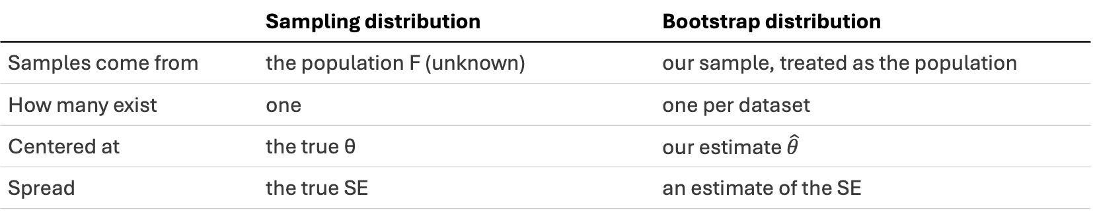
Review: Sampling Distribution vs. Bootstrap Distribution
The sampling distribution resamples from the population
The bootstrap resamples from our sample
 | Sampling distribution | Bootstrap distribution
Samples come from | the population F (unknown) | our sample, treated as the population
How many exist | one | one per dataset
Centered at | the true θ | our estimate $\hat{θ}$
Spread | the true SE | an estimate of the SE
The bet: $\hat{θ_{R}^{∗}}−\hat{θ}$ behaves like $\hat{θ}−θ$
the bootstrap copies the spread and shape, never the location
Notes:
Why we're allowed to make the bet: the bootstrap error (θ̂* − θ̂) behaves like the real error (θ̂ − θ).
1. Plug-in. The sampling distribution depends only on the population F and the recipe. The bootstrap runs the same recipe on F̂, our sample treated as the population. If F̂ is close to F, the two distributions are close. Glivenko–Cantelli and DKW guarantee F̂ → F as n grows.
2. For the mean, the CLT makes it concrete. The real error √n(x̄ − μ) ≈ N(0, σ²). The bootstrap error √n(x̄* − x̄) ≈ N(0, σ̂²), by the CLT applied inside the bootstrap world. Since σ̂ → σ, they match. The bet is the CLT applied twice.
3. It holds for smooth statistics, not all statistics. AoS Thm 8.3 (and Bickel & Freedman 1981) prove bootstrap consistency for statistics that depend smoothly on F: means, smooth functions of means, regression coefficients. It fails for the sample maximum, dependent data, very heavy tails, and very small n.
Why the error and not θ̂ itself: θ̂* is centered at θ̂, not θ, so the bootstrap can't tell us where θ is. The error is centered near 0 in both worlds, and its spread and shape transfer. That's the 'spread and shape, never location' line.

Slide 18
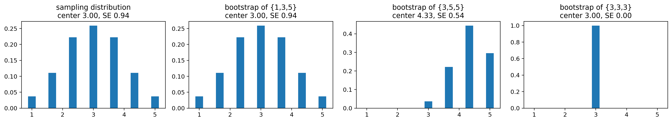
Three Students, One Population
Population {1, 3, 5}, samples of size 3. True sampling distribution: centered at 3, SE = 0.94
Each student bootstraps their own sample:
sample | bootstrap center | bootstrap SE
{1, 3, 5} | 3 | 0.94
{3, 5, 5} | 4.33 | 0.54
{3, 3, 3} | 3 | 0
The point: each bootstrap is centered at that student's own x̄, not at μ (4.33 vs. 3), and its spread is only as good as their sample's ({3, 5, 5} too narrow, {3, 3, 3} zero)

Slide 19
Bootstrapping
a regression

Slide 20
Hedonic Pricing: Ames, Iowa
You have covered OLS/linear regression in ML1, so we can play with it here
2,930 house sales in Ames, Iowa
Regress arcsinh(price) on total rooms, arcsinh(age), arcsinh(area), and full-bath dummies, with an intercept
Bootstrap: resample whole rows R = 1,000 times and refit the regression each time
Each refit gives one draw of every coefficient: an estimate of each coefficient's sampling distribution

Slide 21
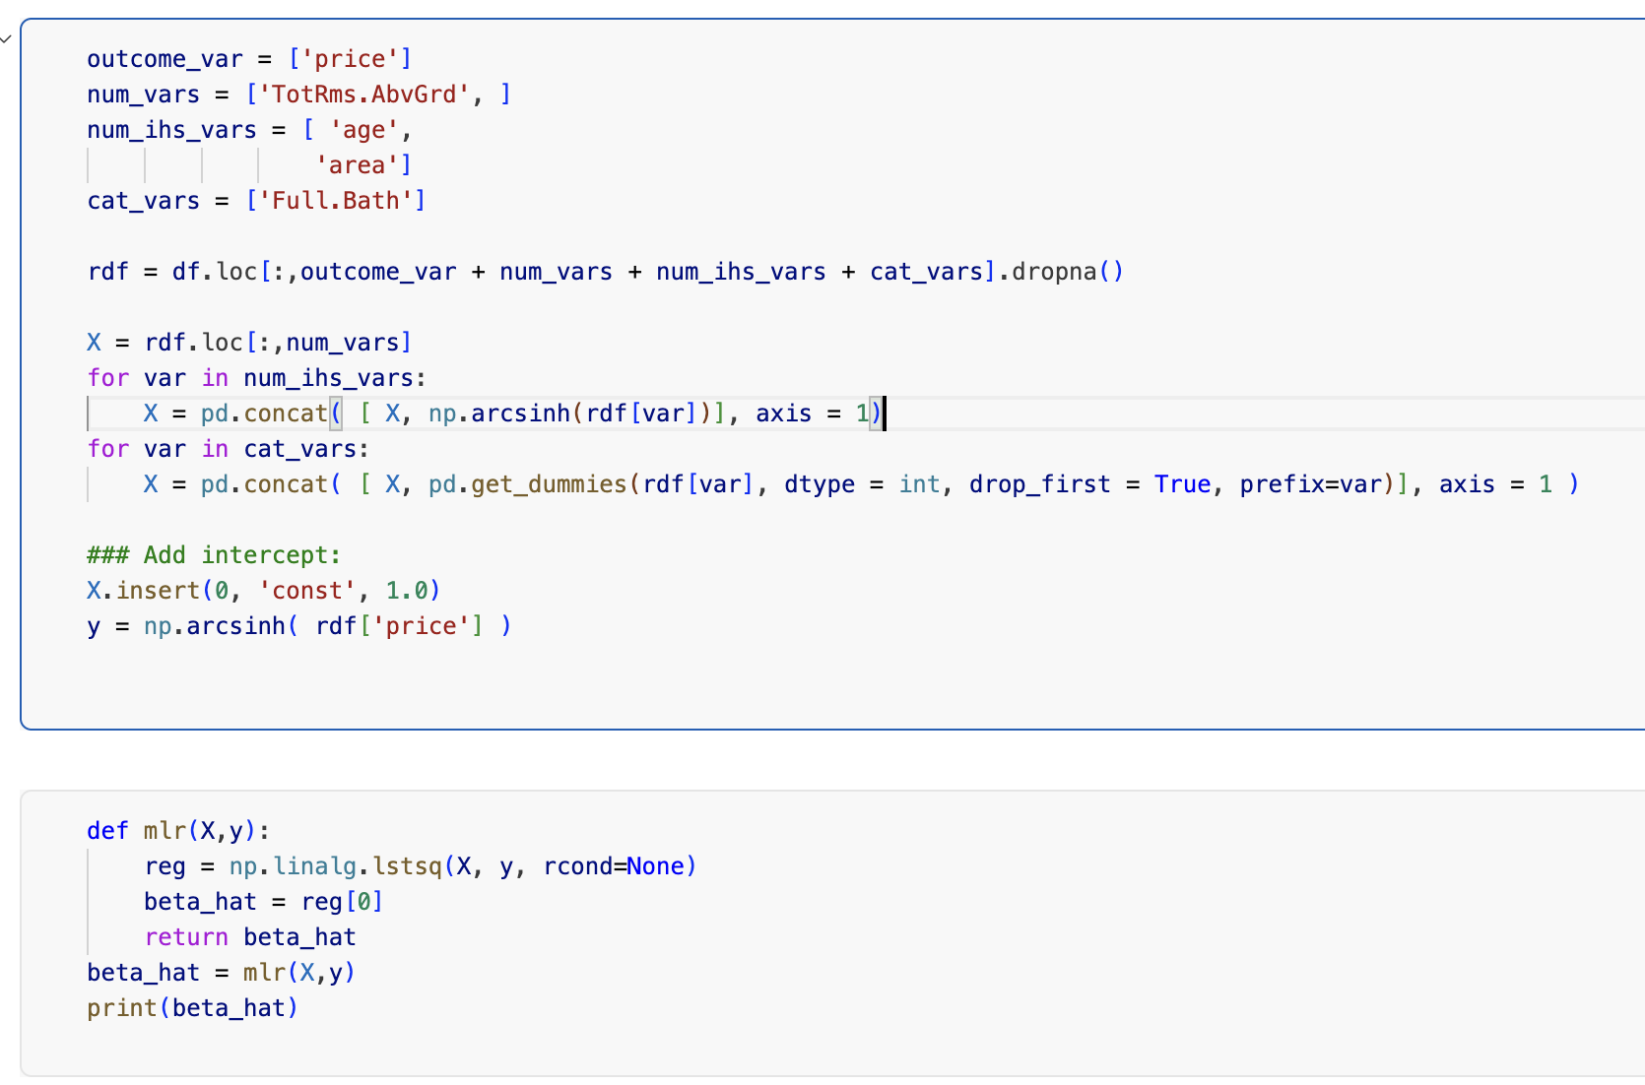
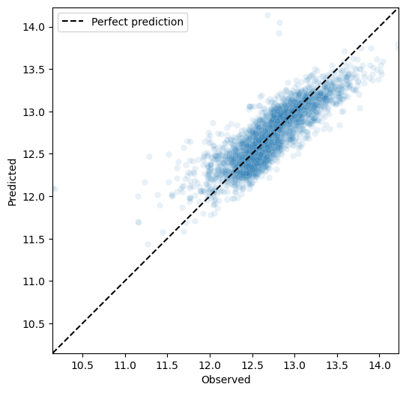

Regress arcsinh(price) on total rooms, arcsinh(age), arcsinh(area), and full-bath dummies, with an intercept

Slide 22
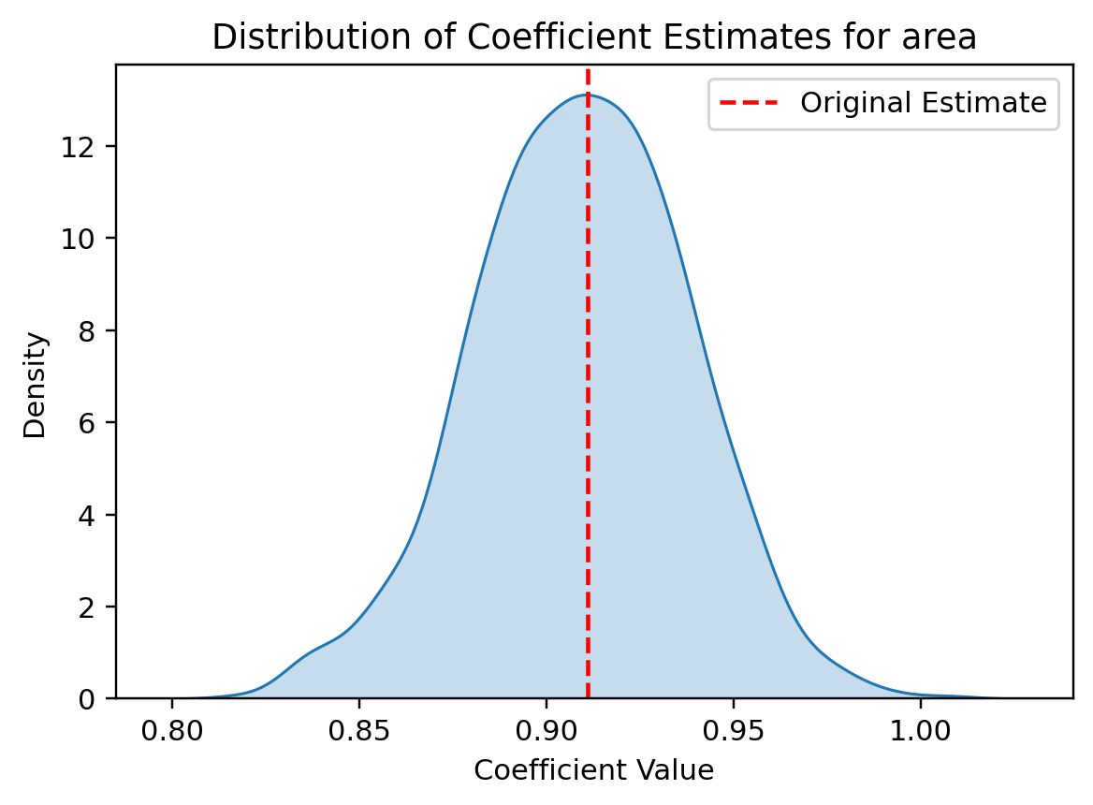
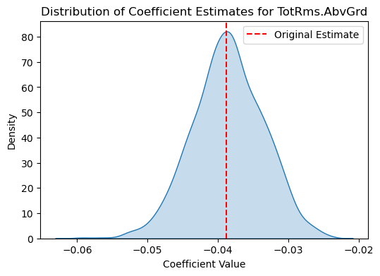
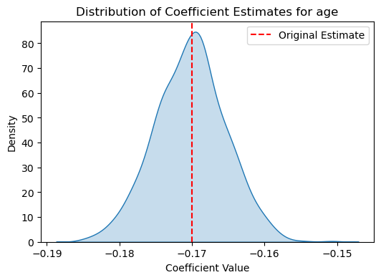
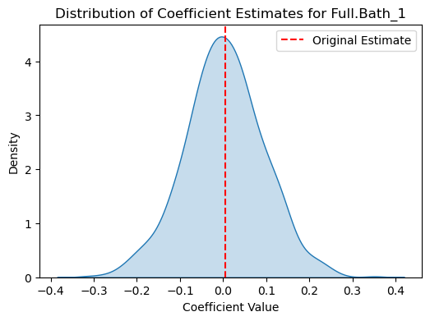
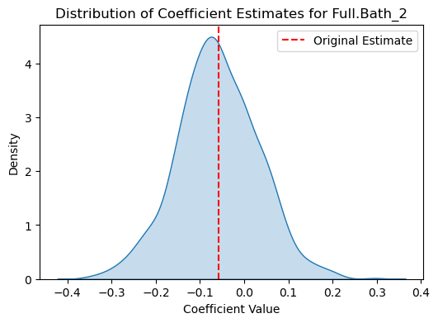
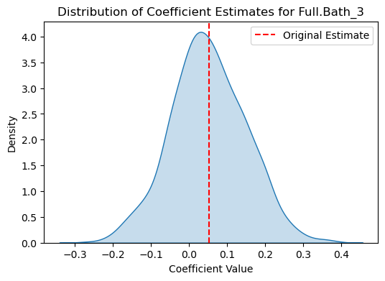
Bootstrapped Coefficients

Slide 23
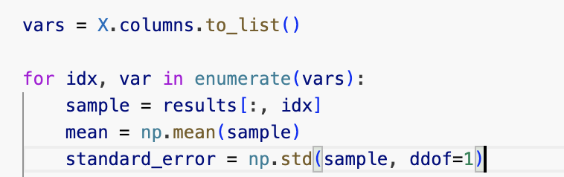
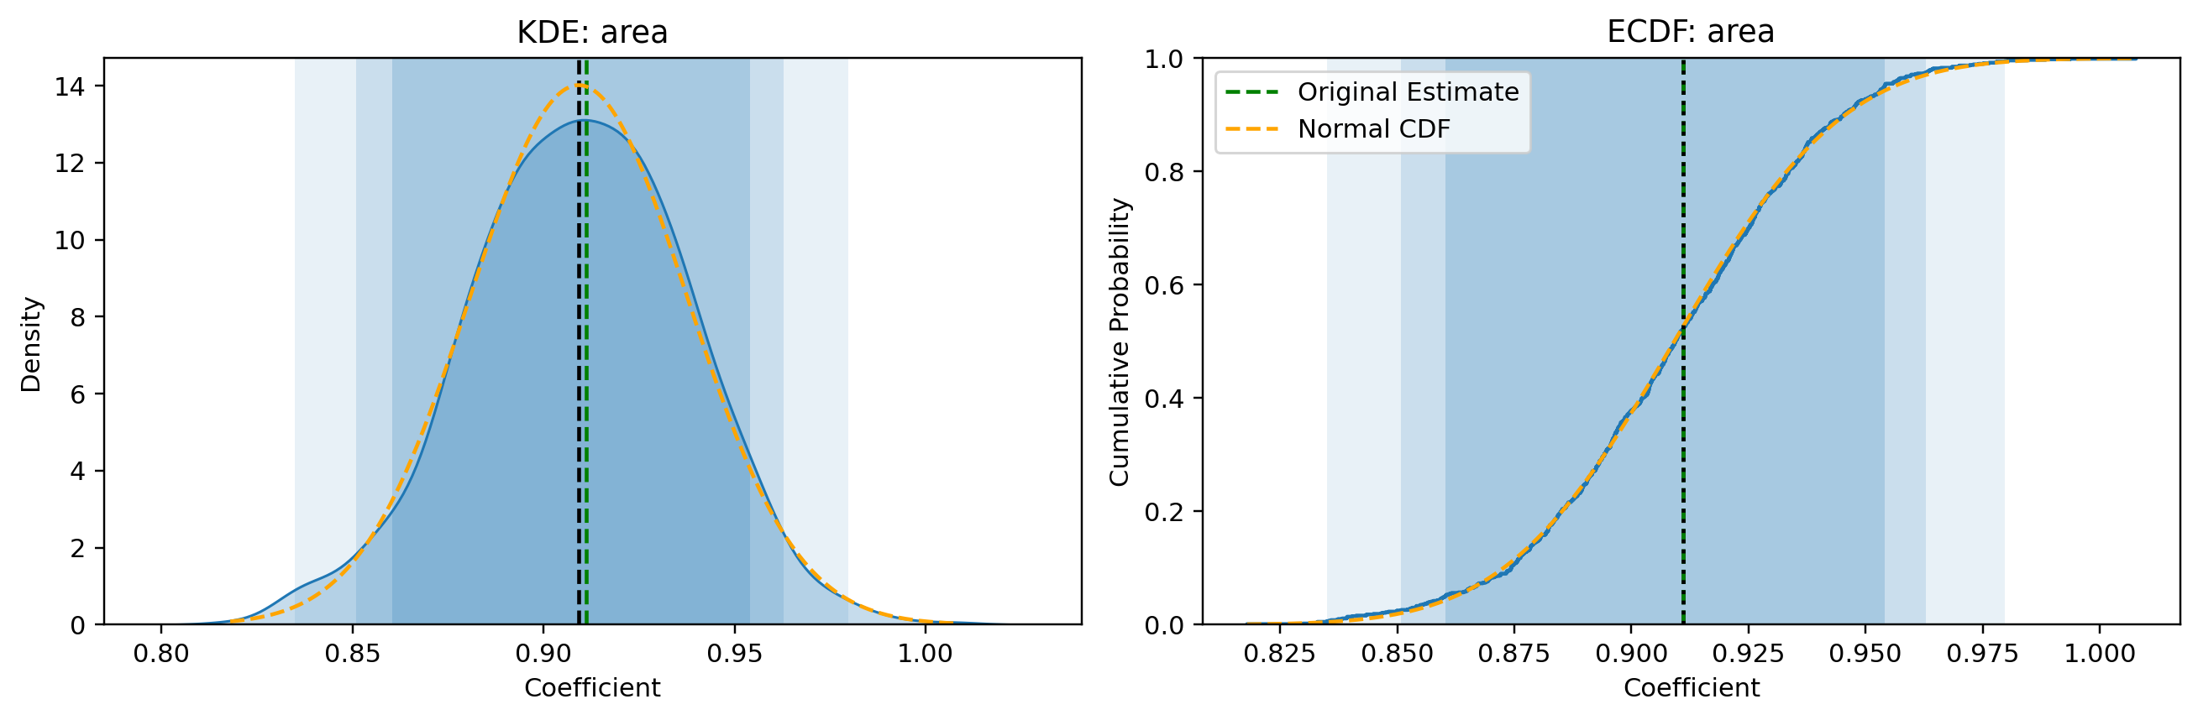
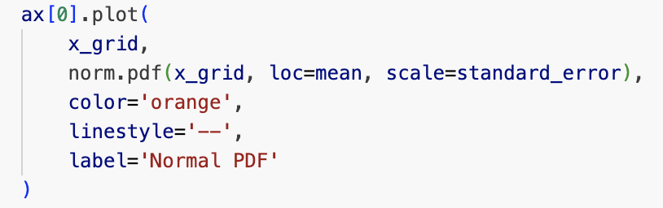
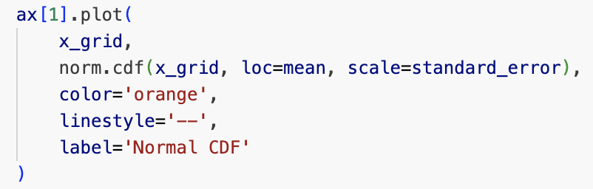
Fitting the Bootstrapped Sampling Distribution
What if we overlay a normal with the bootstrap mean and the standard deviation of the bootstrap sample (our estimate of the standard error)?

Slide 24
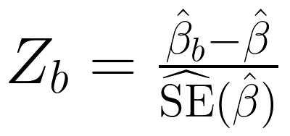
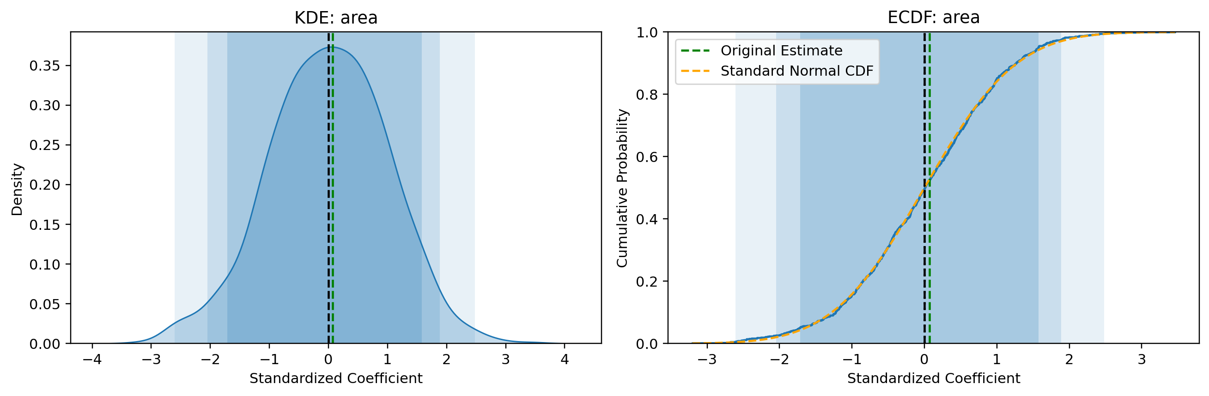
z-Score Normalization
Let's go a step further and z-score normalize our estimates:
Are the Z_b values approximately standard normal? Look at what happens to the confidence intervals

Slide 25
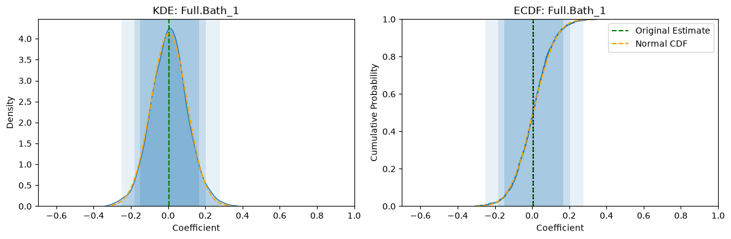
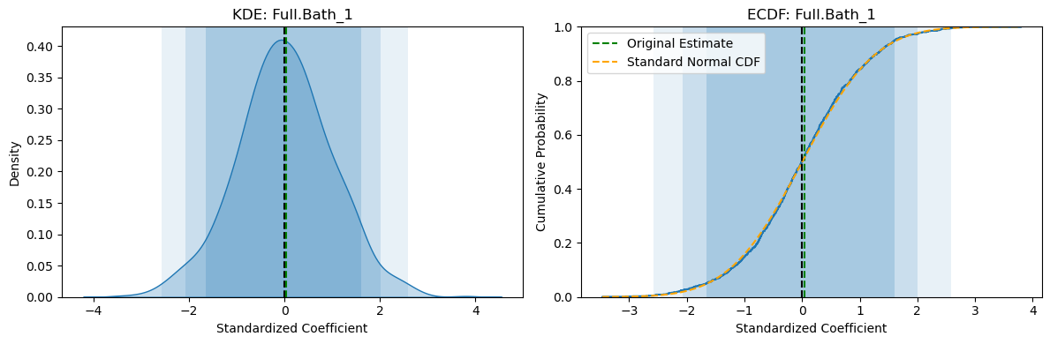
Raw vs. z-Scored
Bootstrap coefficients
Full.Bath_1
z-scored
(b − mean) / SE

Slide 26
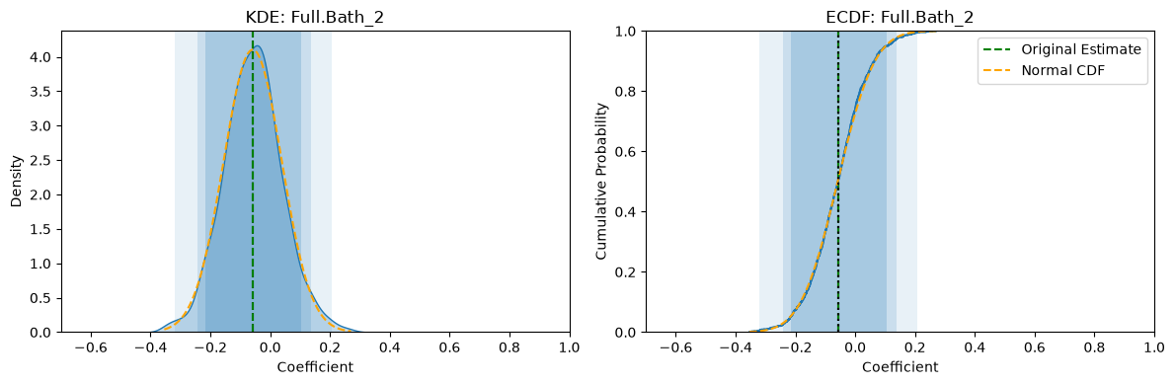
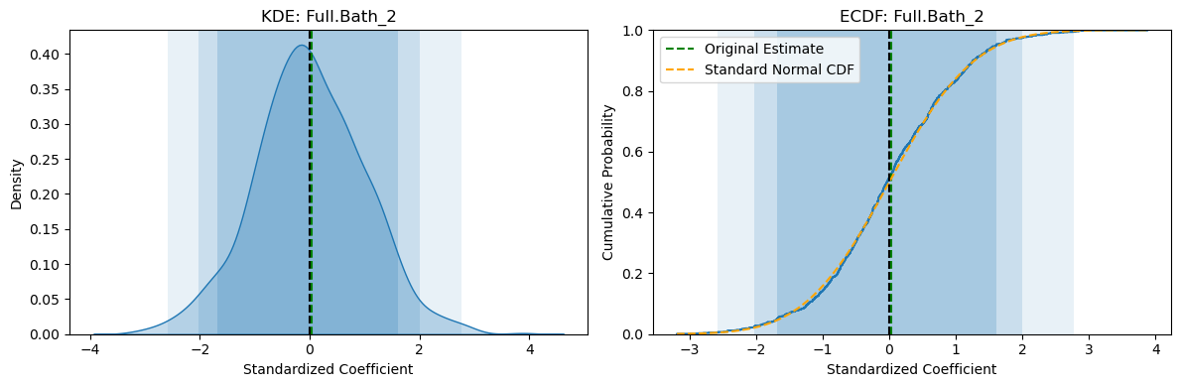
Raw vs. z-Scored
Bootstrap coefficients
Full.Bath_2
z-scored
(b − mean) / SE

Slide 27
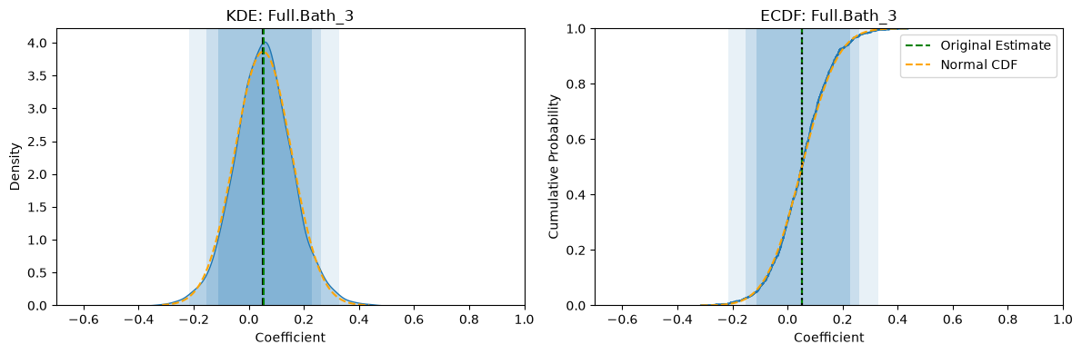
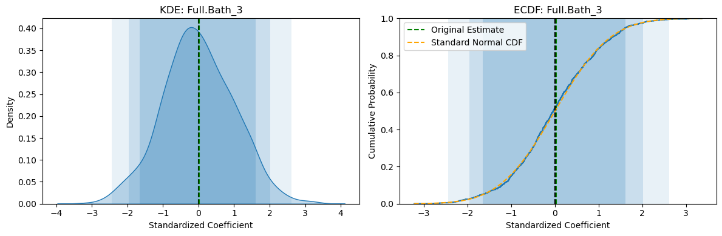
Raw vs. z-Scored
Bootstrap coefficients
Full.Bath_3
z-scored
(b − mean) / SE

Slide 28
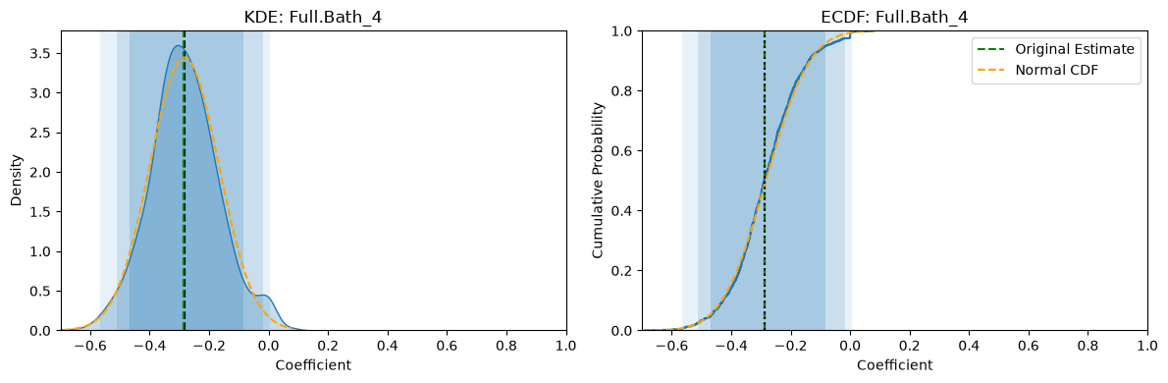
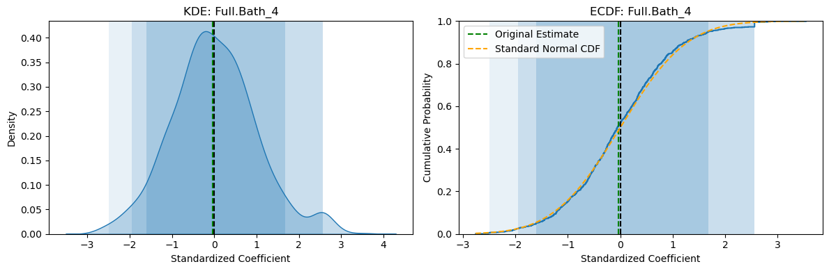
Raw vs. z-Scored
Bootstrap coefficients
Full.Bath_4
z-scored
(b − mean) / SE

Slide 29
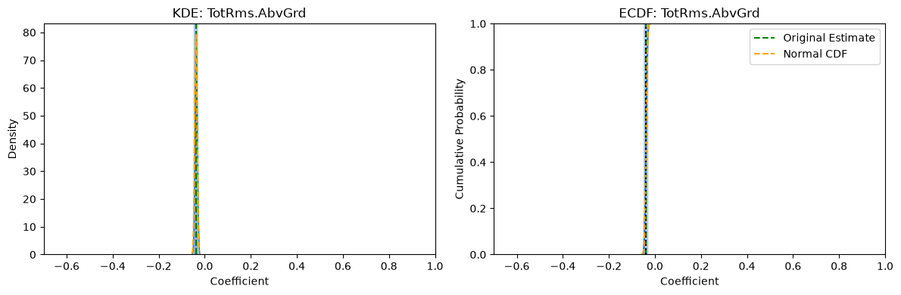
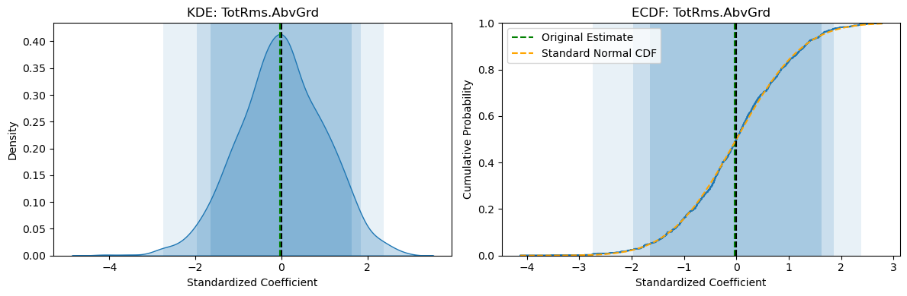
Raw vs. z-Scored
Bootstrap coefficients
TotRms.AbvGrd
z-scored
(b − mean) / SE

Slide 30
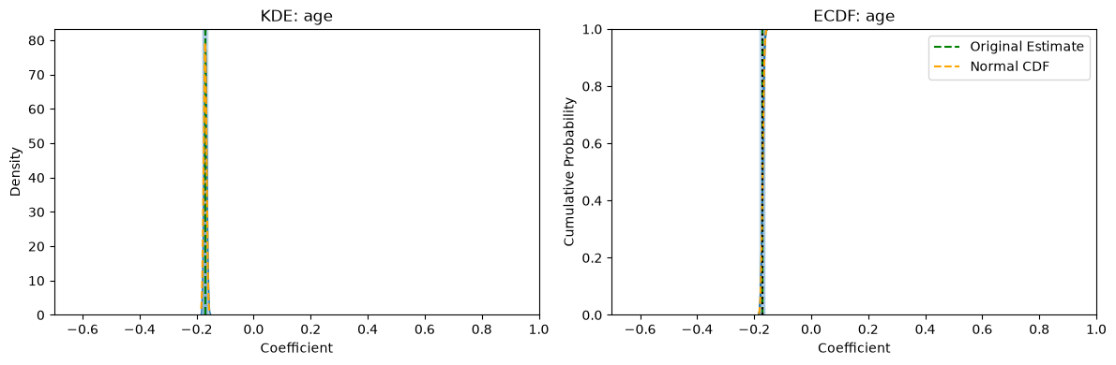
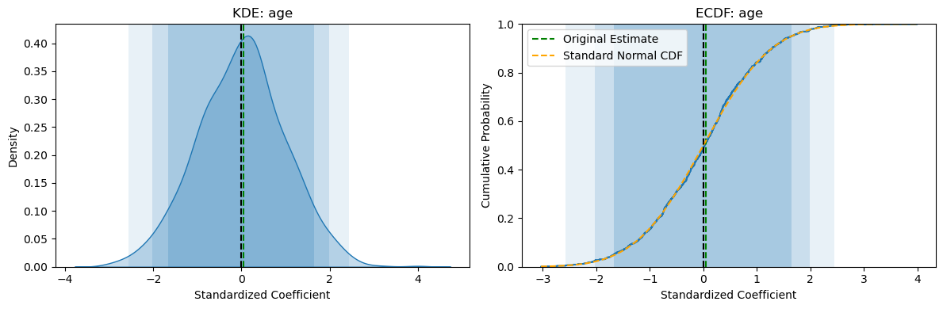
Raw vs. z-Scored
Bootstrap coefficients
age
z-scored
(b − mean) / SE

Slide 31
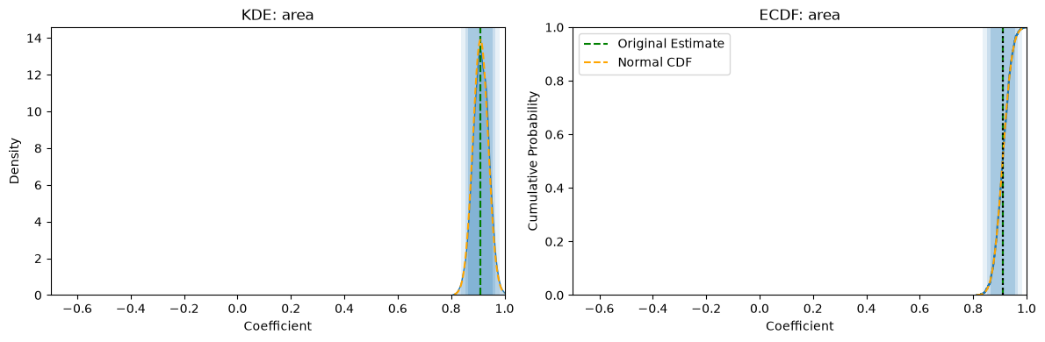
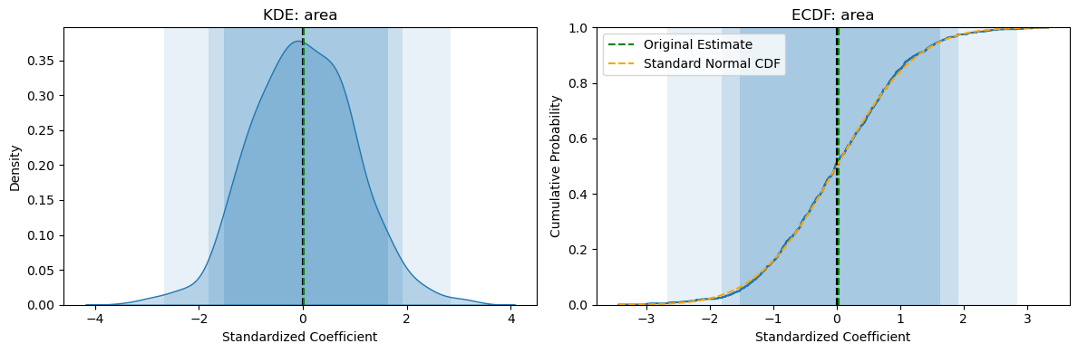
Raw vs. z-Scored
Bootstrap coefficients
area
z-scored
(b − mean) / SE

Slide 32
But Wait
After z-score normalizing, we got roughly the same picture, over and over
If we get basically the same picture every time, and the bootstrap ECDF and the standard Normal align almost perfectly, then can't we just approximate the sampling distribution of Z-scores by a standard Normal?
This is the basic logic behind classical asymptotic inferential statistics

Slide 33
Checkpoint: Discuss with someone sitting next to you
A colleague bootstraps the mean of 25 house prices: the bootstrap distribution is centered at $182k with SD $9k. They write "house prices are $182k ± $9k." What's wrong? About how spread out are the prices themselves?
With 100 houses instead of 25, about what SD would their bootstrap distribution have?
Why do we resample whole rows (price and area together) instead of resampling price and area separately?
Predict: every z-scored coefficient looked standard normal. Would the bootstrap still give that picture for (a) the maximum price, (b) the coefficient on a house style that only 8 houses in the data have, (c) the same regression fit to just 5 houses?

Slide 34
Checkpoint Answers
Houses: ±$9k is the SE of the average, not the spread of prices. Price SD ≈ 9 × √25 = $45k
100 houses: SE ≈ 45/√100 = $4.5k. Four times the data halves the SE
Rows: resampling separately breaks the pairing, so the bootstrap slopes center near 0. It simulates a world where area doesn't predict price
(a) No: a resample can never exceed the largest house, so the bootstrap max piles up at one value. (b) Lumpy: only 8 houses drive that coefficient. (c) Lumpy and skewed: 5 rows allow very few distinct resamples. That's the next section: why the bell curve shows up, and when it doesn't

Slide 35
Checkpoint: At the Boards
Think (2 min, alone) → Pair (3 min) → Share at the boards
Population {0, 4}. Draw n = 2 with replacement
1. List every possible sample and its x̄. What are μ, σ², V[x̄], and the true SE?
2. Your sample is (0, 4). Compute s² and the estimated SE. Now your sample is (4, 4). Same questions
3. Neither estimate equals the true SE. Is either one a mistake?
4. Average s² over all four samples, then average the estimated SE. What do you notice?
Notes:
{0, 4}: samples (0,0), (0,4), (4,0), (4,4) give x̄ = 0, 2, 2, 4. μ = 2, σ² = 4, V[x̄] = (4 + 0 + 0 + 4)/4 = 2 = σ²/n, true SE = √2 = 1.41
(0, 4): s² = 8, estimated SE = √(8/2) = 2. (4, 4): s² = 0, estimated SE = 0. Neither is a mistake: each is an estimate from one sample, and (4, 4) happens to show none of the population's spread
Average s² = (0 + 8 + 8 + 0)/4 = 4 = σ² (unbiased). Average estimated SE = (0 + 2 + 2 + 0)/4 = 1, not 1.41 (biased low)

Slide 36
Why it works:
the CLT

Slide 37
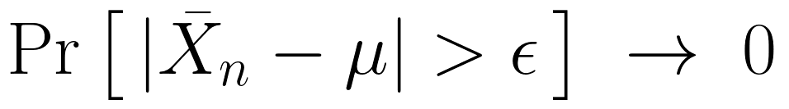
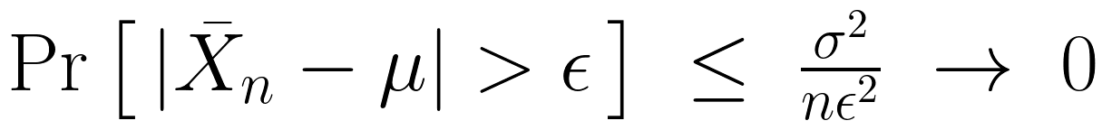
The Law of Large Numbers
Law of Large Numbers: if X₁, …, Xₙ are IID with mean μ, then for any ε > 0
This is consistency: one long sample's average approaches μ
It is not unbiasedness. E[x̄] = μ is true for every n, even n = 1
Estimator | Unbiased? | Consistent?
x̄ | yes | yes
X₁ (first observation only) | yes | no
x̄ + 1/n | no | yes
Unbiased plus variance going to zero gives consistency:

Slide 38
Two Kinds of Getting Close
In probability: the values get close. Pr[|Xₙ − X| > ε] → 0. This is the LLN
In distribution: only the histogram (CDF) gets close. Pr[Xₙ ≤ z] → Pr[X ≤ z]. This is the CLT
Example: if X ~ N(0, 1) and Xₙ = −X, then Xₙ has exactly the right distribution but is never close to X
Probability implies distribution, but not the other way around (unless the limit is a constant)

Slide 39
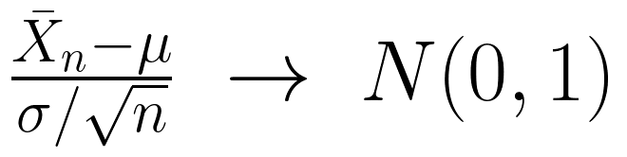
The Central Limit Theorem
Why is this happening?
Central Limit Theorem: let X₁, …, Xₙ be IID random variables, each with mean μ and variance σ². Then as n goes to infinity,
This is what we observed above: for a big enough sample, that quantity is roughly normal
We replace x̄ by our parameter estimate, and σ/√n by the standard error of the parameter, the SD of the sampling distribution (do not divide by √n again; it's baked into the bootstrap estimate)
For many of the quantities we study, there is a sum of IID random variables happening somewhere, to which the CLT applies

Slide 40
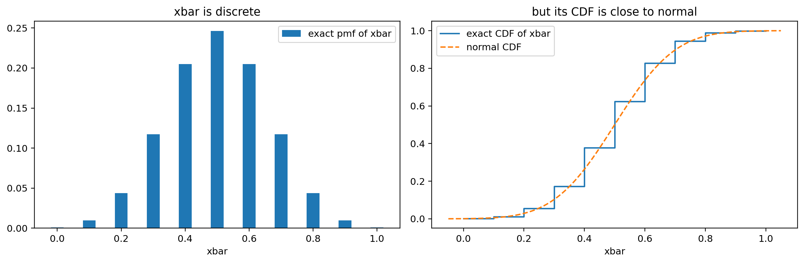
What the CLT Does Not Say
The CLT says probability statements about x̄ can be computed as if it were normal. It does not say x̄ is normal
10 coin flips: x̄ can only be 0, 0.1, …, 1, and Pr[x̄ = 0.5] = 252/1024 = 0.246. A normal gives 0 to any single point
For an interval it works: Pr[0.45 < x̄ < 0.55] ≈ 0.248 (exact: 0.246)

Slide 41
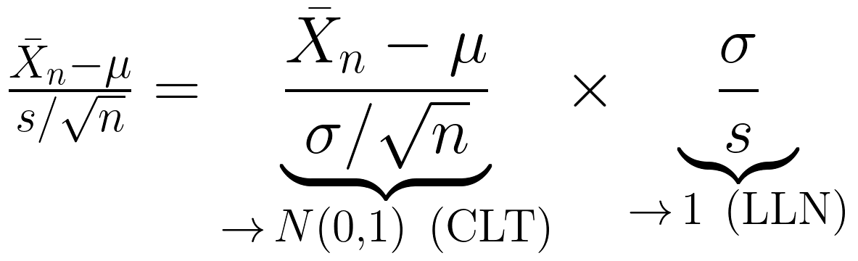
Why We Can Plug In s for σ
The CLT is stated with the true σ. In practice we divide by an estimate. Write
The first piece goes to N(0, 1) by the CLT; the second goes to 1 by the LLN. Slutsky's theorem says the product goes to N(0, 1)
This licenses every "estimate ± 1.96 SE" interval
It says nothing about how fast s gets close to σ: that's the small-sample problem

Slide 42
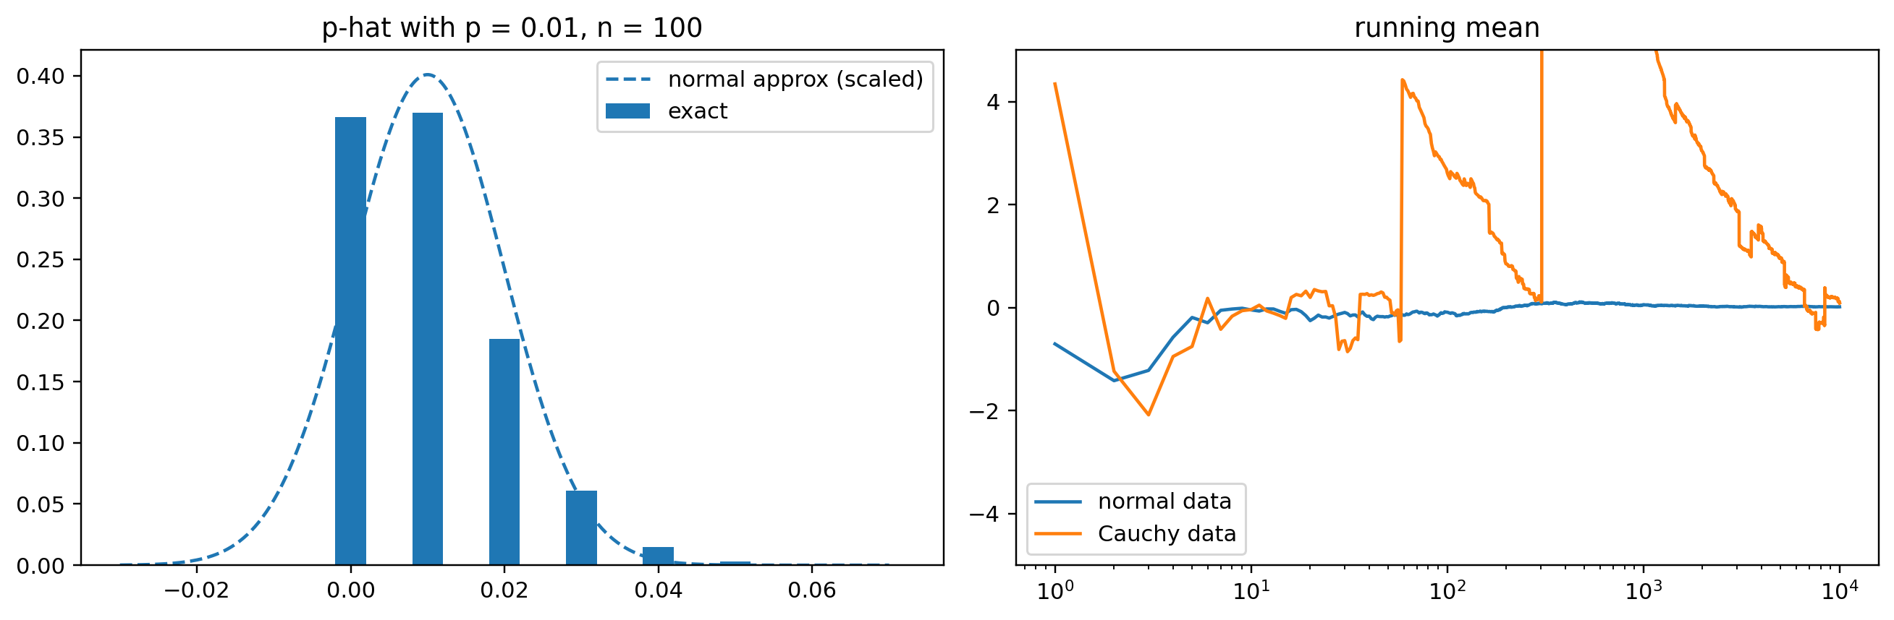
Example: A Rare Event
p = 0.01, n = 100. Expected number of successes: 1. Pr[no successes] = 0.99¹⁰⁰ = 0.37
Then p̂ = 0, estimated SE = 0, and the "95% CI" is [0, 0]. The normal approximation even says Pr[p̂ < 0] ≈ 0.16
Right: the running mean of Cauchy data never settles

Slide 43
Confidence intervals
and tests

Slide 44
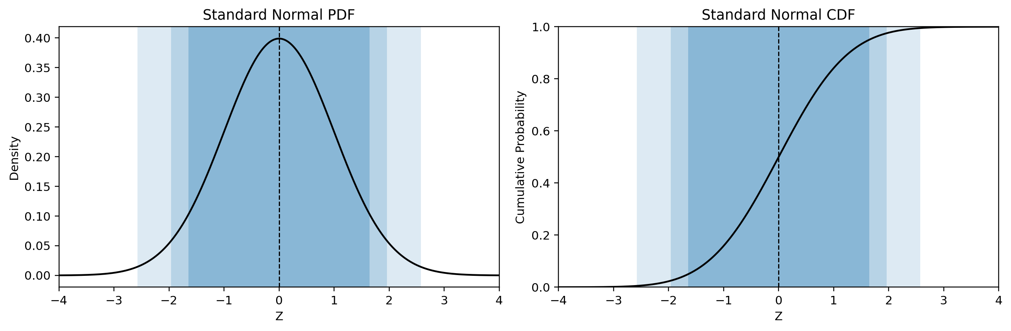
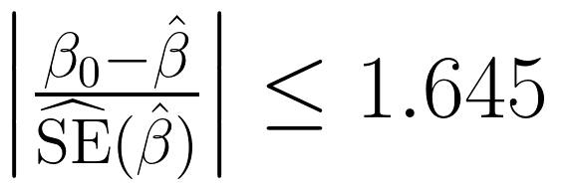
Just Memorize These
Instead of taking the quantiles of our bootstrap sample, take the quantiles of the standard Normal, then invert the z-score normalization
Confidence | Lower | Upper | Level (α)
90% | −1.645 | +1.645 | .10
95% | −1.960 | +1.960 | .05
99% | −2.576 | +2.576 | .01
So the 90% CI comes from this bound:

Slide 45
Constructing Confidence Intervals

Slide 46
Thought Experiment: Would the CLT work in each case?
For each one: does "estimate ± 1.96 SE" work? If not, what breaks down each time?
1. You survey 100 students that come in 10 friend groups whose members answer the same way
2. You average the profit ratio (this year's profit ÷ last year's) across 100 stores, where many stores roughly broke even last year
3. A condition affects 1 in 100 people. You test 100 people and find 0 cases
4. You bootstrap the largest sale price in the Ames data
5. You poll 10,000 people, but only those who answer a landline at 2 pm

Slide 47
Thought Experiment: Answers
1. Dependence. The 100 answers carry about 10 independent pieces of information, so s/√100 is too small
2. Infinite variance. A store that broke even has a denominator near 0, so one ratio can be enormous, of either sign. Ratios like this have Cauchy-type tails: the mean of 100 is as spread out as a single ratio
3. Too little data for the skew. Pr[0 cases] = 0.99¹⁰⁰ = 0.37. Then p̂ = 0, SE = 0, and the "95% CI" is [0, 0]
4. Not a sum. The max is not an average of many pieces. A resample can never exceed the sample's largest price, so the bootstrap max piles up at one value
5. Wrong target. The CLT still holds: x̄ is normal around the mean of landline-at-2-pm answerers. The interval is precise about the wrong number, and more data only makes it more confidently wrong
Estimate ± 1.96 SE can fail because the CLT fails (2, 4), the SE is wrong (1, 3), or the target is wrong (5)

Slide 48
Example
You run a regression and get a coefficient of 5 with a standard error of 2 for a key coefficient
90% CI: (5 − 1.645 × 2, 5 + 1.645 × 2) = (1.71, 8.29)
95% CI: (5 − 1.960 × 2, 5 + 1.960 × 2) = (1.08, 8.92)
99% CI: (5 − 2.576 × 2, 5 + 2.576 × 2) = (−0.15, 10.15)
For which levels of confidence is a statistically significant difference from 0 detected?

Slide 49
Exercise on the board
You run a regression and get a coefficient of 10 with a standard error of 5 for a key coefficient
Compute 90/95/99% confidence intervals for the coefficient
For which levels of confidence is a statistically significant difference from 0 detected?
Notes:
Answer: 90% (1.78, 18.23); 95% (0.20, 19.80); 99% (−2.88, 22.88). Significant at 90% and 95%, not at 99%.

Slide 50
Exercise: Answers
Coefficient 10, SE 5
90% CI: (10 − 1.645 × 5, 10 + 1.645 × 5) = (1.78, 18.23)
95% CI: (10 − 1.960 × 5, 10 + 1.960 × 5) = (0.20, 19.80)
99% CI: (10 − 2.576 × 5, 10 + 2.576 × 5) = (−2.88, 22.88)
Significantly different from 0 at 90% and 95% (0 is outside), but not at 99% (0 is inside)
Shortcut: the estimate is 10/5 = 2 SEs from 0. It's significant whenever 2 beats the critical value: 2 > 1.645, 2 > 1.960, 2 < 2.576

Slide 51
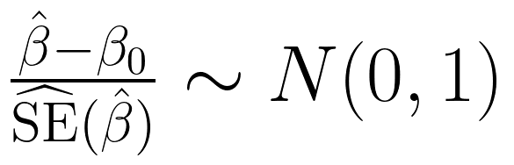
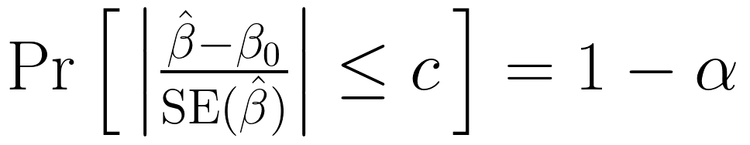
What Is a Confidence Interval?
Suppose our estimator is approximately normally distributed:
Choose a critical value c such that:
What is random? The interval, because β̂ changes with every sample. What is fixed? β₀. The 95% describes the procedure, not any one interval
Rearrange to get:
This is a statistical reliability claim, not a statement about the value of the true parameter β₀

Slide 52
CI to Hypothesis Test: TEST = INTERVAL
If we hypothesize β₀ the take some value, usually zero, this becomes a hypothesis test: is the hypothesized value β₀ in the interval or not?
Is β₀ (often 0) outside the CI? If so, reject H₀; if it is inside the CI, fail to reject H₀

Slide 53
The CI Is Not...
This is just not Pr_β₀[ |β̂ − β₀| ≤ c ]
It couldn't be this: we don't know the true β₀
If β₀ was random, and had a distribution associated with it, then you'd use Bayes' Rule to observe data and update that distribution
We often say things like, "Gravity is −9.81 m/s²." We don't often say things like, "Gravity is normally distributed with mean −9.81 m/s² and standard deviation .0051"
If you did talk like that, you'd be a Bayesian statistician, and we'll talk about Bayesian statistics at the end of the course

Slide 54
The CI Is...
If we did this kind of analysis many times, what range of values is plausible for our estimates?
A set of parameter values that our data do not allow us to reject, using a procedure designed to exclude the true parameter only a specified fraction of the time (the Type 1 error probability).
The probability that the random CI covers the true β₀ is 1 − α; we expect the CI to cover the true β₀ with probability 1 − α
If we repeatedly sampled data and constructed a new confidence interval each time, approximately 95% of those intervals would contain the fixed, unknown parameter β₀ (the bootstrapping connection is clear here)

Slide 55
Coverage You Can Count
At the boards. Population {1, 3, 5}, draw n = 2 with replacement, so μ = 3
1. List all 9 possible samples and their x̄
2. Our interval rule is x̄ ± 1.5. For how many of the 9 samples does the interval contain μ = 3? What is the coverage?
3. Repeat for x̄ ± 0.5 and x̄ ± 2.5
4. You drew (1, 1), so your interval is [−0.5, 2.5]. What is the probability that this interval contains μ?

Slide 56
Coverage You Can Count: Answers
Back to {1, 3, 5} with n = 2: μ = 3, and the 9 sample means are 1, 2, 3, 2, 3, 4, 3, 4, 5
The rule "x̄ ± 1.5" covers μ when x̄ ∈ {2, 3, 4}: 7 of the 9 samples
So x̄ ± 1.5 is a 78% confidence interval, by counting
half-width | samples that cover | coverage
0.5 | 3 | 33%
1.5 | 7 | 78%
2.5 | 9 | 100%
4. Zero. [−0.5, 2.5] misses 3, and nothing random is left once you've drawn your sample. The 78% belongs to the rule, not to your interval
coverage is a property of the rule, computed over all samples before you see yours

Slide 57
Is the SE Itself Uncertain?
Yes: the estimated SE comes from the same sample, so it has its own sampling distribution
For normal data, its typical relative error is about 1/√(2(n − 1)): 35% at n = 5, 24% at n = 10, 7% at n = 92
Too small an SE hurts more than too big helps, so coverage drops
The t-distribution fixes this exactly for normal data; for skewed data it helps but can't fix it
n | normal: z | normal: t | cars: z | cars: t
5 | 87.5% | 94.8% | 78.3% | 86.2%
10 | 92.2% | 95.3% | 85.0% | 88.1%
30 | 94.0% | 95.1% | 91.8% | 92.7%
92 | 94.9% | 95.2% | 93.9% | 94.2%
Coverage of a nominal 95% interval (20,000 simulated samples each)

Slide 58
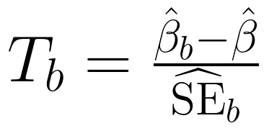
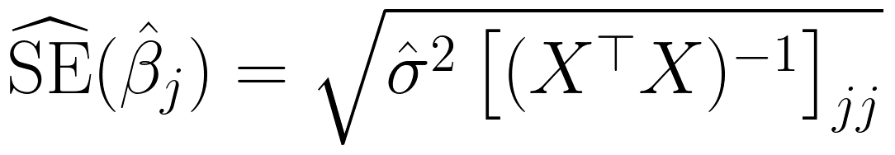
More on Standard Errors
Standard errors are important but hard to pin down: the data and model create the standard error
We've been using the SD of the bootstrap sample as the SE. This is the centered bootstrap:
If you can get an SE from each resample, you can upgrade to the studentized version, which has more variation because the SE is allowed to vary:
The analytical formula for OLS standard errors (you can bootstrap this by resampling rows):

Slide 59
Inference routine

Slide 60
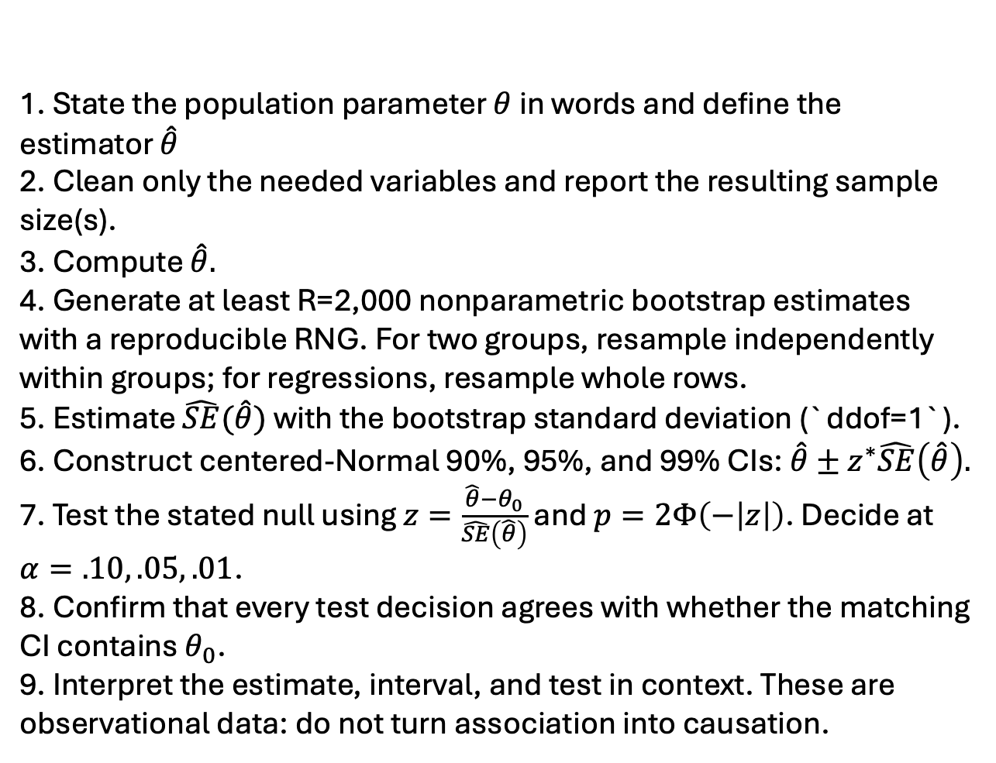
1. State the population parameter $θ$ in words and define the estimator $\hat{θ}$
2. Clean only the needed variables and report the resulting sample size(s).
3. Compute $\hat{θ}.$
4. Generate at least R=2,000 nonparametric bootstrap estimates with a reproducible RNG. For two groups, resample independently within groups; for regressions, resample whole rows.
5. Estimate $\hat{SE}(\hat{θ})$ with the bootstrap standard deviation (`ddof=1`).
6. Construct centered-Normal 90%, 95%, and 99% CIs: $\hat{θ}±z^{∗}\hat{SE}\left(\hat{θ}\right).$
7. Test the stated null using $z=\frac{\hat{θ}−θ_{0}}{\hat{SE}\left(\hat{θ}\right)}$ and $p=2Φ\left(−\left|z\right|\right)$. Decide at $α=.10, .05, .01$.
8. Confirm that every test decision agrees with whether the matching CI contains $θ_{0}$.
9. Interpret the estimate, interval, and test in context. These are observational data: do not turn association into causation.
Inference routine:
bootstrapping an estimate to understand its uncertainty
EXPLORE the data non-parametrically before modeling
ESTIMATION: decide on what’s important
INFERENCE: non-parametric bootstrap evaluation of parameters
PREDICTION (and quantifying the uncertainty of predictions)
Notes:
Non-parametric exploration of data before explicit modeling
Non-parametric bootstrap evaluation of parameters or predictions, in every assignment
For these models, ESTIMATION and then INFERENCE and then PREDICTION in every lab
Focus on the idea and the application (e.g. count data and Poisson), rather than a mathematical derivation
Our job is INFERENCE about parameters and quantifying the uncertainty of PREDICTIONS; we're not worried about the machine learning part, but about exploiting the inference framework we've built using resampling to instill a worldview in the students that resampling methods are the natural solution to most problems

Slide 61
Non-parametric exploration of data BEFORE modeling
You should ALWAYS do

Slide 62
Inference to evaluate estimators NOT JUST prediction
You should ALWAYS do

Slide 63
At the Boards: Does It Pay for Itself?
A retail chain pilots an energy-management system in 5 stores. It costs $200 per store per month. Monthly savings on each store's electric bill: $100, $300, $400, $500, $700
1. Compute x̄, s², and the estimated SE
2. Build a 95% CI with 1.96. Does the system save money at all? (Test H₀: average savings = 0)
3. Does it pay for itself? Is the $200 break-even inside or outside your CI?
4. The CFO writes: "There is a 95% chance the system saves between $204 and $596 per store." Rewrite it correctly
5. All 5 pilot stores are in Phoenix. What does your CI tell you about the stores in Maine?

Slide 64
At the Boards: Answers
1. x̄ = 20/5 = 4 ($400). Deviations −3, −1, 0, 1, 3, so the sum of squares is 20 and s² = 20/4 = 5. SE = √(5/5) = 1 ($100)
2. 4 ± 1.96 × 1 = ($204, $596). 0 is outside, so reject H₀: it saves money (the estimate is 4 SEs from 0)
3. The lower end, $204, is just above $200: it pays for itself, barely
4. 4 ± 2.78 × 1 = ($122, $678). Still saves money, but $200 is now inside: we can't be confident it pays for itself. Same data, different decision, because 5 stores give a noisy SE. Pilot more stores before rolling out
4. "If we ran this pilot on 5 new stores many times, about 95% of the intervals built this way would contain the true average savings." The true savings is fixed: it is either in ($204, $596) or it isn’t
5. Not much. The interval targets Phoenix stores, where air conditioning drives the bill. More Phoenix stores would shrink the SE but not change the target (like the landline poll)

Slide 65
Coding example
Load the Metabric breast cancer dataset, and describe/plot `Overall Survival (Months)`.
Describe a strategy for selecting variables that you'll use to predict `Overall Survival (Months)`, then implement your strategy and run your regression.
Construct 90/95/99% non-parametric Bootstrap confidence intervals for the coefficients of your regression, as well as ones based on the Normal approximation using the standard deviation of the bootstrap sample as the standard error of the sampling distribution. How do they compare?
Which variables are statistically significant, and at what levels?

Slide 66
Summary

Slide 67
Five Things to Think About
The parameter is fixed but unknown. We're trying to learn something about a property of the population.
Our estimates/confidence intervals are random variables of the data. Different samples produce different estimates, even for the same population doesn't change.
The standard error measures variability in our estimators, and bootstrapping gives us a practical way to estimate it.
The confidence interval translates variability into uncertainty about the parameter. Under the Normal approximation, that's . A hypothesized value outside the corresponding interval is rejected as implausible give the data and estimator.
The Bootstrap and the CLT are different approaches to understanding the underlying sampling distribution and making inferences about it, with their own strengths and weaknesses.

Slide 68
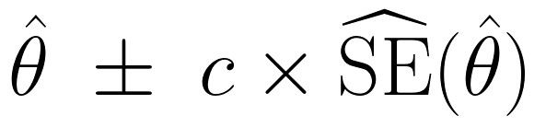
Summary
The standard error is the standard deviation of the sampling distribution
The bootstrap estimates the spread and shape of the sampling distribution from one sample
The CLT says that, standardized, the sampling distribution is approximately N(0, 1): that's why the bootstrap pictures all looked the same
So we can replace bootstrap quantiles with ±1.645, 1.96, 2.576:
A CI is a reliability claim about the procedure. A test asks whether the null value is inside the CI
It breaks with dependence, heavy tails, small samples of skewed data, and estimates that aren't averages

