Slide 1
Side channel attacks
Computer Security - Ymir Vigfusson

Slide 2
Background
An algorithm or software can be designed to be provably secure.
E.g. cryptosystems, small OS kernels, TPM modules, ...
Involves proving that certain situations cannot arise
Or that breaking them would be just as hard as doing something incredibly tedious
Such as factoring large numbers
But what about the environment in which these algorithms or software are located?

Slide 3
Side channel attacks
Correlation between physical measurements during computation (side channel) and the internal state of the computer
Attacks that exploit the physical implementation of a system

Slide 4
Side channel attacks
Timing attacks
Measure time between computations
Power monitoring attacks
Measure varying power consumption during computation
Electromagnetic attacks
Measure radiation from devices (e.g. monitors)
Acoustic attacks
Listen to sounds emitted during computation
Differential fault analysis
Deliberately provoke faults in computation to discover secrets
Data remanence
Resurrect data that was thought to have been deleted
Such as the memset() of the password example from first class

Slide 5
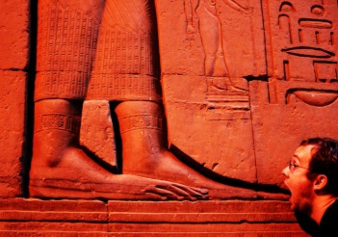
Early attacks
1956: Operation ENGULF
British&US did not want to fund Egyptian President Nasser to build the Ashwan High Dam so he turned to the Soviets
Nasser takes over the Suez Canal, formerly under British&French control, to collect tolls on ships
MI5 places bugs in the Egyptian embassy to listen to 2-3 rotors of Hagelin cipher machines that were communicating sensitive information with French and Soviets
Soviets helped sweep the embassy for bugs, but left the MI5 one!
Relies on an attack of the physical implementation of the Hagelin cipher machine: a side channel attack
What was the side channel?

Slide 6
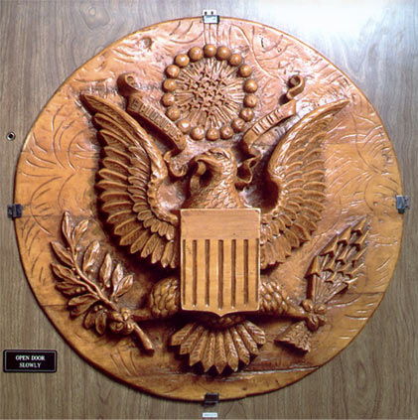
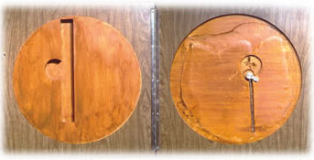
Early attacks
1946-1952: The Thing
Soviets gave US ambassador to the USSR 2“ hand crafted seal for his office.
Ingenious passive listening device inside based on a spring by Theremin
Spies shot radiowaves at 330MHz at distance to activate microphone and listen in for 6 years
Discovered by a stroke of
luck by a technician

Slide 7
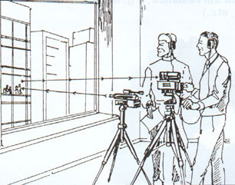
Early attacks
1947-ish: Laser microphone („Buran“)
Theremin also developed a technique for showning a low power infrared beam on glass windows to detect vibrations from sound at distance
Used by precursor of KGB to spy on U.S., U.K. and French embassies in Moscow
Works best with smooth
surfaces, hence the use of
rippled glass by security
agencies...

Slide 8
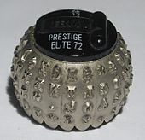
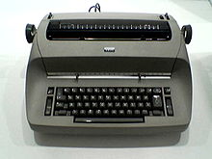
Early attacks
1980: Soviets accused of planting bugs in IBM Selectric printers to listen to the sound of the type ball as it rotates and strikes the paper
Allows the spies to “listen“ to what was being printed

Slide 9
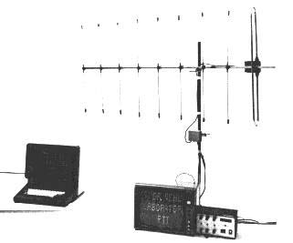
Early attacks
1985: Wim van Eck eavesdrops CRT/LCD emissions
Oscillating electronic currents inside video displays generate electromagnetic radiation in the radio frequency range that correlated with the image being shown on the screen.
CRT: Cost ~$15.
LCD (2004): Cost ~$2000

Slide 10
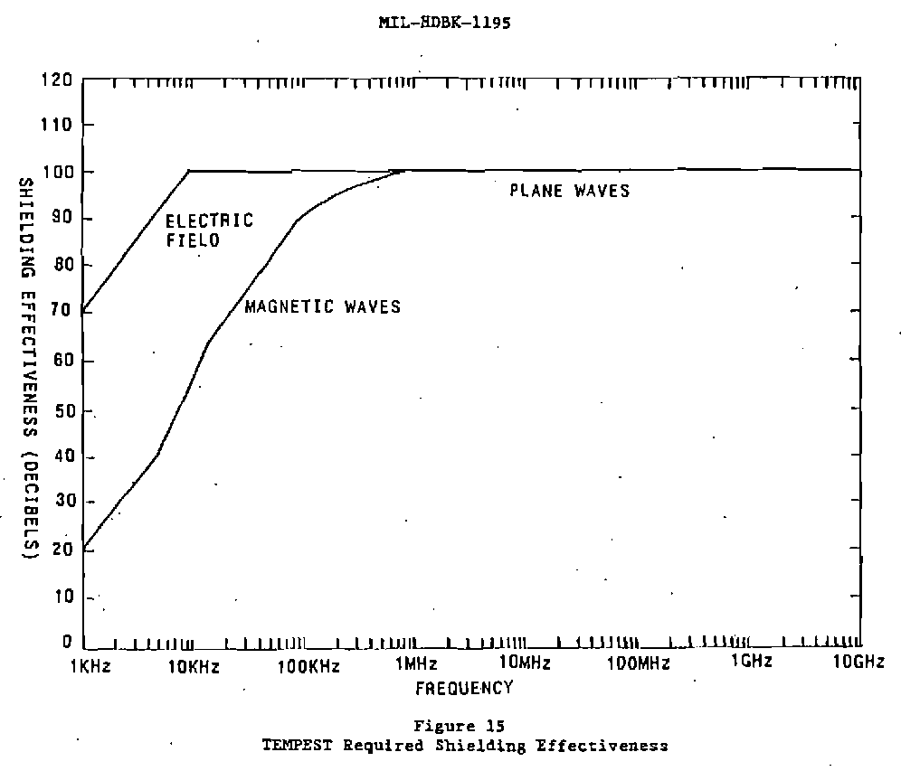
Early countermeasures
TEMPEST: NSA specification for protection against side-channel attacks. Been partially declassified.
U.S. initially playing catch-up to Soviet intelligence on exploiting emanations
Sets up zones depending on how physically close an attacker can get (0-100m)
Add extra noise (shielding) when required:

Slide 11
More modern attacks
Loughry & Umphress (2002): Information Leakage from Optical Emanations
1991: Briol shows that sounds from dot-matrix printers leak significant details on the contents being printed
2002: Loughry and Umphress show that the LED lights on networking equipment are heavily correlated with the data they are transmitting
Could effectively listen in on all network traffic
Mostly theoretical

Slide 12
More modern attacks
Zhuang et al: http://www.tygar.net/papers/Keyboard_Acoustic_Emanations_Revisited/ccs.pdf
2004: Asonov and Agrawal of IBM show that keyboard and keypads (such as on ATMs) emit different sounds for different keys
Practical experiments by Berkeley in 2005 for covert listening for passwords, PINs, etc.
Needs a training phase (each key 100 times)
2005: Zhuang, Zhou and Tygar recover 96% of English text from keyboard sound recording
No training required, if recording is at least 10 min.

Slide 13
Timing attacks
2004: Shamir and Tromer use timing attacks against CPUs
Different operations cause variable ultrasonic noise from the capacitors/inductors
2013: Shamir, Tromer and Genkin use techniques to listen to GnuPG via a cell phone
Able to extract 4096-bit private key by listening to the computation

Slide 14
More recent attacks
http://www2007.org/papers/paper555.pdf
2007: Bortz, Boneh and Nandy show observing timing data of TCP packets (even HTTPS) allows you to infer:
number of Facebook friends (effectively),
contents of shopping cart,
and so forth
Recent discussions about impact on TOR: check whether a connection exists between a user and a server
Think oppressed journalist and Twitter via TOR
Spoof TCP packets to halve the window size of a connection

Slide 15
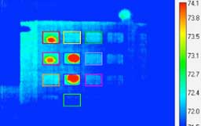
More modern attacks
https://www.usenix.org/legacy/events/woot11/tech/final_files/Mowery.pdf
2011: Thermal imaging
Mowery et al. show how ATM keypads can be broken by looking at residual heat from keypressed by a target user
Works up to a minute after the user enters the password
Reduces search space from 10,000 to about 24 for 4-digit PIN

Slide 16
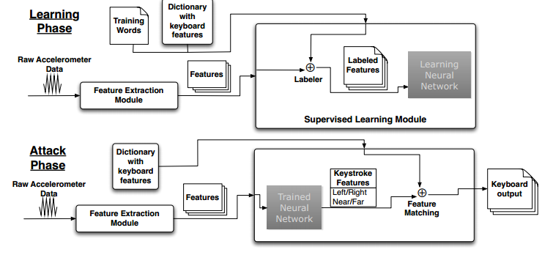
More modern attacks
2011: Traynor et al. from Gatech show how the accelerometer on a cell phone can decode vibrations emitted from a nearby keyboard
Effectively a listening device for any app on the phone
Sampling rate much smaller than with previous gizmos
Perhaps 100Hz on iPhone 4, or 400x less then Asonov et al.
Instead, modeled keypress events
Models proximity between keys, left/right, duration of keystroke, ...
This timing attack was investigated in depth for SSH passwords in 2002

Slide 17
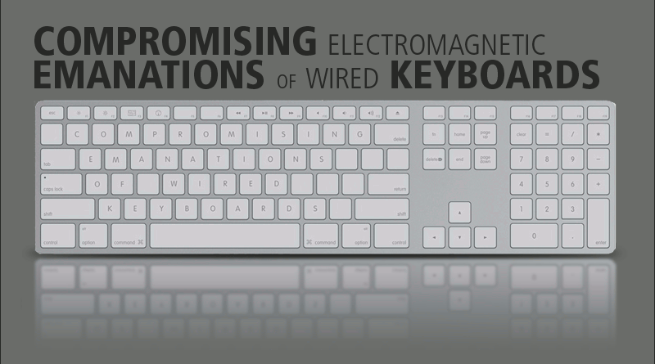
More modern attacks
http://lasec.epfl.ch/keyboard/
2009: Vuagnoux and Pasini capture electromagnetic emanations directly from keyboards at 20m distance
No need for other wires providing physical support for emanations
Demo:
http://vimeo.com/2008343

Slide 18
What‘s happening today
http://thehackernews.com/2014/09/unmasking-google-users-with-new-timing.html
2014: Timing attack to identify Google users
Want to know if a particular Gmail address being used?
Link to a picture that only the authenticated user could access
Triggers onerror() in Javascript in 891ms if image was accessible, but 573ms if not.

Slide 19
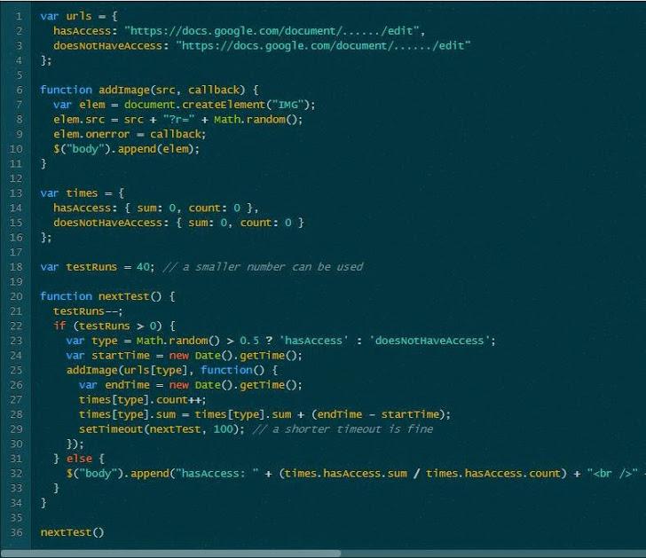
What‘s happening today
http://thehackernews.com/2014/09/unmasking-google-users-with-new-timing.html

Slide 20
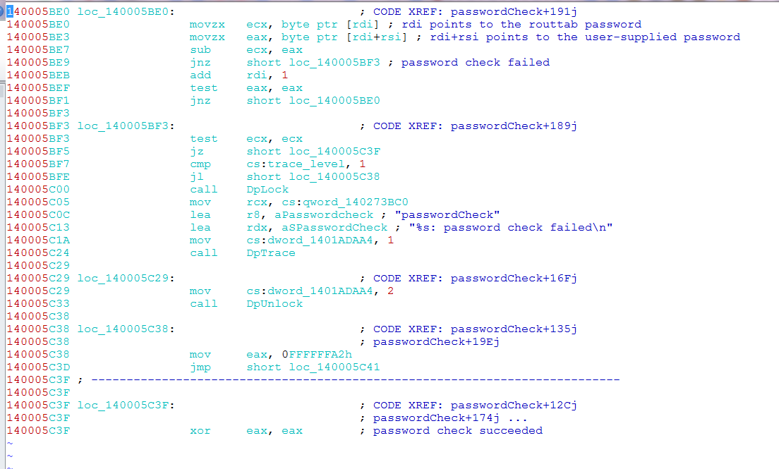
SAP flaw

Slide 21
SAP flaw
Roughly equal to the following C code:
What‘s the flaw? How would you exploit it?
int passwordCheck(char *truepw, char *pw) {
while (*truepw) {
if (*truepw != *pw) {
printf ("Password check failed\n");
return -1;
}
}
return 0;
}

Slide 22
SAP flaw
2014: SAP Router Password Timing Attack
Router disallows connections based on a table, unless the correct password is specified.
Just walk linearly through the passwords, asking:
„Hey, is the next character A? No? How about B? ...“
Illustrates a general problem for cryptosystems (and caches)

Slide 23
Today!
2016: Cache side-channel attacks
Has something been requested before?
2017: Timing attack on SGX Enclave
Work done at Georgia Tech (Taesoo Kim et al.)
2017: Optical side-channels
See the photons that are emitted as part of your computation!

Slide 24
Countermeasures
http://www.cs.cornell.edu/andru/papers/ccs11.pdf
Side-channel attacks rely on merging information from the side channel to the original data
Approach 1: Eliminate side channels
Put government buildings in a Faraday cage (anti-TEMPEST)
Jam the channels / add random delays
Let execution paths not depend on secret information (PC-secure)
Myers et al. (2011) Predictively mitigate timing attacks
Approach 2: Remove correlation between side channel and original data
Blinding in cryptography
In RSA, multiply encrypted ciphertext with a random number before decrypting, then factoring it back out.

