Slide 1


x86 Assembly Review or “What happens when someone hacks me?”
Most slides gratefully borrowed from 18-213@CMU
Ýmir Vigfússon
S.P.E.C.T.R.E.

Slide 2
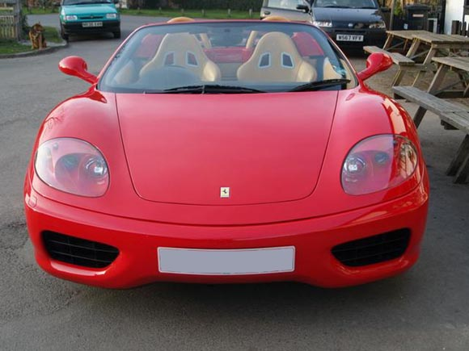
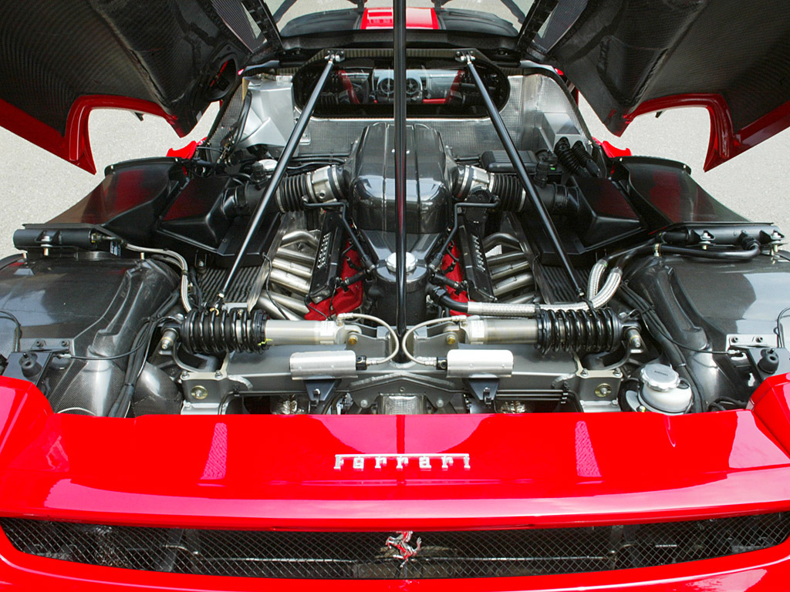
So what is assembly really?

Slide 3

Why study assembly?
mainframe$

Slide 4
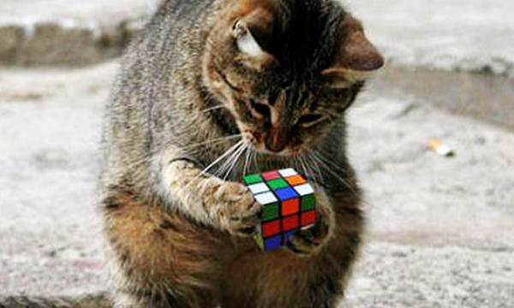
One reason: Reverse engineering
Can we track what that malware actually does?
Great money!

Slide 5
Motivation: The Turing Machine!
http://www.youtube.com/watch?v=cYw2ewoO6c4

Slide 6
Intel x86 Processors: Overview
Architectures
Processors
X86-16
8086
286
X86-32/IA32
386
486
Pentium
Pentium MMX
Pentium III
Pentium 4
Pentium 4E
MMX
SSE
SSE2
SSE3
X86-64 / EM64t
Pentium 4F
Core 2 Duo
Core i7
time
SSE4
IA: often redefined as latest Intel architecture

Slide 7
Intel x86 Evolution: Milestones
Name Date Transistors MHz
8086 1978 29K 5-10
First 16-bit processor. Basis for IBM PC & DOS
1MB address space
386 1985 275K 16-33
First 32 bit processor , referred to as IA32
Added “flat addressing”
Capable of running Unix
32-bit Linux/gcc uses no instructions introduced in later models
Pentium 4F 2004 125M 2800-3800
First 64-bit processor, referred to as x86-64
Core i7 2008 731M 2667-3333
Our shark machines

Slide 8
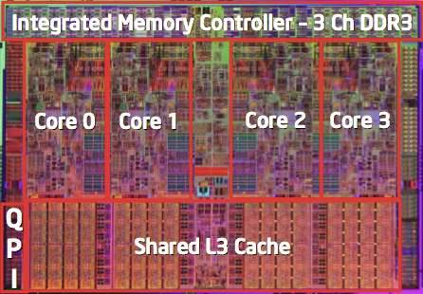
Intel x86 Processors
Machine Evolution
386 1985 0.3M
Pentium 1993 3.1M
Pentium/MMX 1997 4.5M
PentiumPro 1995 6.5M
Pentium III 1999 8.2M
Pentium 4 2001 42M
Core 2 Duo 2006 291M
Core i7 2008 731M
Added Features
Instructions to support multimedia operations
Parallel operations on 1, 2, and 4-byte data, both integer & FP
Instructions to enable more efficient conditional operations
Linux/GCC Evolution
Two major steps: 1) support 32-bit 386. 2) support 64-bit x86-64

Slide 9
What is this?
(gdb) disass checksum
Dump of assembler code for function checksum:
0x08048400 <+0>: push %ebp
0x08048401 <+1>: xor %edx,%edx
0x08048403 <+3>: mov %esp,%ebp
0x08048405 <+5>: xor %eax,%eax
0x08048407 <+7>: push %esi
0x08048408 <+8>: mov 0x8(%ebp),%esi
0x0804840b <+11>: push %ebx
0x0804840c <+12>: mov 0xc(%ebp),%ebx
0x0804840f <+15>: test %ebx,%ebx
0x08048411 <+17>: jle 0x8048425 <checksum+37>
0x08048413 <+19>: nop
0x08048414 <+20>: lea 0x0(%esi,%eiz,1),%esi
0x08048418 <+24>: movsbl (%esi,%edx,1),%ecx
0x0804841c <+28>: add $0x1,%edx
0x0804841f <+31>: xor %ecx,%eax
0x08048421 <+33>: cmp %ebx,%edx
0x08048423 <+35>: jne 0x8048418 <checksum+24>
0x08048425 <+37>: pop %ebx
0x08048426 <+38>: pop %esi
0x08048427 <+39>: pop %ebp
0x08048428 <+40>: ret
End of assembler dump.

Slide 10
Assembly Programmer’s View
CPU
Memory
Registers
Addresses
Data
Code
Data
Stack
PC
Condition
Codes
Instructions
Programmer-Visible State
PC: Program counter
Address of next instruction
Called “EIP” (IA32) or “RIP” (x86-64)
Register file
Heavily used program data
Condition codes
Store status information about most recent arithmetic operation
Used for conditional branching
Memory
Byte addressable array
Code and user data
Stack to support procedures

Slide 11
Turning C into Object Code
Code in files p1.c p2.c
Compile with command: gcc –O1 p1.c p2.c -o p
Use basic optimizations (-O1)
Put resulting binary in file p
text
C program (p1.c p2.c)
Compiler (gcc -S)
text
Asm program (p1.s p2.s)
Assembler (gcc or as)
binary
Object program (p1.o p2.o)
Static libraries (.a)
Linker (gcc or ld)
binary
Executable program (p)

Slide 12
Compiling Into Assembly
C Code
Generated IA32 Assembly
int sum(int x, int y)
{
int t = x+y;
return t;
}
sum:
pushl %ebp
movl %esp,%ebp
movl 12(%ebp),%eax
addl 8(%ebp),%eax
popl %ebp
ret
Some compilers use instruction “leave”
Obtain with command
/usr/local/bin/gcc –O1 –m32 -S code.c
Produces file code.s

Slide 14
Assembly Characteristics: Data Types
“Integer” data of 1, 2, or 4 bytes
Data values
Addresses (untyped pointers)
Floating point data of 4, 8, or 10 bytes
No aggregate types such as arrays or structures
Just contiguously allocated bytes in memory

Slide 15
Assembly Characteristics: Operations
Perform arithmetic function on register or memory data
Transfer data between memory and register
Load data from memory into register
Store register data into memory
Transfer control
Unconditional jumps to/from procedures
Conditional branches

Slide 16
Object Code
Code for sum
Assembler
Translates .s into .o
Binary encoding of each instruction
Nearly-complete image of executable code
Missing linkages between code in different files
Linker
Resolves references between files
Combines with static run-time libraries
E.g., code for malloc, printf
Some libraries are dynamically linked
Linking occurs when program begins execution
0x401040 <sum>:
0x55
0x89
0xe5
0x8b
0x45
0x0c
0x03
0x45
0x08
0x5d
0xc3
Total of 11 bytes
Each instruction 1, 2, or 3 bytes
Starts at address 0x401040

Slide 17
Machine Instruction Example
C Code
Add two signed integers
Assembly
Add 2 4-byte integers
“Long” words in GCC parlance
Same instruction whether signed or unsigned
Operands:
x: Register %eax
y: Memory M[%ebp+8]
t: Register %eax
Return function value in %eax
Object Code
3-byte instruction
Stored at address 0x80483ca
int t = x+y;
addl 8(%ebp),%eax
Similar to expression:
x += y
More precisely:
int eax;
int *ebp;
eax += ebp[2]
0x80483ca: 03 45 08

Slide 18
Disassembling Object Code
Disassembled
080483c4 <sum>:
80483c4: 55 push %ebp
80483c5: 89 e5 mov %esp,%ebp
80483c7: 8b 45 0c mov 0xc(%ebp),%eax
80483ca: 03 45 08 add 0x8(%ebp),%eax
80483cd: 5d pop %ebp
80483ce: c3 ret
Disassembler
objdump -d p
Useful tool for examining object code
Analyzes bit pattern of series of instructions
Produces approximate rendition of assembly code
Can be run on either complete executable or .o file

Slide 19
Alternate Disassembly
Disassembled
Object
0x401040:
0x55
0x89
0xe5
0x8b
0x45
0x0c
0x03
0x45
0x08
0x5d
0xc3
Dump of assembler code for function sum:
0x080483c4 <sum+0>: push %ebp
0x080483c5 <sum+1>: mov %esp,%ebp
0x080483c7 <sum+3>: mov 0xc(%ebp),%eax
0x080483ca <sum+6>: add 0x8(%ebp),%eax
0x080483cd <sum+9>: pop %ebp
0x080483ce <sum+10>: ret
Within gdb Debugger
gdb p
disassemble sum
Disassemble procedure
x/11xb sum
Examine the 11 bytes starting at sum

Slide 20
Registers, operands, move operation

Slide 21
Integer Registers (IA32)
Origin
(mostly obsolete)
%eax
%ax
%ah
%al
accumulate
%ecx
%cx
%ch
%cl
counter
%edx
%dx
%dh
%dl
data
general purpose
%ebx
%bx
%bh
%bl
base
%esi
source
index
%si
%edi
destination
index
%di
%esp
stack
pointer
%sp
%ebp
base
pointer
%bp
16-bit virtual registers
(backwards compatibility)

Slide 22
Moving Data: IA32
%eax
%ecx
Moving Data
movl Source, Dest:
Operand Types
Immediate: Constant integer data
Example: $0x400, $-533
Like C constant, but prefixed with ‘$’
Encoded with 1, 2, or 4 bytes
Register: One of 8 integer registers
Example: %eax, %edx
But %esp and %ebp reserved for special use
Others have special uses for particular instructions
Memory: 4 consecutive bytes of memory at address given by register
Simplest example: (%eax)
Various other “address modes”
%edx
%ebx
%esi
%edi
%esp
%ebp

Slide 23

movl Operand Combinations
Source
Dest
Src,Dest
C Analog
Reg
movl $0x4,%eax
temp = 0x4;
Imm
Mem
movl $-147,(%eax)
*p = -147;
Reg
movl %eax,%edx
temp2 = temp1;
movl
Reg
Mem
movl %eax,(%edx)
*p = temp;
Mem
Reg
movl (%eax),%edx
temp = *p;
Cannot do memory-memory transfer with a single instruction

Slide 24
Simple Memory Addressing Modes
Normal (R) Mem[Reg[R]]
Register R specifies memory address movl (%ecx),%eax
Displacement D(R) Mem[Reg[R]+D]
Register R specifies start of memory region
Constant displacement D specifies offset movl 8(%ebp),%edx

Slide 25
Using Simple Addressing Modes
swap:
pushl %ebp
movl %esp,%ebp
pushl %ebx
movl 8(%ebp), %edx
movl 12(%ebp), %ecx
movl (%edx), %ebx
movl (%ecx), %eax
movl %eax, (%edx)
movl %ebx, (%ecx)
popl %ebx
popl %ebp
ret
void swap(int *xp, int *yp)
{
int t0 = *xp;
int t1 = *yp;
*xp = t1;
*yp = t0;
}
Set
Up
Body
Finish

Slide 26
Using Simple Addressing Modes
swap:
pushl %ebp
movl %esp,%ebp
pushl %ebx
movl 8(%ebp), %edx
movl 12(%ebp), %ecx
movl (%edx), %ebx
movl (%ecx), %eax
movl %eax, (%edx)
movl %ebx, (%ecx)
popl %ebx
popl %ebp
ret
void swap(int *xp, int *yp)
{
int t0 = *xp;
int t1 = *yp;
*xp = t1;
*yp = t0;
}
Set
Up
Body
Finish

Slide 27
Understanding Swap
•
•
•
void swap(int *xp, int *yp)
{
int t0 = *xp;
int t1 = *yp;
*xp = t1;
*yp = t0;
}
Stack
(in memory)
Offset
12
yp
8
xp
4
Rtn adr
0
Old %ebp
%ebp
-4
Old %ebx
%esp
Register Value
%edx xp
%ecx yp
%ebx t0
%eax t1
movl 8(%ebp), %edx # edx = xp
movl 12(%ebp), %ecx # ecx = yp
movl (%edx), %ebx # ebx = *xp (t0)
movl (%ecx), %eax # eax = *yp (t1)
movl %eax, (%edx) # *xp = t1
movl %ebx, (%ecx) # *yp = t0

Slide 28
Understanding Swap
Address
123
0x124
456
0x120
0x11c
%eax
0x118
%edx
Offset
0x114
%ecx
yp
12
0x120
0x110
xp
8
0x124
0x10c
%ebx
4
Rtn adr
0x108
%esi
%ebp
0
0x104
%edi
-4
0x100
%esp
movl 8(%ebp), %edx # edx = xp
movl 12(%ebp), %ecx # ecx = yp
movl (%edx), %ebx # ebx = *xp (t0)
movl (%ecx), %eax # eax = *yp (t1)
movl %eax, (%edx) # *xp = t1
movl %ebx, (%ecx) # *yp = t0
%ebp
0x104

Slide 29
Understanding Swap
Address
123
0x124
456
0x120
0x11c
%eax
0x118
%edx
0x124
Offset
0x114
yp
12
0x120
%ecx
0x120
0x110
xp
8
0x124
0x10c
%ebx
4
Rtn adr
0x108
%esi
%ebp
0
0x104
%edi
-4
0x100
%esp
movl 8(%ebp), %edx # edx = xp
movl 12(%ebp), %ecx # ecx = yp
movl (%edx), %ebx # ebx = *xp (t0)
movl (%ecx), %eax # eax = *yp (t1)
movl %eax, (%edx) # *xp = t1
movl %ebx, (%ecx) # *yp = t0
%ebp
0x104

Slide 30
Understanding Swap
Address
123
0x124
456
0x120
0x11c
%eax
0x118
%edx
0x124
Offset
0x114
%ecx
0x120
yp
12
0x120
0x110
xp
8
0x124
0x124
0x10c
%ebx
4
Rtn adr
0x108
%esi
%ebp
0
0x104
%edi
-4
0x100
%esp
movl 8(%ebp), %edx # edx = xp
movl 12(%ebp), %ecx # ecx = yp
movl (%edx), %ebx # ebx = *xp (t0)
movl (%ecx), %eax # eax = *yp (t1)
movl %eax, (%edx) # *xp = t1
movl %ebx, (%ecx) # *yp = t0
%ebp
0x104

Slide 31
Understanding Swap
Address
123
0x124
456
456
0x120
0x11c
%eax
0x118
%edx
0x124
Offset
0x114
%ecx
0x120
yp
12
0x120
0x110
xp
8
0x124
0x10c
%ebx
123
4
Rtn adr
0x108
%esi
%ebp
0
0x104
%edi
-4
0x100
%esp
movl 8(%ebp), %edx # edx = xp
movl 12(%ebp), %ecx # ecx = yp
movl (%edx), %ebx # ebx = *xp (t0)
movl (%ecx), %eax # eax = *yp (t1)
movl %eax, (%edx) # *xp = t1
movl %ebx, (%ecx) # *yp = t0
%ebp
0x104

Slide 32
Understanding Swap
Address
123
123
0x124
456
0x120
0x11c
%eax
456
0x118
%edx
0x124
Offset
0x114
%ecx
0x120
yp
12
0x120
0x110
xp
8
0x124
0x10c
%ebx
123
4
Rtn adr
0x108
%esi
%ebp
0
0x104
%edi
-4
0x100
%esp
movl 8(%ebp), %edx # edx = xp
movl 12(%ebp), %ecx # ecx = yp
movl (%edx), %ebx # ebx = *xp (t0)
movl (%ecx), %eax # eax = *yp (t1)
movl %eax, (%edx) # *xp = t1
movl %ebx, (%ecx) # *yp = t0
%ebp
0x104

Slide 33
Understanding Swap
Address
456
0x124
456
0x120
0x11c
%eax
456
456
0x118
%edx
0x124
Offset
0x114
%ecx
0x120
yp
12
0x120
0x110
xp
8
0x124
0x10c
%ebx
123
123
4
Rtn adr
0x108
%esi
%ebp
0
0x104
%edi
-4
0x100
%esp
movl 8(%ebp), %edx # edx = xp
movl 12(%ebp), %ecx # ecx = yp
movl (%edx), %ebx # ebx = *xp (t0)
movl (%ecx), %eax # eax = *yp (t1)
movl %eax, (%edx) # *xp = t1
movl %ebx, (%ecx) # *yp = t0
%ebp
0x104

Slide 34
Understanding Swap
Address
456
0x124
123
0x120
0x11c
%eax
456
0x118
%edx
0x124
Offset
0x114
%ecx
0x120
yp
12
0x120
0x110
xp
8
0x124
0x10c
%ebx
123
123
4
Rtn adr
0x108
%esi
%ebp
0
0x104
%edi
-4
0x100
%esp
movl 8(%ebp), %edx # edx = xp
movl 12(%ebp), %ecx # ecx = yp
movl (%edx), %ebx # ebx = *xp (t0)
movl (%ecx), %eax # eax = *yp (t1)
movl %eax, (%edx) # *xp = t1
movl %ebx, (%ecx) # *yp = t0
%ebp
0x104

Slide 35

Complete Memory Addressing Modes
Most General Form
D(Rb,Ri,S) Mem[Reg[Rb]+S*Reg[Ri]+ D]
D: Constant “displacement” 1, 2, or 4 bytes
Rb: Base register: Any of 8 integer registers
Ri: Index register: Any, except for %esp
Unlikely you’d use %ebp, either
S: Scale: 1, 2, 4, or 8 (why these numbers?)
Special Cases
(Rb,Ri) Mem[Reg[Rb]+Reg[Ri]]
D(Rb,Ri) Mem[Reg[Rb]+Reg[Ri]+D]
(Rb,Ri,S) Mem[Reg[Rb]+S*Reg[Ri]]

Slide 36
Data Representations: IA32 + x86-64
Sizes of C Objects (in Bytes)
C Data Type Generic 32-bit Intel IA32 x86-64
unsigned 4 4 4
int 4 4 4
long int 4 4 8
char 1 1 1
short 2 2 2
float 4 4 4
double 8 8 8
long double 8 10/12 16
char * 4 4 8
Or any other pointer

Slide 37
Assembly Programmer’s View
CPU
Memory
Registers
Addresses
Data
Code
Data
Stack
PC
Condition
Codes
Instructions
Programmer-Visible State
PC: Program counter
Address of next instruction
Called “EIP” (IA32) or “RIP” (x86-64)
Register file
Heavily used program data
Condition codes
Store status information about most recent arithmetic operation
Used for conditional branching
Memory
Byte addressable array
Code and user data
Stack to support procedures

Slide 38
Complete addressing mode and address computation (leal)

Slide 39
Complete Memory Addressing Modes
Most General Form
D(Rb,Ri,S) Mem[Reg[Rb]+S*Reg[Ri]+ D]
D: Constant “displacement” 1, 2, or 4 bytes
Rb: Base register: Any of 8 integer registers
Ri: Index register: Any, except for %esp
Unlikely you’d use %ebp, either
S: Scale: 1, 2, 4, or 8 (why these numbers?)
Special Cases
(Rb,Ri) Mem[Reg[Rb]+Reg[Ri]]
D(Rb,Ri) Mem[Reg[Rb]+Reg[Ri]+D]
(Rb,Ri,S) Mem[Reg[Rb]+S*Reg[Ri]]

Slide 40
Address Computation Examples
%edx | 0x7000
%ecx | 0x0200
Expression | Address Computation | Address
0x8(%edx) | 0xf000 + 0x8 | 0xf008
(%edx,%ecx) | 0xf000 + 0x100 | 0xf100
(%edx,%ecx,4) | 0xf000 + 4*0x100 | 0xf400
0x80(,%edx,2) | 2*0xf000 + 0x80 | 0x1e080
Expression | Address Computation | Address
0x8(%edx)
(%edx,%ecx)
(%edx,%ecx,4)
0x80(,%edx,2)
Notes:
0xf000 + 0x8 = 0xf008
0xf000 + 0x0100 = 0xf100
0xf000 + 4*0x0100 = 0xf400
2*0xf000 + 0x80 = 0x1d080

Slide 41
Address Computation Instruction
leal Src,Dest
Src is address mode expression
Set Dest to address denoted by expression
Uses
Computing addresses without a memory reference
E.g., translation of p = &x[i];
Computing arithmetic expressions of the form x + k*y
k = 1, 2, 4, or 8
Example
int mul12(int x)
{
return x*12;
}
Converted to ASM by compiler:
leal (%eax,%eax,2), %eax ;t <- x+x*2
sall $2, %eax ;return t<<2

Slide 42
Arithmetic operations

Slide 43
Some Arithmetic Operations
Two Operand Instructions:
Format Computation
addl Src,Dest Dest = Dest + Src
subl Src,Dest Dest = Dest − Src
imull Src,Dest Dest = Dest * Src
sall Src,Dest Dest = Dest << Src Also called shll
sarl Src,Dest Dest = Dest >> Src Arithmetic
shrl Src,Dest Dest = Dest >> Src Logical
xorl Src,Dest Dest = Dest ^ Src
andl Src,Dest Dest = Dest & Src
orl Src,Dest Dest = Dest | Src
Watch out for argument order!
No distinction between signed and unsigned int (why?)

Slide 44
Some Arithmetic Operations
One Operand Instructions
incl Dest Dest = Dest + 1
decl Dest Dest = Dest − 1
negl Dest Dest = − Dest
notl Dest Dest = ~Dest
See the chapter from CSAPP for more instructions

Slide 45
Arithmetic Expression Example
arith:
pushl %ebp
movl %esp, %ebp
movl 8(%ebp), %ecx
movl 12(%ebp), %edx
leal (%edx,%edx,2), %eax
sall $4, %eax
leal 4(%ecx,%eax), %eax
addl %ecx, %edx
addl 16(%ebp), %edx
imull %edx, %eax
popl %ebp
ret
Set
Up
int arith(int x, int y, int z)
{
int t1 = x+y;
int t2 = z+t1;
int t3 = x+4;
int t4 = y * 48;
int t5 = t3 + t4;
int rval = t2 * t5;
return rval;
}
Body
Finish

Slide 46
Understanding arith
 | •
 | •
 | •
16 | z
12 | y
8 | x
4 | Rtn Addr
0 | Old %ebp
int arith(int x, int y, int z)
{
int t1 = x+y;
int t2 = z+t1;
int t3 = x+4;
int t4 = y * 48;
int t5 = t3 + t4;
int rval = t2 * t5;
return rval;
}
Offset
%ebp
movl 8(%ebp), %ecx
movl 12(%ebp), %edx
leal (%edx,%edx,2), %eax
sall $4, %eax
leal 4(%ecx,%eax), %eax
addl %ecx, %edx
addl 16(%ebp), %edx
imull %edx, %eax

Slide 47
Understanding arith
Stack
 | •
 | •
 | •
16 | z
12 | y
8 | x
4 | Rtn Addr
0 | Old %ebp
int arith(int x, int y, int z)
{
int t1 = x+y;
int t2 = z+t1;
int t3 = x+4;
int t4 = y * 48;
int t5 = t3 + t4;
int rval = t2 * t5;
return rval;
}
Offset
%ebp
movl 8(%ebp), %ecx # ecx = x
movl 12(%ebp), %edx # edx = y
leal (%edx,%edx,2), %eax # eax = y*3
sall $4, %eax # eax *= 16 (t4)
leal 4(%ecx,%eax), %eax # eax = t4 +x+4 (t5)
addl %ecx, %edx # edx = x+y (t1)
addl 16(%ebp), %edx # edx += z (t2)
imull %edx, %eax # eax = t2 * t5 (rval)

Slide 48
Observations about arith
Instructions in different order from C code
Some expressions require multiple instructions
Some instructions cover multiple expressions
Get exact same code when compile:
(x+y+z)*(x+4+48*y)
int arith(int x, int y, int z)
{
int t1 = x+y;
int t2 = z+t1;
int t3 = x+4;
int t4 = y * 48;
int t5 = t3 + t4;
int rval = t2 * t5;
return rval;
}
movl 8(%ebp), %ecx # ecx = x
movl 12(%ebp), %edx # edx = y
leal (%edx,%edx,2), %eax # eax = y*3
sall $4, %eax # eax *= 16 (t4)
leal 4(%ecx,%eax), %eax # eax = t4 +x+4 (t5)
addl %ecx, %edx # edx = x+y (t1)
addl 16(%ebp), %edx # edx += z (t2)
imull %edx, %eax # eax = t2 * t5 (rval)

Slide 49
Assembly Programmer’s View
CPU
Memory
Registers
Addresses
Data
Code
Data
Stack
PC
Condition
Codes
Instructions
Programmer-Visible State
PC: Program counter
Address of next instruction
Called “EIP” (IA32) or “RIP” (x86-64)
Register file
Heavily used program data
Condition codes
Store status information about most recent arithmetic operation
Used for conditional branching
Memory
Byte addressable array
Code and user data
Stack to support procedures

Slide 50
Control: Conditon codes

Slide 51
Processor State (IA32, Partial)
Information about currently executing program
Temporary data ( %eax, … )
Location of runtime stack ( %ebp,%esp )
Location of current code control point ( %eip, … )
Status of recent tests ( CF, ZF, SF, OF )
%eax
%ecx
%edx
General purpose
registers
%ebx
%esi
%edi
%esp
Current stack top
%ebp
Current stack frame
%eip
Instruction pointer
CF
ZF
SF
OF
Condition codes

Slide 52
Condition Codes (Implicit Setting)
Single bit registers
CF Carry Flag (for unsigned) SF Sign Flag (for signed)
ZF Zero Flag OF Overflow Flag (for signed)
Implicitly set (think of it as side effect) by arithmetic operations
Example: addl/addq Src,Dest ↔ t = a+b
CF set if carry out from most significant bit (unsigned overflow)
ZF set if t == 0
SF set if t < 0 (as signed)
OF set if two’s-complement (signed) overflow (a>0 && b>0 && t<0) || (a<0 && b<0 && t>=0)
Not set by lea instruction

Slide 53
Condition Codes (Explicit Setting: Compare)
Explicit Setting by Compare Instruction
cmpl Src2, Src1
cmpl b,a like computing a-b without setting destination
CF set if carry out from most significant bit (used for unsigned comparisons)
ZF set if a == b
SF set if (a-b) < 0 (as signed)
OF set if two’s-complement (signed) overflow (a>0 && b<0 && (a-b)<0) || (a<0 && b>0 && (a-b)>0)

Slide 54
Condition Codes (Explicit Setting: Test)
Explicit Setting by Test instruction
testl Src2, Src1 testl b,a like computing a&b without setting destination
Sets condition codes based on value of Src1 & Src2
Useful to have one of the operands be a mask
ZF set when a&b == 0
SF set when a&b < 0

Slide 55
Reading Condition Codes
SetX Instructions
Set single byte based on combinations of condition codes
SetX | Condition | Description
sete | ZF | Equal / Zero
setne | ~ZF | Not Equal / Not Zero
sets | SF | Negative
setns | ~SF | Nonnegative
setg | ~(SF^OF)&~ZF | Greater (Signed)
setge | ~(SF^OF) | Greater or Equal (Signed)
setl | (SF^OF) | Less (Signed)
setle | (SF^OF)|ZF | Less or Equal (Signed)
seta | ~CF&~ZF | Above (unsigned)
setb | CF | Below (unsigned)

Slide 56
Reading Condition Codes (Cont.)
SetX Instructions:
Set single byte based on combination of condition codes
One of 8 addressable byte registers
Does not alter remaining 3 bytes
Typically use movzbl to finish job
%eax | %ah | %al
%ecx | %ch | %cl
%edx | %dh | %dl
%ebx | %bh | %bl
%esi
%edi
%esp
%ebp
int gt (int x, int y)
{
return x > y;
}
Body
movl 12(%ebp),%eax # eax = y
cmpl %eax,8(%ebp) # Compare x : y
setg %al # al = x > y
movzbl %al,%eax # Zero rest of %eax

Slide 57
Conditional branches and moves

Slide 58
Jumping
jX Instructions
Jump to different part of code depending on condition codes
jX | Condition | Description
jmp | 1 | Unconditional
je | ZF | Equal / Zero
jne | ~ZF | Not Equal / Not Zero
js | SF | Negative
jns | ~SF | Nonnegative
jg | ~(SF^OF)&~ZF | Greater (Signed)
jge | ~(SF^OF) | Greater or Equal (Signed)
jl | (SF^OF) | Less (Signed)
jle | (SF^OF)|ZF | Less or Equal (Signed)
ja | ~CF&~ZF | Above (unsigned)
jb | CF | Below (unsigned)

Slide 59
Conditional Branch Example
int absdiff(int x, int y)
{
int result;
if (x > y) {
result = x-y;
} else {
result = y-x;
}
return result;
}
absdiff:
pushl %ebp
movl %esp, %ebp
movl 8(%ebp), %edx
movl 12(%ebp), %eax
cmpl %eax, %edx
jle .L6
subl %eax, %edx
movl %edx, %eax
jmp .L7
.L6:
subl %edx, %eax
.L7:
popl %ebp
ret
Setup
Body1
Body2a
Body2b
Finish

Slide 60

Conditional Branch Example (Cont.)
int goto_ad(int x, int y)
{
int result;
if (x <= y) goto Else;
result = x-y;
goto Exit;
Else:
result = y-x;
Exit:
return result;
}
absdiff:
pushl %ebp
movl %esp, %ebp
movl 8(%ebp), %edx
movl 12(%ebp), %eax
cmpl %eax, %edx
jle .L6
subl %eax, %edx
movl %edx, %eax
jmp .L7
.L6:
subl %edx, %eax
.L7:
popl %ebp
ret
Setup
Body1
Body2a
C allows “goto” as means of transferring control
Closer to machine-level programming style
Generally considered bad coding style
Body2b
Finish

Slide 61


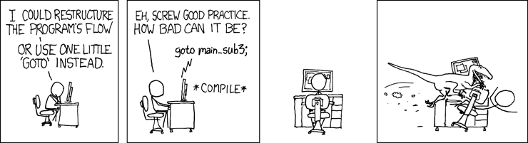
GO TO statements considered harmful

Slide 62
Conditional Branch Example (Cont.)
int goto_ad(int x, int y)
{
int result;
if (x <= y) goto Else;
result = x-y;
goto Exit;
Else:
result = y-x;
Exit:
return result;
}
absdiff:
pushl %ebp
movl %esp, %ebp
movl 8(%ebp), %edx
movl 12(%ebp), %eax
cmpl %eax, %edx
jle .L6
subl %eax, %edx
movl %edx, %eax
jmp .L7
.L6:
subl %edx, %eax
.L7:
popl %ebp
ret
Setup
Body1
Body2a
Body2b
Finish

Slide 63
Conditional Branch Example (Cont.)
int goto_ad(int x, int y)
{
int result;
if (x <= y) goto Else;
result = x-y;
goto Exit;
Else:
result = y-x;
Exit:
return result;
}
absdiff:
pushl %ebp
movl %esp, %ebp
movl 8(%ebp), %edx
movl 12(%ebp), %eax
cmpl %eax, %edx
jle .L6
subl %eax, %edx
movl %edx, %eax
jmp .L7
.L6:
subl %edx, %eax
.L7:
popl %ebp
ret
Setup
Body1
Body2a
Body2b
Finish

Slide 64
Conditional Branch Example (Cont.)
int goto_ad(int x, int y)
{
int result;
if (x <= y) goto Else;
result = x-y;
goto Exit;
Else:
result = y-x;
Exit:
return result;
}
absdiff:
pushl %ebp
movl %esp, %ebp
movl 8(%ebp), %edx
movl 12(%ebp), %eax
cmpl %eax, %edx
jle .L6
subl %eax, %edx
movl %edx, %eax
jmp .L7
.L6:
subl %edx, %eax
.L7:
popl %ebp
ret
Setup
Body1
Body2a
Body2b
Finish

Slide 65
Loops

Slide 66

“Do-While” Loop Example
C Code
Goto Version
int pcount_do(unsigned x) {
int result = 0;
do {
result += x & 0x1;
x >>= 1;
} while (x);
return result;
}
int pcount_do(unsigned x)
{
int result = 0;
loop:
result += x & 0x1;
x >>= 1;
if (x)
goto loop;
return result;
}
Count number of 1’s in argument x (“popcount”)
Use conditional branch to either continue looping or to exit loop

Slide 67
“Do-While” Loop Compilation
Goto Version
int pcount_do(unsigned x) {
int result = 0;
loop:
result += x & 0x1;
x >>= 1;
if (x)
goto loop;
return result;
}
movl $0, %ecx # result = 0
.L2: # loop:
movl %edx, %eax
andl $1, %eax # t = x & 1
addl %eax, %ecx # result += t
shrl %edx # x >>= 1
jne .L2 # If !0, goto loop
Registers:
%edx x
%ecx result

Slide 68

General “Do-While” Translation
C Code
Goto Version
do
Body
while (Test);
loop:
Body
if (Test)
goto loop
Body:
Test returns integer
= 0 interpreted as false
≠ 0 interpreted as true
{
Statement₁;
Statement₂;
…
Statement_{n};
}

Slide 69
“While” Loop Example
C Code
Goto Version
int pcount_while(unsigned x) {
int result = 0;
while (x) {
result += x & 0x1;
x >>= 1;
}
return result;
}
int pcount_do(unsigned x) {
int result = 0;
if (!x) goto done;
loop:
result += x & 0x1;
x >>= 1;
if (x)
goto loop;
done:
return result;
}
Is this code equivalent to the do-while version?
Must jump out of loop if test fails

Slide 70

General “While” Translation
While version
while (Test)
Body
Goto Version
Do-While Version
if (!Test)
goto done;
loop:
Body
if (Test)
goto loop;
done:
if (!Test)
goto done;
do
Body
while(Test);
done:

Slide 71
“For” Loop Example
C Code
#define WSIZE 8*sizeof(int)
int pcount_for(unsigned x) {
int i;
int result = 0;
for (i = 0; i < WSIZE; i++) {
unsigned mask = 1 << i;
result += (x & mask) != 0;
}
return result;
}
Is this code equivalent to other versions?

Slide 72
“For” Loop → While Loop
For Version
for (Init; Test; Update )
Body
While Version
Init;
while (Test ) {
Body
Update;
}

Slide 73
“For” Loop Form
Init
General Form
i = 0
for (Init; Test; Update )
Body
Test
i < WSIZE
Update
i++
for (i = 0; i < WSIZE; i++) {
unsigned mask = 1 << i;
result += (x & mask) != 0;
}
Body
{
unsigned mask = 1 << i;
result += (x & mask) != 0;
}

Slide 74
“For” Loop → … → Goto
Init;
if (!Test)
goto done;
loop:
Body
Update
if (Test)
goto loop;
done:
For Version
for (Init; Test; Update )
Body
While Version
Init;
while (Test ) {
Body
Update;
}
Init;
if (!Test)
goto done;
do
Body
Update
while(Test);
done:

Slide 75
“For” Loop Conversion Example
Goto Version
C Code
int pcount_for_gt(unsigned x) {
int i;
int result = 0;
i = 0;
if (!(i < WSIZE))
goto done;
loop:
{
unsigned mask = 1 << i;
result += (x & mask) != 0;
}
i++;
if (i < WSIZE)
goto loop;
done:
return result;
}
#define WSIZE 8*sizeof(int)
int pcount_for(unsigned x) {
int i;
int result = 0;
for (i = 0; i < WSIZE; i++) {
unsigned mask = 1 << i;
result += (x & mask) != 0;
}
return result;
}
Init
!Test
Body
Update
Test
Initial test can be optimized away

Slide 76
Assembly Programmer’s View
CPU
Memory
Registers
Addresses
Data
Code
Data
Stack
PC
Condition
Codes
Instructions
Programmer-Visible State
PC: Program counter
Address of next instruction
Called “EIP” (IA32) or “RIP” (x86-64)
Register file
Heavily used program data
Condition codes
Store status information about most recent arithmetic operation
Used for conditional branching
Memory
Byte addressable array
Code and user data
Stack to support procedures

Slide 77
Summary
So far
Complete addressing mode, address computation (leal)
Arithmetic operations
Control: Condition codes
Conditional branches & conditional moves
Loops
Coming up!
Switch statements
Stack
Call / return
Procedure call discipline

Slide 78

Memory

Slide 79

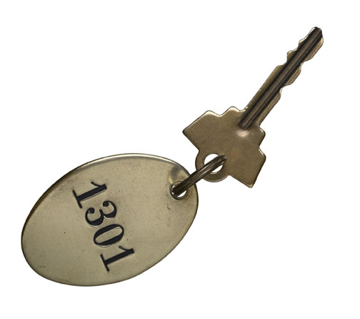

Memory
1296 1297 1298 1299 1300 1301 1302 1303 1304 1305
Memory manager
Address

Slide 80
Memory
1296 1297 1298 1299 1300 1301 1302 1303 1304 1305
Address

Slide 81


I: Storing data in memory
1296 1297 1298 1299 1300 1301 1302 1303 1304 1305
mov ,
9000
9000
movl %eax, 1301

Slide 82


II: Retrieving data from memory
1296 1297 1298 1299 1300 1301 1302 1303 1304 1305
Register | Value
%eax | 9000
%ecx | 1301
Register | Value
%eax | ???
%ecx | 1301
mov ,
movl 1301, %eax
or movl (%ecx), %eax

Slide 83
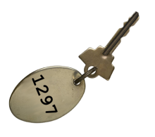
III: Pointers to memory
1296 1297 1298 1299 1300 1301 1302 1303 1304 1305
mov ( ),
movl (1301), %eax

Slide 84



Note: Copying pointers does not copy contents
int *a, *b;
a = ;
b = ;
1296 1297 1298
b = a;
*b = *a;

Slide 85
But how does one create a „key“ ?
In the course so far, we have used local and static variables.
Local variables are allocated memory on the stack
The stack is a portion of global memory governed by a special principle
As mentioned before, the stack on Intel x86 grows down
char *global;
int func(void)
{
char *buf = “I ♥ CS485”;
int n;
n = strlen(buf);
printf ("Buf[%d]: %s\n", n, buf);
return (n);
}
Local variables

Slide 86

Local variables: the stack principle
9990 9991 9992 9993 9994 9995 9996 9997 9998 9999
%esp
Int i
void bla(void) {
char A[16];
function();
}
void function(void) {
char B[12];
int i;
...
}
Buffer B
Return address
Buffer A
STACK
I assign memory addresses sequentially

Slide 87
Is the stack principle enough?
Not really sufficient for modern memory use
You may want to create variables for parent functions to use
You may want to have very large data in memory
You may want to control when some memory is and isn‘t available
Most languages also provide dynamic memory allocation
Think “new“ and “delete“ in C++.
Exception: Functional programming languages

Slide 88

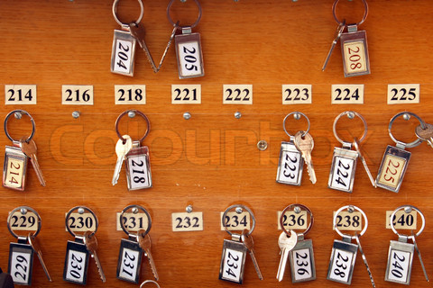
Dynamic memory allocation
1296 1297 1298 1299 1300 1301 1302 1303 1304 1305
int *a, *b, *c;
char *c, *d;
a = (int *)malloc(sizeof(int));
b = (int *)malloc(sizeof(int));
c = a;
free (a);
d = (char *)malloc(5);
To where does c point under the end?
What happens if d gets written now?
Now I assign new data to any series of „empty“ lockers that can fit the data

Slide 89
Locker analogy overview
Computing world (C / assembly)
Address space (consecutive memory)
Data in memory
Memory address / pointer
Memory management strategy
Array or struct
Stack pointer
Copying a pointer (e.g. ptr = ptr2;)
Freeing memory (via free() or delete())
Releasing pointer (e.g. ptr = NULL;)
Writing to an uninitialized variable
Stale reference to a freed object
Memory leakage
Locker world
Rows of lockers
Contents of a locker
Key to the locker (on a keyring)
Locker manager
Series of consecutive lockers
Next available locker in a sequence
Copying a key (not the locker contents)
Telling the manager the locker is available
Returning the key
Accidentally using someone else‘s locker because you kept the old key
Forgetting to return the keys for a locker
Forgetting to telling the manager that the locker was indeed free

Slide 90
Today
Switch statements
IA 32 Procedures
Stack Structure
Calling Conventions
Illustrations of Recursion & Pointers

Slide 91
IA32 Stack
Stack “Bottom”
Region of memory managed with stack discipline
Grows toward lower addresses
Register %esp contains lowest stack address
address of “top” element
Increasing
Addresses
Stack Grows
Down
Stack Pointer: %esp
Stack “Top”

Slide 92
IA32 Stack: Push
Stack “Bottom”
pushl Src
Fetch operand at Src
Decrement %esp by 4
Write operand at address given by %esp
Increasing
Addresses
Stack Grows
Down
Stack Pointer: %esp
-4
Stack “Top”

Slide 93
IA32 Stack: Pop
Stack “Bottom”
Increasing
Addresses
Stack Grows
Down
Stack Pointer: %esp
+4
Stack “Top”

Slide 94
Procedure Control Flow
Use stack to support procedure call and return
Procedure call: call label
Push return address on stack
Jump to label
Return address:
Address of the next instruction right after call
Example from disassembly
804854e: e8 3d 06 00 00 call 8048b90 <main>
8048553: 50 pushl %eax
Return address = 0x8048553
Procedure return: ret
Pop address from stack
Jump to address

Slide 95
Procedure Call Example
804854e: e8 3d 06 00 00 call 8048b90 <main>
8048553: 50 pushl %eax
call 8048b90
0x110
0x110
0x10c
0x10c
0x108
123
0x108
123
0x104
0x8048553
%esp
0x108
%esp
0x104
%eip
0x804854e
%eip
0x8048b90
%eip: program counter

Slide 96
Procedure Return Example
8048591: c3 ret
ret
0x110
0x110
0x10c
0x10c
0x108
123
0x108
123
0x104
0x8048553
0x8048553
%esp
0x104
%esp
0x108
%eip
0x8048591
%eip
0x8048553
%eip: program counter

Slide 97
Stack-Based Languages
Languages that support recursion
e.g., C, Pascal, Java
Code must be “Reentrant”
Multiple simultaneous instantiations of single procedure
Need some place to store state of each instantiation
Arguments
Local variables
Return pointer
Stack discipline
State for given procedure needed for limited time
From when called to when return
Callee returns before caller does
Stack allocated in Frames
state for single procedure instantiation

Slide 98
Call Chain Example
Example
Call Chain
yoo(…)
{
•
•
who();
•
•
}
yoo
who(…)
{
• • •
amI();
• • •
amI();
• • •
}
who
amI(…)
{
•
•
amI();
•
•
}
amI
amI
amI
amI
Procedure amI() is recursive

Slide 99
Stack Frames
Previous Frame
Frame for proc
Contents
Local variables
Return information
Temporary space
Management
Space allocated when enter procedure
“Set-up” code
Deallocated when return
“Finish” code
Frame Pointer: %ebp
Stack Pointer: %esp
Stack “Top”

Slide 100
Example
Stack
yoo
yoo(…)
{
•
•
who();
•
•
}
yoo
%ebp
yoo
who
%esp
amI
amI
amI
amI

Slide 101
Example
Stack
yoo
who
yoo(…)
{
•
•
who();
•
•
}
yoo
who(…)
{
• • •
amI();
• • •
amI();
• • •
}
yoo
who
%ebp
amI
amI
%esp
amI
amI

Slide 102
Example
Stack
yoo
who
amI
yoo(…)
{
•
•
who();
•
•
}
yoo
who(…)
{
• • •
amI();
• • •
amI();
• • •
}
yoo
amI(…)
{
•
•
amI();
•
•
}
who
amI
amI
%ebp
amI
%esp
amI

Slide 103
Example
Stack
yoo
who
amI
amI
yoo(…)
{
•
•
who();
•
•
}
yoo
who(…)
{
• • •
amI();
• • •
amI();
• • •
}
yoo
amI(…)
{
•
•
amI();
•
•
}
who
amI(…)
{
•
•
amI();
•
•
}
amI
amI
amI
%ebp
amI
%esp

Slide 104
Example
Stack
yoo
who
amI
amI
amI
yoo(…)
{
•
•
who();
•
•
}
yoo
who(…)
{
• • •
amI();
• • •
amI();
• • •
}
yoo
amI(…)
{
•
•
amI();
•
•
}
who
amI(…)
{
•
•
amI();
•
•
}
amI
amI
amI(…)
{
•
•
amI();
•
•
}
amI
amI
%ebp
%esp

Slide 105
Example
Stack
yoo
who
amI
amI
yoo(…)
{
•
•
who();
•
•
}
yoo
who(…)
{
• • •
amI();
• • •
amI();
• • •
}
yoo
amI(…)
{
•
•
amI();
•
•
}
who
amI(…)
{
•
•
amI();
•
•
}
amI
amI
amI
%ebp
amI
%esp

Slide 106
Example
Stack
yoo
who
amI
yoo(…)
{
•
•
who();
•
•
}
yoo
who(…)
{
• • •
amI();
• • •
amI();
• • •
}
yoo
amI(…)
{
•
•
amI();
•
•
}
who
amI
amI
%ebp
amI
%esp
amI

Slide 107
Example
Stack
yoo
who
yoo(…)
{
•
•
who();
•
•
}
yoo
who(…)
{
• • •
amI();
• • •
amI();
• • •
}
yoo
who
%ebp
amI
amI
%esp
amI
amI

Slide 108
Example
Stack
yoo
who
amI
yoo(…)
{
•
•
who();
•
•
}
yoo
who(…)
{
• • •
amI();
• • •
amI();
• • •
}
yoo
amI(…)
{
•
•
amI();
•
•
}
who
amI
amI
%ebp
amI
%esp
amI

Slide 109
Example
Stack
yoo
who
yoo(…)
{
•
•
who();
•
•
}
yoo
who(…)
{
• • •
amI();
• • •
amI();
• • •
}
yoo
who
%ebp
amI
amI
%esp
amI
amI

Slide 110
Example
Stack
yoo
yoo
yoo(…)
{
•
•
who();
•
•
}
%ebp
yoo
who
%esp
amI
amI
amI
amI

Slide 111
IA32/Linux Stack Frame
Current Stack Frame (“Top” to Bottom)
“Argument build:” Parameters for function about to call
Local variables If can’t keep in registers
Saved register context
Old frame pointer
Caller Stack Frame
Return address
Pushed by call instruction
Arguments for this call
Caller
Frame
Arguments
Frame pointer %ebp
Return Addr
Old %ebp
Saved
Registers
+
Local
Variables
Argument
Build
Stack pointer
%esp

Slide 112
Revisiting swap
Calling swap from call_swap
int course1 = 15213;
int course2 = 18243;
void call_swap() {
swap(&course1, &course2);
}
call_swap:
• • •
subl $8, %esp
movl $course2, 4(%esp)
movl $course1, (%esp)
call swap
• • •
•
•
•
Resulting
Stack
void swap(int *xp, int *yp)
{
int t0 = *xp;
int t1 = *yp;
*xp = t1;
*yp = t0;
}
%esp
&course2
subl
&course1
%esp
call
Rtn adr
%esp

Slide 113
Revisiting swap
swap:
pushl %ebp
movl %esp, %ebp
pushl %ebx
movl 8(%ebp), %edx
movl 12(%ebp), %ecx
movl (%edx), %ebx
movl (%ecx), %eax
movl %eax, (%edx)
movl %ebx, (%ecx)
popl %ebx
popl %ebp
ret
void swap(int *xp, int *yp)
{
int t0 = *xp;
int t1 = *yp;
*xp = t1;
*yp = t0;
}
Set
Up
Body
Finish

Slide 114
swap Setup #1
Entering Stack
Resulting Stack
•
•
•
%ebp
•
•
•
%ebp
&course2
yp
&course1
xp
Rtn adr
%esp
Rtn adr
Old %ebp
%esp
swap:
pushl %ebp
movl %esp,%ebp
pushl %ebx

Slide 115
swap Setup #2
Entering Stack
Resulting Stack
•
•
•
%ebp
•
•
•
&course2
yp
&course1
xp
Rtn adr
%esp
Rtn adr
%ebp
Old %ebp
%esp
swap:
pushl %ebp
movl %esp,%ebp
pushl %ebx

Slide 116
swap Setup #3
Entering Stack
Resulting Stack
•
•
•
%ebp
•
•
•
&course2
yp
&course1
xp
Rtn adr
%esp
Rtn adr
Old %ebp
%ebp
Old %ebx
%esp
swap:
pushl %ebp
movl %esp,%ebp
pushl %ebx

Slide 117
swap Body
Entering Stack
Resulting Stack
•
•
•
%ebp
•
•
•
Offset relative to %ebp
&course2
12
yp
&course1
8
xp
Rtn adr
%esp
4
Rtn adr
Old %ebp
%ebp
Old %ebx
%esp
movl 8(%ebp),%edx # get xp
movl 12(%ebp),%ecx # get yp
. . .

Slide 118
swap Finish
Stack Before Finish
Resulting Stack
•
•
•
•
•
•
%ebp
popl %ebx
popl %ebp
yp
yp
xp
xp
Rtn adr
Rtn adr
%esp
Old %ebp
%ebp
Old %ebx
%esp
Observation
Saved and restored register %ebx
Not so for %eax, %ecx, %edx

Slide 119
Disassembled swap
08048384 <swap>:
8048384: 55 push %ebp
8048385: 89 e5 mov %esp,%ebp
8048387: 53 push %ebx
8048388: 8b 55 08 mov 0x8(%ebp),%edx
804838b: 8b 4d 0c mov 0xc(%ebp),%ecx
804838e: 8b 1a mov (%edx),%ebx
8048390: 8b 01 mov (%ecx),%eax
8048392: 89 02 mov %eax,(%edx)
8048394: 89 19 mov %ebx,(%ecx)
8048396: 5b pop %ebx
8048397: 5d pop %ebp
8048398: c3 ret
Calling Code
80483b4: movl $0x8049658,0x4(%esp) # Copy &course2
80483bc: movl $0x8049654,(%esp) # Copy &course1
80483c3: call 8048384 <swap> # Call swap
80483c8: leave # Prepare to return
80483c9: ret # Return

Slide 120
IA32/Linux+Windows Register Usage
%eax, %edx, %ecx
Caller saves prior to call if values are used later
%eax
also used to return integer value
%ebx, %esi, %edi
Callee saves if wants to use them
%esp, %ebp
special form of callee save
Restored to original values upon exit from procedure
%eax
Caller-Save
Temporaries
%edx
%ecx
%ebx
Callee-Save
Temporaries
%esi
%edi
%esp
Special
%ebp

Slide 121
Assembly Programmer’s View
CPU
Memory
Registers
Addresses
Data
Code
Data
Stack
PC
Condition
Codes
Instructions
Programmer-Visible State
PC: Program counter
Address of next instruction
Called “EIP” (IA32) or “RIP” (x86-64)
Register file
Heavily used program data
Condition codes
Store status information about most recent arithmetic operation
Used for conditional branching
Memory
Byte addressable array
Code and user data
Stack to support procedures

Slide 122
Creating and Initializing Local Variable
int add3(int x) {
int localx = x;
incrk(&localx, 3);
return localx;
}
Variable localx must be stored on stack
Because: Need to create pointer to it
Compute pointer as -4(%ebp)
8
x
4
Rtn adr
0
Old %ebp
%ebp
First part of add3
-4
localx = x
add3:
pushl %ebp
movl %esp, %ebp
subl $24, %esp # Alloc. 24 bytes
movl 8(%ebp), %eax
movl %eax, -4(%ebp) # Set localx to x
-8
Unused
-12
-16
-20
-24
%esp

Slide 123
Creating Pointer as Argument
int add3(int x) {
int localx = x;
incrk(&localx, 3);
return localx;
}
Use leal instruction to compute address of localx
8
x
4
Rtn adr
0
Old %ebp
%ebp
Middle part of add3
-4
localx
movl $3, 4(%esp) # 2nd arg = 3
leal -4(%ebp), %eax # &localx
movl %eax, (%esp) # 1st arg = &localx
call incrk
-8
Unused
-12
-16
-20
3
%esp+4
-24
%esp

Slide 124
Retrieving local variable
int add3(int x) {
int localx = x;
incrk(&localx, 3);
return localx;
}
Retrieve localx from stack as return value
8
x
4
Rtn adr
0
Old %ebp
%ebp
Final part of add3
-4
localx
movl -4(%ebp), %eax # Return val= localx
leave
ret
-8
Unused
-12
-16
-20
-24
%esp

Slide 125
IA32/Linux+Windows Register Usage
%eax, %edx, %ecx
Caller saves prior to call if values are used later
%eax
also used to return integer value
%ebx, %esi, %edi
Callee saves if wants to use them
%esp, %ebp
special form of callee save
Restored to original values upon exit from procedure
%eax
Caller-Save
Temporaries
%edx
%ecx
%ebx
Callee-Save
Temporaries
%esi
%edi
%esp
Special
%ebp

Slide 126
So what about these arrays?
int a[16];
char *c;
c = (char *)malloc(256);
How are arrays actually represented in assembly?

Slide 127
Basic Data Types
Integral
Stored & operated on in general (integer) registers
Signed vs. unsigned depends on instructions used
Intel ASM Bytes C
byte b 1 [unsigned] char
word w 2 [unsigned] short
double word l 4 [unsigned] int
quad word q 8 [unsigned] long int (x86-64)
Floating Point
Stored & operated on in floating point registers
Intel ASM Bytes C
Single s 4 float
Double l 8 double
Extended t 10/12/16 long double

Slide 128
Array Allocation
Basic Principle
T A[L];
Array of data type T and length L
Contiguously allocated region of L * sizeof(T) bytes
char string[12];
x
x + 12
int val[5];
x
x + 4
x + 8
x + 12
x + 16
x + 20
double a[3];
x
x + 8
x + 16
x + 24
char *p[3];
IA32
x
x + 4
x + 8
x + 12
x86-64
x
x + 8
x + 16
x + 24

Slide 129



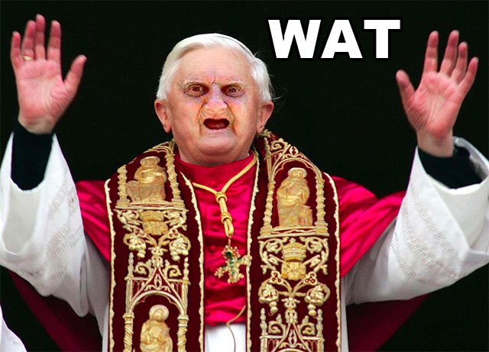


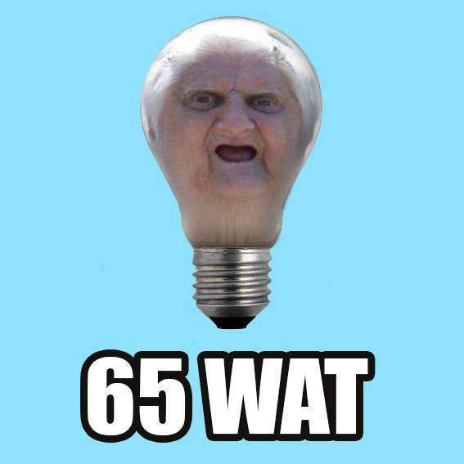




Array Access
Basic Principle
T A[L];
Array of data type T and length L
Identifier A can be used as a pointer to array element 0: Type T*
Reference Type? Value?
val[4] int 3
val int * x
val+1 int * x + 4
&val[2] int * x + 8
val[5] int ??
*(val+1) int 5
val + i int * x + 4i
int val[5];
1
5
2
1
3
x
x + 4
x + 8
x + 12
x + 16
x + 20
WAT
WAT

Slide 130
Array Example
#define ZLEN 5
typedef int zip_dig[ZLEN];
zip_dig cmu = { 1, 5, 2, 1, 3 };
zip_dig mit = { 0, 2, 1, 3, 9 };
zip_dig ucb = { 9, 4, 7, 2, 0 };
zip_dig cmu;
1
5
2
1
3
16
20
24
28
32
36
zip_dig mit;
0
2
1
3
9
36
40
44
48
52
56
zip_dig ucb;
9
4
7
2
0
56
60
64
68
72
76
Declaration “zip_dig cmu” equivalent to “int cmu[5]”
Example arrays were allocated in successive 20 byte blocks
Not guaranteed to happen in general

Slide 131

Array Access - Idea
4 element array of ints
Offset
%eax
Array start
%edx

Slide 132
Array Accessing Example
zip_dig cmu;
1
5
2
1
3
16
20
24
28
32
36
int get_digit
(zip_dig z, int dig)
{
return z[dig];
}
Register %edx contains starting address of array
Register %eax contains array index
Desired digit at 4*%eax + %edx
Use memory reference (%edx,%eax,4)
IA32
# %edx = z
# %eax = dig
movl (%edx,%eax,4),%eax # z[dig]

Slide 133
Array Loop Example (IA32)
void zincr(zip_dig z) {
int i;
for (i = 0; i < ZLEN; i++)
z[i]++;
}
# edx = z
movl $0, %eax # %eax = i
.L4: # loop:
addl $1, (%edx,%eax,4) # z[i]++
addl $1, %eax # i++
cmpl $5, %eax # i:5
jne .L4 # if !=, goto loop

Slide 134
Pointer Loop Example (IA32)
void zincr_v(zip_dig z) {
void *vz = z;
int i = 0;
do {
(*((int *) (vz+i)))++;
i += ISIZE;
} while (i != ISIZE*ZLEN);
}
void zincr_p(zip_dig z) {
int *zend = z+ZLEN;
do {
(*z)++;
z++;
} while (z != zend);
}
# edx = z = vz
movl $0, %eax # i = 0
.L8: # loop:
addl $1, (%edx,%eax) # Increment vz+i
addl $4, %eax # i += 4
cmpl $20, %eax # Compare i:20
jne .L8 # if !=, goto loop

Slide 135

How do we fit a 2D matrix into memory?
Row-major ordering
Q: How do we find cell (i,j)?
a | b | c
a | b | c
WAT
d | e | f
d | e | f
g | h | i
g | h | i

Slide 136
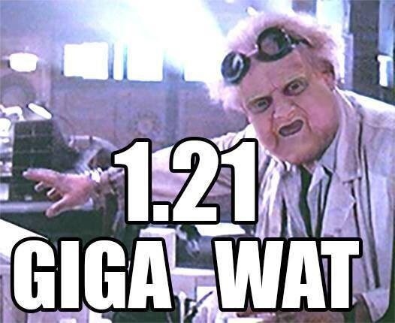

Slide 137
Nested Array Example
#define PCOUNT 4
zip_dig pgh[PCOUNT] =
{{1, 5, 2, 0, 6},
{1, 5, 2, 1, 3 },
{1, 5, 2, 1, 7 },
{1, 5, 2, 2, 1 }};
zip_dig
pgh[4];
1
5
2
0
6
1
5
2
1
3
1
5
2
1
7
1
5
2
2
1
76
96
116
136
156
“zip_dig pgh[4]” equivalent to “int pgh[4][5]”
Variable pgh: array of 4 elements, allocated contiguously
Each element is an array of 5 int’s, allocated contiguously
Important: “Row-Major” ordering of all elements guaranteed

Slide 138
Multidimensional (Nested) Arrays
Declaration
T A[R][C];
2D array of data type T
R rows, C columns
Type T element requires K bytes
Array Size
R * C * K bytes
Arrangement
Row-Major Ordering
A[0][0]
a | b | c
• • •
A[0][C-1]
•
•
•
•
•
•
d | e | f
A[R-1][0]
g | h | i
• • •
A[R-1][C-1]
int A[R][C];
• • •
A
[0]
[0]
A
[0]
[C-1]
• • •
A
[1]
[0]
A
[1]
[C-1]
• • •
• • •
A
[R-1]
[0]
A
[R-1]
[C-1]
4*R*C Bytes

Slide 139
Nested Array Row Access
Row Vectors
A[i] is array of C elements
Each element of type T requires K bytes
Starting address A + i * (C * K)
int A[R][C];
A[0]
A[i]
A[R-1]
• • •
A
[0]
[0]
A
[0]
[C-1]
• • •
• • •
A
[i]
[0]
A
[i]
[C-1]
• • •
• • •
A
[R-1]
[0]
A
[R-1]
[C-1]
A
A+i*C*4
A+(R-1)*C*4

Slide 140
Nested Array Row Access Code
int *get_pgh_zip(int index)
{
return pgh[index];
}
#define PCOUNT 4
zip_dig pgh[PCOUNT] =
{{1, 5, 2, 0, 6},
{1, 5, 2, 1, 3 },
{1, 5, 2, 1, 7 },
{1, 5, 2, 2, 1 }};
# %eax = index
leal (%eax,%eax,4),%eax # 5 * index
leal pgh(,%eax,4),%eax # pgh + (20 * index)
Row Vector
pgh[index] is array of 5 int’s
Starting address pgh+20*index
IA32 Code
Computes and returns address
Compute as pgh + 4*(index+4*index)

Slide 141
Nested Array Row Access
Array Elements
A[i][j] is element of type T, which requires K bytes
Address A + i * (C * K) + j * K = A + (i * C + j)* K
int A[R][C];
A[0]
A[i]
A[R-1]
• • •
A
[0]
[0]
A
[0]
[C-1]
• • •
• • • • • •
A
[i]
[j]
• • •
• • •
A
[R-1]
[0]
A
[R-1]
[C-1]
A
A+i*C*4
A+(R-1)*C*4
A+i*C*4+j*4

Slide 142
Nested Array Row Access
Array Elements
A[i][j] is element of type T, which requires K bytes
Address A + i * (C * K) + j * K = A + (i * C + j)* K
A[i][j]
==
A + (i*C + j)*K
int A[R][C];
A[0]
A[i]
A[R-1]
• • •
A
[0]
[0]
A
[0]
[C-1]
• • •
• • • • • •
A
[i]
[j]
• • •
• • •
A
[R-1]
[0]
A
[R-1]
[C-1]
A
A+i*C*4
A+(R-1)*C*4
A+i*C*4+j*4

Slide 143
Nested Array Element Access Code
int get_pgh_digit
(int index, int dig)
{
return pgh[index][dig];
}
movl 8(%ebp), %eax # index
leal (%eax,%eax,4), %eax # 5*index
addl 12(%ebp), %eax # 5*index+dig
movl pgh(,%eax,4), %eax # offset 4*(5*index+dig)
Array Elements
pgh[index][dig] is int
Address: pgh + 20*index + 4*dig
= pgh + 4*(5*index + dig)
IA32 Code
Computes address pgh + 4*((index+4*index)+dig)

Slide 144
Structure Allocation
struct rec {
int a[3];
int i;
struct rec *n;
};
Memory Layout
a
i
n
0
12
16
20
Concept
Contiguously-allocated region of memory
Refer to members within structure by names
Members may be of different types

Slide 145
Structure Access
r
r+12
struct rec {
int a[3];
int i;
struct rec *n;
};
a
i
n
0
12
16
20
Accessing Structure Member
Pointer indicates first byte of structure
Access elements with offsets
void
set_i(struct rec *r,
int val)
{
r->i = val;
}
IA32 Assembly
# %edx = val
# %eax = r
movl %edx, 12(%eax) # Mem[r+12] = val

Slide 146
Generating Pointer to Structure Member
r
r+idx*4
struct rec {
int a[3];
int i;
struct rec *n;
};
a
i
n
0
12
16
20
Generating Pointer to Array Element
Offset of each structure member determined at compile time
Arguments
Mem[%ebp+8]: r
Mem[%ebp+12]: idx
int *get_ap
(struct rec *r, int idx)
{
return &r->a[idx];
}
movl 12(%ebp), %eax # Get idx
sall $2, %eax # idx*4
addl 8(%ebp), %eax # r+idx*4

Slide 147
Assembly Programmer’s View
CPU
Memory
Registers
Addresses
Data
Code
Data
Stack
PC
Condition
Codes
Instructions
Programmer-Visible State
PC: Program counter
Address of next instruction
Called “EIP” (IA32) or “RIP” (x86-64)
Register file
Heavily used program data
Condition codes
Store status information about most recent arithmetic operation
Used for conditional branching
Memory
Byte addressable array
Code and user data
Stack to support procedures

