Slide 1
Marketing Strategy For Indeed
@ Tom Hong
@ Xiaojing Dong
@ Ziyi Ye
@ Zhongxing Xue
@ Wenyi Tao
Significant 5

Slide 2
What do we want
to do with the data?
First

Slide 3



Company
Job Seeker

Slide 4


Slide 5
1.Market Retention
1.1 Matching Efficiency
1.2 General Strategy
2.Market Expansion
2.1 Market Segmentation
2.2 Focusing Strategy
3 External Data Insights

Slide 6
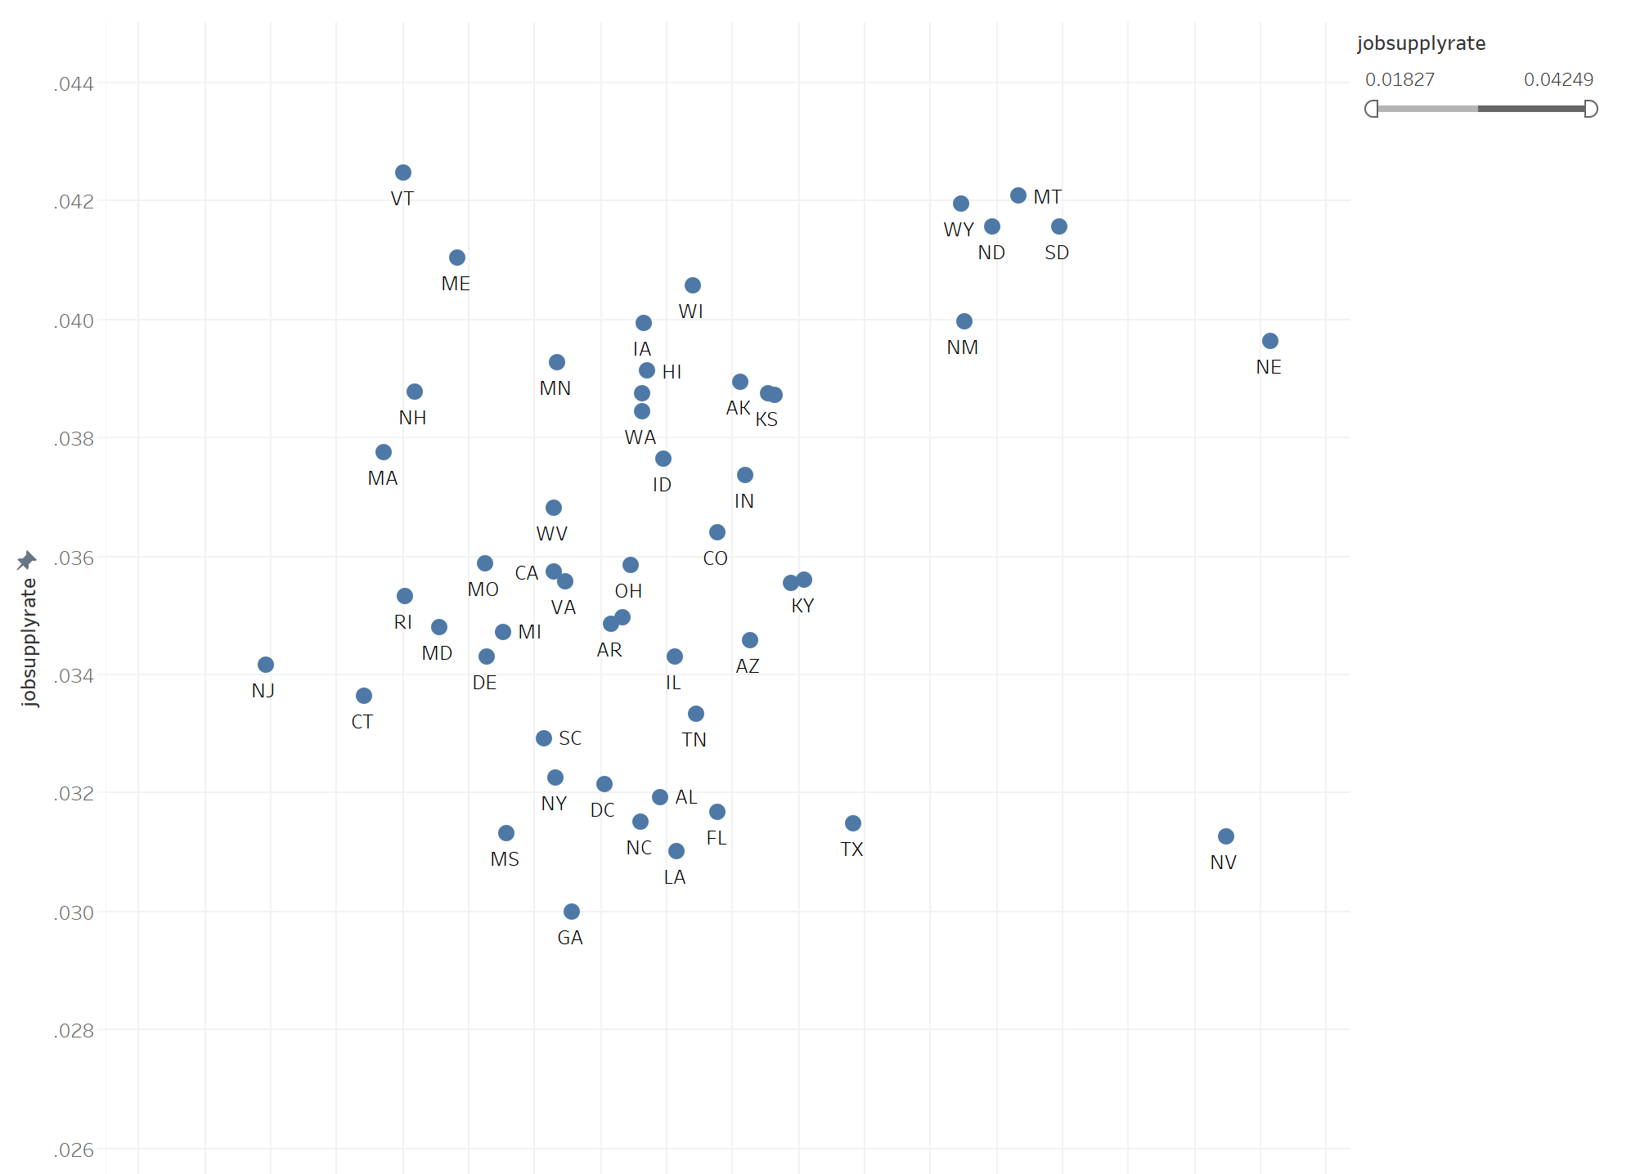
1.Market Retention
Job Supply Rate:
# Job post/sum (clicks)
1.1 Matching Efficiency
1.2 General Strategy
2.Market Expansion
Target States
2.1 Market Segmentation
2.2 Focusing Strategy
3 External Data Insights
Local Eagerness:
local clicks /sum (clicks)

Slide 7
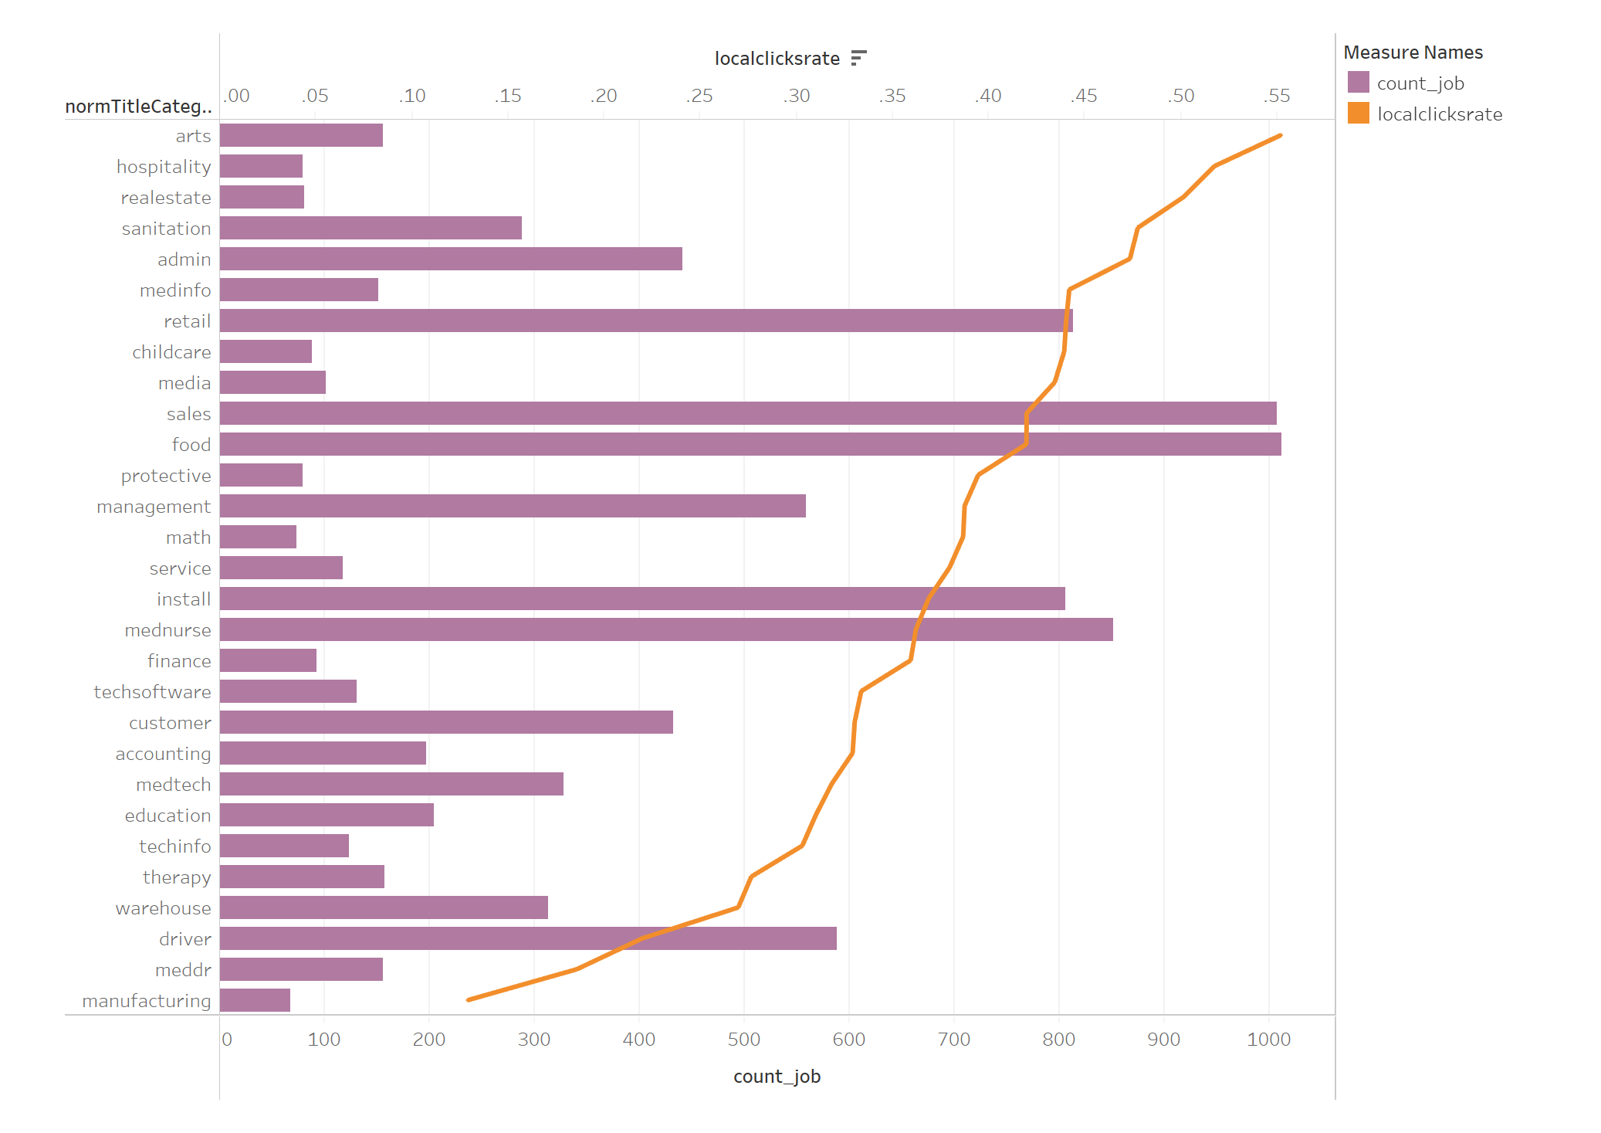
Nevada
1. Retention
1.1 Matching Efficiency
1.2 General Strategy
2.Expansion
2.1 Market Segmentation
2.2 Focusing Strategy
3 External Data Insights
Lobby those companies with those job demand

Slide 8
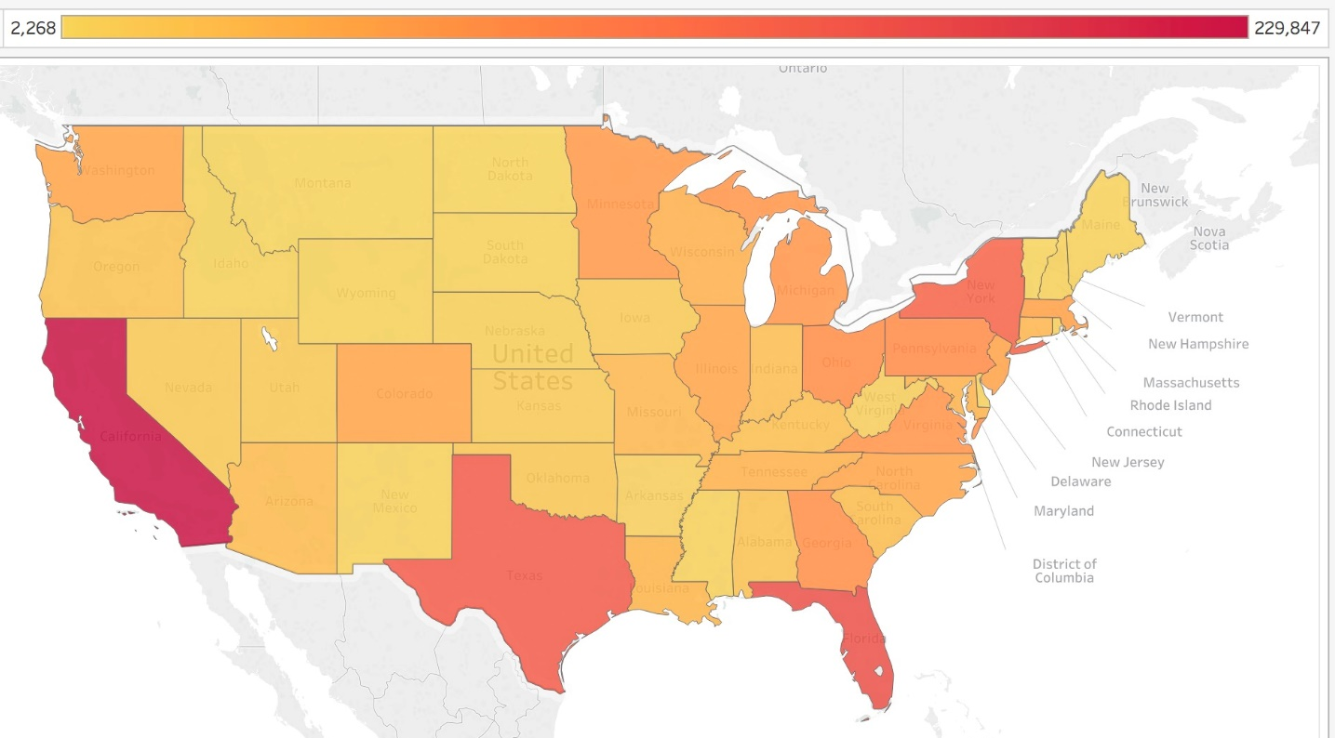
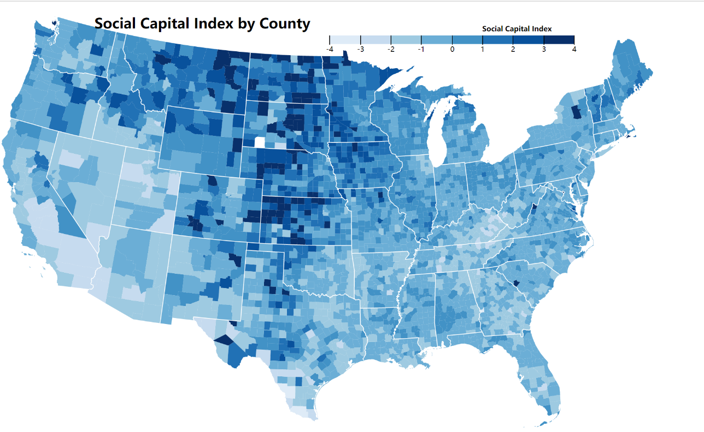
1.Market Retention
1.1 Matching Efficiency
1.2 General Strategy
2.Market Expansion
2.1 Market Segmentation
2.2 Focusing Strategy
3 External Data Insights

Slide 9
Cherry
Picking
The Top 20 significant Flags are selected for diving in the data
Based on probability and linear regression result

Slide 10
1.Model Validation
Set theory and Probability
Runtime Error
2.Algorithm for Association Rule
3.Model Result

Slide 11
1.Statistical Model
GCTH
Nothing more than set theory and probability

Slide 12
Hold on a second….
2. Pruning data with linear regression

Slide 13

Number of offers
All the flags
Y =
$${β_{i}X}_{i}$$

Slide 14
Listed Flags
Verteran_owned
firm8a
State_government
Women_owned
AI_owned
APA_owned
Na_owned
Federal_government
hbcu
Verteran_owned
local_government
Minority owend
Sba_certified
Hubzone
Sheltered_workshop
Tribal_government

Slide 15
Explanatory and Result
Min Support>0.045:
Sdb_flag: Indicates whether the vendor is a Self-Certified Small Disadvantaged Business Organization
Is Sba_certified small disadvantaged business:
Indicates whether the vendor is a Small Disadvantaged Business Organization
3. Women_owned flag:
Indicates whether the vendor is a Woman Owned Business.

Slide 16
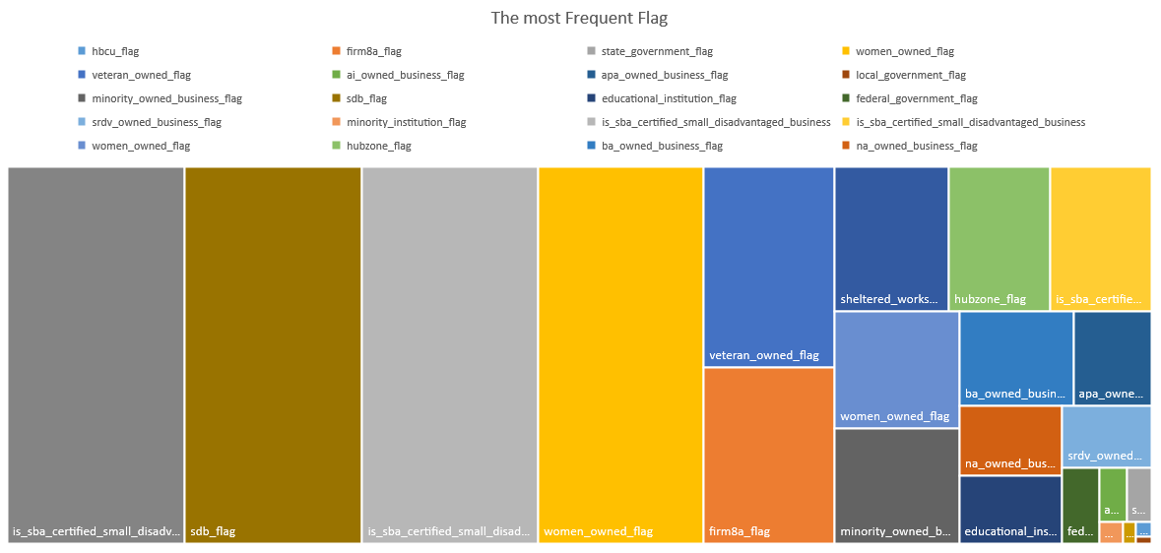

Slide 17
Thanks
@HGCH
2017年9月23日

