Slide 1
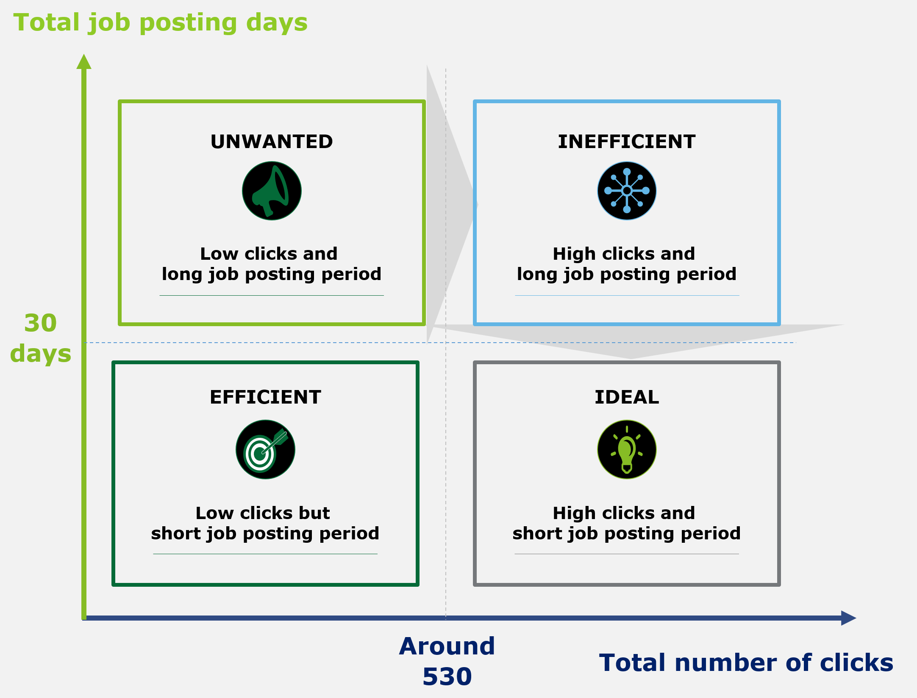
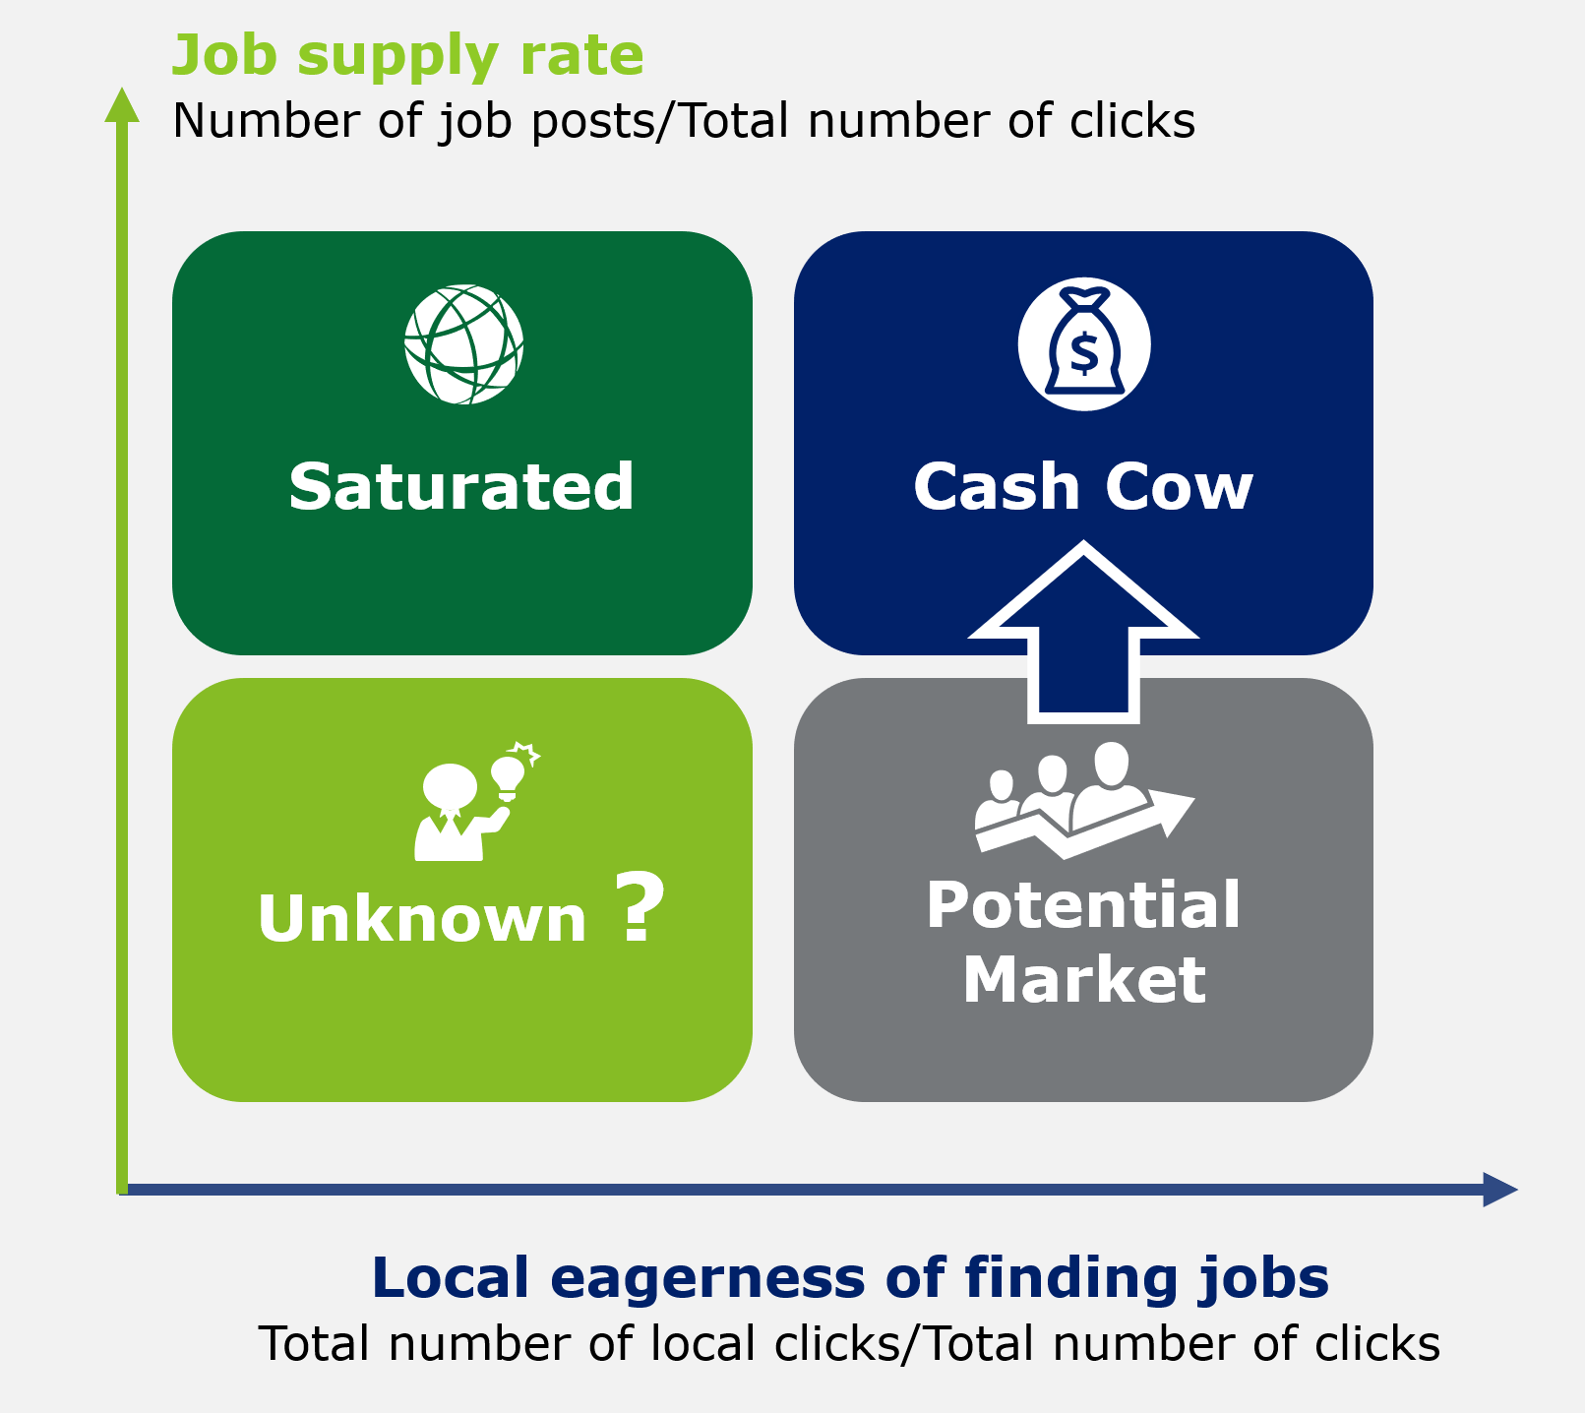

Data Insights For the Market
Increase Customer Retention
Discover Market opportunities
ASA DataFest 2018
Marketing Strategy
for Indeed
Tom Chen
Xiaojing Dong
Wenyi Tao
Zhongxing Xue
Ziyi Ye

Slide 2
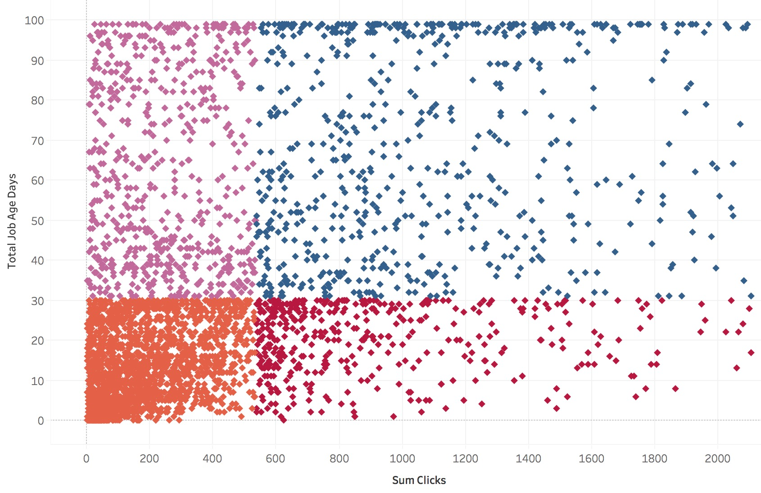
Customer Retention: Job-Match-Efficiency Matrix
Improve job matching efficiency
Total job posting days
Key Correlated Features
Key Correlated Features
Accuracy of Logistic Regression 73%
Accuracy of Logistic Regression 59%
UNWANTED
INEFFICIENT
2
1
Negative Correlated
Low clicks and
long job posting period
High clicks and
long job posting period
Post in December
30
days
3
4
Positive Correlated
EFFICIENT
IDEAL
Post in November
License required
Single day boosting rate (“Sponsored” or not)
Low clicks but
short job posting period
High clicks and
short job posting period
Around
530
Total number of clicks

Slide 3
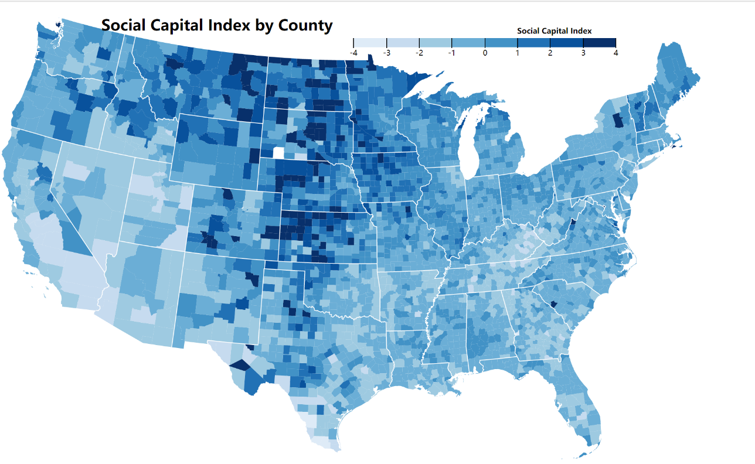
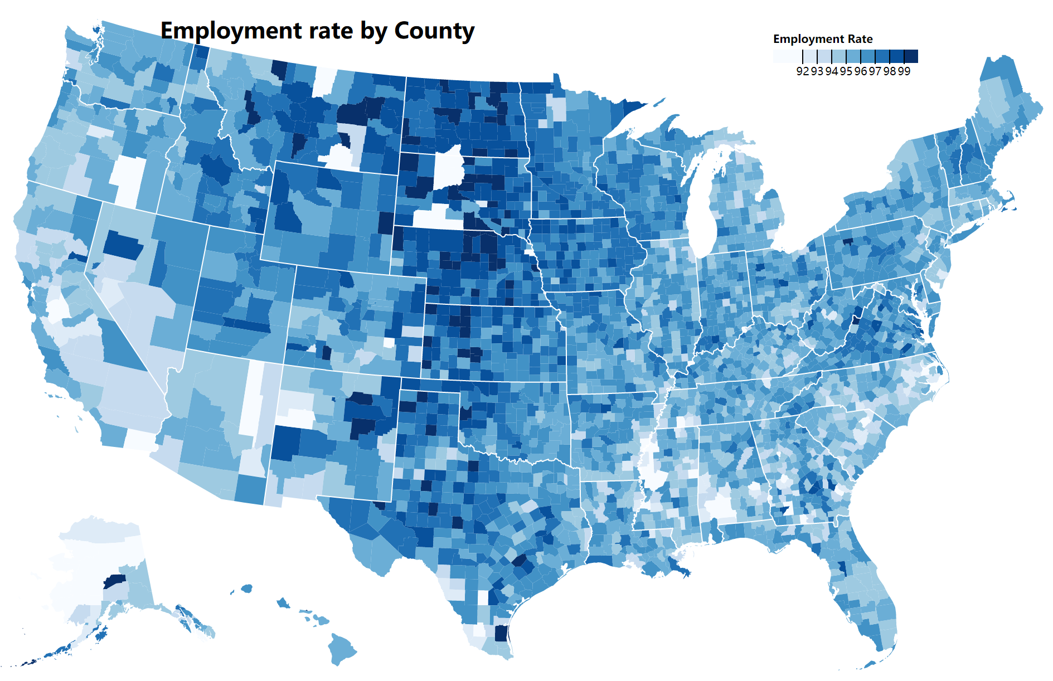
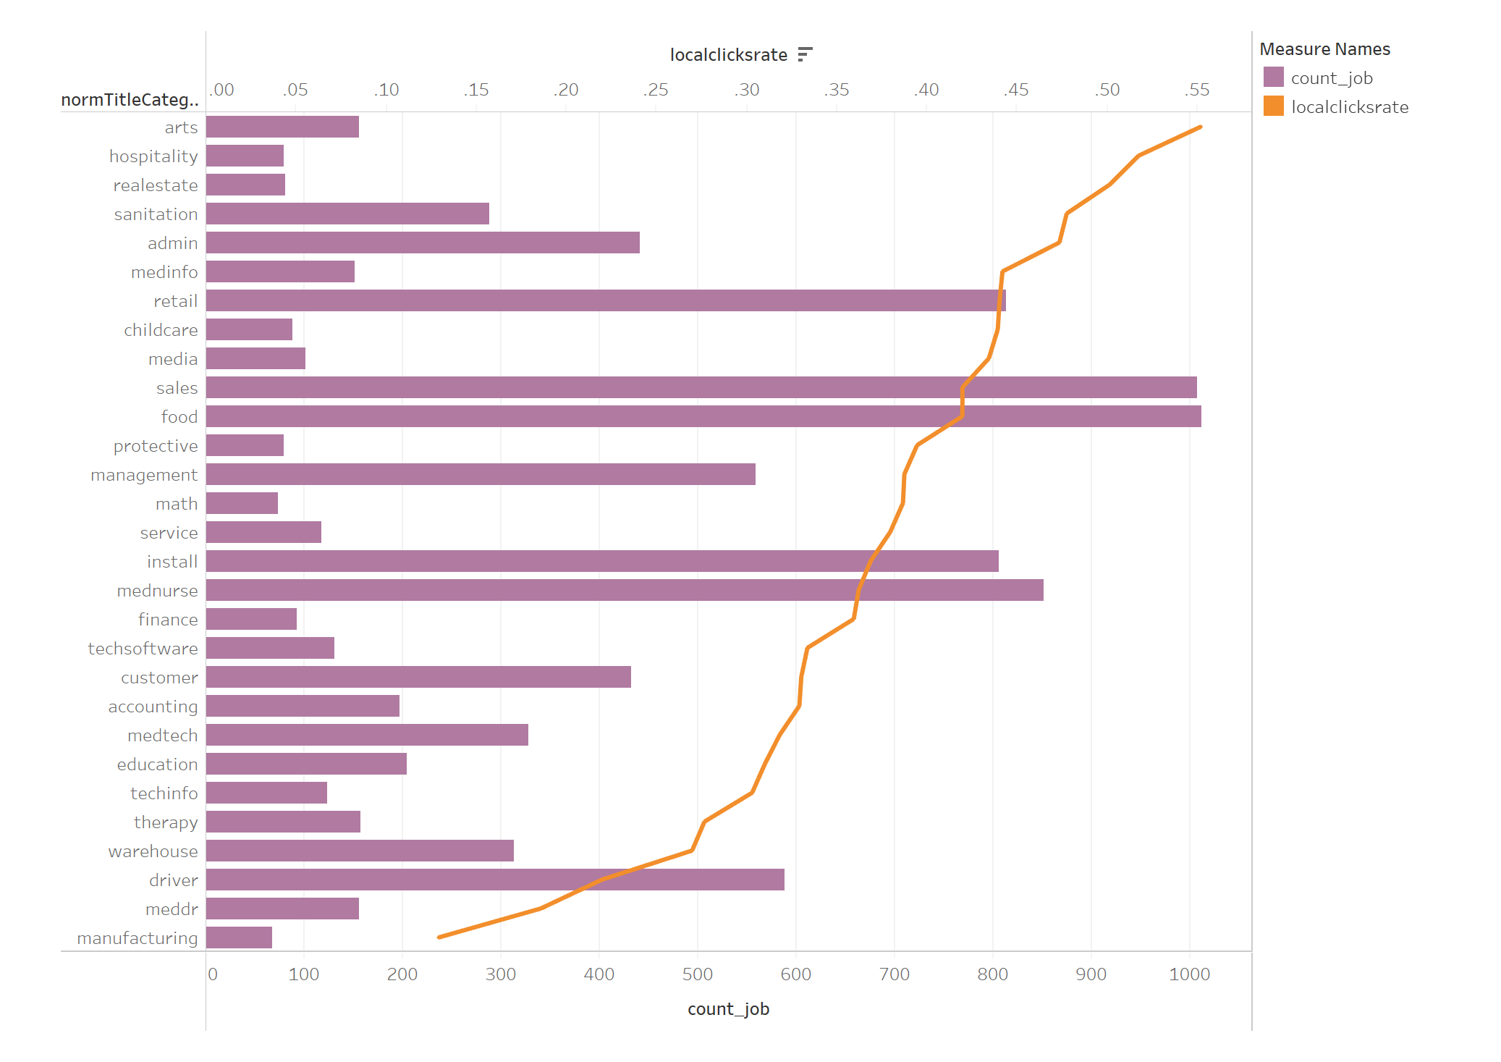
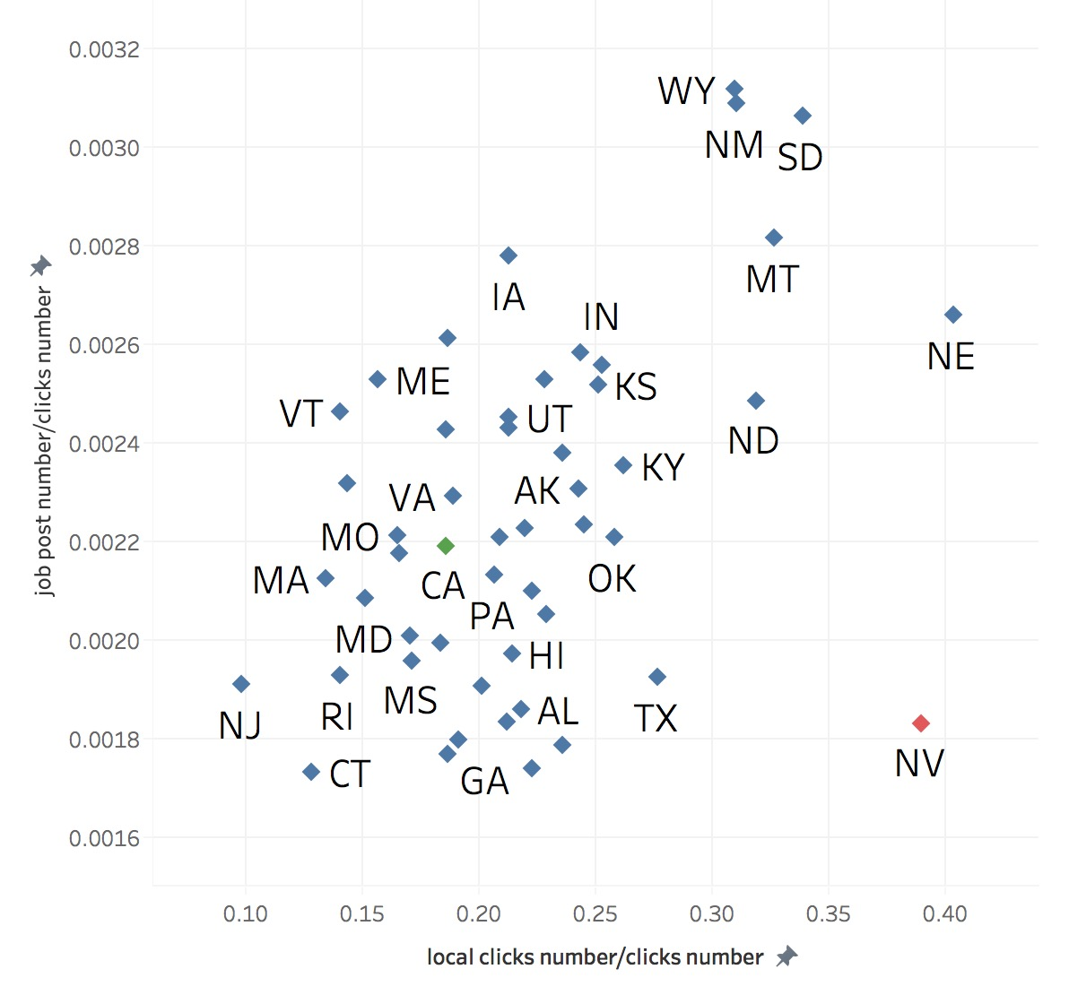
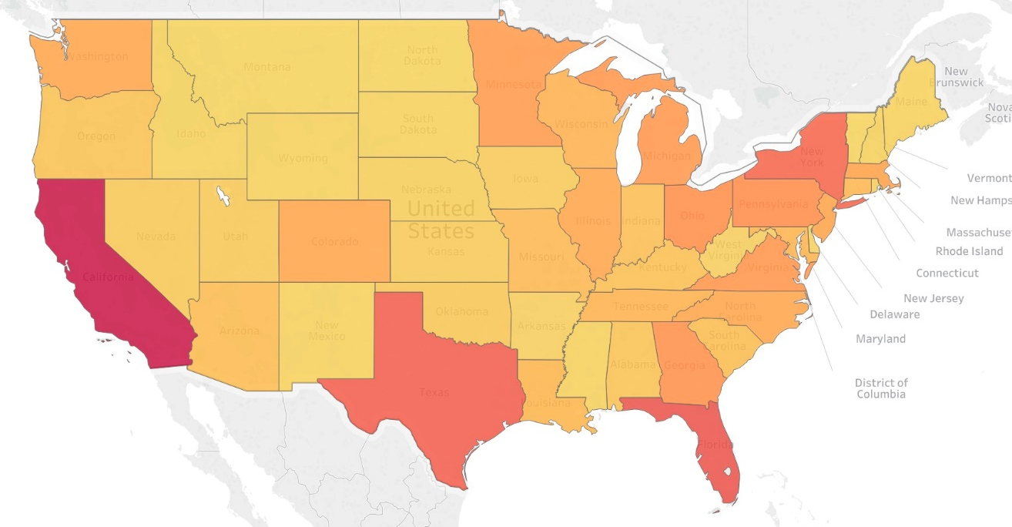
Market Expansion: Growth-Eagerness Matrix
Figures exploring selected variables
Identify states with high potential of job supply
Market Segmentation
Job supply rate
Number of job posts/Total number of clicks
Job supply rate
Number of job posts/Total number of clicks
Saturated
Cash Cow
Unknown ?
Potential Market
Total Sum of Clicks/Population
Local eagerness of finding jobs
Total number of local clicks/Total number of clicks
Local eagerness of finding jobs
Total number of local clicks/Total number of clicks

