Slide 1

ASA DataFest 2018
Marketing Strategy for Indeed
Tom Chen
Xiaojing Dong
Wenyi Tao
Zhongxing Xue
Ziyi Ye

Slide 2
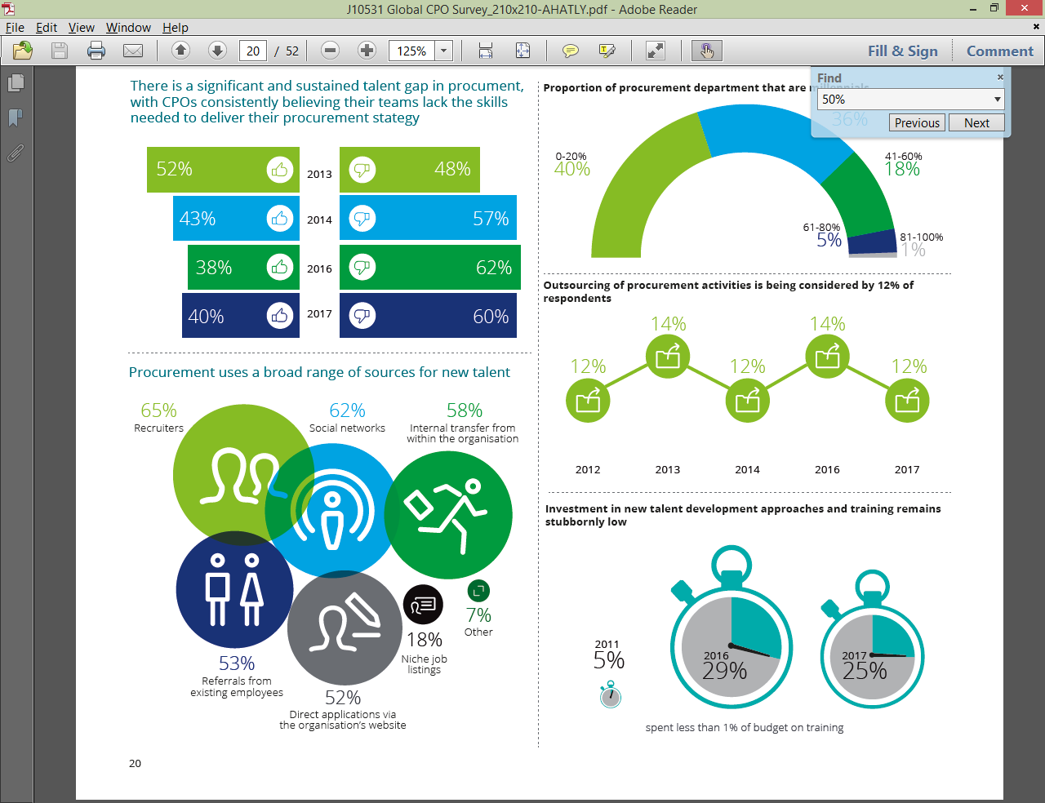
Important variables
Customer Retention
Improve job matching efficiency
Total job posting days
UNWANTED
INEFFICIENT
Low clicks and
long job posting period
High clicks and
long job posting period
Figures exploring selected variables
30
days
EFFICIENT
IDEAL
Low clicks but
short job posting period
High clicks and
short job posting period
Around
530
Total number of clicks

Slide 3
Important variables
Customer Retention
Improve job matching efficiency
Total job posting days
UNWANTED
INEFFICIENT
Low clicks and
long job posting period
High clicks and
long job posting period
Figures exploring selected variables
30
days
EFFICIENT
IDEAL
Low clicks but
short job posting period
High clicks and
short job posting period
Around
530
Total number of clicks

Slide 4
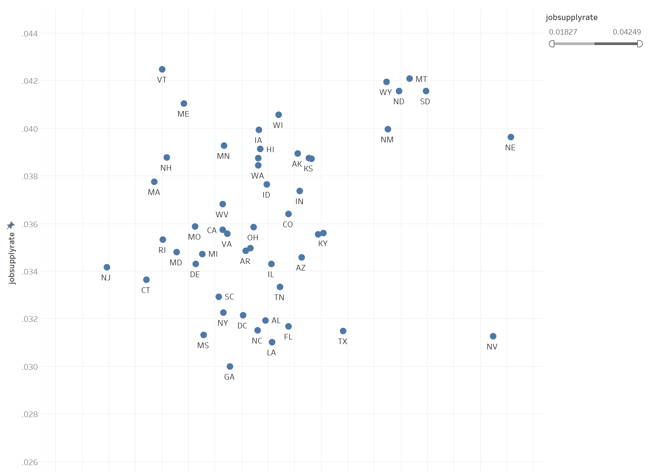
Market Expansion
Identify states with high potential of job supply
Job supply rate
Number of job posts/Total number of clicks
New figure with bigger labels
Saturated
Cash Cow
Unknown ?
Potential Market
Local eagerness of finding jobs
Total number of local clicks/Total number of clicks

Slide 5
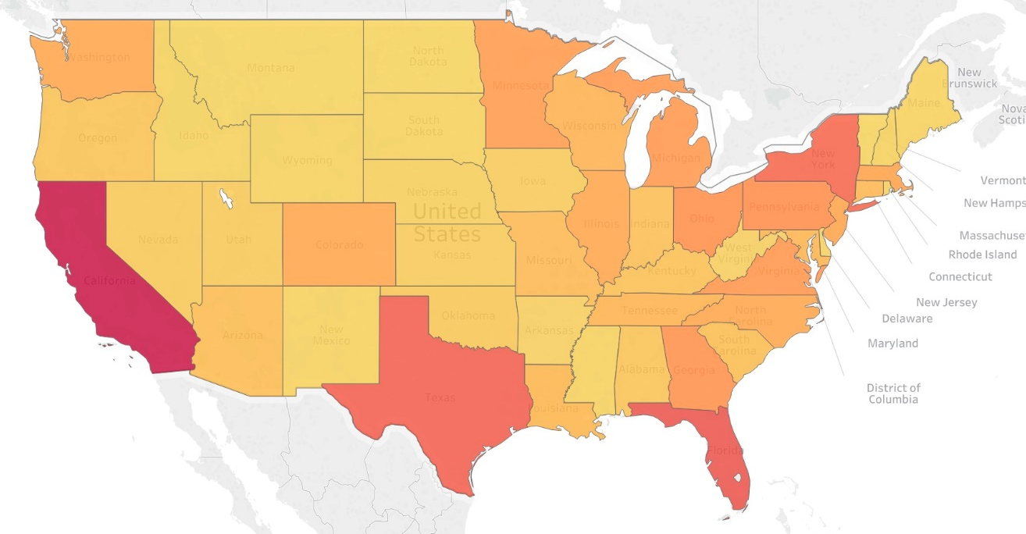
Market Expansion
Figures exploring selected variables
Identify states with high potential of job supply
Job supply rate
Number of job posts/Total number of clicks
Saturated
Cash Cow
Unknown ?
Potential Market
Figures exploring selected variables
Local eagerness of finding jobs
Total number of local clicks/Total number of clicks

