Slide 1

ASA DataFest 2018
Marketing Strategy for Indeed
Tom Chen
Xiaojing Dong
Wenyi Tao
Zhongxing Xue
Ziyi Ye

Slide 2
Data Insights For the Market
Increase Customer Retention
by Improving job matching efficiency
Discover Market opportunities
by local supply and demand analysis

Slide 3
Customer Retention
Improve job matching efficiency
Total job posting days
High Clicks low Job age Desireable
UNWANTED
INEFFICIENT
Low clicks and
long job posting period
High clicks and
long job posting period
30
days
EFFICIENT
IDEAL
Low clicks but
short job posting period
High clicks and
short job posting period
Around
530
Total number of clicks

Slide 4
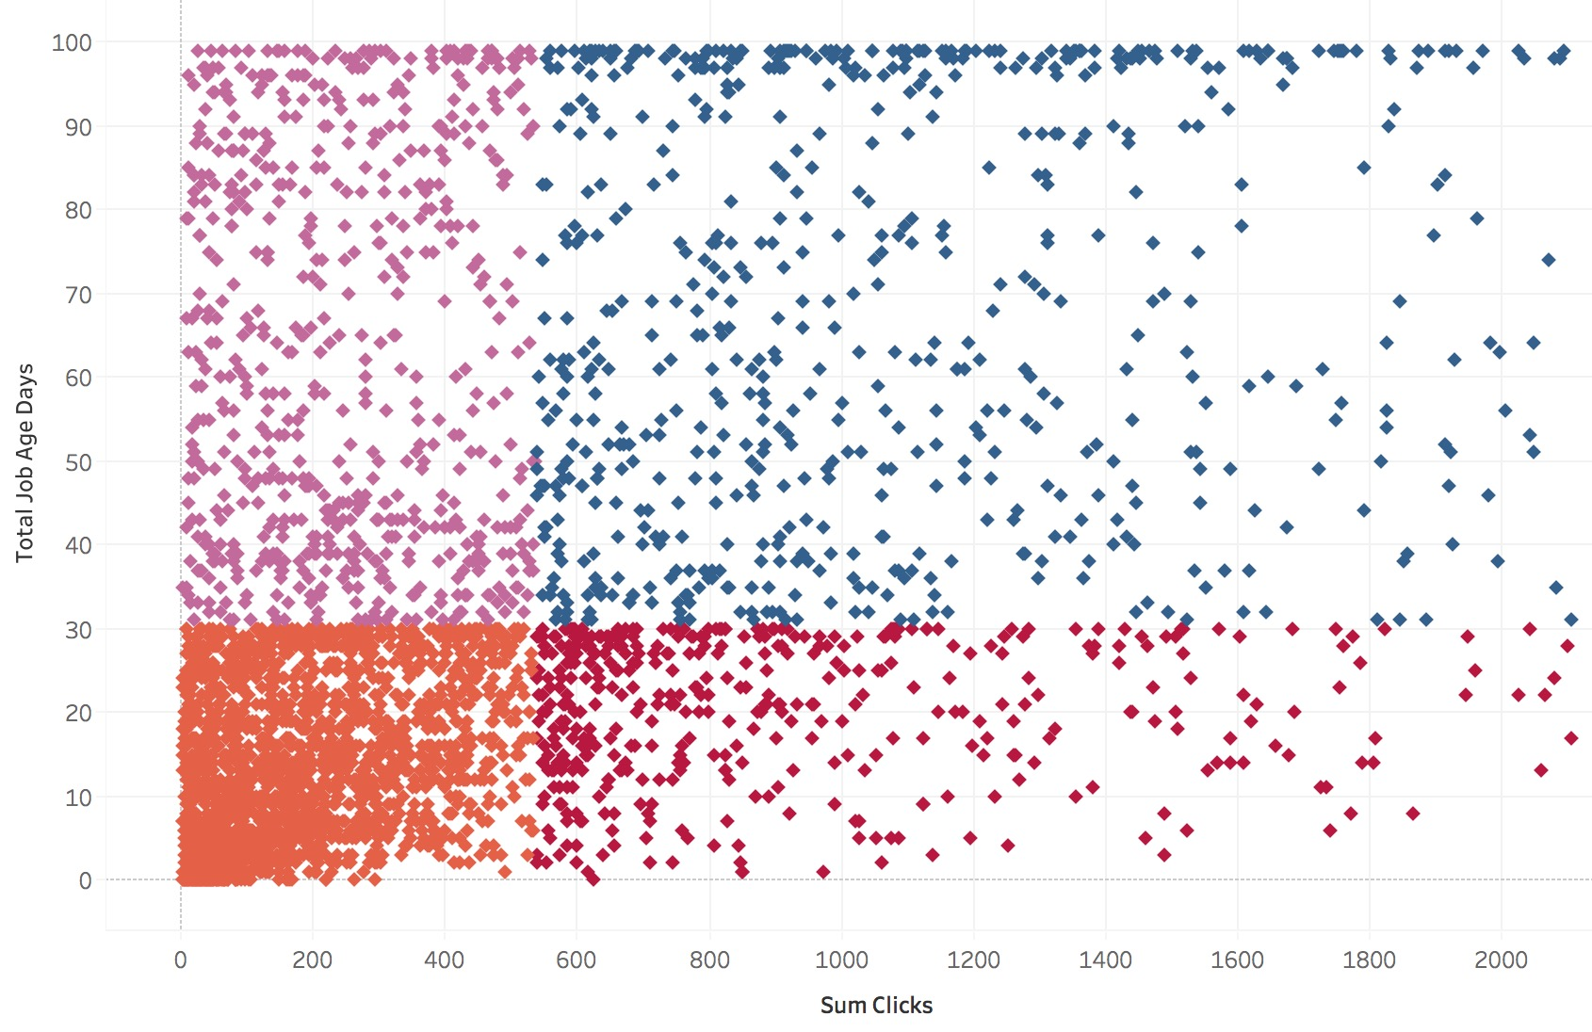
Customer Retention
Accuracy 73%
Logistic Regression
Improve job matching efficiency
Total job posting days
Negative Correlated
UNWANTED
INEFFICIENT
2
1
Experienced required
Num Review
Description Character Length
December
Low clicks and
long job posting period
High clicks and
long job posting period
Around
30 days
3
4
Positive Correlated
IDEAL
November
Estimated Salary
Admin(category)
Cluster result
Around
530
Total number of clicks

Slide 5
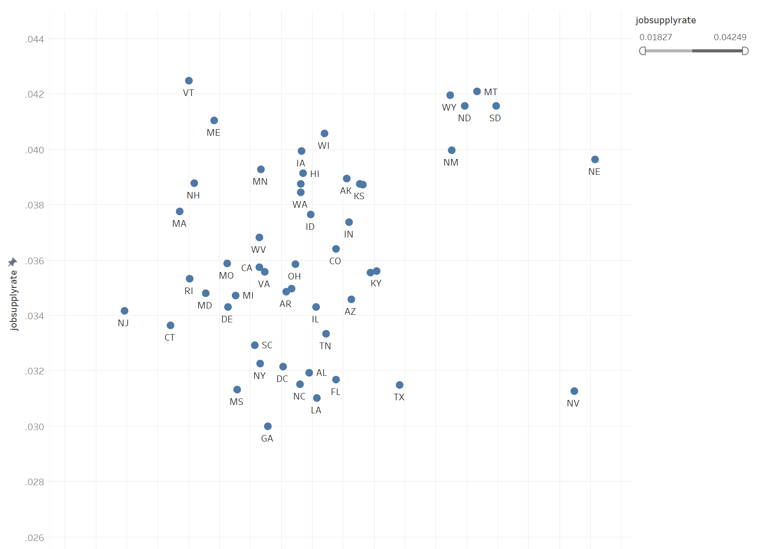
Market Expansion
Identify states with high potential of job supply
Potential Market
Job supply rate
Number of job posts/Total number of clicks
Saturated
Cash Cow
Unknown ?
Potential Market
Local eagerness of finding jobs
Total number of local clicks/Total number of clicks

Slide 6
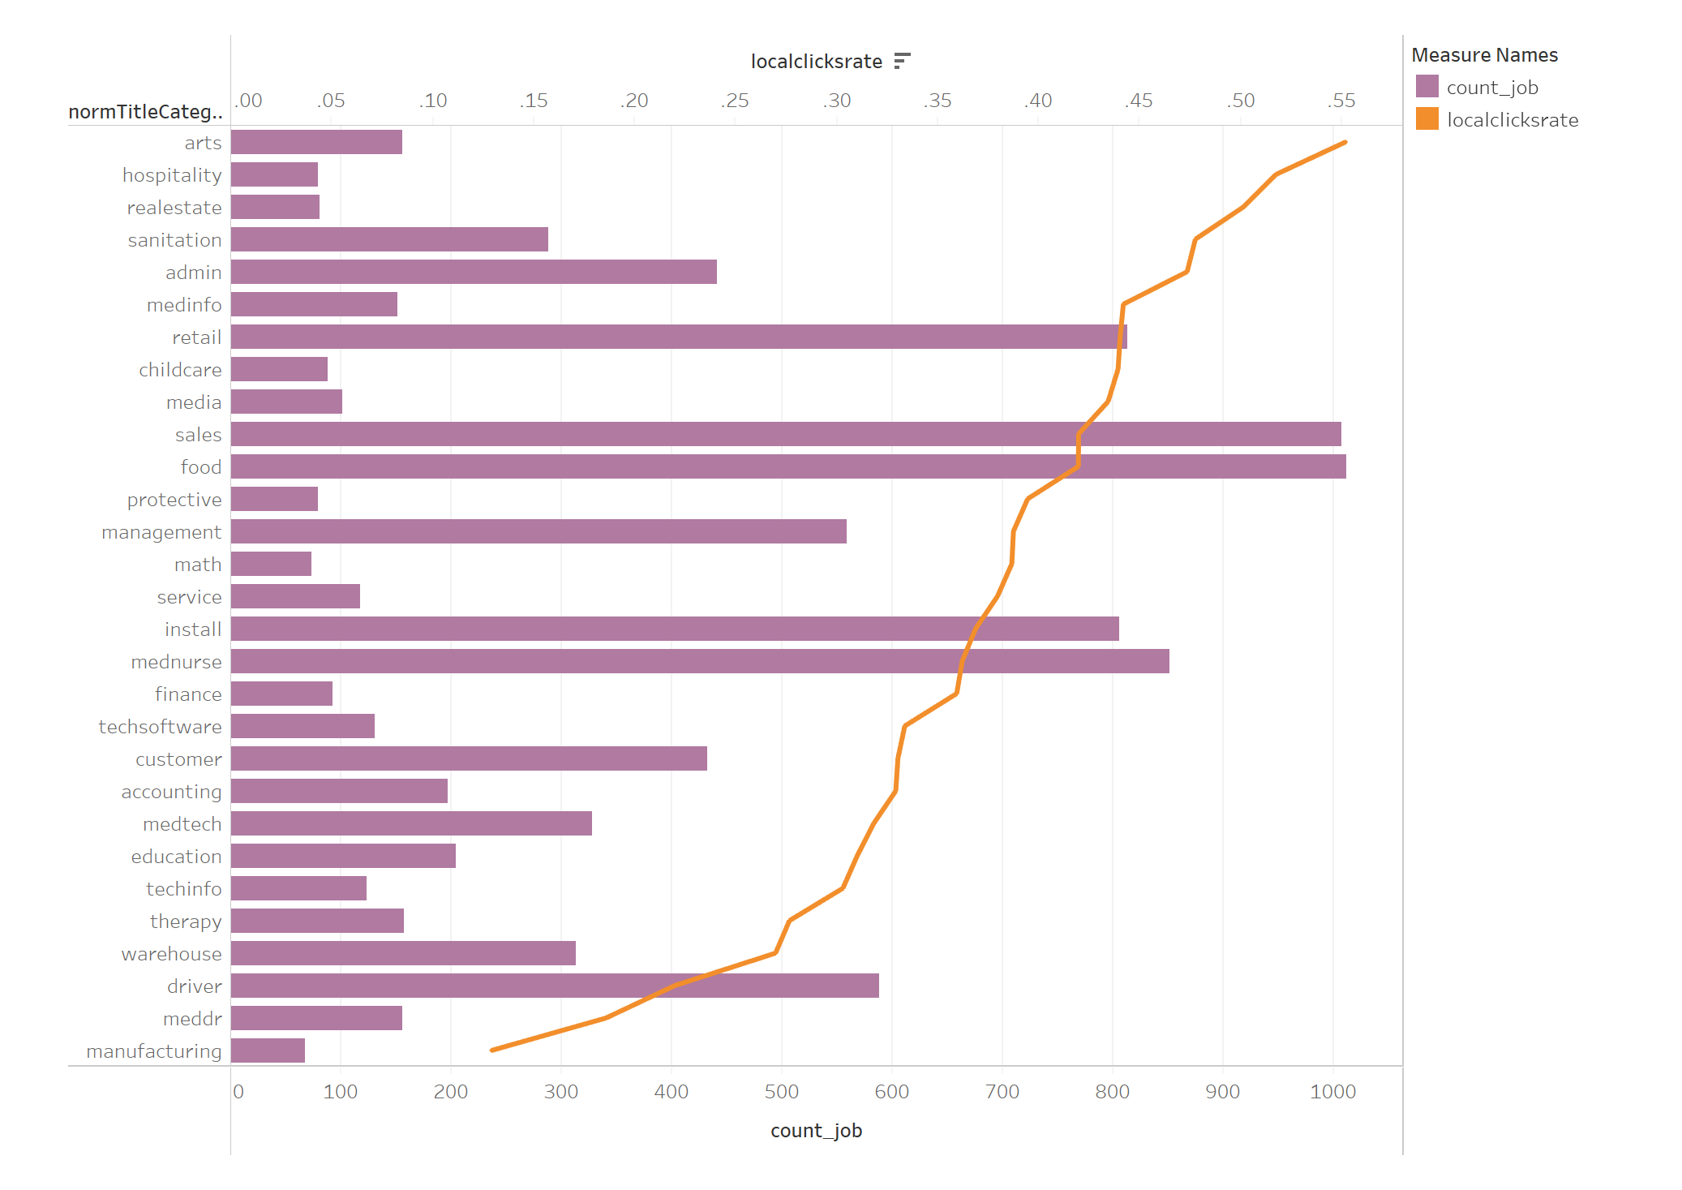
Market Expansion
Identify states with high potential of job supply
Potential Market
Job supply rate
Number of job posts/Total number of clicks
Saturated
Cash Cow
Unknown ?
Potential Market
Local eagerness of finding jobs
Total number of local clicks/Total number of clicks

Slide 7
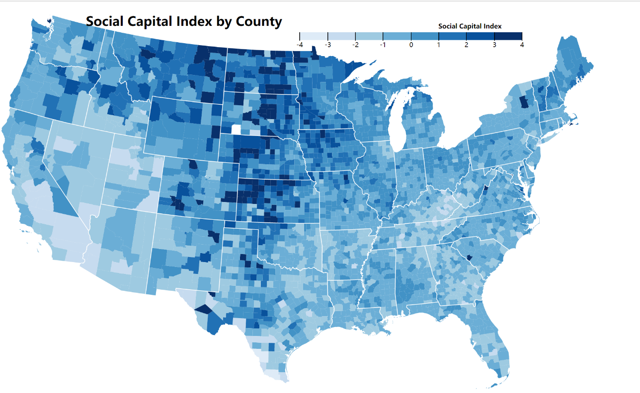
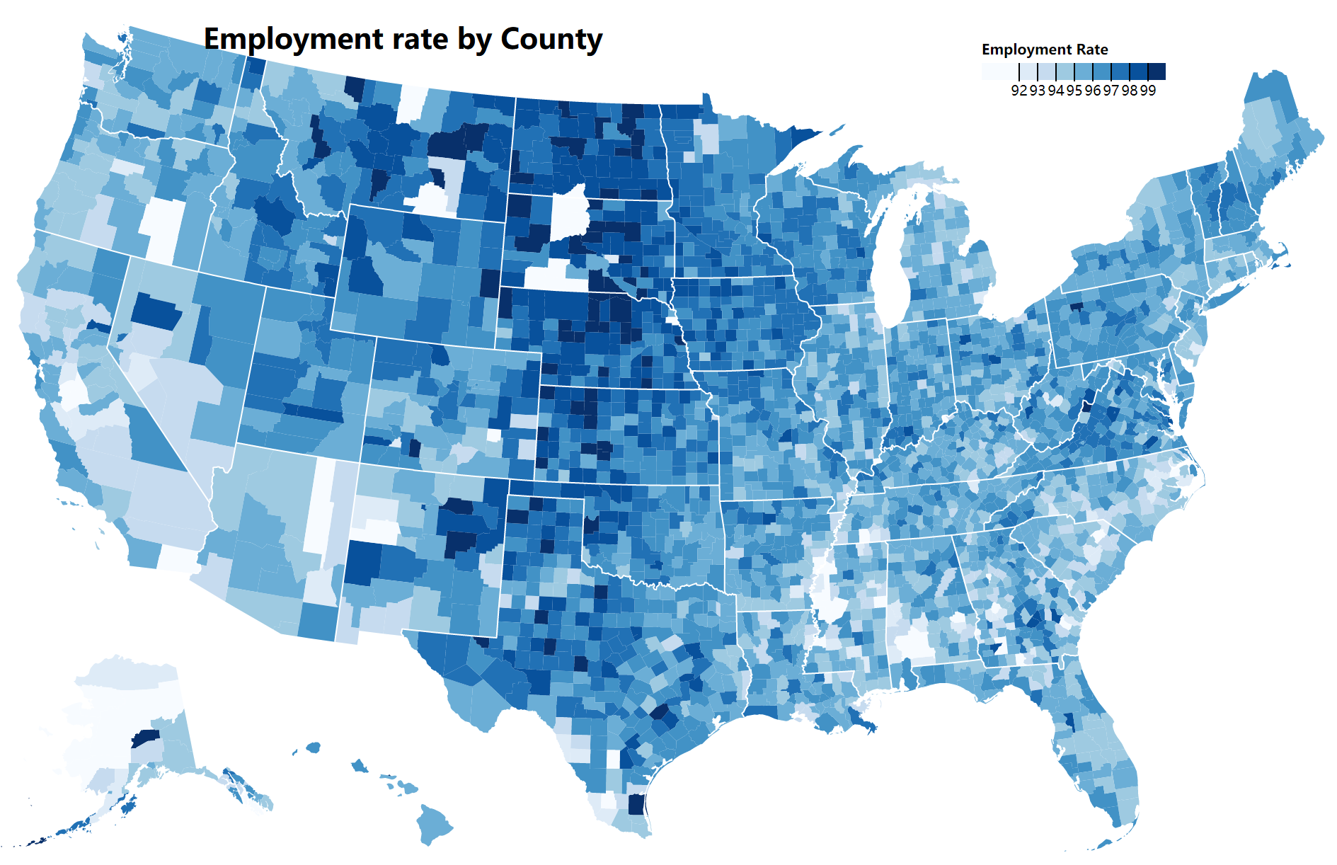
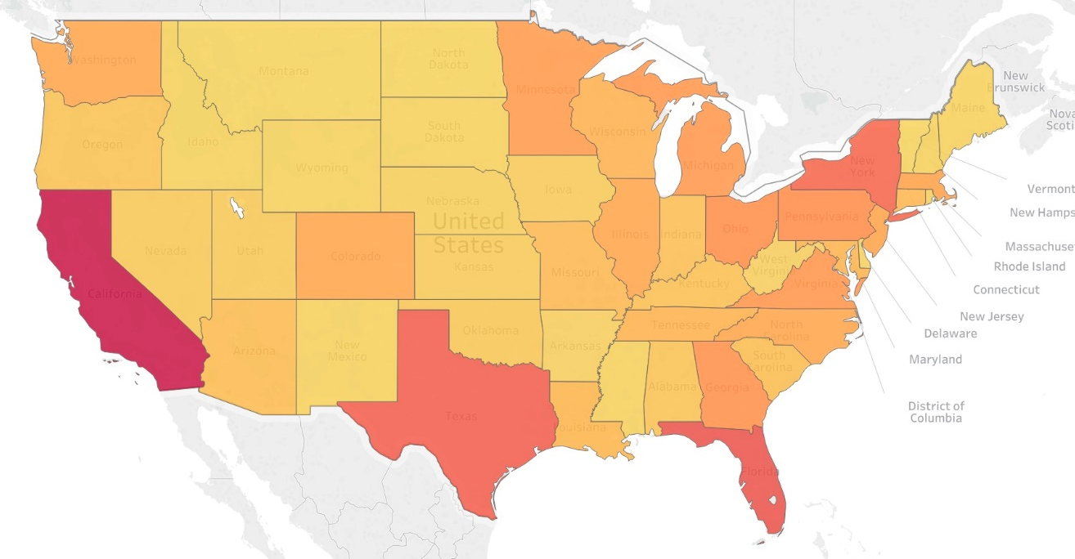
Market Expansion
Figures exploring selected variables
Identify states with high potential of job supply
Job supply rate
Number of job posts/Total number of clicks
Saturated
Cash Cow
Unknown ?
Potential Market
Total Sum of Clicks/Population
Local eagerness of finding jobs
Total number of local clicks/Total number of clicks

