Slide 1

Data Insights For the Market
ASA DataFest 2018
Marketing Strategy
for Indeed
Increase Customer Retention
by Improving job matching efficiency
Discover Market opportunities
by local supply and demand analysis
Tom Chen
Xiaojing Dong
Wenyi Tao
Zhongxing Xue
Ziyi Ye

Slide 2
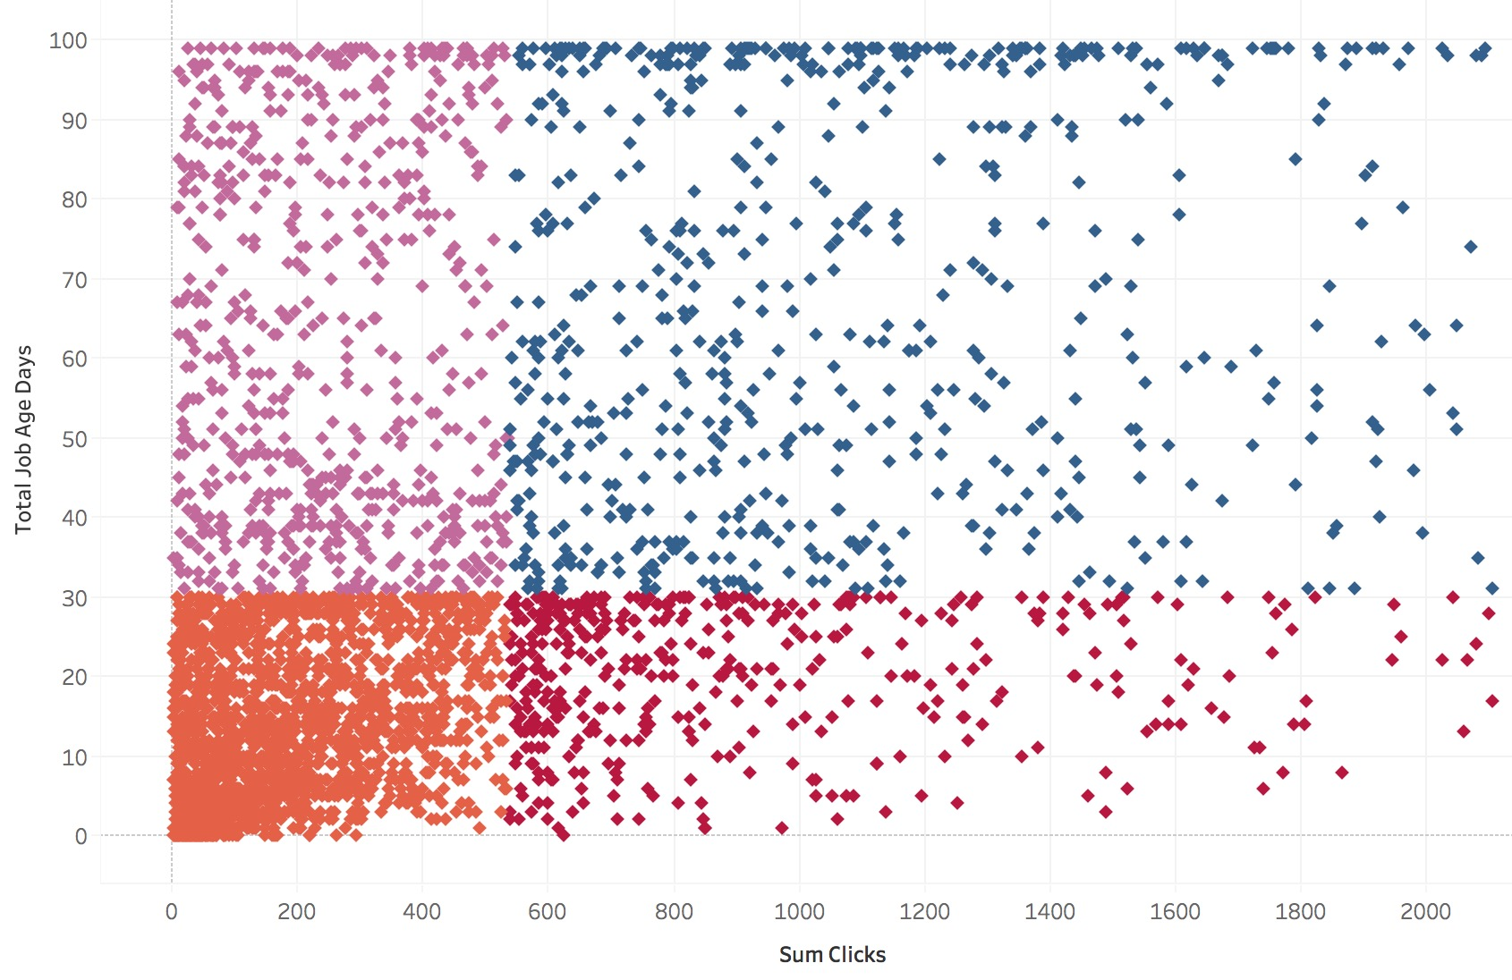
Customer Retention
Improve job matching efficiency
Total job posting days
Key Correlated Features
Key Correlated Features
Key Correlated Features
Accuracy of Logistic Regression 73%
Accuracy of Logistic Regression 59%
Accuracy of Logistic Regression 73%
UNWANTED
INEFFICIENT
2
1
Negative Correlated
Negative Correlated
Low clicks and
long job posting period
High clicks and
long job posting period
Post in December
Experienced required
Num Review
Description Character Length
30
days
3
4
EFFICIENT
IDEAL
Positive Correlated
Post in November
License required
Single day boosting rate
Low clicks but
short job posting period
High clicks and
short job posting period
Positive Correlated
Estimated Salary
Admin(category)
Around
530
Total number of clicks

Slide 3
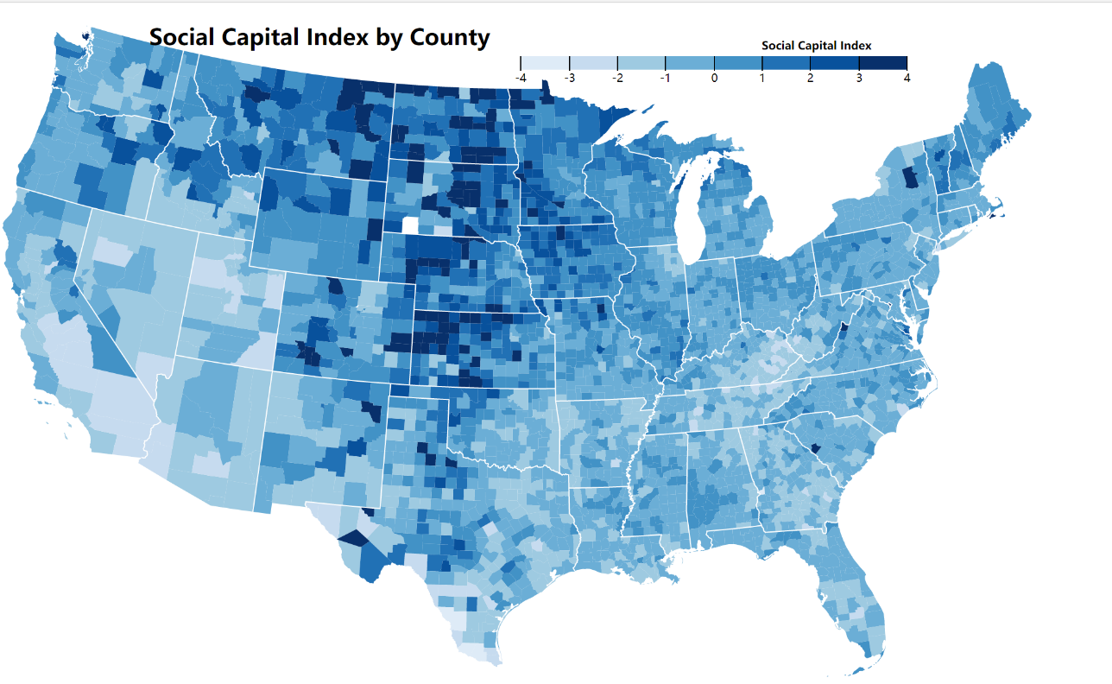
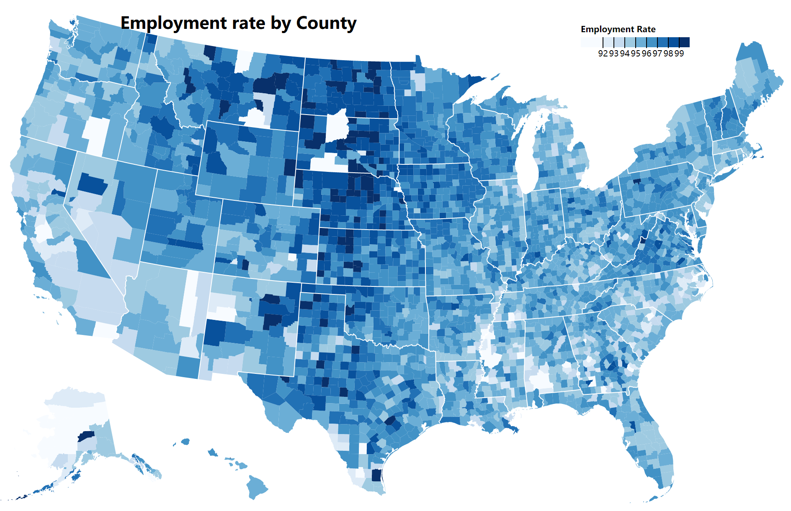
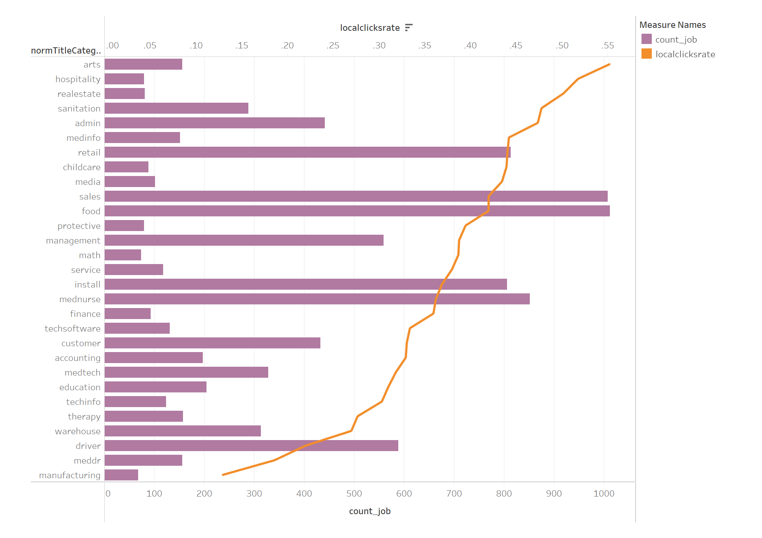
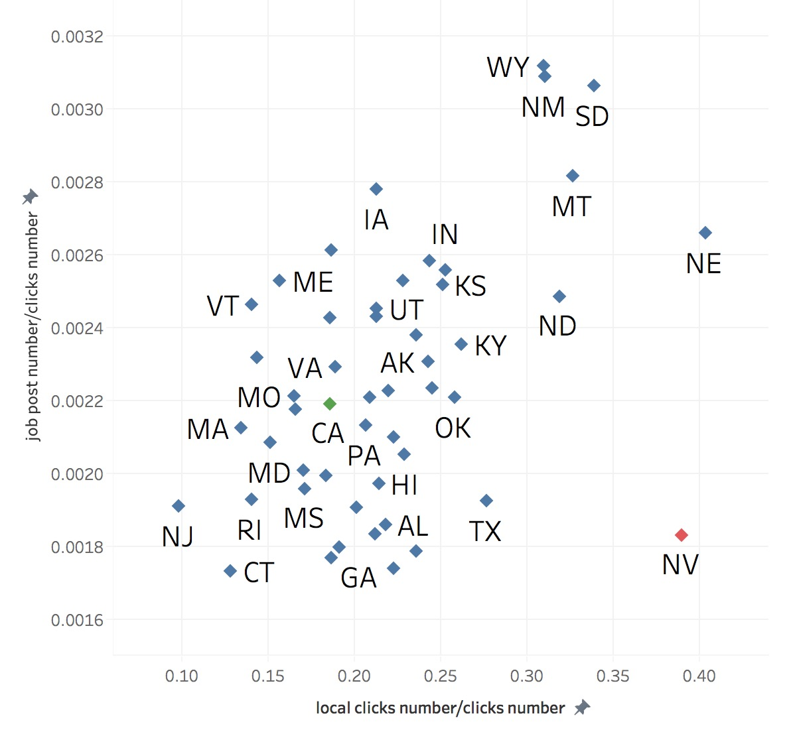
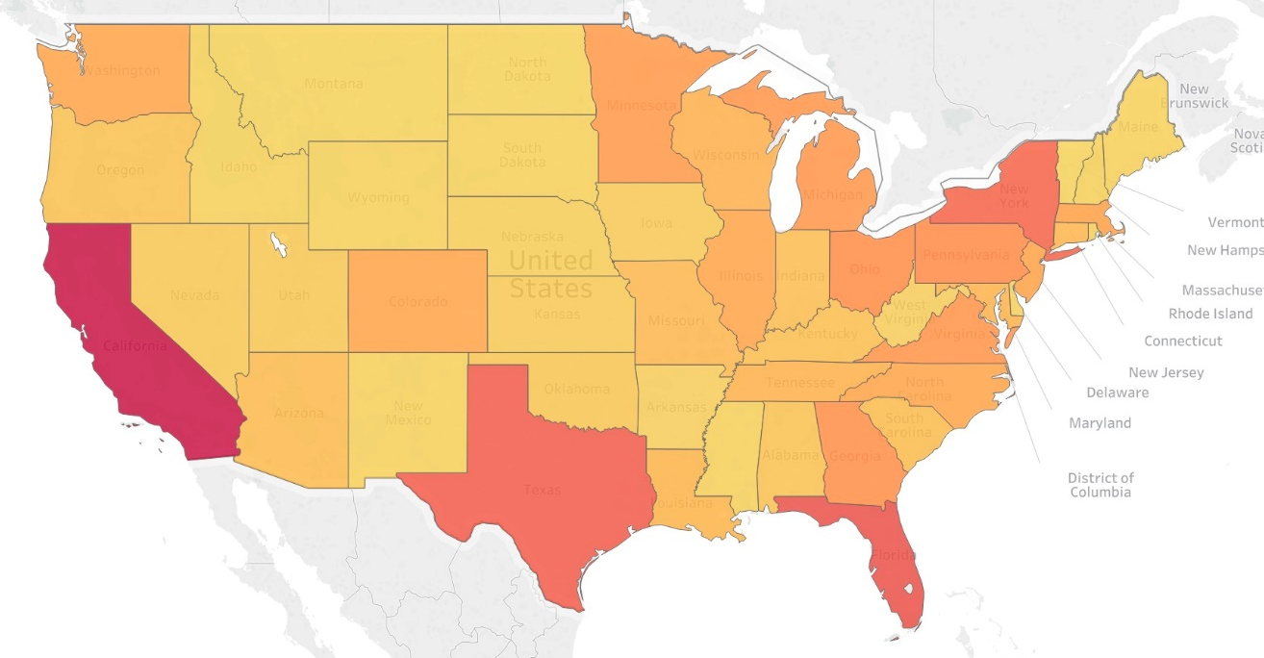
Market Expansion
Figures exploring selected variables
Identify states with high potential of job supply
Market Segmentation
Job supply rate
Number of job posts/Total number of clicks
Job supply rate
Number of job posts/Total number of clicks
Saturated
Cash Cow
Unknown ?
Potential Market
Total Sum of Clicks/Population
Local eagerness of finding jobs
Total number of local clicks/Total number of clicks
Local eagerness of finding jobs
Total number of local clicks/Total number of clicks

