Slide 1
Using Association analysis to explore the preference of government spending and visualize data flow
@ Yixiang Cai
@ Xiaohui Guo
@ Jiaheng Hu
@ Wenyi Tao
GCTH team

Slide 2
Structure
S
tatistical Description
L
inear Regression
A
Ssociation Rule
E
xplanation & our insights

Slide 3
What do we want
to play with the data?
First

Slide 4



Customer
Vs
Shopping Basket
Government
Vs
Company Basket

Slide 5
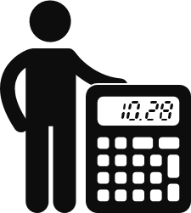
Each Supplier Company is a Shopping Basket. In the basket, Company’s features are the goods

Slide 6
1.Statistical Model
GCTH
Nothing more than set theory and probability

Slide 7
Company list | Education Flag | Women Owned Flag | Minority Institution Flag | State Government Flag | Sole Propietoryship | Domestic Shelter Flag
Company A | 0 | 0 | 1 | 0 | 0 | 1
Company B | 1 | 0 | 0 | 1 | 0 | 0
Company C | 1 | 0 | 0 | 1 | 0 | 1
Company D | 0 | 1 | 0 | 0 | 1 | 0
Company E | 1 | 0 | 0 | 1 | 0 | 1
Company F | 0 | 0 | 0 | 0 | 0 | 1
Company G | 0 | 1 | 0 | 0 | 1 | 1

Slide 8
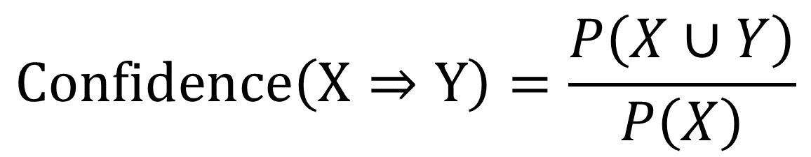
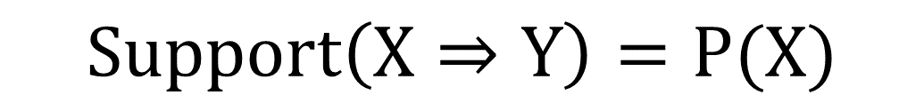
1.Model Validation
Set theory and Probabiliy
$$Support\left(X⇒Y\right)=P(X)$$
2.Algorithm for Association Rule
$$Confidence\left(X⇒Y\right)=\frac{P\left(X∪Y\right)}{P\left(X\right)}$$
3.Model Result

Slide 9
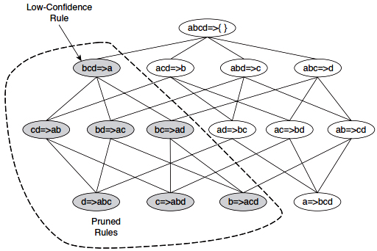
1.Model Validation
Set theory and Probability
2.Algorithm for Association Rule
3.Model Result

Slide 10
1.Model Validation
Set theory and Probability
Runtime Error
2.Algorithm for Association Rule
3.Model Result

Slide 11
Hold on a second….
2. Pruning data with linear regression

Slide 12

Number of offers
All the flags
Y =
$${β_{i}X}_{i}$$

Slide 13
Cherry
Picking
The Top 20 significant Flags are selected for diving in the data
Based on probability and linear regression result

Slide 14
Listed Flags
Verteran_owned
firm8a
State_government
Women_owned
AI_owned
APA_owned
Na_owned
Federal_government
hbcu
Verteran_owned
local_government
Minority owend
Sba_certified
Hubzone
Sheltered_workshop
Tribal_government

Slide 15
Explanatory and Result
Min Support>0.045:
Sdb_flag: Indicates whether the vendor is a Self-Certified Small Disadvantaged Business Organization
Is Sba_certified small disadvantaged business:
Indicates whether the vendor is a Small Disadvantaged Business Organization
3. Women_owned flag:
Indicates whether the vendor is a Woman Owned Business.

Slide 16
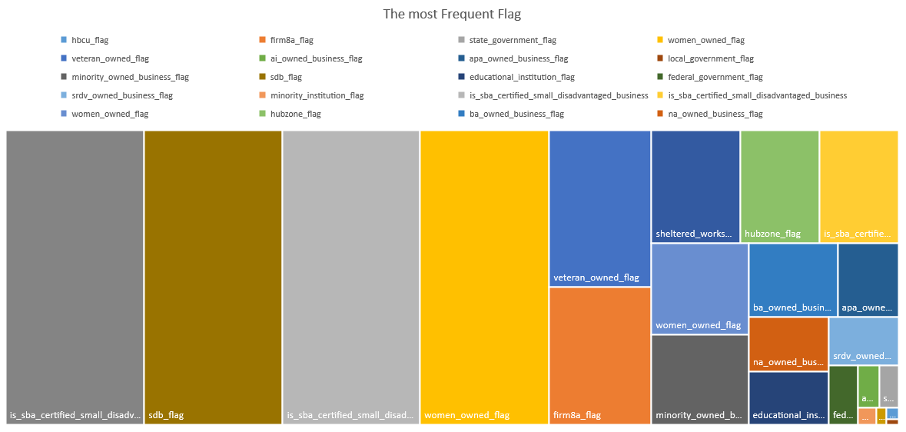

Slide 17
Thanks
@HGCH
2017年9月23日

