Slide 1
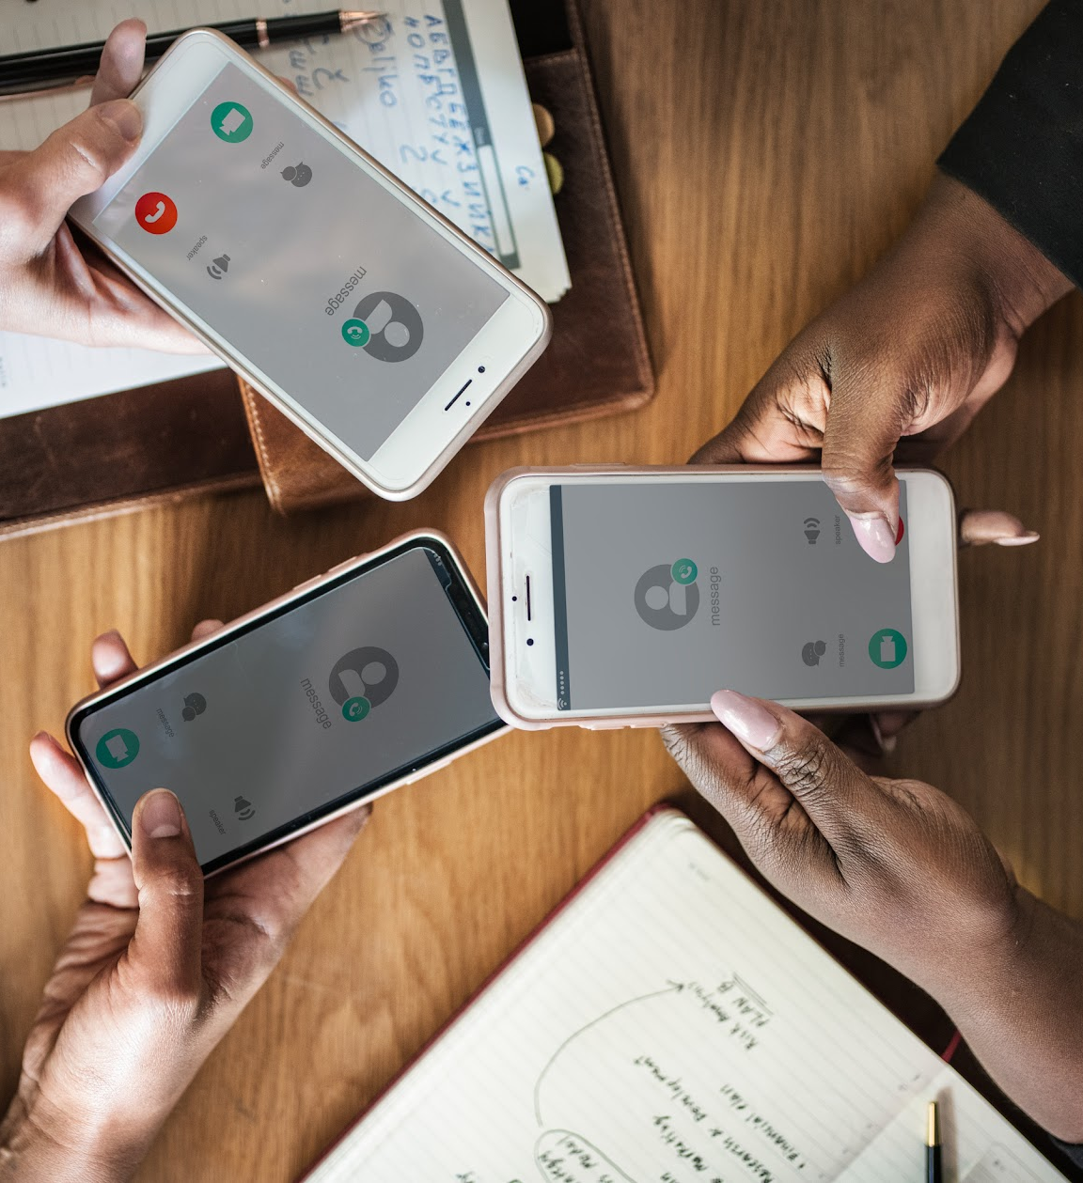

Team 5: Hard Punch and Precision Spin
Wesley, Renee, Max, Minna
Notes:
reload the timer.

Slide 2
1. apparatus

Slide 3
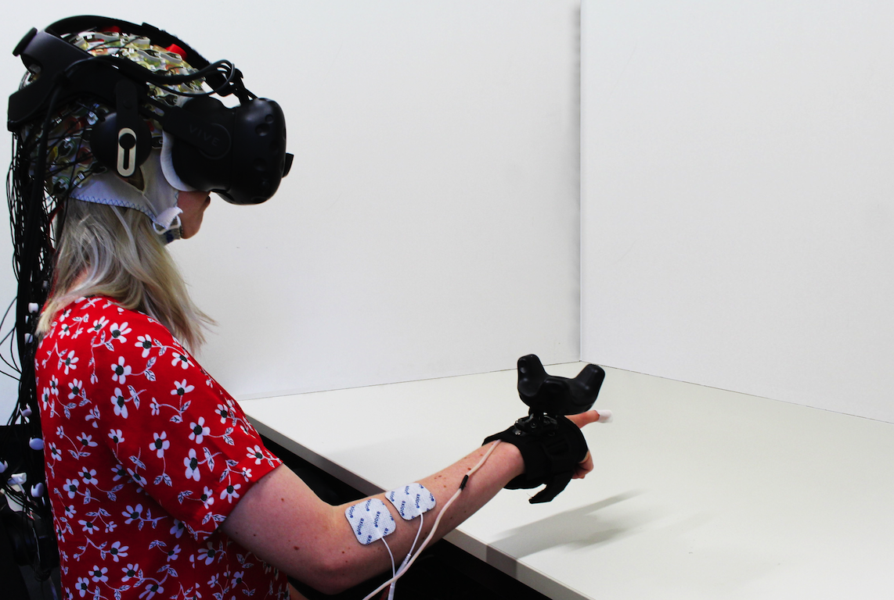
64 channel EEG
Notes:
so our goal here is to understand whether we could find a new metric for haptic realism, that does not involve asking participants questions. and this is a project I did together with my collaborators LukasGerhke and Klaus Gramann, who leads the Neuroergonomics group at TU Berlin. CLICK.
So, this participant here sees virtual objects, such as cubes that appear in several possible locations [CLICK]. and we asked participants to rech out and touch every single cube they see.

Slide 4
2. study design

Slide 5
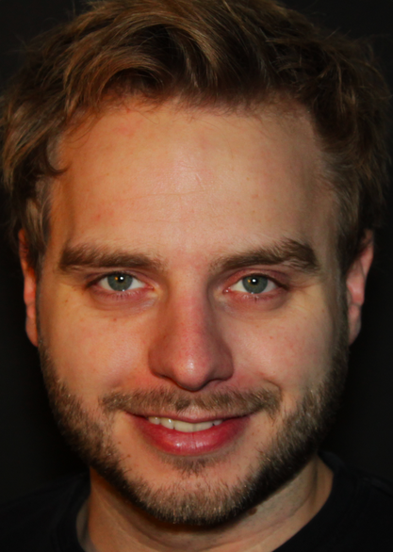

64 channel EEG
Lukas Gerhke Klaus Gramann
TU Berlin TU Berlin
feedback conditions:
1. visual
2. visual + vibro
3. visual + vibro + EMS
Notes:
so our goal here is to understand whether we could find a new metric for haptic realism, that does not involve asking participants questions. and this is a project I did together with my collaborators LukasGerhke and Klaus Gramann, who leads the Neuroergonomics group at TU Berlin. CLICK.
So, this participant here sees virtual objects, such as cubes that appear in several possible locations [CLICK]. and we asked participants to rech out and touch every single cube they see.

Slide 7
<>. <>
Copy this template and make as many subsections as possible to describe your study properly

Slide 9
3. results

Slide 10
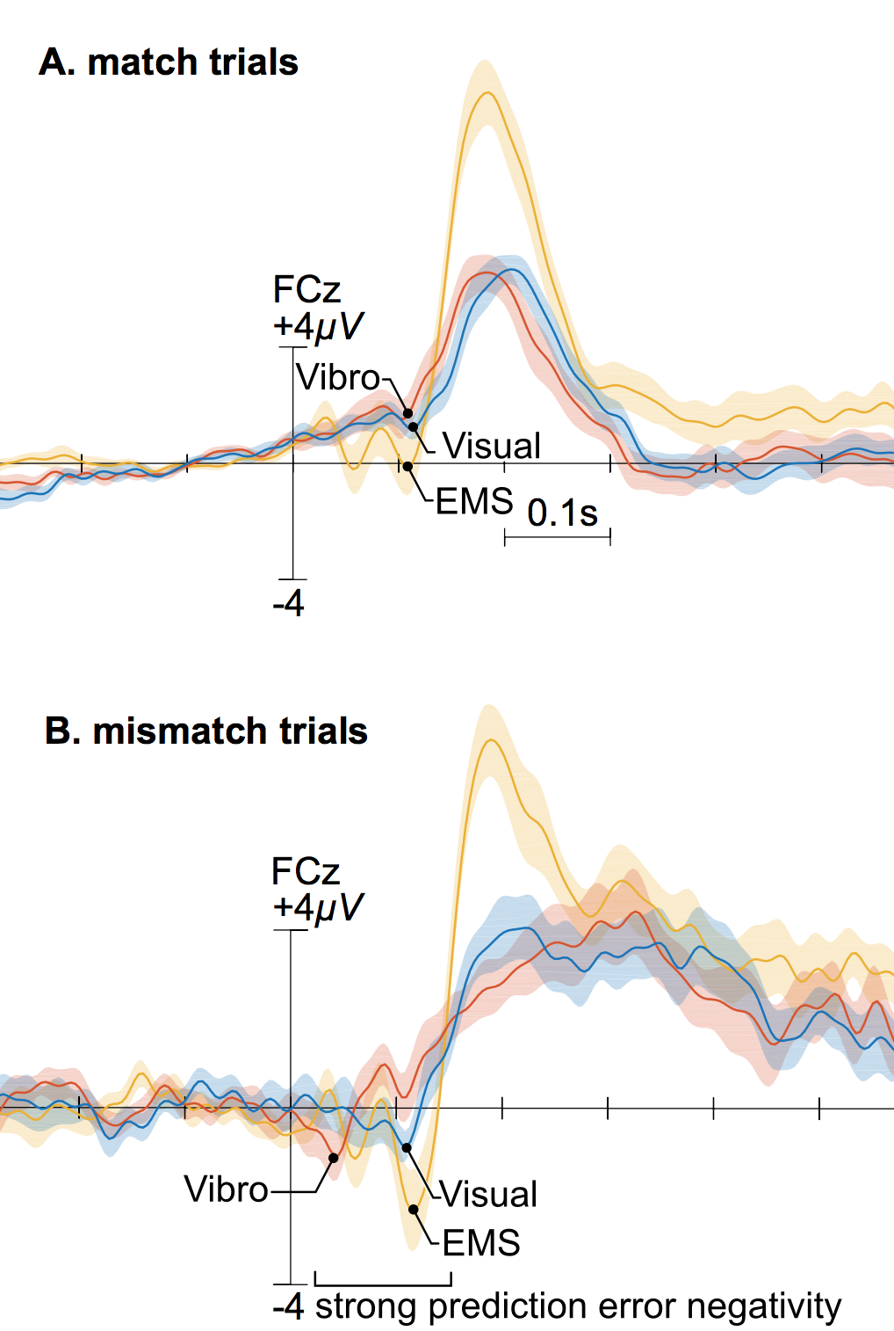
realistic trials
(75%)
typical evoked-related potential (ERP)

Slide 11
realistic trials
(75%)
unrealistic trials
(25%)
typical evoked-related potential (ERP)
Notes:
and now when you compare this with the trials where things were off and did not feel realistic, you see this early negetaivity component in the ERP, which correlates with something being off.
What is interesting is that many researchers have been discussing what is the neural origin of such components and some theories suggest a micmatch in the preciction during sensory integration. Which our case
seems to fit pretty well since we even see an increase with the number of added modalities. So while this suff won’t replace questionnaires any time soon, youc an imagine the value of finding a real time metric to detect mismatches and unrealistic conditions in VR haptcs.

Slide 12
4. discussion

Slide 14
talk title & best image possible to describe it
list of authors,
list of universitties
Add best image to describe your talk
Notes:
reload the timer.

