Slide 1
Results
Use Case 1: InsecureBankv2
Use Case 2: Fake Whatsapp
Visualization

Slide 2
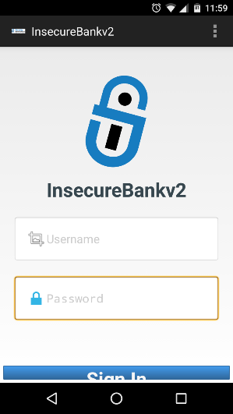
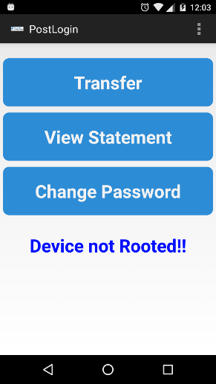
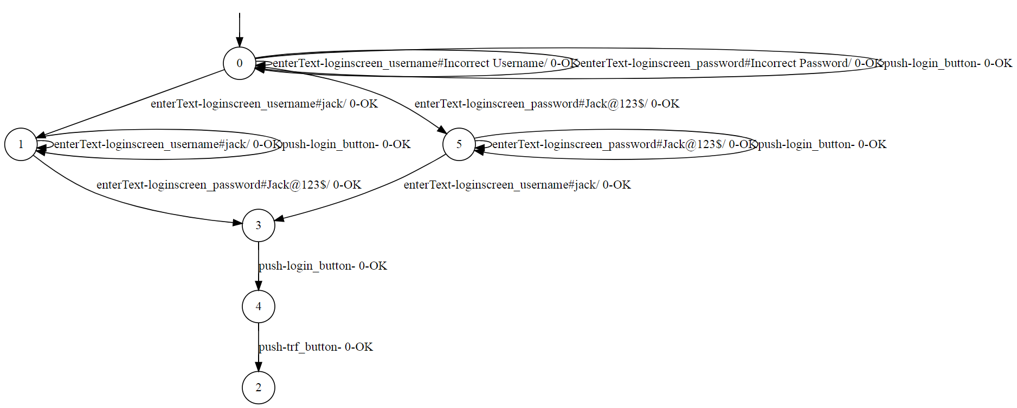
Use Case 1: InsecureBankv2
Login

Slide 3
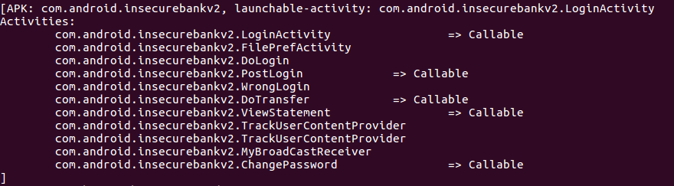


?
Improper Platform Usage
./ViewStatement
Valid credentials are:
Username: jack
Password: Jack@123$
Login
Authentication Bypass
./PostLogin
./DoTransfer

Slide 4
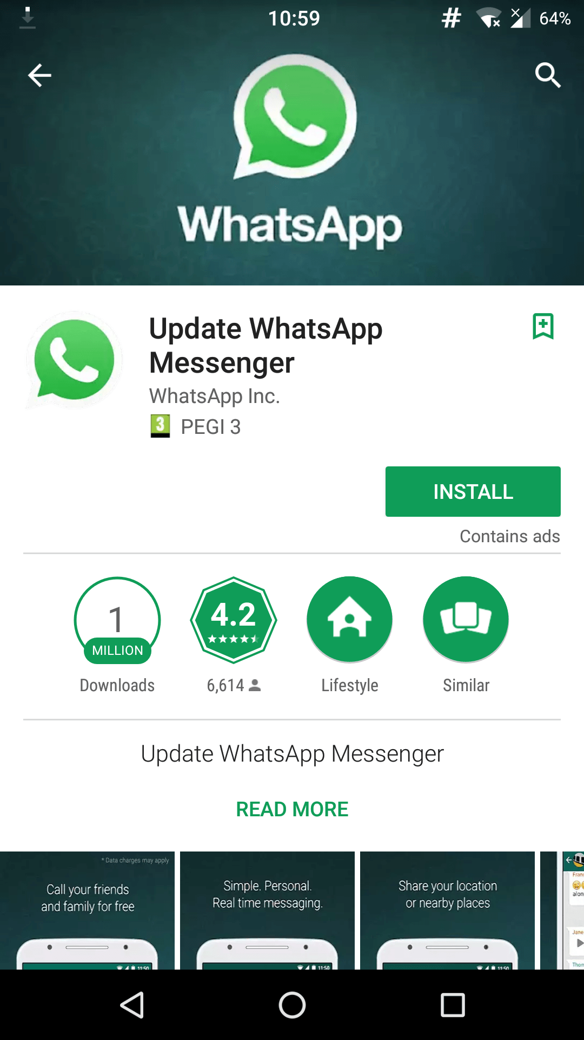
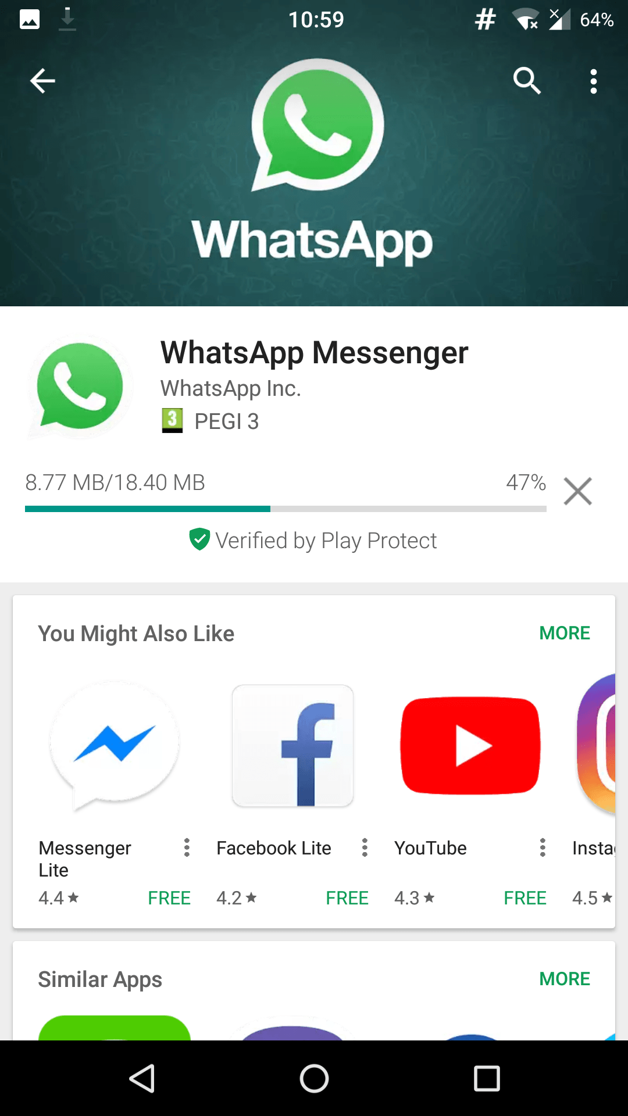
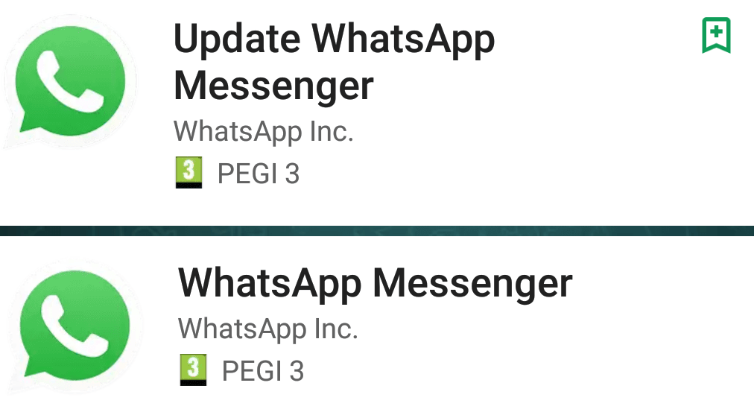
Use Case 2: WhatsApp Fake Update (Nov. 2017)
Background: Unicode trick allows malicious developers to impersonate WhatsApp devlopers
> 1M downloads, now deleted from Play Store

Slide 5
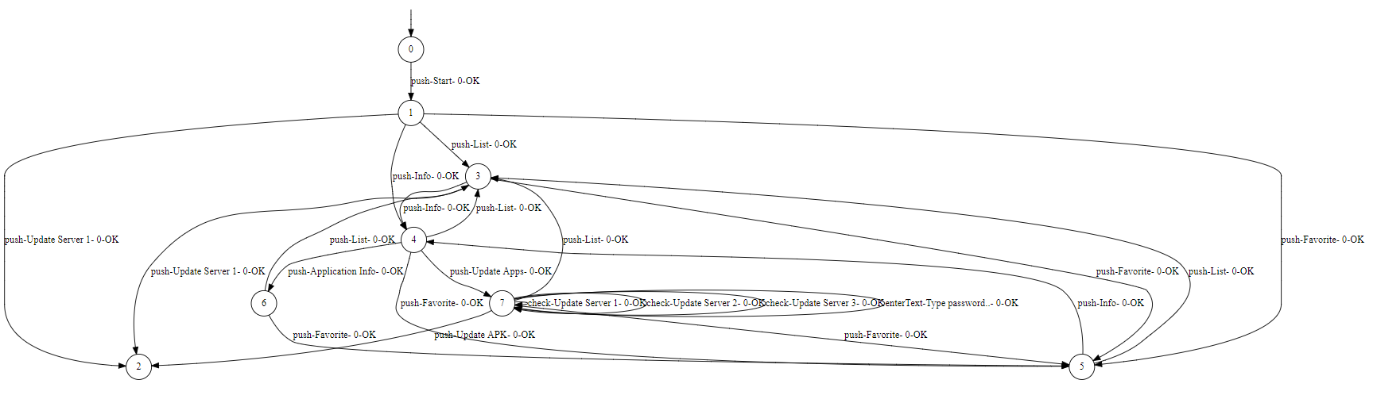
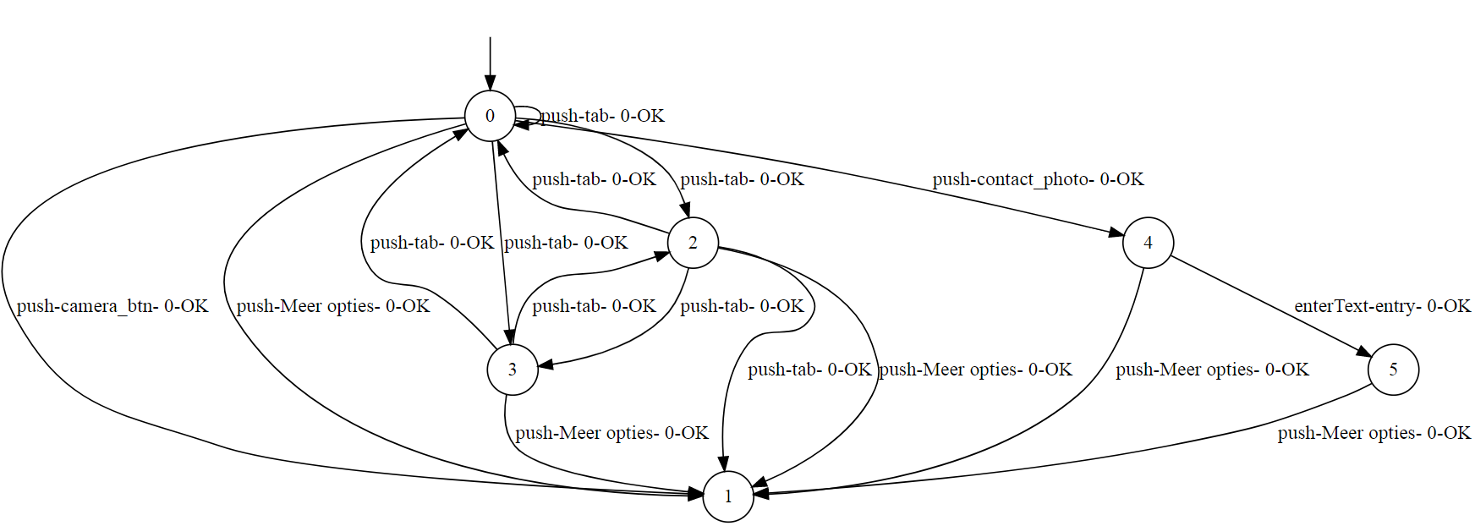
Malicious
Differences:
100% different alphabet
→ Code Tampering/
Extraneous Functionality
Malicious uses http traffic
For tracking and advertising
→ Insecure Communication
Benign
http://req.startappservice.com/1.4/gethtmlad?productId=209893312&os=android&sdkVersion=3.6.6&flavor=1023&packageId=whyuas.fullversion.update2017&userAdvertisingId=a1daf34f-5392-4bd2-b370-e1871c9a24c8&advertisingIdSource=APP&model=Android%20SDK%20built%20for%20x86&manufacturer=Google&deviceVersion=24&locale=en_US&inputLangs=en_US&isp=310260&ispName=Android&netOper=UiszMjsg%0A&networkOperName=IHRncmJ5YA%3D%3D%0A&roaming=false&grid=13&silev=2&cellSignalLevel=2&outsource=true&width=1080&height=1776&density=3.0&fgApp=true&sdkId=3&clientSessionId=eefaaf6c-8585-42dd-83b4-59c2450cbc5a&appVersion=1.3&appCode=1&placement=INAPP_SPLASH&testMode=false&adsNumber=1&packageExclude=whyuas.fullversion.update2017&offset=0&twoClicks=true&engInclude=true&timeSinceSessionStart=16730&adsDisplayed=0&hardwareAccelerated=true&dts=true&downloadingMode=CACHE&contentAd=false&ts=1510825785034&afh=M%2F%2BKkbil1erQSnobT8AE0g&token=1510825779026-4-H4sIAAAAAAAAADMwIBYYUlUZfmBEDUOoACwo1I*fH3TwJcQKE1I10B4MlhgeBejAAkagRhEJaYjugDK3kaF7MAcGWYDmHhr4*I7qAkpLdmqbgwsMu5RGd0DjEERP2KS3fwY_a6AD0hM1XAcAkYCFzlAKAAA%23

Slide 6
