Slide 1


Self Assessment Tax Return

Slide 2
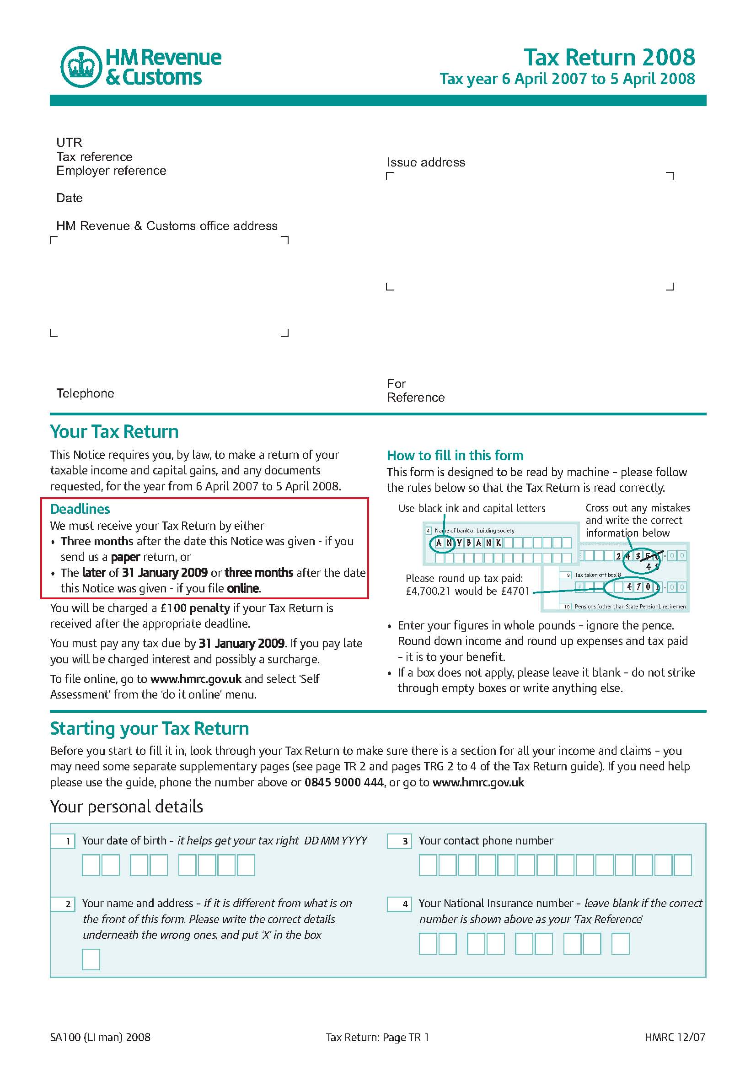
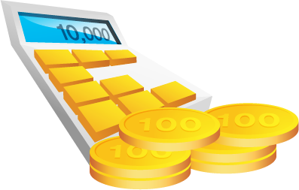


Slide 3
Introduction
Self Assessment tax returns are normally sent out in April each year
Every self-employed person must complete a self assessment tax return. It's used to work out how much tax and Class 4 National Insurance contributions you must pay.

Slide 4
Introduction
Instead of paying tax on your income, you pay tax on your business profits. Like a company, you can deduct business expenses from your business income to work out how much taxable profit you have made.

Slide 5
Introduction
It's your responsibility to return the correct details of income and expenditure. It's easier to do this if you have kept good, up-to-date records.
And you are responsible for completing an accurate self assessment return on time and for paying any tax and National Insurance contributions you owe.

Slide 6
Business Profits
Income | £12,000
- Expenses | £5,000
= Net Profit | £7,000
- Personal Allowance | £6,035
= Taxable Profit | £965
Income Tax
National Insurance contribution class 4 (NIC4)

Slide 7

Taxable Profit | £965
Example:
Income Tax | 20% £965 | = £ 193
NIC4 | 8% £965 | = £77.20
Total Tax |  | =£270.20
Income Tax
£0 – £34,800 | 20%
Higher than £34,800 | 40%
Payment – 2 Payments on Account
31/01/2010 | 50% | £135.10
31/07/2010 | 50% | £135.10
National Insurance contribution class 4 (NIC4)
0 – £34,605 | 8%
Higher than £34.605 | 1%

Slide 8
Tax Deductible Expenses
Item | Deductible against Profits | Not Deductible
Capital items (i.e. items expected to be used for more than 1 year) | An annual capital allowance is available on most items of equipment | Freeholds and long leaseholds of most non-industrial premises
Computer software | If bought separately from hardware | Otherwise, capital allowances available
Gifts to customers | Gifts costing up to £50 and bearing the business name | Any item of food or drink
Home expenses | Reasonable proportion of home running expenses, depending on the extent of use of home for business | Domestic expenses not related to the business
Telephone bills | Business proportion based on calls | Private element and home line rental
Motor expenses | Business proportion based on mileage | Private element

Slide 9
Tax Deductible Expenses
Item | Deductible against Profits | Not Deductible
Travel expenses | Business travel | Travel between home and normal place of business
Subscriptions | Professional subscriptions, relevant magazines and journals | Clubs, charities and items not associated with the business
Wages and salaries | Staff (including family where duties genuinely carried out) | Proprietor's own drawings and gratuitous wages to family
Bank charges and interest | Charges on business accounts and business related loans | Interest for personal overdrafts and loans
Other interest | Interest on business loans | Interest on income tax paid late and interest paid to proprietors

Slide 10
Item | Deductible against Profits | Not Deductible
Insurance | Business related policies | Life assurance, self-employed NI, health and sickness insurance
Bad debts | Specific bad debts from unrelated parties | General provisions and debts written off voluntarily
Accountancy fees | Normal business related fees | Costs of unsuccessfully defending a Revenue & Customs investigation
Legal fees | Most business related advice | Partnership agreements, company formations
Personal expenditure | Modest subsistence expenses in certain cases when working away | Lunches, private expenses and bills, gifts, clothing (unless a uniform)

Slide 11

FILL IN EXCEL SPREADSHEET
SEND T VERTICE SERVICES TO CONCLUDE THE SERVICE
VERTICE SERVICES WILL SEND THE TAX RETURN TO PARTNER BY POST

Slide 12

www.verticeservices.com
Tel: +44 (0) 20 7624 1616 • Fax: +44 (0) 20 7624 2121
63 Loveridge Road Kilburn NW6 2DR London UK
Registered Company 06315064

