Slide 1

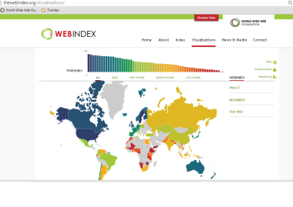
External
sources
wiFetcher
wiCompute
Raw Data
(Excel)
Raw data
(RDF)
Computed data
(RDF)
RDF
Datastore
Visualizations
(Wesby)

