Slide 1
Dev Week 2017
Machine Learning & Recommender Systems

Slide 2
Fundamentals of Machine Learning

Slide 3
Some important points that we must keep in mind for this talk
In terms of concept size:
Data Science and AI concepts is bigger than Machine Learning;
Machine Learning concept is bigger than Deep Learning;

Slide 4
What is learning?
Using past experiences to acquire expertise in execute a specific task;
Do you wanna an example? Pretend to grab a stone from ground near a street dog!

Slide 5
What is machine learning?
When you program a machine to learn how to execute a specific task;
The old but gold example of filtering Spams;

Slide 6
Types of learning
Supervised versus Unsupervised
Supervised: when you learn from a targeted amount of data how to target another amount of data;
Unsupervised: no targets;

Slide 7
Classification, regression, multiclass, ranking and complex predictions
Simple (binary) classification: you have two classes and a new sample must fit one of the two classes;
Regression: you must to predict a continuous value for your new samples;
Multi classification: you have more than two classes;
Ranking: You must order a set of instances by relevance;
Complex prediction: As an example, cost sensitive classification;

Slide 8
Learning lifecycle
Active versus Passive learners
About how the learner interacts with the environment at training time. If actively performs interactions (A/B tests, questions, etc.) or wait for another actor to bring to learnship.
Online versus batch learning¶
The frequency and/or lifecycle of when your learner incorporates the learnship;

Slide 9
Overfitting
When your predictor performance on the training set is excellent, yet its performance on the ground truth is very poor;
In other words, occurs when your hypothesis fits the training data "too well";

Slide 10
Bias
When you inducts your learn to a specific "conclusion";
Be CAREFUL with assumptions;
"In the face of ambiguity, refuse the temptation to guess." (The Zen of Python, by Tim Peters)

Slide 11
Algorithms types
Linear regression;
Support Vector Machines;
Decision trees;
Ensembles;
Neural networks;
etc...

Slide 12
Connecting Machine Learning to a business goal

Slide 13
Goals and metrics
In successful Machine Learning projects, the intelligence being developed is strongly coupled to a very specific goal and measured by a very specific metric. So:
Always define the goal and metric before the development kick-off
Plan and architect your Machine Learning strategy over the goal and metric previously defined
Use goal and metric to measure the performance of your intelligence

Slide 14
Data domains
A data domain are the group of datasets that compose the available description of your context and its players and events;
For example, if you have an e-commerce, your data domain is all data available that describes your customers, the products being selled, financial transactions, etc.
Two different data domains can have distinct definitions of the same player or event. Wanna an example? CHURN!

Slide 15
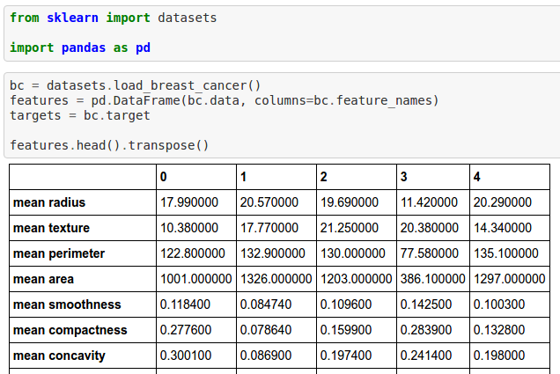

Slide 16
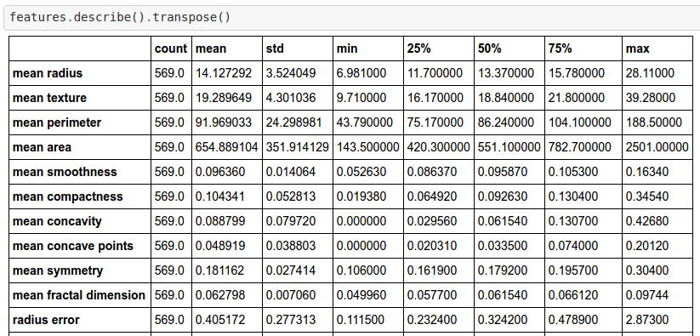

Slide 17
Offline evaluation framework
The offline evaluation framework is the ruler that you will use to measure the performance of your model based on your business goals.
For example, suppose you are the manager of a Breast Cancer campaign and you should chose between a more greedy approach or a highly assertive one based on the cost of the approach. The error costs of your campaign are:
A False Negative (your model does not identify a case which is Breast Cancer) is US\$ 15000,00 to take a late treatment;
A False Positive (your model classify as Cancer a case that actually is not) is US\$ 3000,00
A True Positive (your model classifiy as Cancer a real case of Cancer) saves US\$ 7000,00 from government
A True Negative (your model classify as not Cancer a real case of not Cancer) doesn't impact the costs

Slide 18
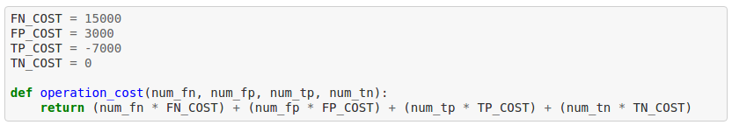

Slide 19
Feature engineering & data quality

Slide 20
Features types
Numeric value (int or float)
Normalization
Categorical values (classes not necessarially exclusive)
Dummy variables, feature hashing
Boolean values (true of false, 1 or 0)

Slide 21
Missing values
You must to make a choice about the missing (NULL) values within your dataset:
Drop them
Fill them with some standard value
Zero
Average
Median
etc.
Be careful with BIAS, mtf!

Slide 22
Classes balancing
Sometimes your dataset has a huge proportion between positive and negative classes
This kind of situation screws up with the algorithm learning because it is very hard to detect the behavior / characteristics of the minor class
There are some techniques to rebalance the data for the training step
SMOTE is a good one to get started

Slide 23
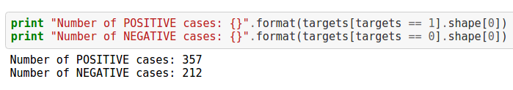

Slide 24
Dimensionality analysis
In datasets with so many features you will face some performance issues: more data available, more data to process
There are some techniques to reduce the dimensionality of your dataset without exclude by relevance or major losses of information
Get started with PCA

Slide 25
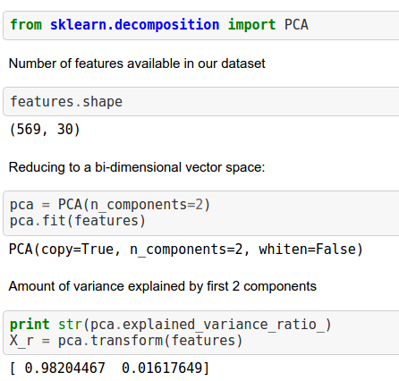

Slide 26
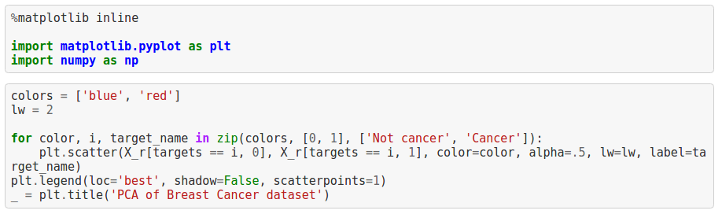

Slide 27
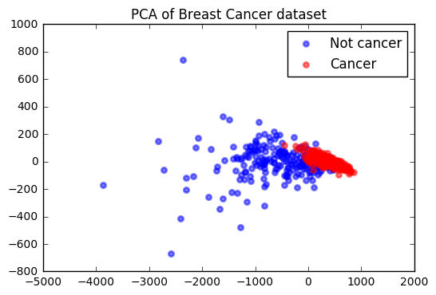

Slide 28
Different representation of the same data
It is possible to represent the same data in several representations
Suppose you have a the results of heart beats 24/7 monitoring from a person (per second):
You can use all entries;
Average / median per minute / hour / day;
Max / min value of hour;
Standard deviation / variance;
etc.
Depends on what really matter for your data
In some cases, the magnitude doesn't matter. Just the variance
Some cases, peak values are the most valuable

Slide 29
Correlation / covariance between features
For machine learning, two features highly correlated (linear dependent) are not so valuable;
We need more information "variety";
An investigation about features correlation / covariance can save some processing from classification time and increase your results;
And always remember: CORRELATION DOES NOT IMPLY CAUSATION

Slide 30
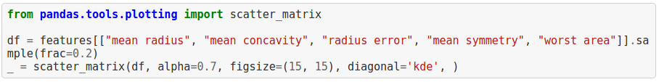

Slide 31
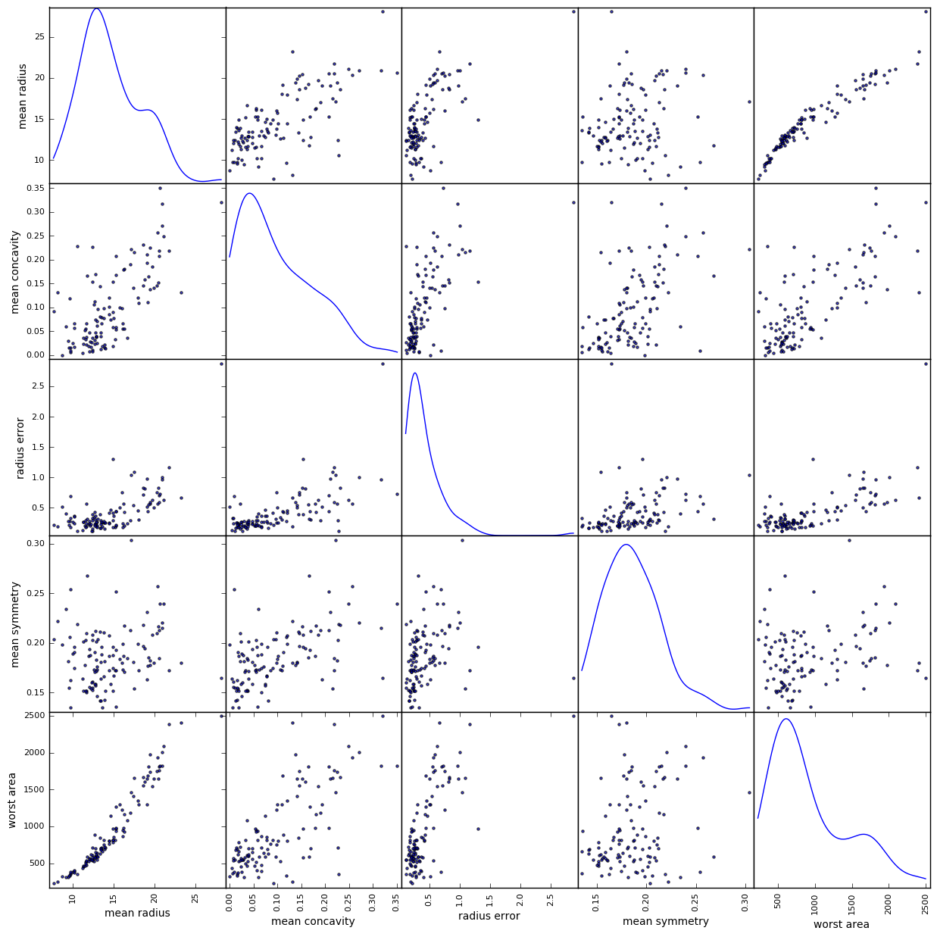

Slide 32
Algorithm engineering

Slide 33
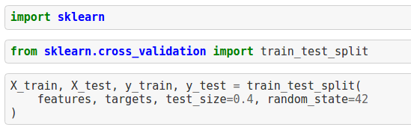
Train / test split

Slide 34
How to measure your algorithm performance
There are several metrics to measure your algorithm performance
KS score
AUC / ROC curve
Precision / recall
Confusion matrix
etc.

Slide 35
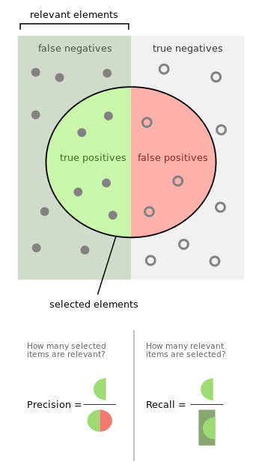

Slide 36
Chosing your algorithm
There is a long list of algorithms already available to get started
You can also develop your own customized one for specific applications
Ask these two questions first:
Should your final model be human readable?
What is your SLA of delivering classification results?
I'm supposing you already know what kind of problem you are solving (classification, regression, ranking, etc);

Slide 37
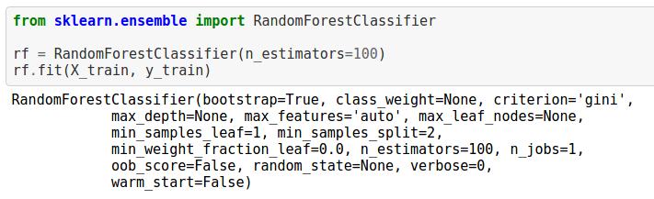
Random Forest

Slide 38
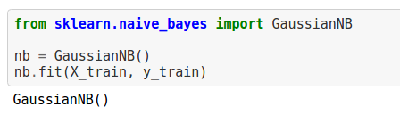
Naive Bayes

Slide 39

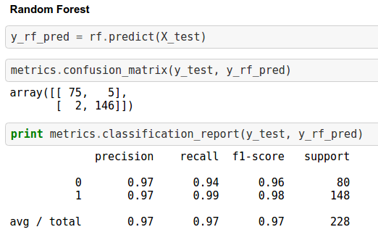
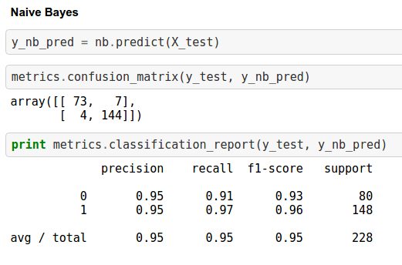
Evaluating model performance

Slide 40
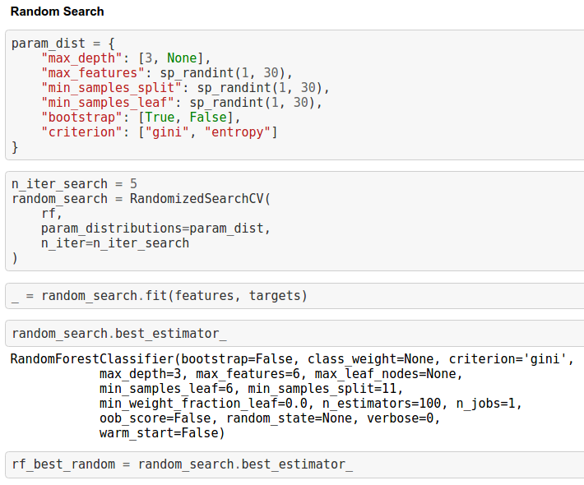
Tools for tunning

Slide 41
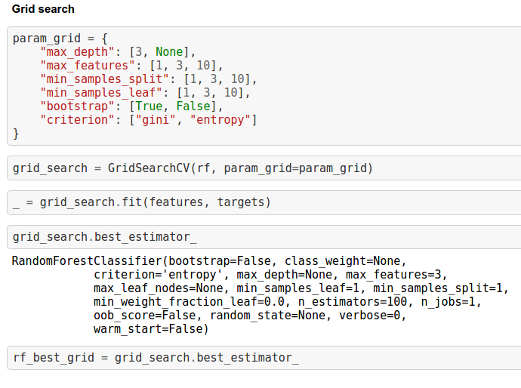
Tools for tunning

Slide 42
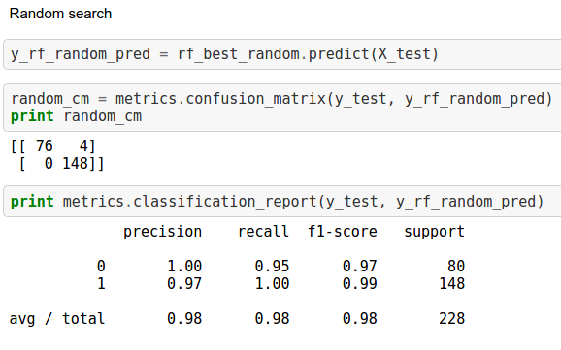
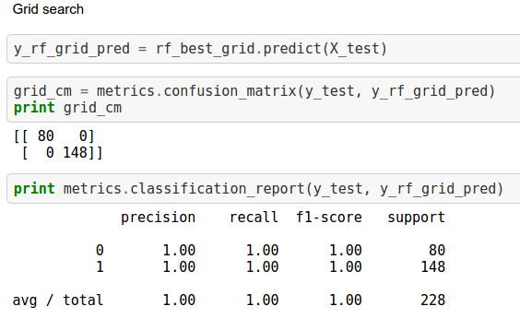

Slide 43
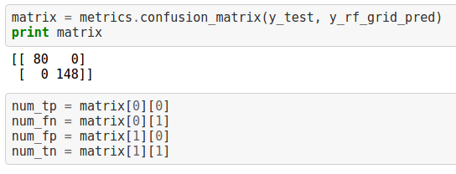
Evaluating (offline) business gains
Now we need to measure our performance based on the ruler that exactly represents our business goal.

Slide 44


Evaluating (offline) business gains
Calculating the operation cost / savings based on classification parameters:
Using the "worst" classifier got by Random Search

Slide 45
What to do if learning fails?
Improve your feature engineering;
Get more data related to the problem;
Change the feature representation of the data;
Also consider try more sofisticated methods to extract more information of that data
Example for text data: string similarity, IDF, Entity recognition, word2vec, etc;
Change the optimization algorithm used to apply your learning rule;

Slide 46
Evaluating model lifecycle
For time based events, you need to know how long is the lifecycle of your model;
Get historical data long enough to get some fade;
Apply your trained classifier to "future" data and see when it starts to fail significantly;

Slide 47
Wanna some code?https://github.com/wespatrocinio/devweek_2017/blob/master/notebooks/machine_learning.ipynb

Slide 48
Recommender Systems

Slide 49
Overview of a recommender
A recommender is a system which offers some suggestions about what should be displayed to an user in order to engage him to take some actions in your product or business.

Slide 50
Strategies
Recommendation based in general hot topics;
Suggest the most popular items by which user is not interested yet
User-based collaborative filtering;
Based in similarities between users;
Item-based collaborative filtering;
Based in similarities between items;

Slide 51
Wanna some code?
https://github.com/wespatrocinio/devweek_2017/blob/master/notebooks/recommender_systems.ipynb

Slide 52
Architecting a recommender
A recommender is a real system / product.
The engineering side is so important as the intelligence one.
And both should be quite coupled with prodcut and business.

Slide 53
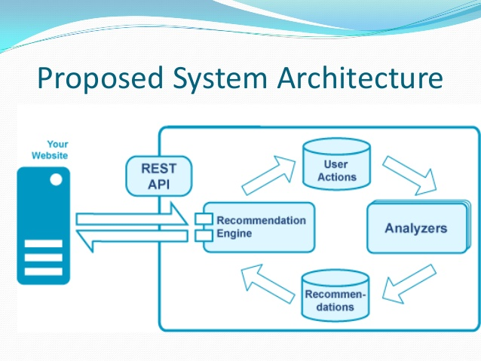

Slide 54
Very very important questions
How should your user get the recommendations? Real-time, online, batch, etc;
How long a recommendation will live?
Do you have cold start scenario?

Slide 55
Recommendation SLA & getting mode
For passive recommendations (i.e. user requires new suggestion), usually we have real time or/and online strategies;
Cache always as possible;
But you should remember that cache is limited. And so?
Will you create a very very long cache which includes some long tail (aka crap) recommendations?
Will you fill the cache with fresh recommendations processed during the user interaction?
Will you jump to an online strategy after reach some threshold?
If online, SLA is your big guy;

Slide 56
Recommendation lifecycle
What is the seasonality of your suggestion?
Your offer strategy MUST to be aligned with this seasonality;
When some user stay without use your product for a long time, treat him as a new one;

Slide 57
Cold start
To recommend based on similarities, you need some user preferences to compare with other. But if you don't have?
Cold start strategy for newly subscribed users
In our basic strategies, the general hot topic is a good one

