Slide 1
Azure Scheduler
Corey Vittitow

Slide 2
Agenda
Scheduler
Features
Alternatives
Benefits
Drawbacks
Use Cases
Getting Started

Slide 3
Scheduler
Jobs (Triggers)
  Background
Schedule
  Now
  Future
  Recurring
Cloud
  Availability

Slide 4
Features
Inside/Outside Azure
Flexible Schedules
Azure Storage Queues
Invoke Endpoints (HTTP/HTTPS)

Slide 5
Alternatives
Quartz Scheduler
Fluent Scheduler
Web Backgrounder
Azure Web Jobs

Slide 6
Benefits
Reliability
Availability
Scalability
Logging
Failover

Slide 7
Drawbacks
Pricing
Closed Source
Not Extensible
Security

Slide 8
Use Case
Batching
  Email/SMS Notifications
  Payroll Processing
  Data Parsing
  Archiving

Slide 9
Use Case
Monitoring
  Reporting
  Analytics
  Metrics
  Status

Slide 10
Use Case
Maintenance
  Database Cleanup
  File Cleanup
  Reboots
  Patches

Slide 11
Use Case
Automation
  Verification
  Testing
  Capturing

Slide 12
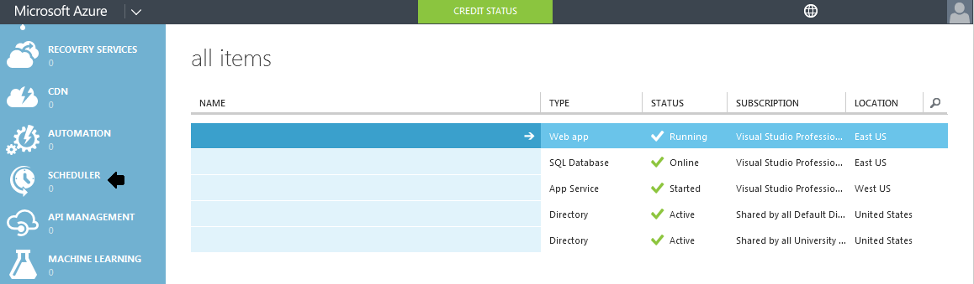
Getting Started
Login to Azure Portal
Locate Scheduler
Begin Custom Create

Slide 13
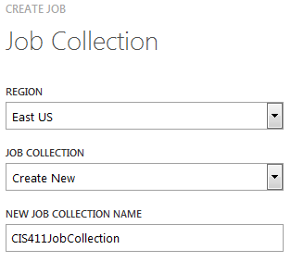
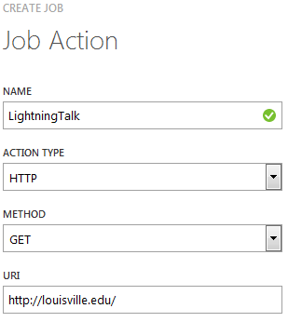
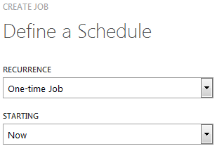

Job Creation
1
2
3

Slide 14
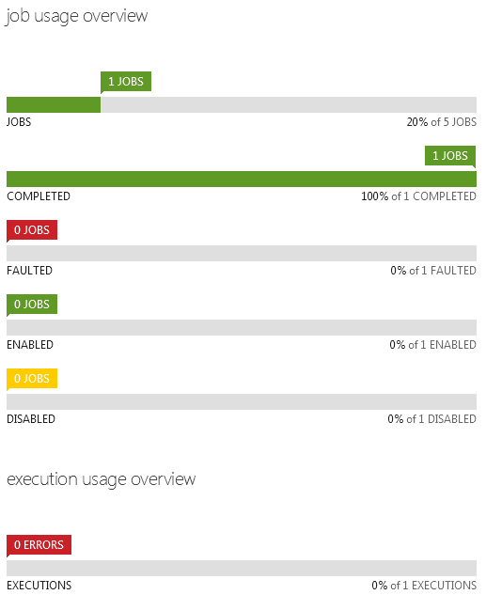
Dashboard
Current Jobs
Completed Jobs
Faulted Jobs
Enabled Jobs
Disabled Jobs
Job Executions

Slide 15
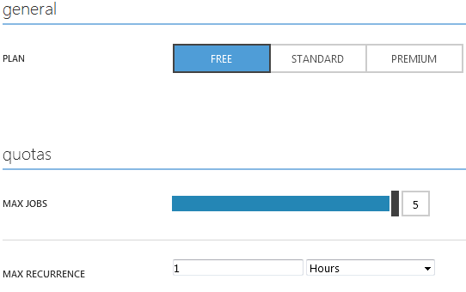
Scale
Plan
  Free
  Standard
Quotas
  Max Jobs
  Max Frequency
  Max Interval

Slide 16
History
Metrics
  Status
  Details
  Retry Attempts
  Number of Executions
  Timestamp of Execution

Slide 17
Jobs
Disable, Enable or Delete
Metrics
  Status
  Executions
  Action Type
Configurations

Slide 18
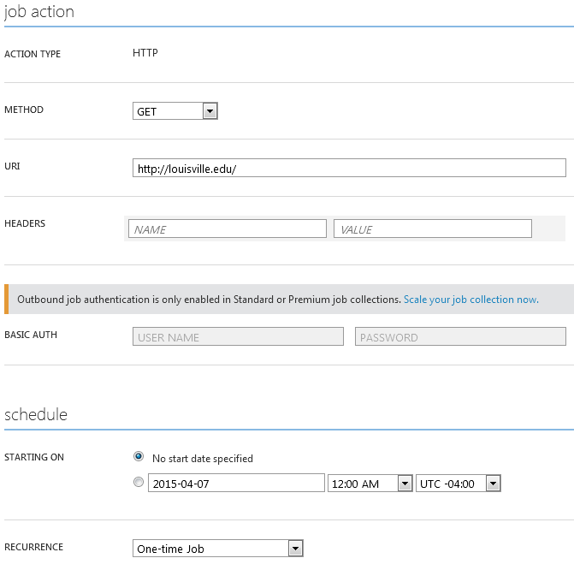
Job Configuration

Slide 19

Sources
http://azure.microsoft.com/en-us/services/scheduler/
http://azure.microsoft.com/en-us/documentation/services/scheduler/
https://msdn.microsoft.com/library/azure/dn528946.aspx
http://gauravmantri.com/2013/11/10/windows-azure-scheduler-service-part-i-introduction/
http://fabriccontroller.net/blog/posts/a-complete-overview-to-get-started-with-the-windows-azure-scheduler/
https://msdn.microsoft.com/en-us/library/azure/dn495651.aspx

