Slide 1

Machine Learning in Python
Mike Crabtree

Slide 2

What is Python?
Modern, lightweight, object-oriented programming language
Easy to code
Scales easily
Growing quickly ( ͡° ͜ʖ ͡°)
Heavily used by Google

Slide 3

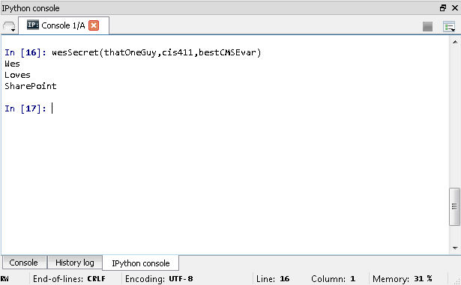
Python Example
Example Function:

Slide 4







Why Use Python?
Most popular data science tools according to Stack Overflow survey: R, Python.
Not as cool
Less scalable
Not as popular
More difficult to operationalize
Cool
Scalable
Popular
But wait, there’s more!

Slide 5


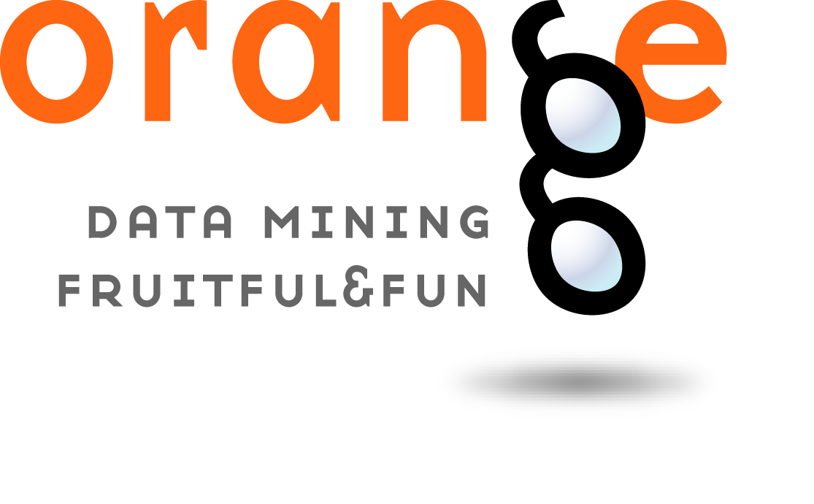

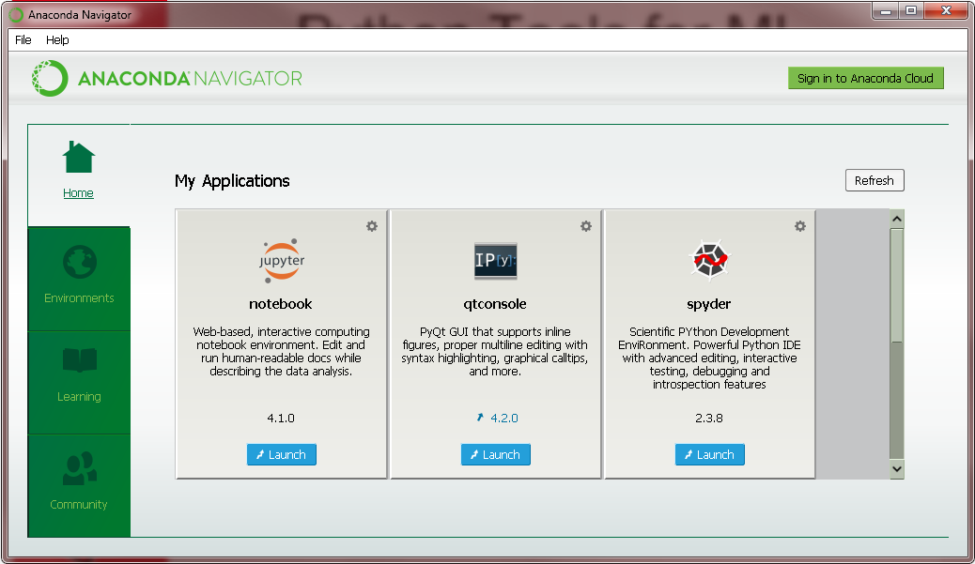
Python Tools for ML

Slide 6
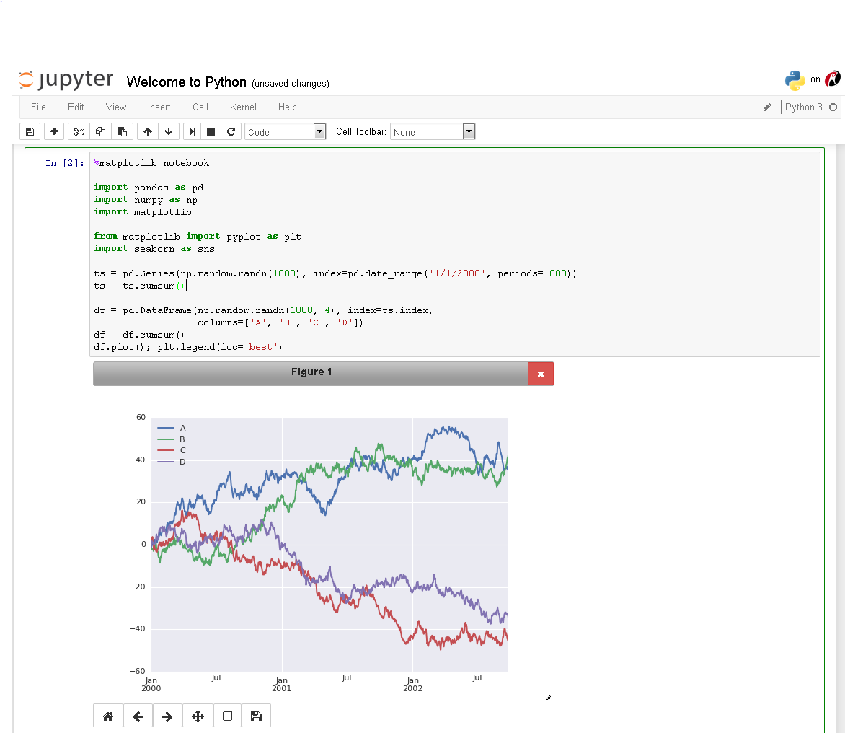
Python notebook server
Shareable notebooks
Notebooks can run lines of code
Saves automatically

Slide 7
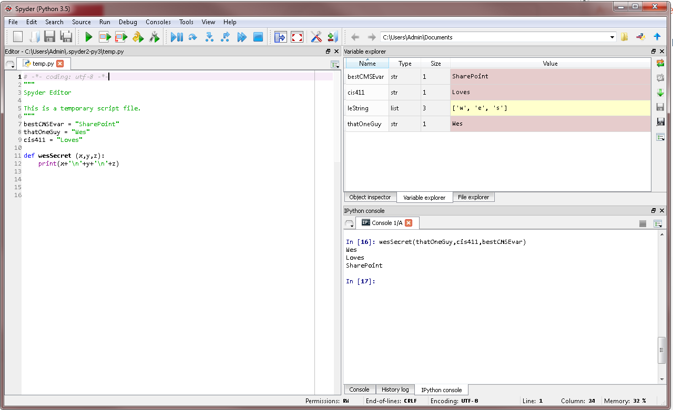
A sweet IDE with: code completion, error checking, introspection/analysis. Similar to Rstudio, Matlab, and Octave

Slide 8
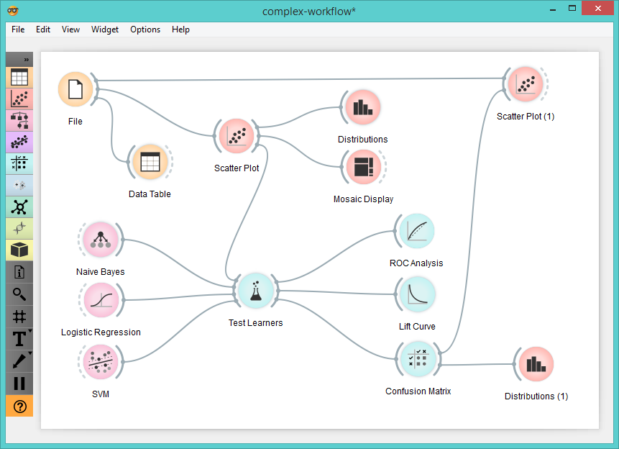
Intuitive data mining interface familiar to all data miners

Slide 9
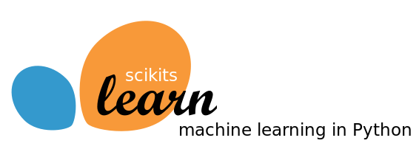

One of the most popular machine learning libraries for Python
Easy to use
Easy to interface with existing models
Cool visuals

Slide 10
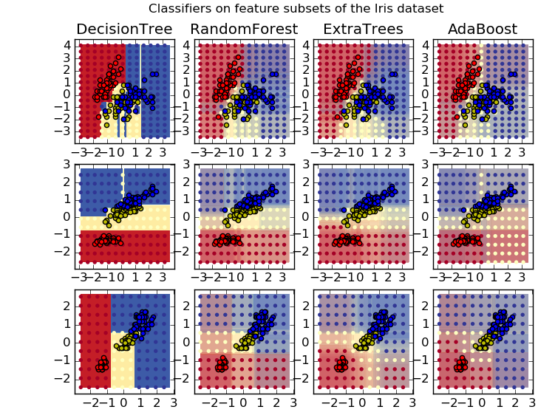
Classification: Decision Surfaces

Slide 11
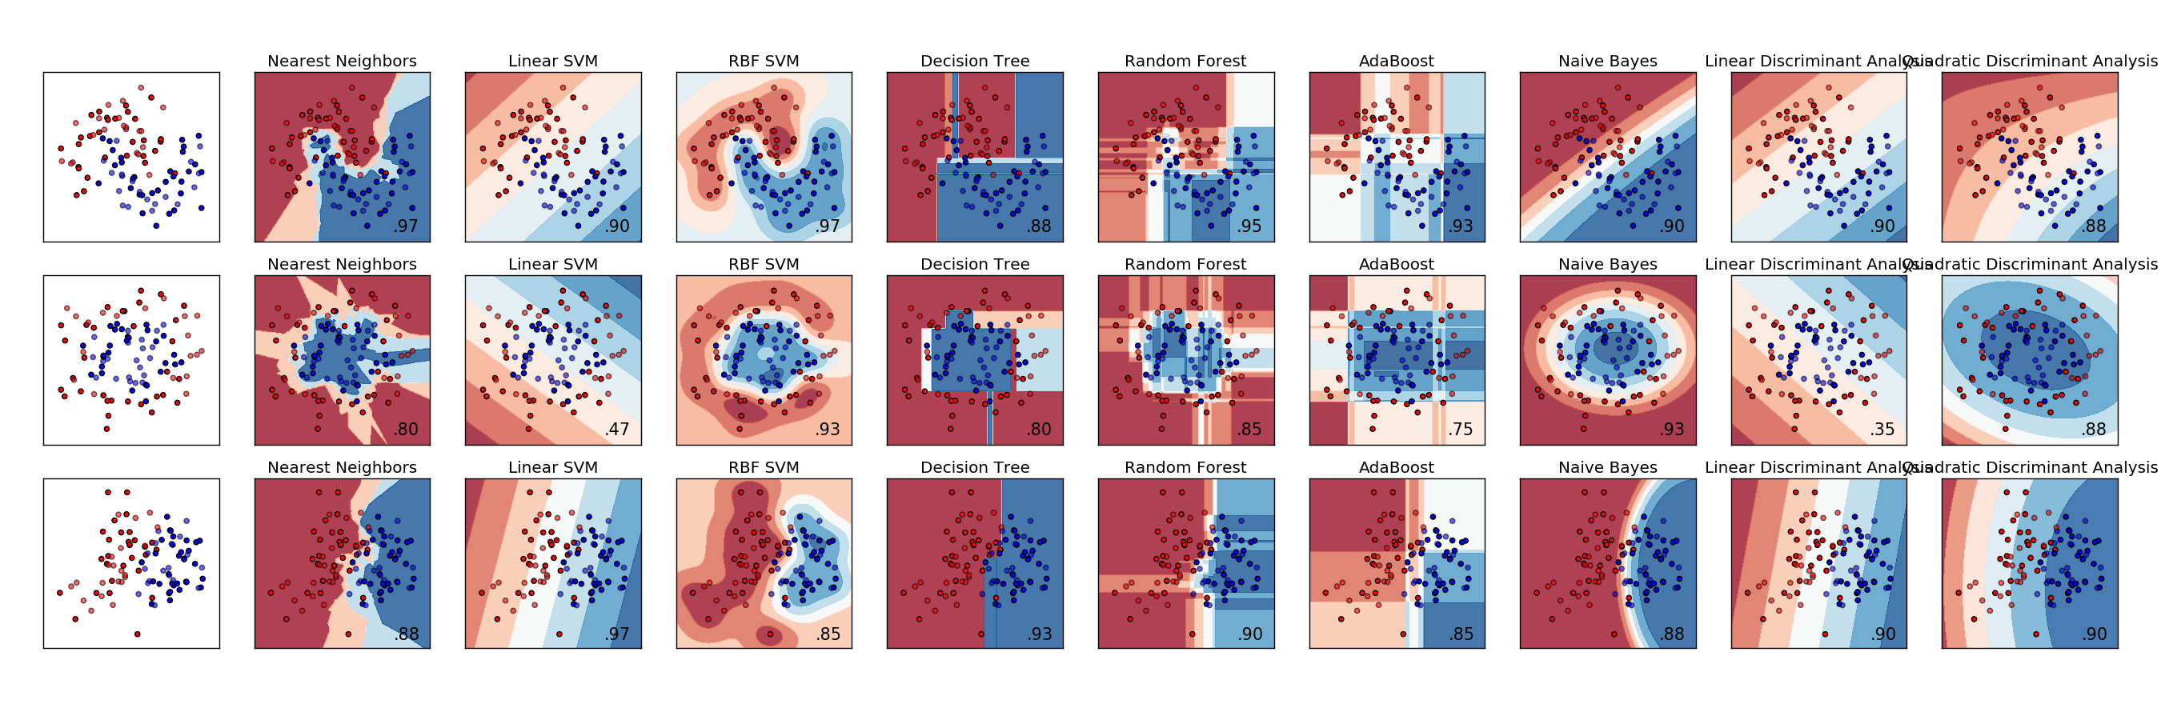

Classification: comparison
Compare a large number of classification models’ performance on your data at a high-level!

Slide 12
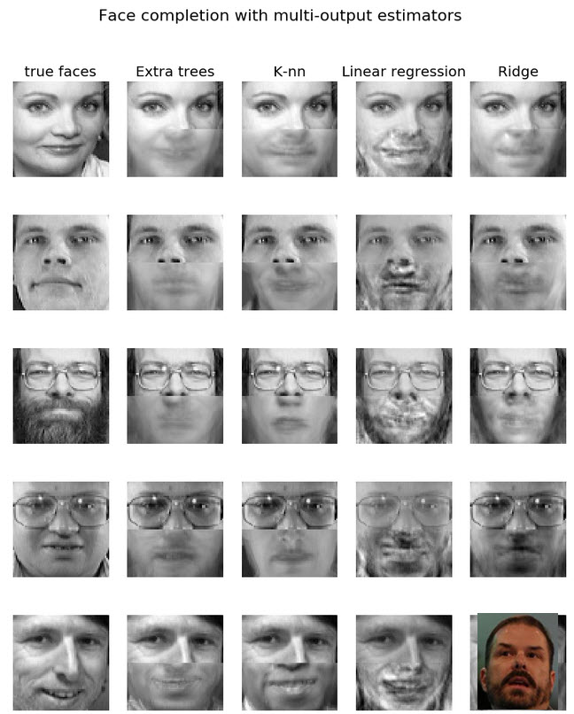
Prediction: learning from data
The poor performance from the linear regression is because classification for image data is based on a non-linear hypothesis, which is not handled well by linear models.

Slide 13
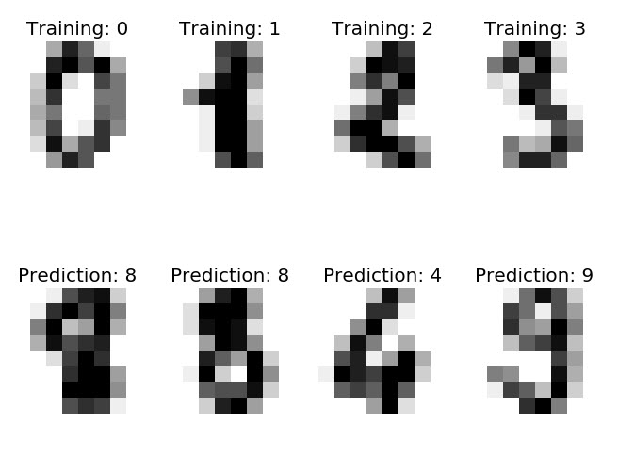
Patterns: picture data

Slide 14
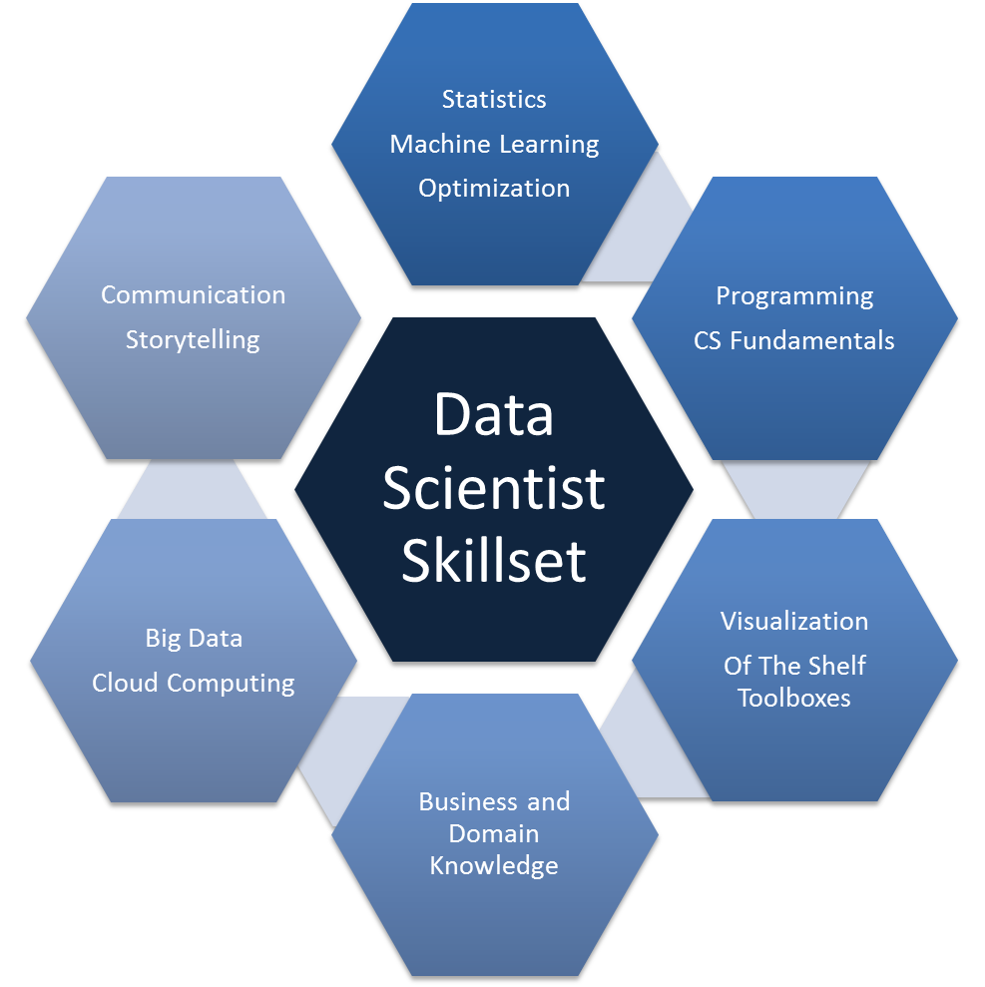
Where to Begin?
Teach yourself:
  Computer Science
  Statistics
  Numerical Methods
  Linear Algebra
  Python Programming
  Data Analysis
Train monkeys to joust
Profit!

Slide 15

Motivation
Valued skill set
Complex and challenging
Fun!
Competitive salary
“If it don’t make dollaz, it don’t make sense.” ~DJ Quik

Slide 16
Learning Resources
CIS445
Courses on Edx and Coursera
Resources on Standford Online and MIT Open Courseware
Programs on Udacity

Slide 17

Conclusion
Once you learn how to use Python for machine learning, the world is yours.

Slide 18

Sources
https://www.python.org/doc/essays/blurb/
https://www.continuum.io/why-anaconda
http://jupyter.org/
https://en.wikipedia.org/wiki/Spyder_%28software%29
https://en.wikipedia.org/wiki/Orange_%28software%29
http://scikit-learn.org/stable/auto_examples/index.html
https://www.coursera.org/
https://www.edx.org/
https://www.udacity.com/
http://ocw.mit.edu/index.htm
http://stackoverflow.com/research/developer-survey-2015

