Slide 1
Bootstrap
Nathan Naylor

Slide 2
Background
Developed by Twitter
Project exploded a few months in
Released August 19, 2011
Latest Version (v3) mobile first

Slide 3
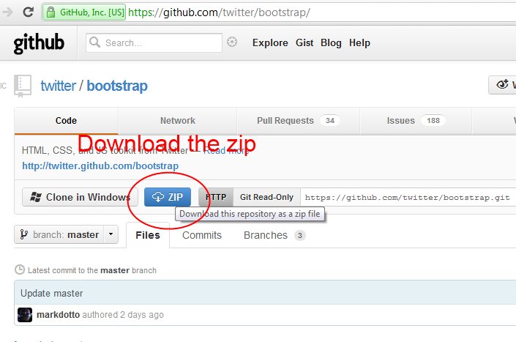
To Get Started

Slide 4
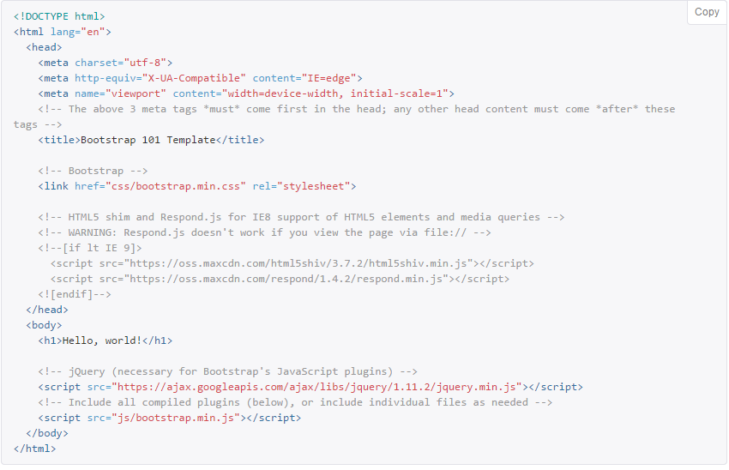
To Get Started (cont)

Slide 5

Why Bootstrap?
Outstanding Support
Development Time
Consistency

Slide 6
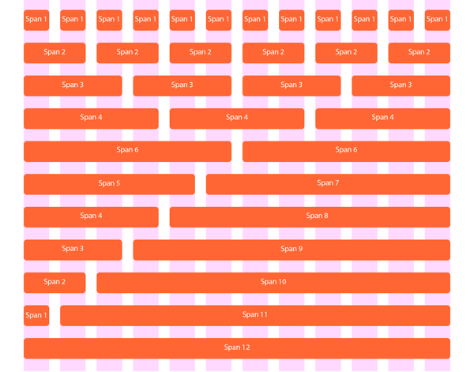
The Grid

Slide 7
The Grid

Slide 8
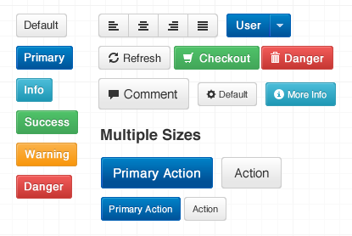
Base Styling
Provides base styling for some elements
Pre styled components
Allows for easy customization

Slide 9
Base Styling
Provides base styling for some elements
Pre styled components
Allows for easy customization

Slide 10
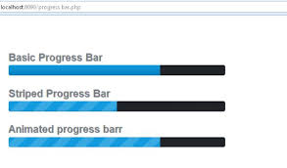
JavaScript
Bundled plugins
Interactive

Slide 11
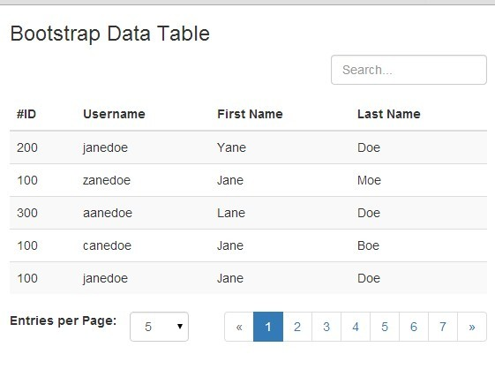
JavaScript
Bundled plugins
Interactive

Slide 12
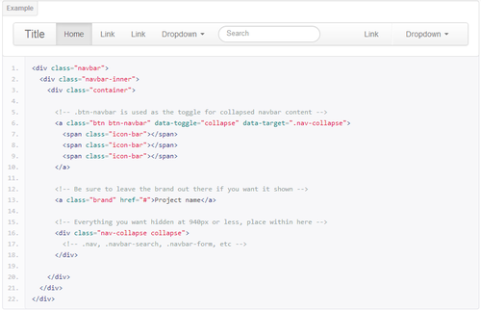
Development Time
You don’t have to write everything from scratch

Slide 13
Development Time
You don’t have to write everything from scratch

Slide 14
CSS & Less
Uses Less
Comes with its own stylesheets

Slide 15
Bootstrap vs Foundation
Calculating Typography
  Pixels vs Rems
Foundation has built in form validation
Bootstrap is more efficient, but not as pretty

Slide 16
Bootstrap vs Foundation (cont)
Browser Support
  Foundation: IE8
Community
  Bootstrap

Slide 17
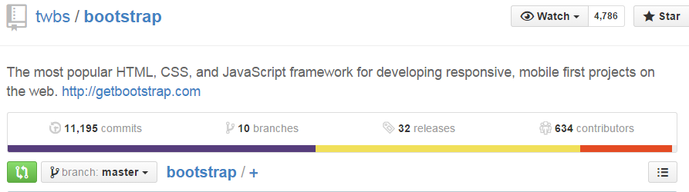
Support

Slide 18
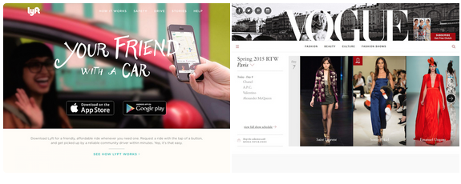
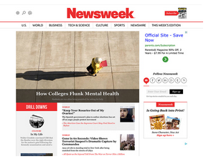

Bootstrap Sites

Slide 19

Sources
https://bootstrapbay.com/blog/reasons-to-use-bootstrap/
https://www.ostraining.com/blog/coding/bootstrap/
https://bootstrapbay.com/blog/bootstrap-vs-foundation/

