Slide 1

Internet of Things
Michael Opper Moser

Slide 2
What is IoT?
Technically, any object that interacts with a network. That’s a lot of stuff.
Estimated to top out at 50 to 100 TRILLION objects
2019: on track for 9.1 Billion devices
Used in manufacturing, infrastructure maintenance, healthcare, transportation, energy management

Slide 3
History of IoT
1982: Carnegie Mellon modifies a Coke machine
1991: Mark Weiser writes “Ubiquitous Computing”
1994: Novel publishes NEST - Novell Embedded Systems Technology
1999: MIT develops RFID tagging for inventory control

Slide 4
Thank You, IPv6
Makes IoT possible
IPv4 = 2³² address, IPv6 = 2¹²⁸
  That’s 340 undecillion more addresses.
Neighbor Discovery Protocol
IPSec

Slide 5
Core Technologies
RFID and near-field communications
Bluetooth (low energy)
6LowPAN (low energy Wi-Fi)
ZigBee
WiFi-Direct

Slide 6
Programming IoT
No real contender for top language.
C is very low level and efficient.
Java is multi-platform. Lots of Programmers thanks to students.
Go, by Google, multi-channel for input/output and processing
Rust, by Mozilla, some improvements over go to eliminate “race conditions”

Slide 7
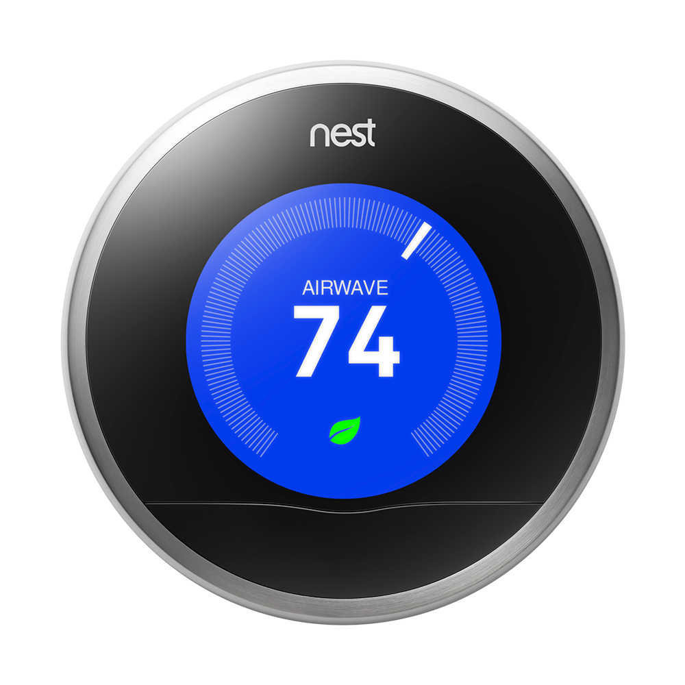
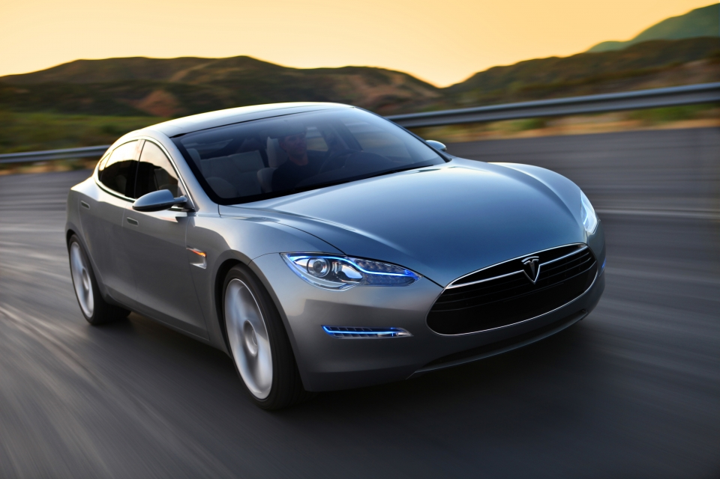
Stuff You Can Buy
Philips Hue — lighting management
Nest — HVAC management
Tesla automobiles — only car on the market with auto-updates.

Slide 8

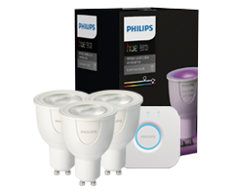
Phillips Hue
“Personal Wireless Lighting” solution
Remote controlled lighting for your home
Wirelessly networked

Slide 9
The Hue System
Three part system:
  Bridge: controls up to 50 bulbs and 12 accessories
  Bulbs: E26 for white light, A19 for 16 million colors (including white)
  Apps: iOS, web, and android
Has accessories like wall-mounted dimmers and light strips

Slide 10
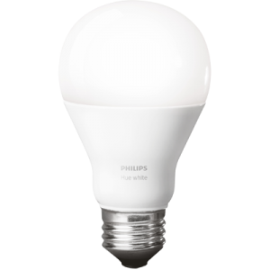
Smart Light Bulbs
Wirelessly communicate with Bridge using ZigBee protocol
Controlled via apps, turn your lights on and forget about them
Can produce 16 million colors
25,000 hour life
Dimmable

Slide 11
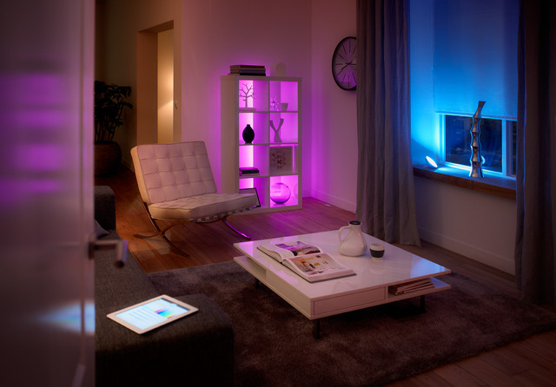
Fun & Cool Stuff
Sync ambient lighting to movies
Designed to work with Nest Learning Thermostat
Wake up to a
  simulated
  sunrise
  every morning

Slide 12
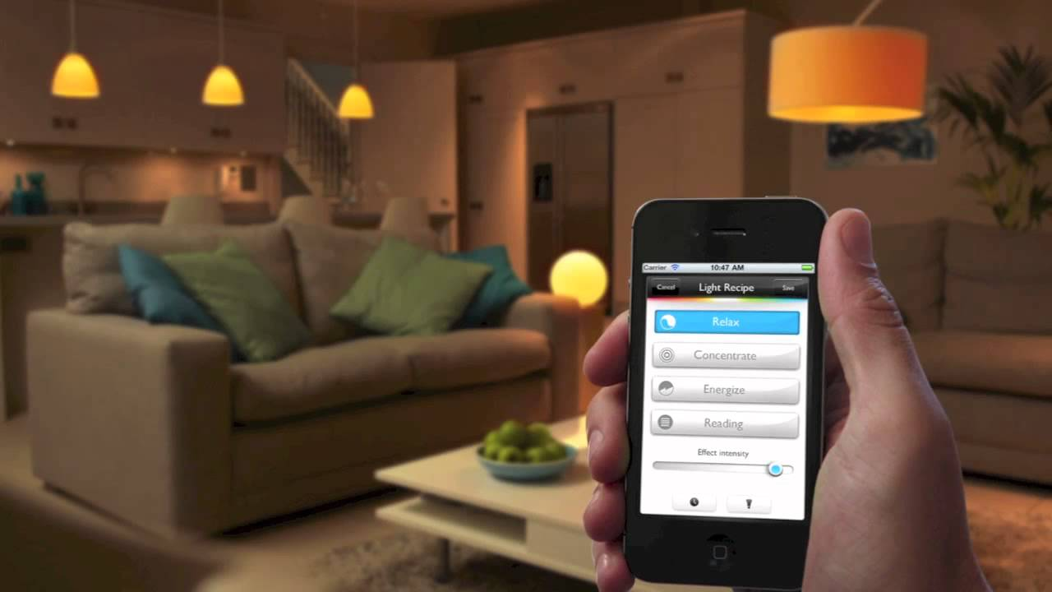
Mobile Apps
Control your lights from your device.
Used to dim lights
Set schedules
Siri Integration through Apple HomeKit

Slide 13
Money Saving
In theory
Smart Energy systems are growing in popularity
Automate when lights go on/off
Energy saving settings
Remote control and override

Slide 14
Hue Applications
Has apps for iOS, Android, and a web portal.
Integrated with Nest and Apple HomeKit.

Slide 15
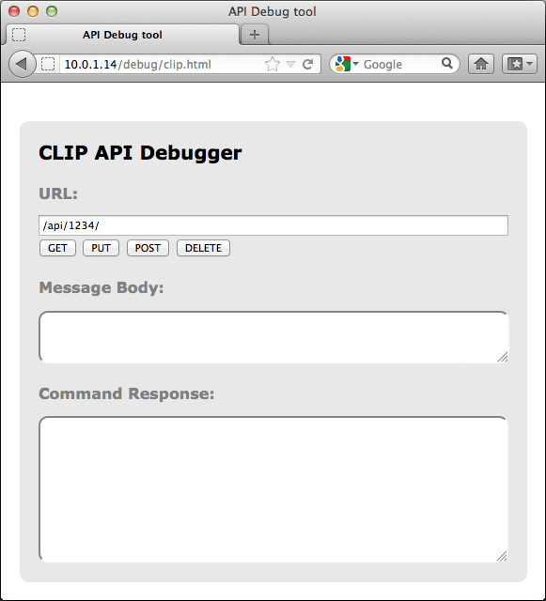
Hue API
Available for free
Locally cached
SDKs available for iOS, OS X, Java, and Android.
CLIP app used for debugging

Slide 16
Developing for Hue
Full documentation at http://www.developers.meethue.com/
RESTful
Uses JSON to reply to devices
Commands are simple: URL + Body + Method

Slide 17
Nice Salary Required
Assume 20 light bulbs for an apartment or small house if you replace everything.
Starter “Philips Hue white and color 9W A19 starter kit” $199.95 (3 bulbs + bridge)
5 A19 Bulbs for living room/office/bedroom @ 59.95 = $300
12 E26 white light bulbs @ 14.95 = $150
Total for basic system: $680

Slide 18
Review
Internet of Things is everything that interacts with a network
9.1 billion devices by 2019
In almost every industry
Learn C for development jobs
Philips Hue is AWESOME but pricey
Developing for Hue is easy because of API

Slide 19

Sources
https://en.wikipedia.org/wiki/Internet_of_Things
http://www.itu.int/ITU-T/recommendations/rec.aspx?rec=y.2060
http://www.eetimes.com/document.asp?doc_id=1278794
https://securityintelligence.com/the-importance-of-ipv6-and-the-internet-of-things/
http://www.informationweek.com/mobile/mobile-applications/11-iot-programming-languages-worth-knowing/d/d-id/1319375
https://en.wikipedia.org/wiki/6LoWPAN
http://www.forbes.com/sites/ibm/2016/03/01/three-trends-to-watch-in-the-internet-of-things/#7477bd69f7b4
http://www.wired.com/insights/2014/11/the-internet-of-things-bigger/
https://www.ietf.org/rfc/rfc2460.txt
http://www2.meethue.com/en-us/
http://www.developers.meethue.com/
http://www.electronichouse.com/daily/home-lighting/4-cool-things-can-philips-hue-lights/

