Slide 1

LESS
Nick Schuler

Slide 2
What’s Covered
What is LESS
Variables
Mixins
Math Operations
Notes:
Focus on benefits of LESS rather than what it does. But to show benefits, I need to do a qick explination of features

Slide 3
What is LESS?
Simply put, LESS is a CSS pre-processor
Pre-processor - a computer program that modifies data to conform with the input requirements of another program.
Notes:
Program which allows ease of use to another program
Uses easy to understand syntax, turns that into normal css

Slide 4
Variables
Stores a value
Ability to use same values
Notes:
Can use same values w/o typing in. Like hex values (@Lightblue is easier to remember than #33ADFF)

Slide 5


Pics of variables

Slide 6
How Variables are Useful
Company specifics
Uniformity
Saves time
Notes:
Specifics – type in the hex once and done
Unformity – Don’t need to worry about missing one and having it look off
Saves Time – type it once, instead of scrolling through code to find all of it

Slide 7
What about Search and Find?
Legal writing at bottom is set to 5. We need to change it to 8.
Search and replace all 5 with 8.
What about padding set to 5?
Unwanted changes.

Slide 8
Mixins
Create a class
Use that class as a base to future classes

Slide 9
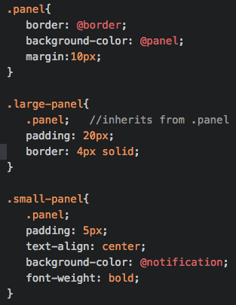

Mixin code

Slide 10
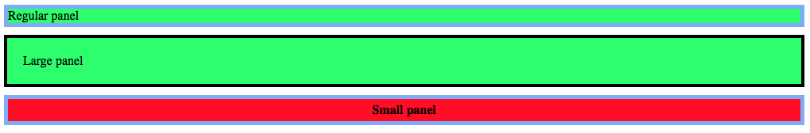
Display Mixins

Slide 11
How Mixins are Useful
Create a base class
Less typing
  Quicker coding

Slide 12

Math Operations
Ability to change values quickly
  Colors
  Fonts

Slide 13
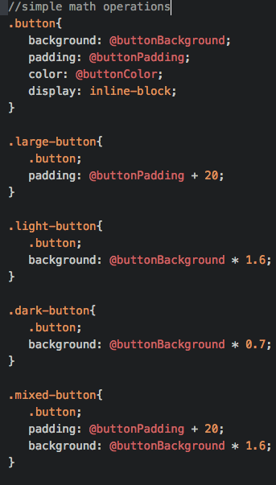
Math Operations

Slide 14
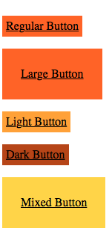
Math Operation Display

Slide 15
How Math Operations are Useful
Change color of button when hovering instead of creating whole new button
Change one value without adding whole new hex
What if they wanted to change the whole color scheme?

Slide 16
Quick Recap
Variables – change in one place rather than scrolling through code
Mixins – make one class so you don’t have to copy paste a lot
Math Operations – can change a single value using basic math rather than hard coding it

Slide 17
SORRY
LESS truly is more…
  (sorry)
  (sorry)
I had to…
  (sorry)

Slide 18
Need Help?
LESS Website:
  http://lesscss.org
GitHub:
  https://github.com/less

Slide 19
Sources
http://designshack.net/articles/css/using-less-js-to-simplify-your-css3/
https://www.youtube.com/watch?v=_bNhGbUSYy8&index=3&list=PL6gx4Cwl9DGCshbAx1JpBtNoKh8iKAAiy

