Slide 1

Chris Jones

Slide 2
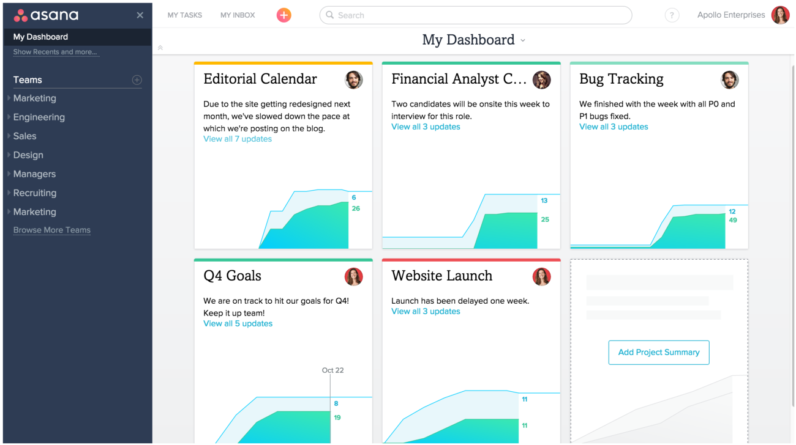
A better way to manage your projects!

Slide 3
Easy to add multiple tasks
Simply click the end of an existing task and add a new task
After you create and item, just press “Enter” to create another!

Slide 4
Subtasks
Easily create subtasks
Assign and set priorities

Slide 5
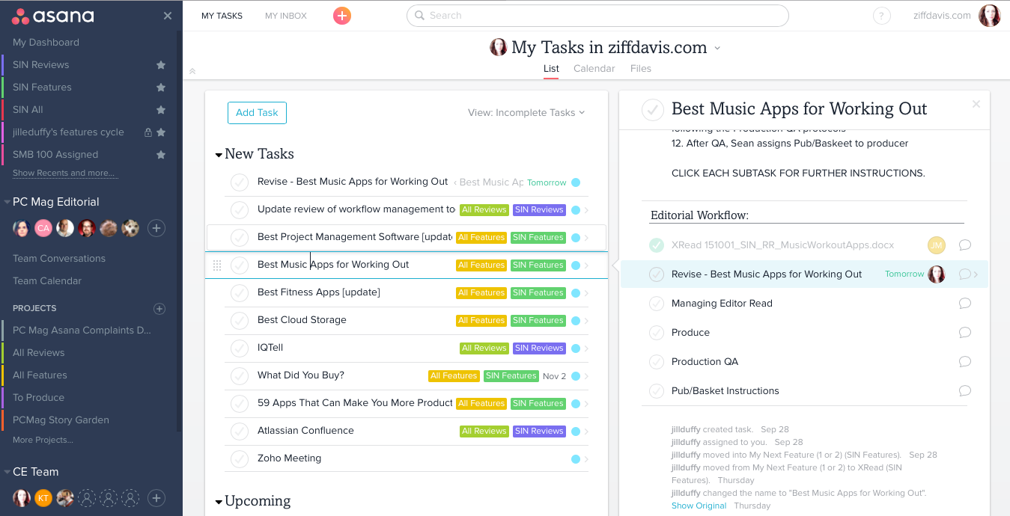

Slide 6
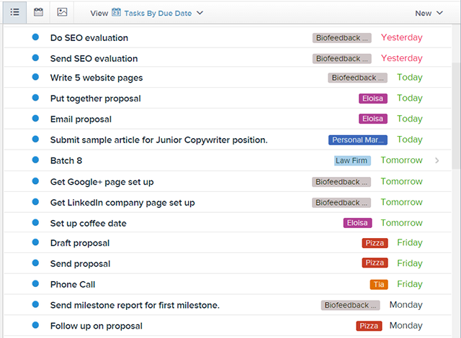

Slide 7
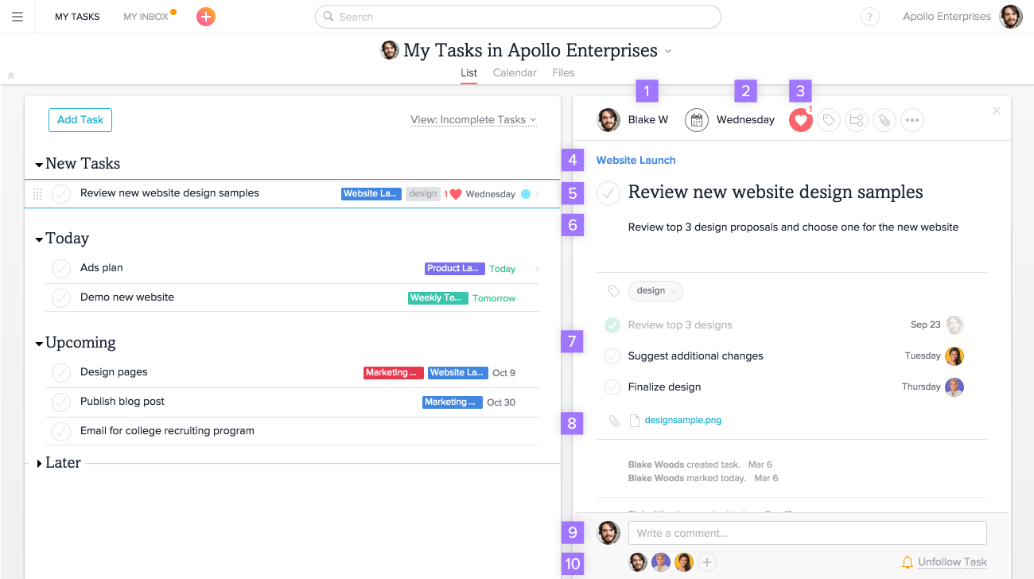

Slide 8
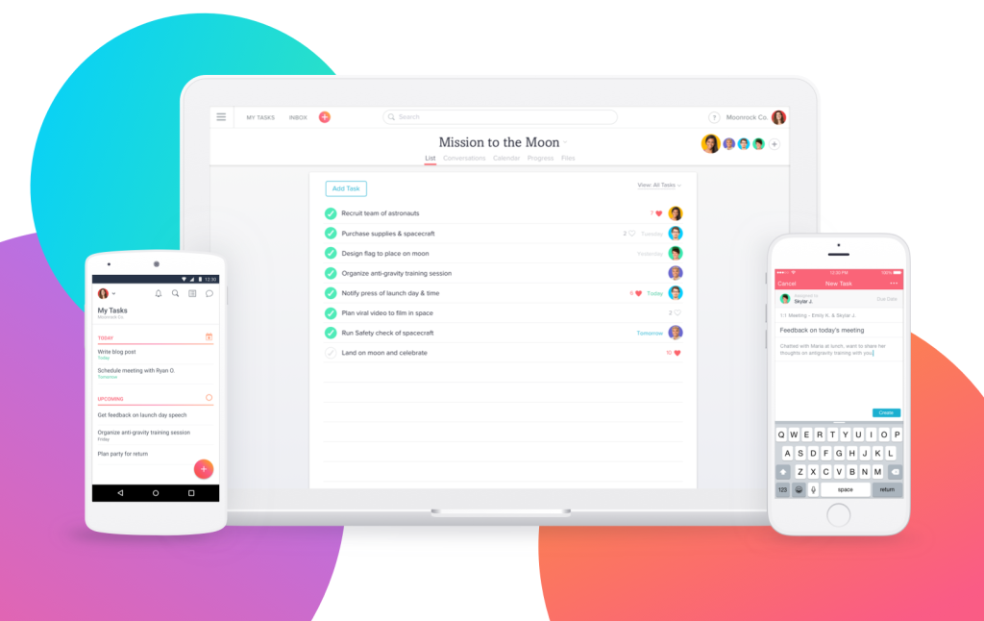
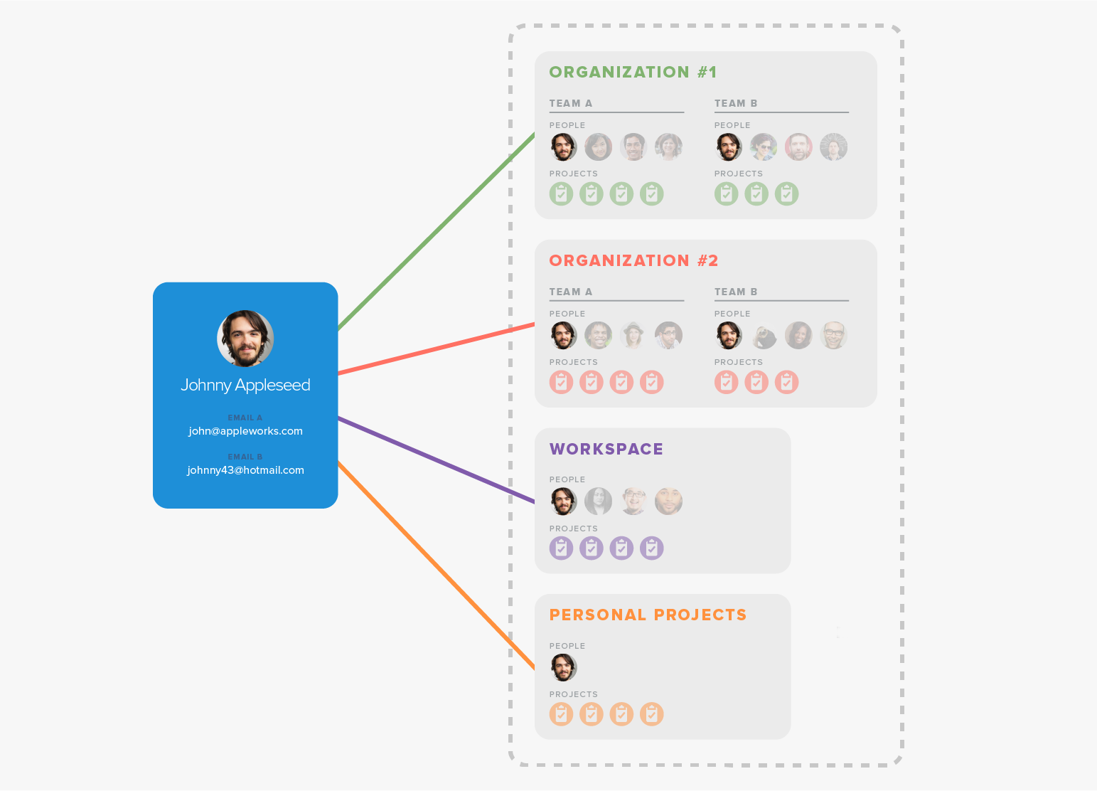

Slide 9


Slide 10
Asana API
RESTful interface (representational state transfer)
  Easily accessible
  Accepts and returns JSON

Slide 11
OAuth 2.0
A mechanism for applications to access the Asana API on behalf of a user without the application having access to the username and password
Instead apps get a token which they can use with their own application credential's to make API calls

Slide 12




Integrations!

Slide 13
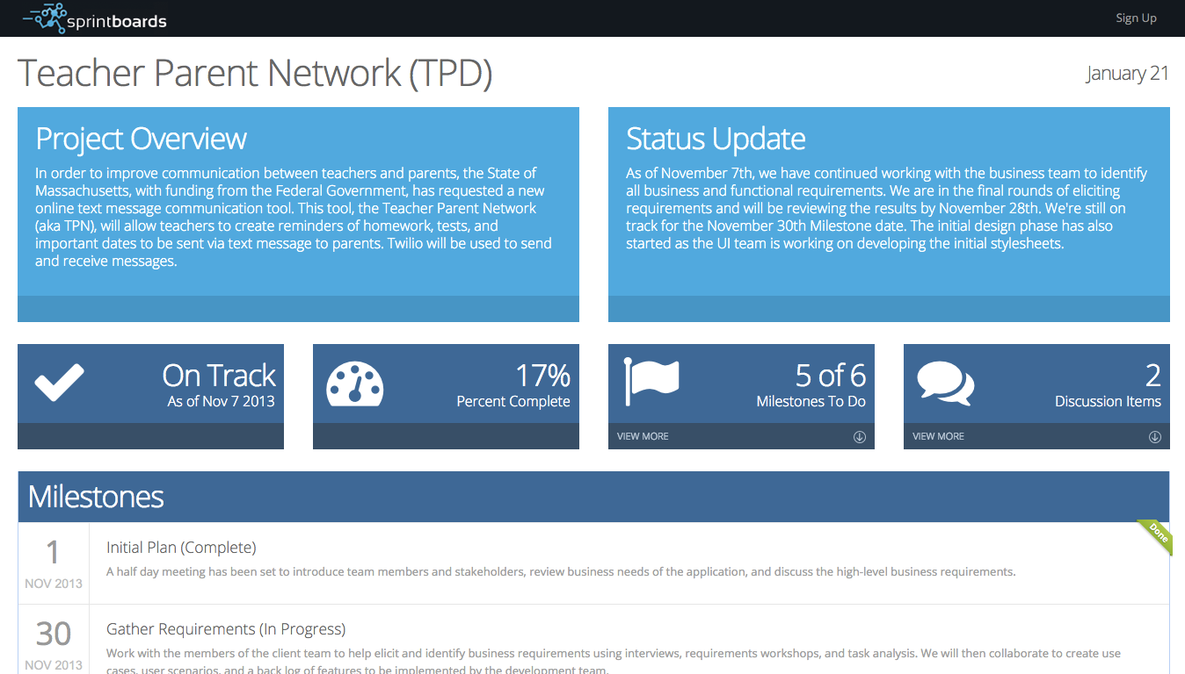

Slide 14
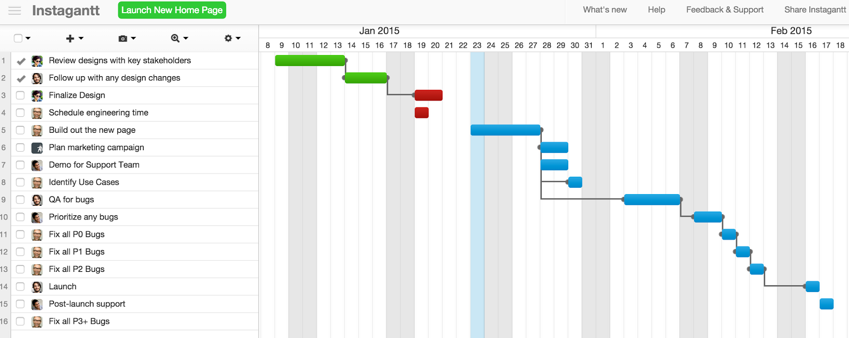

Slide 15
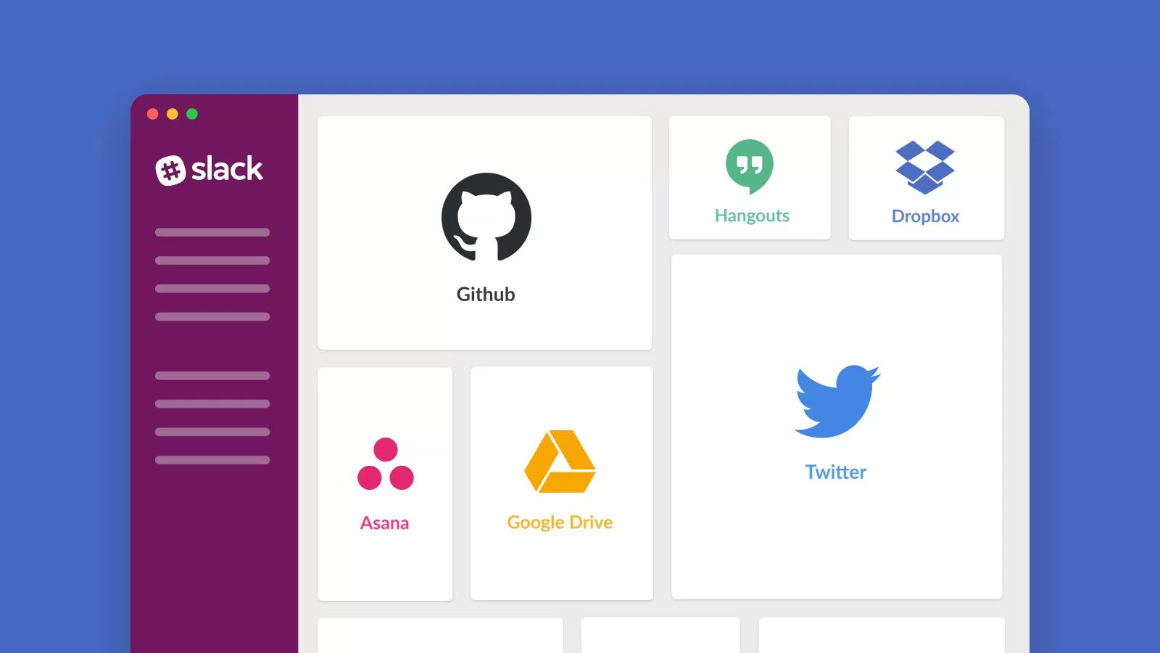
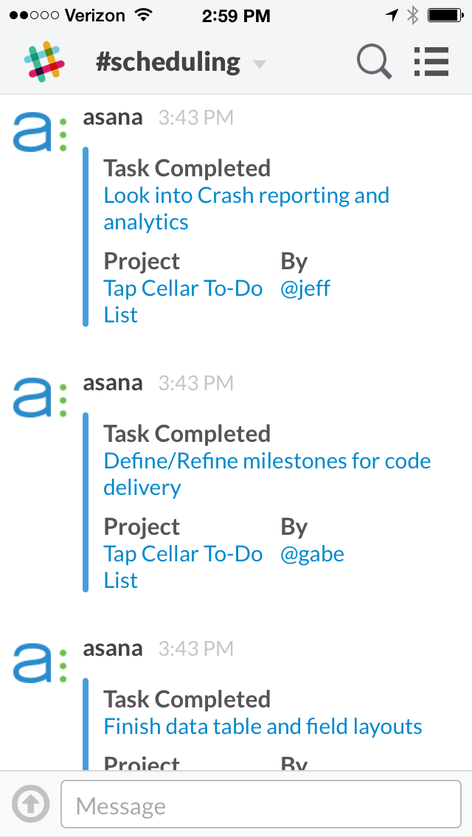
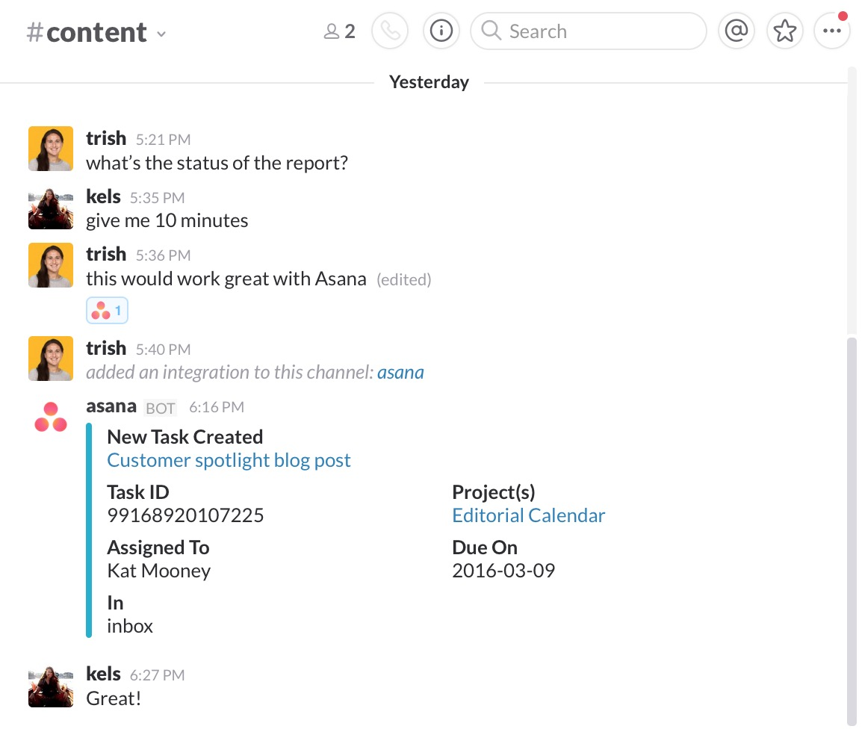

Slide 16
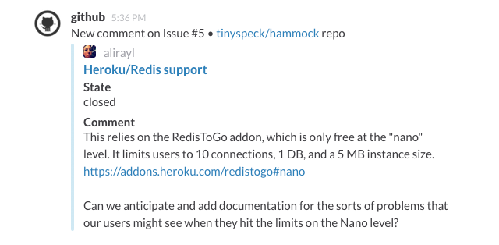
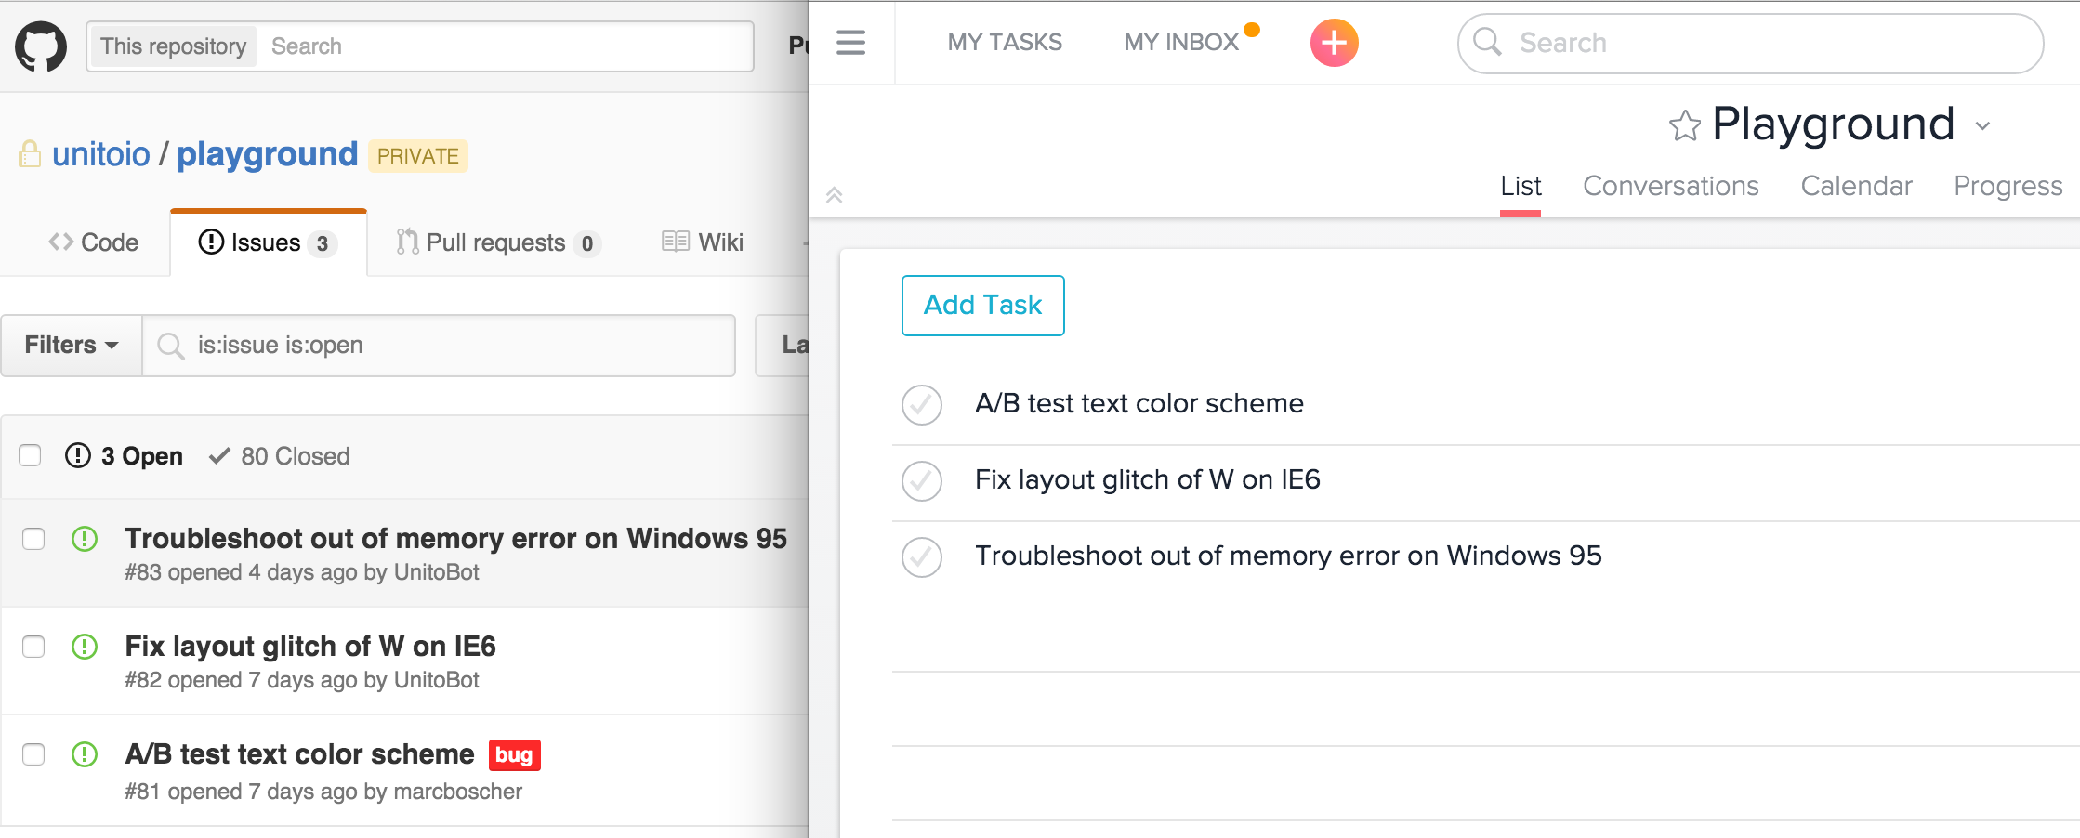

Slide 17
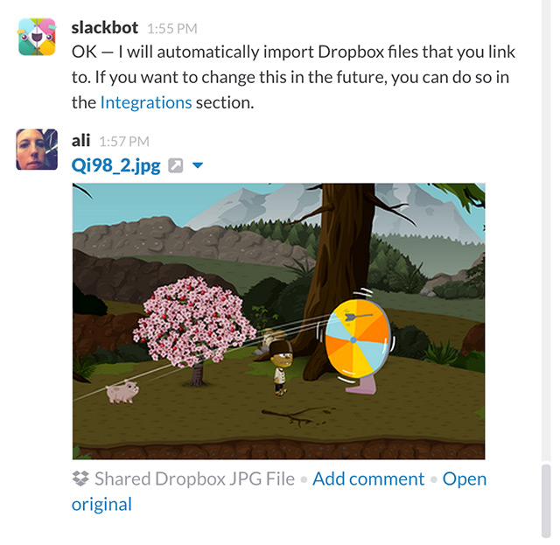
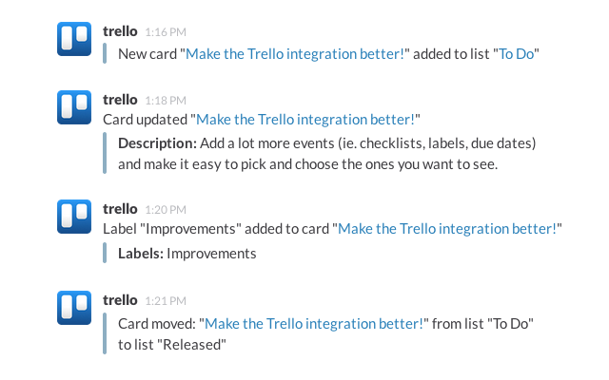

Slide 18
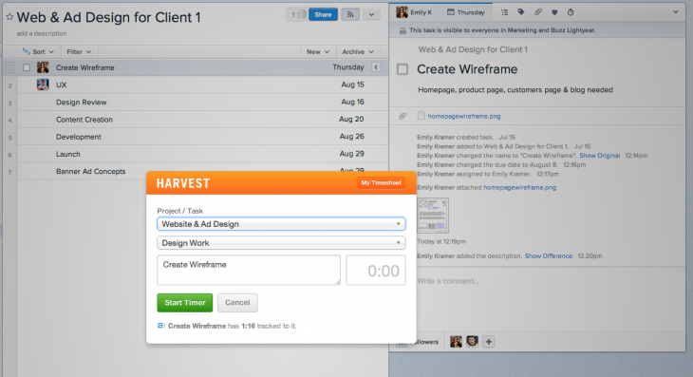
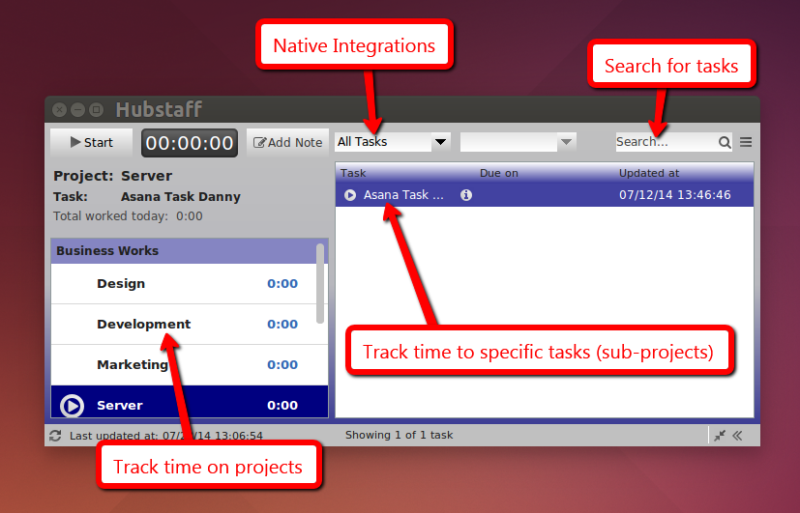

Slide 19

Sources (list them)
https://asana.com/
http://wpcurve.com/slack-integrations/
http://rampview.com/asana-for-amazing-personal-productivity

