Slide 1
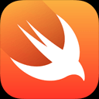
To Swift or Not to Swift
Paige Fenwick

Slide 2
Outline
What is Swift?
  Background and basic overview
Why should you learn Swift?
  Advantages
  Recent changes
Is this the next big thing?

Slide 3
Background
Programming Language
Apple began development in 2011
Before Swift, Objective C = iOS and X OS
Designed to completely replace Objective C

Slide 4
Reasons to learn
Safety
Fast
Expressive
Major Changes
  Open Source
  Available on the Server

Slide 5
Safety
Type Safe Language
Type Inference Language

Slide 6
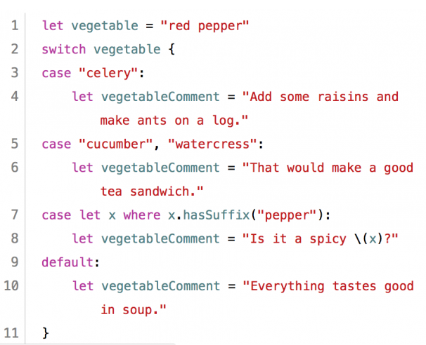
Safety

Slide 7
Fast
Directly compatible with C languages
  Therefore, comparable performance
Predictable and consistent performance

Slide 8
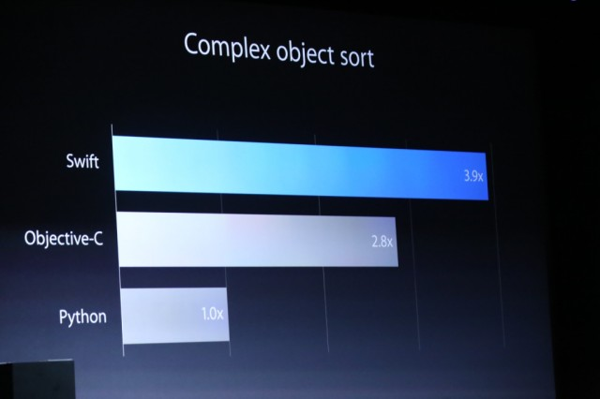
Fast

Slide 9
Expressive
Easy to read and write code
Modernized Objective C
  Syntax of C languages
  Modern features

Slide 10
Open Sourced
Announced in December, 2015
Hosted on GitHub
Anyone is allowed to submit code to project
Developers find the language more trustworthy now

Slide 11
Open Sourced
Communities are being established
Huge developments have come from this
  Server Side Support
  Swift 2

Slide 12
Server
Support cross platform development
Bringing Swift Server Side
Use same language for client and server side development
Use same tools for debugging

Slide 13
Server
Perfect.org
Reduce time and learning curve for developers
Main goal = same language across application ecosystem
Want to expand across all platforms for one native language

Slide 14
Next Big Thing?
All of the benefits of Objective C plus added functionality
Most popular language on GitHub
  Most starred, most forked, etc.
Being featured at the latest conferences

Slide 15
Next Big Thing?
Swift 2 recently released
  Error handling
  Availability
  Syntax Improvements

Slide 16
Should You Learn This?
Yes!

Slide 17

Sources (list them)
http://www.infoq.com/presentations/swift-server
http://www.infoq.com/presentations/swift-open-source
https://swift.org/about/#swiftorg-and-open-source
https://developer.apple.com/swift/
http://magenic.com/Blog/Post/17/The-history-and-future-of-Swift-Analysis-of-Apple%E2%80%99s-new-programming-language-from-an-enterprise-IT-perspective

