Slide 1
Flexbox
Alicia Frizzell

Slide 2

What is Flexbox?
The Flexbox Layout, also known as Flexible Box, is meant to lay out items within a container in a more efficient way

Slide 3

Flexbox
A flexbox layout can be maintained even when the items may be dynamic...
Hence the term “flex”

Slide 4

Why use it?
It makes CSS easier
These flexible boxes are most useful when implemented with a smaller layout whereas grids are used for larger layouts

Slide 5

Responsive Design
With the push of responsive design, it is necessary to create a layout that can accommodate different devices and screen sizes

Slide 6

With flexbox, the container has the ability to alter the size of its items in order to fill the available real estate
Making it very flexible…

Slide 7
Properties of Flexbox
Flexbox is a module. It has its own set of properties
These properties are applied to:
    Flex container
    Flex items

Slide 8
Container Properties
Display: defines the flex container
Flex-direction: establishes the main axis and direction which items are placed in the container

Slide 9
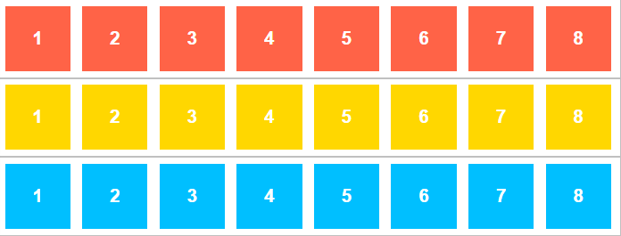
Flex-wrap: allows items to wrap and determines the direction of the wrap

Slide 10
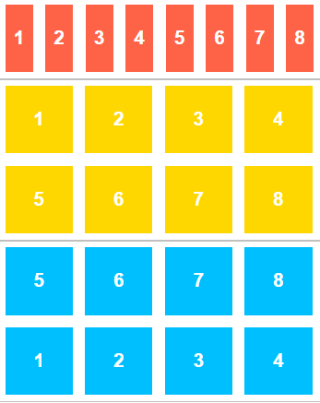
no-wrap →
wrap →
wrap-reverse →

Slide 11
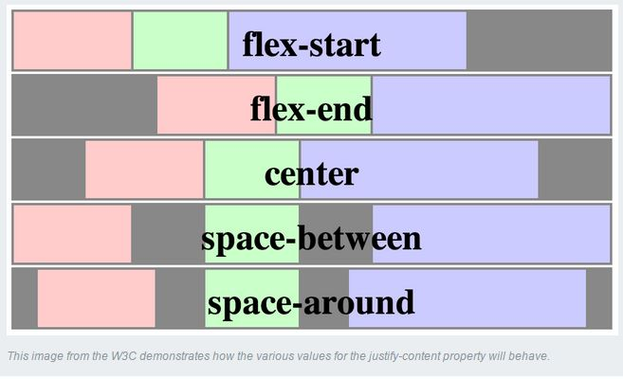
Justify-content: defines the alignments along the main axis

Slide 12
Align-items:
Flex-start, flex-end, center, baseline, stretch
Align-content:
Flex-start, flex-end, center, space-between, space-around, stretch
Flex-flow: shorthand for flex-direction and flex-wrap

Slide 13
Item Properties
Order: Flex items are automatically structured in source order. This property can change the order in which items appear in the container
We will look at an example using this property later

Slide 14
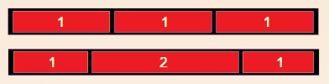
Flex-grow: This property allows items to grow. The item is given a number that represents a proportion of the available space
The item with flex-grow set to 2 will take up twice the space as those set to one

Slide 15
Flex-shrink: allows items to shrink
Flex-basis: defines the default size before distributing space among the items
Align-self
Flex: shorthand for flex-grow, flex-shrink, and flex-basis

Slide 16
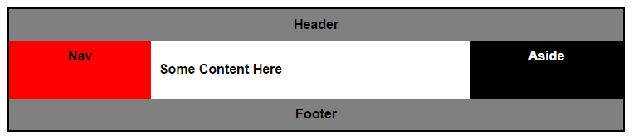
Let’s See an Example
display: flex;
flex-flow: row wrap;
@media all and (min-width: 800px) {
.main { flex: 3 0px; }
.aside-1 { order: 1; }
.main { order: 2; }
.aside-2 { order: 3; }
.footer { order: 4; }}

Slide 17
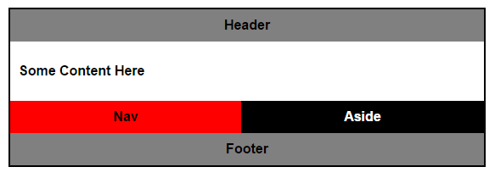
Let’s resize even more!

Slide 18
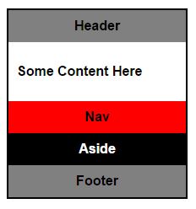
Go try out flexbox and see how you like it !

Slide 19

Sources
http://www.google.com
https://css-tricks.com/snippets/css/a-guide-to-flexbox/
https://developer.mozilla.org/en-US/docs/Web/Guide/CSS/Flexible_boxes
http://learnlayout.com/flexbox.html
http://www.sketchingwithcss.com/samplechapter/cheatsheet.html
http://blog.teamtreehouse.com/flexbox-next-generation-css-layout-arrived

