Slide 1
Don’t XSSpose Yourself by: David Satterly

Slide 2
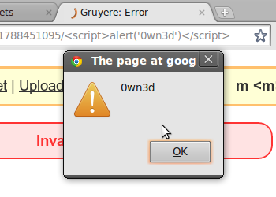
The Basics

Slide 3
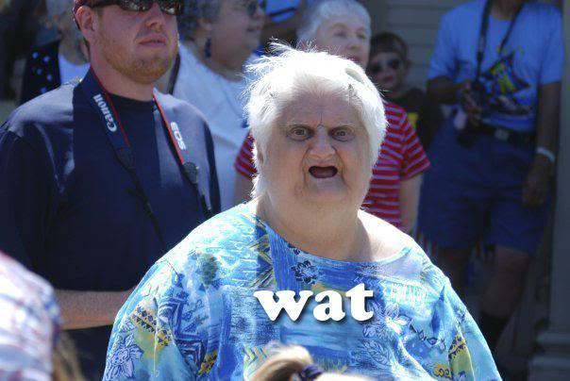
XSS
a type of injection, in which malicious scripts are injected into otherwise benign and trusted web sites. XSS attacks occur when an attacker uses a web application to send malicious code to a different end user.

Slide 4
How am I XSSposed?
Occurs when:
  1. Data enters a Web application through an untrusted source, most frequently a web request.

Slide 5
How am I XSSposed?
  2. The data is included in dynamic content that is sent to a web user without being validated for malicious content.

Slide 6
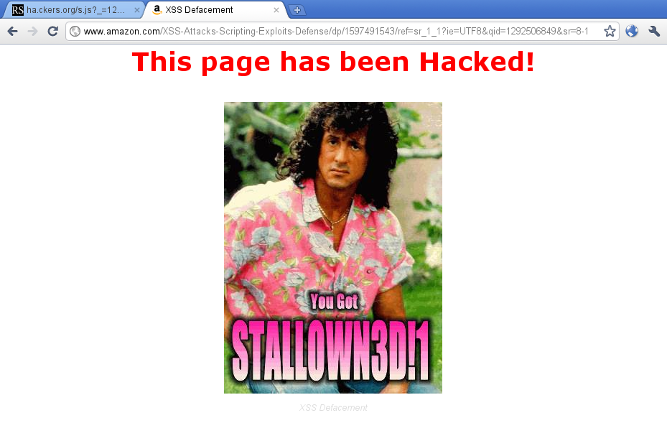
Why XSS?
Defacement

Slide 7
Why XSS?
Cookie stealing and session hijacking
  grab sensitive information
  session hijacking, which in turn can lead to elevated privileges on the system.

Slide 8
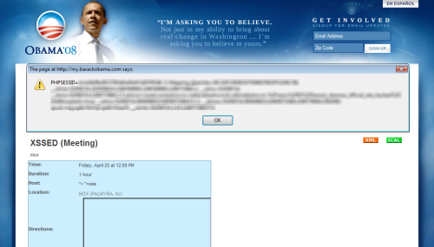
It Happens
An attacker managed to find a XSS vulnerability in barackobama.com. The payload involved redirecting all visitors to hilaryclinton.com

Slide 9

How
Let’s assume we have a jr. developer’s code
  They are not using proper input sanitization for javascript.

Slide 10
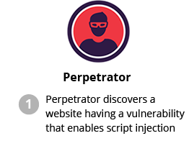

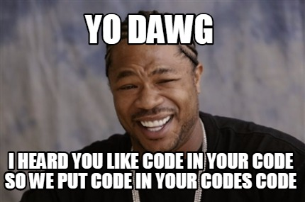
Step 1

Slide 11
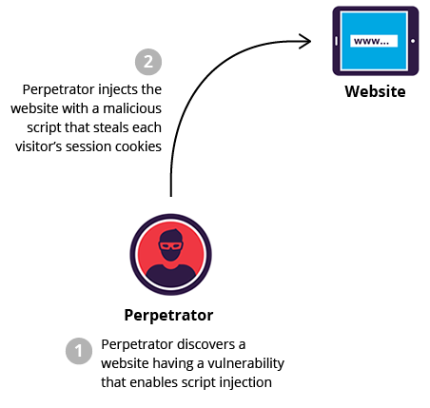
Step 2

Slide 12
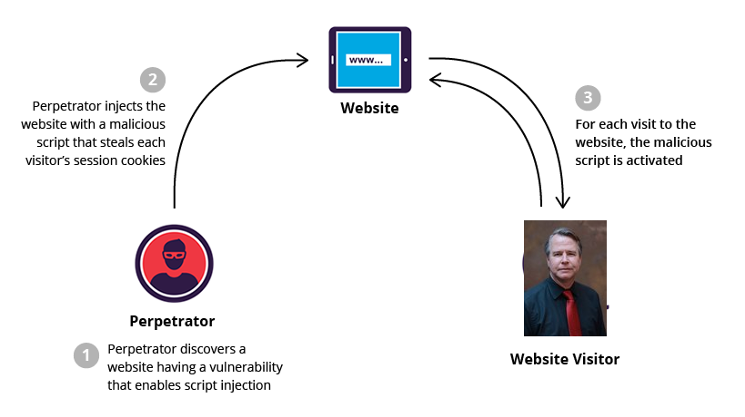
Step 3

Slide 13
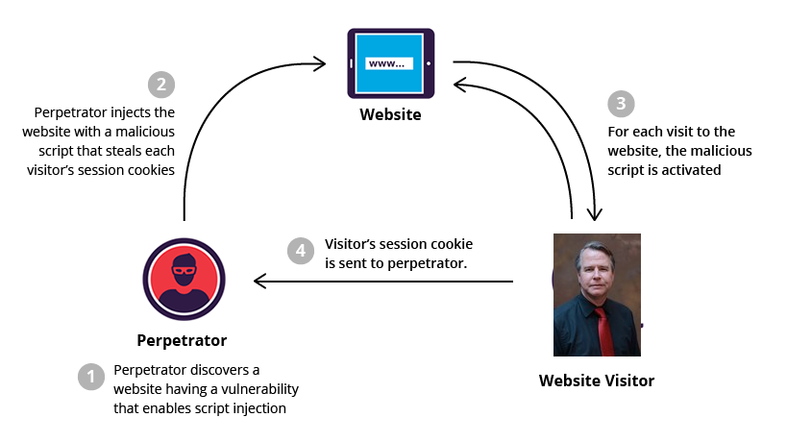
Step 4

Slide 14
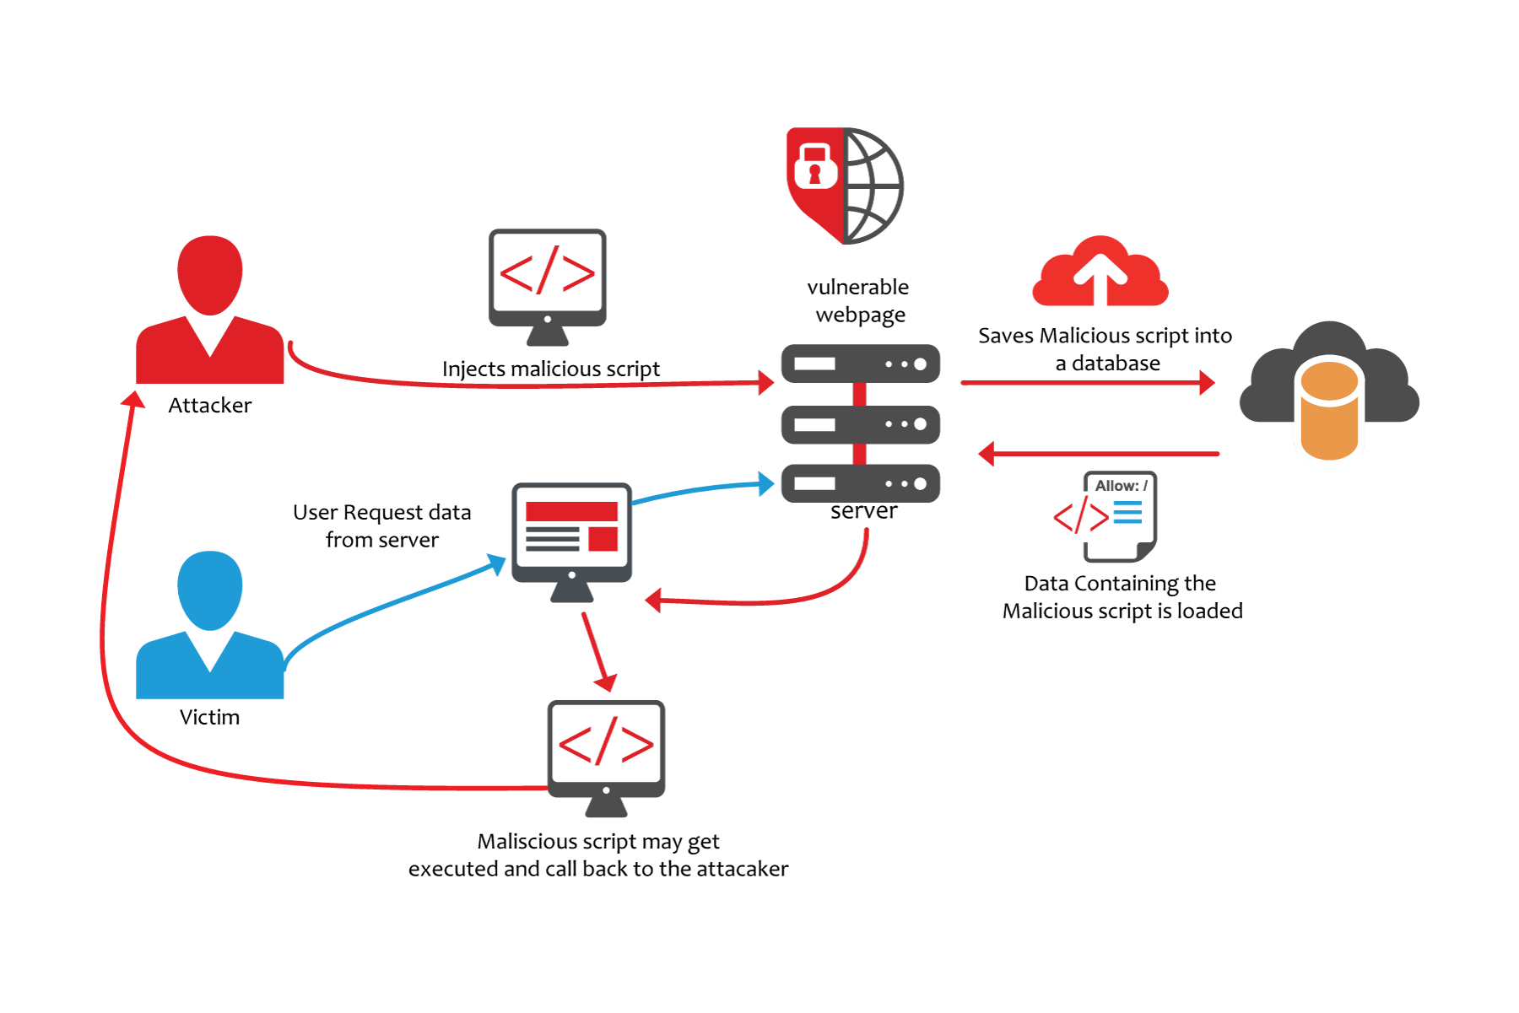
Big Picture

Slide 15

Protect yourself
Encode output based on input parameters for special characters

Slide 16

Protect yourself
Filter input parameters for special characters
  works by removing some or all special characters from your input. Special characters are characters that enable script to be generated within an HTML stream.

Slide 17
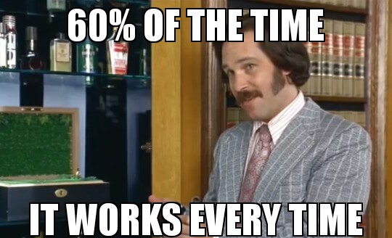
Protect yourself
Use code scanners to help sanitize data.
  Nessus
  Grabber
  Vega

Slide 18

Sources
http://www.google.com
https://www.owasp.org/index.php/Cross-site_Scripting_(XSS)
http://www.securesolutions.no/xss-explained/
https://support.microsoft.com/en-us/kb/252985

