Slide 1
WebGL
By: Chris Steinkamp

Slide 2
What is WebGL?
(Web Graphics Library) is a JavaScript API for rendering interactive 3D computer graphics and 2D graphics within any compatible web browser without the use of plug-ins.

Slide 3
What is WebGL?
WebGL requires HTML5 in order to work, and isn´t supported by all browsers and operating systems right now, but is rapidly growing

Slide 4
History
Created by Vladimir Vukićević who is a software engineer at Mozilla
Created in 2006 when Vukićević demonstrated a 3D prototype using the canvas tag
The first version of WebGL was officially released in March 2011

Slide 5
Benefits?
Most people are probably thinking this is great for computer games
This is true, but it is just a small benefit
Offers the ability to:
  Create 3D models for architecture, entertainment, and art
  Has the potential to work with 3D printing in the future
Basic Example

Slide 6
Drawbacks?
Performance is not great due to the dynamic nature of JavaScript
Used by html5 only
It still needs more browser support

Slide 7
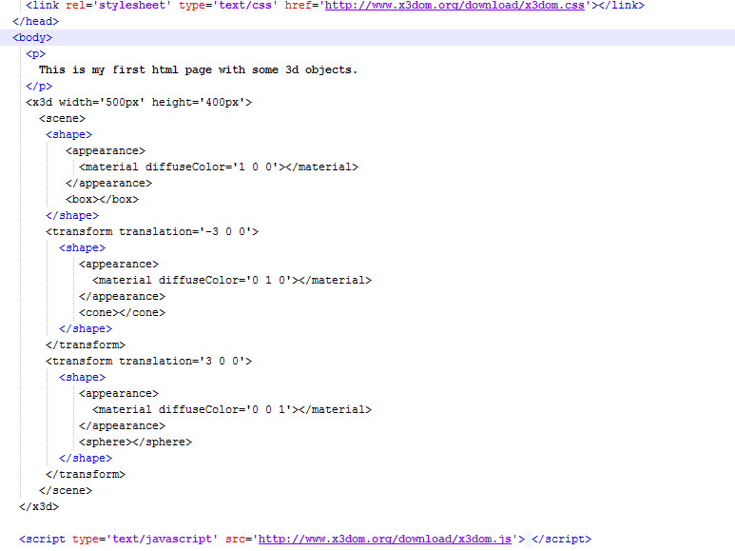
Basic Code Example

Slide 8
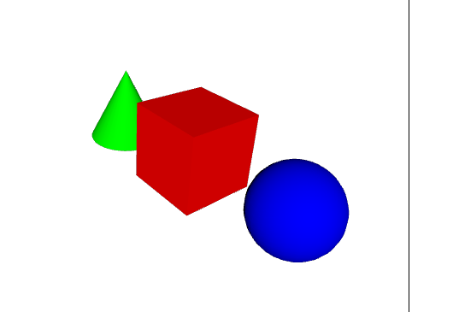
Examples
Basic Example
    http://doc.x3dom.org/tutorials/basics/hello/HelloX3DOM.html

Slide 9
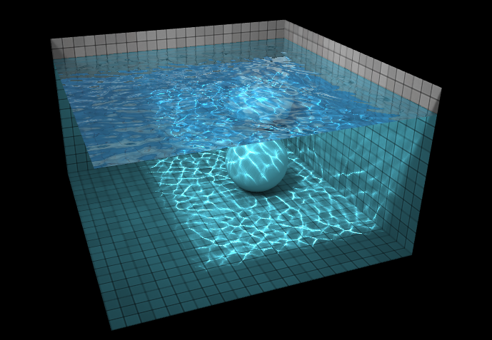
Examples
Demo
    http://madebyevan.com/webgl-water/

Slide 10
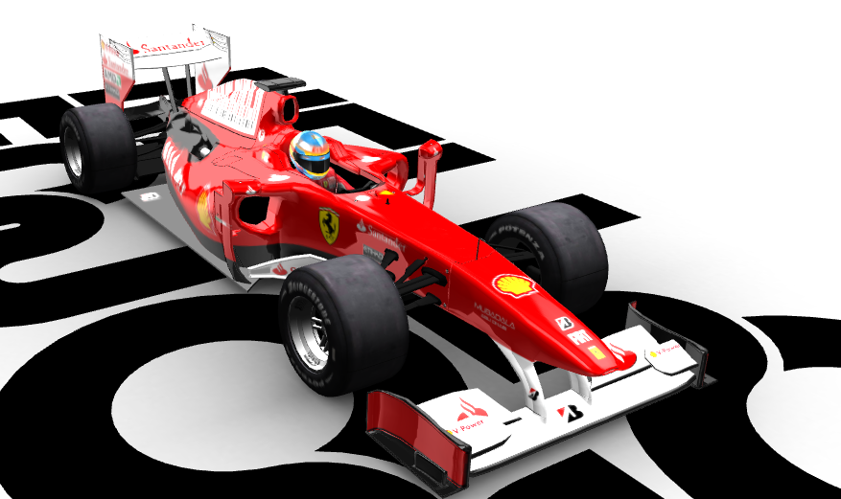
Examples
Demo (Indy Car)
    http://helloracer.com/webgl/

Slide 11
Frameworks
Most Popular Frameworks
  Three.js
  Babylon.js
WebGL is very complex to learn and understand by itself
Luckily developers have made it easier by offering frameworks to lower the complexity for less experienced developers

Slide 12
Three.js vs. Babylon.js
Three.js
  Created with one goal in mind: to take advantage of web based renderers for creating GPU enhanced 3D graphics and animations
  More broad than Babylon.js

Slide 13
Three.js vs. Babylon.js
Babylon.js
  Aimed more toward web based game development
  Originally designed as a Silverlight game engine

Slide 14
WebGL Desktop Browsers
Google Chrome 9.0 and higher
Mozilla Firefox 4.0 and higher
Safari 6.0 and higher
Opera 11 and 12
Internet Exploder 11
    Had many issues during the initial implementation
    Luckily this browser is being discontinued (finally)

Slide 15
OpenGL
OpenGL is the computer industry standard API for defining 2D and 3D graphic images
Before OpenGL, graphical applications had to be rewrite the graphics part for each operating system
Now, an application developed with OpenGL runs on each OS

Slide 16
Summary
WebGL is a great JavaScript API
It has been getting more and more attention
It is considered the “future of webpages” by some professionals

Slide 17
Summary
It currently still needs more work to be completed
There are many frameworks like Babylon.js & Three.js for it already
More and more companies are beginning to use WebGL to a certain extent

Slide 18

Sources (list them)
http://www.google.com
http://www.irrlicht3d.org/pivot/entry.php?id=1255
http://www.sitepoint.com/three-js-babylon-js-comparison-webgl-frameworks/
    http://doc.x3dom.org/tutorials/basics/hello/HelloX3DOM.html
http://examples.x3dom.org/Demos/Siena/siena.html
http://helloracer.com/webgl/
http://en.wikipedia.org/wiki/WebGL

