Slide 1
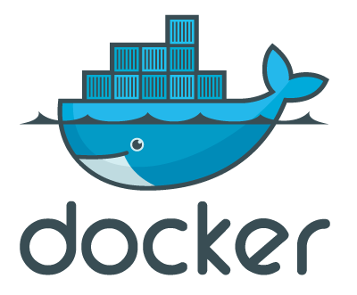
Docker
Tyler Lutz

Slide 2
What is Docker?
Software Container Technology
Created by Solomon Hykes
Started as a side project at dotCloud
Open-Source
  30,088 Stars
  1,340 Contributors
  Forked 8,501

Slide 3
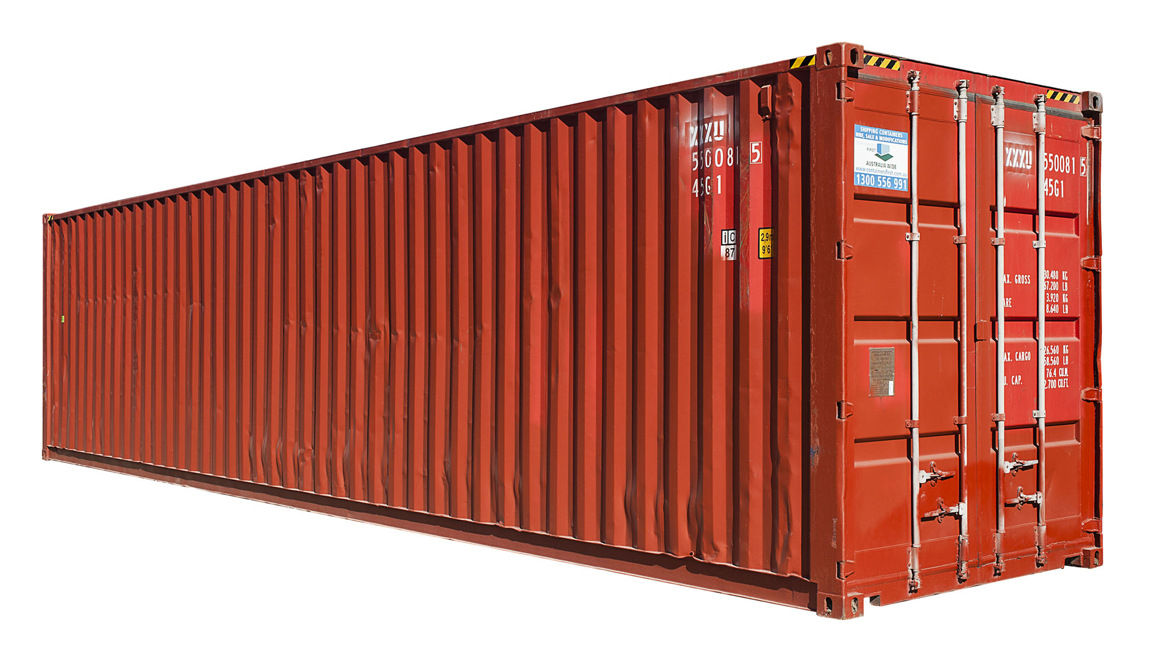
Software Containers?
The idea of software containers come from the shipping industry.

Slide 4
Why create Docker?
Wanted an easier way to deploy applications
Wanted to find a way to utilize infrastructure resources more efficiently

Slide 5
History of the Datacenter
The Datacenter has had 3 evolutions
  Physical Servers
  Virtual Servers
  Software Containers

Slide 6
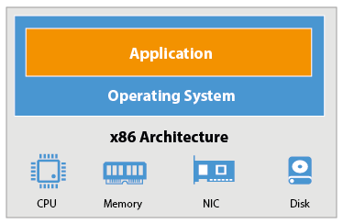
Physical Servers

Slide 7
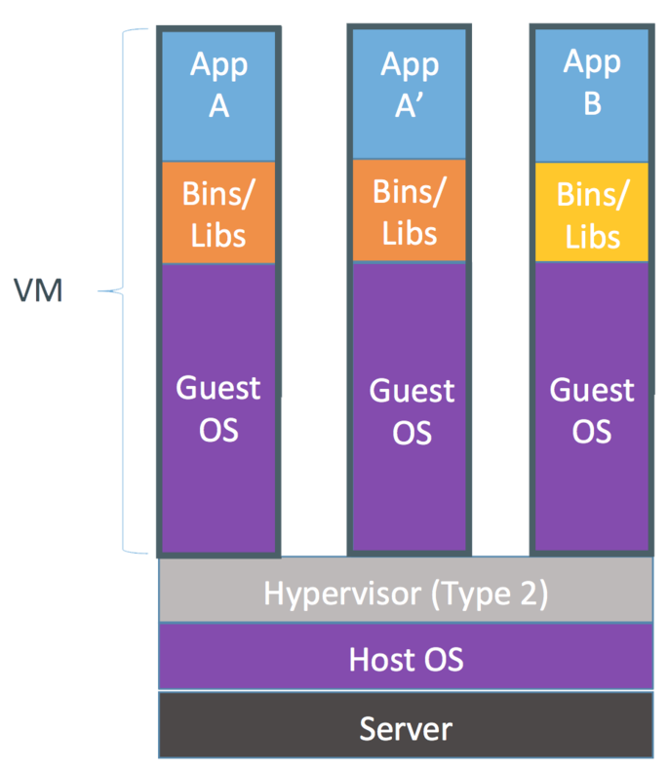
Virtual Servers

Slide 8
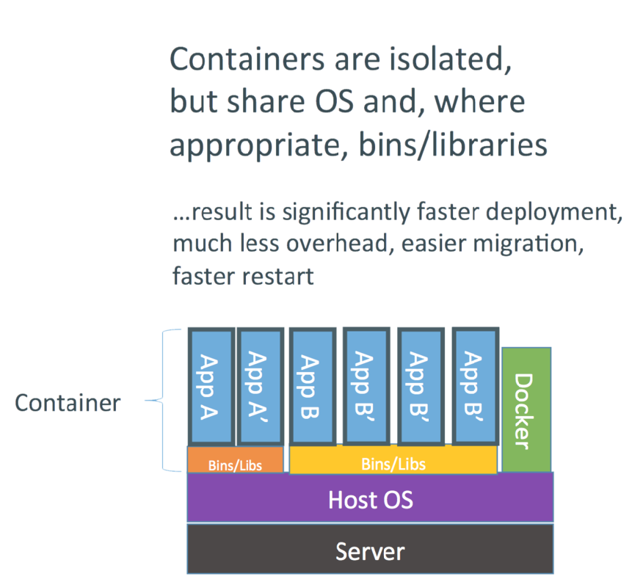
Containers

Slide 9
Advantages of Docker
Little Limitations
  If the server has Docker on it, it will run the container
    Containers share the Host OS Kernel

Slide 10
Advantages of Docker Cont.
Server will run multiple types of applications
  NodeJS and JavaEE application on the same server
VM’s and Physical Servers are limited to only one type of application

Slide 11

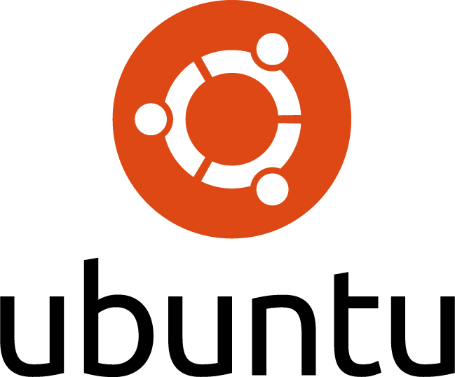
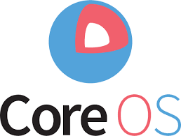
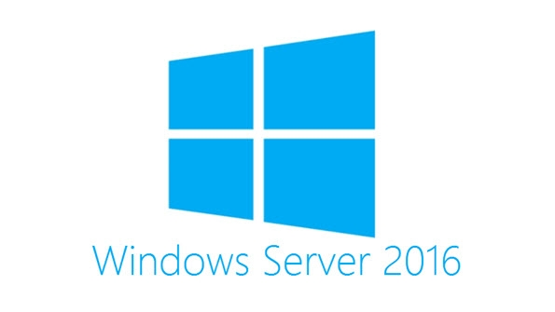
What OS will Run Docker?

Slide 12
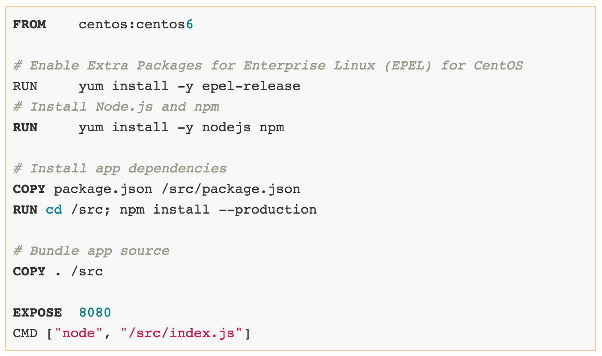
Dockerfile

Slide 13
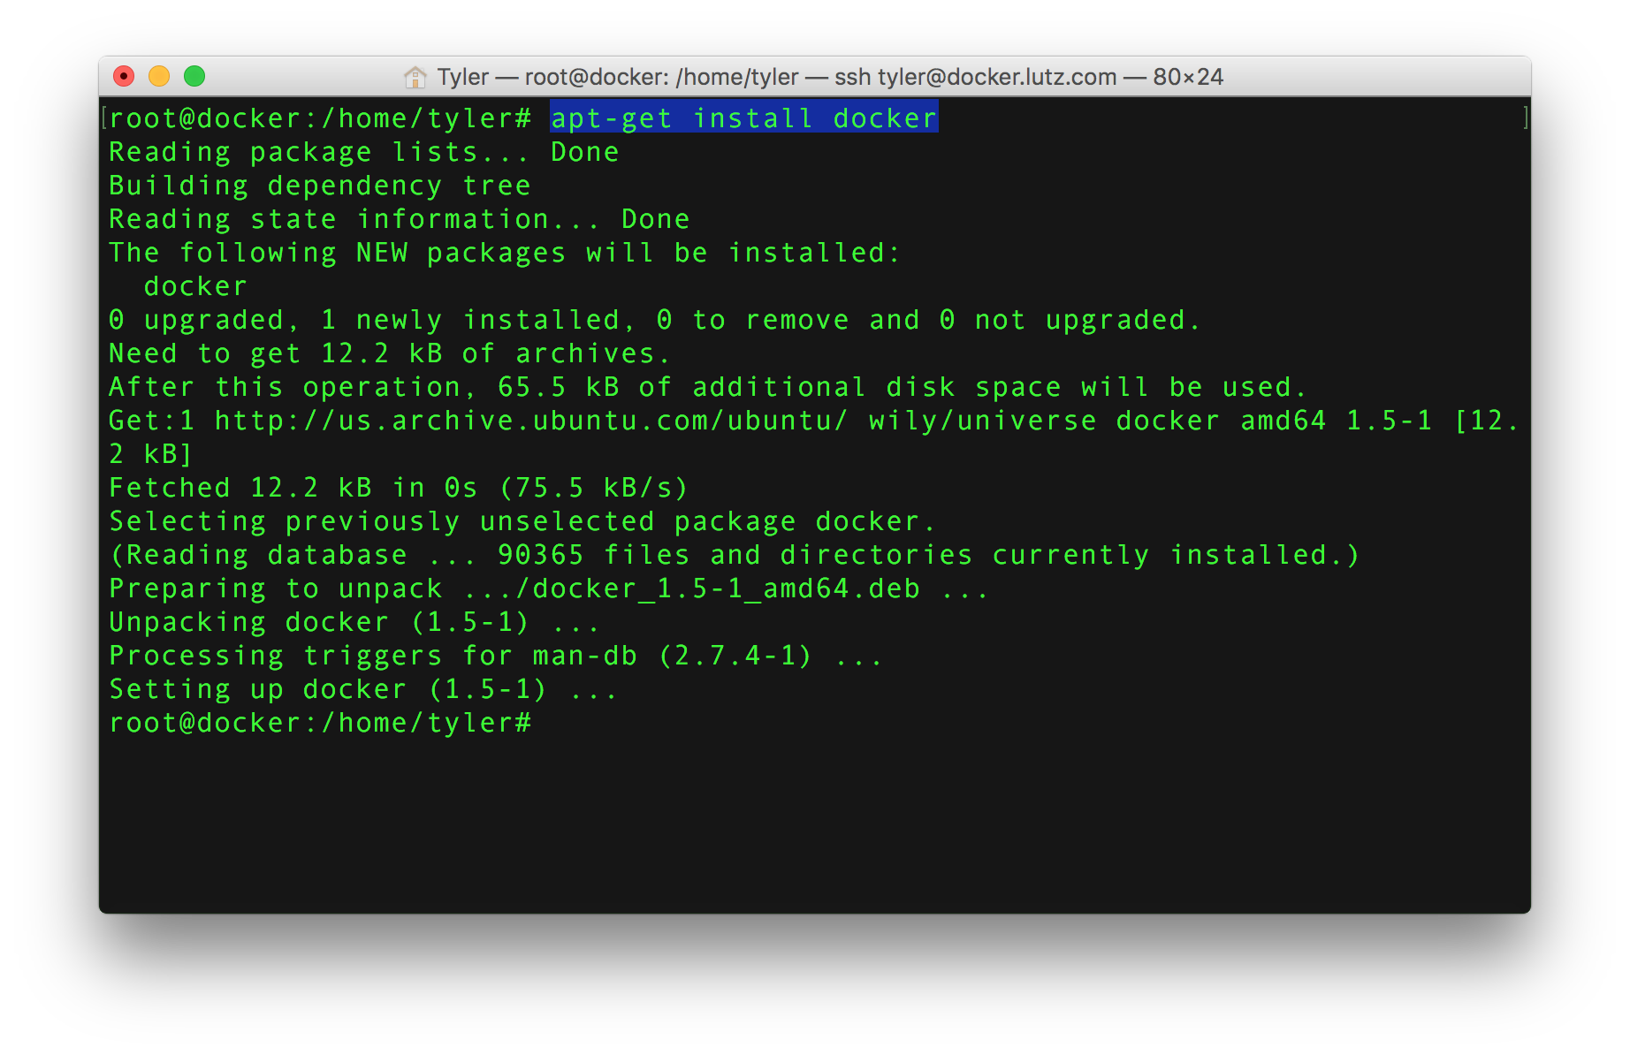
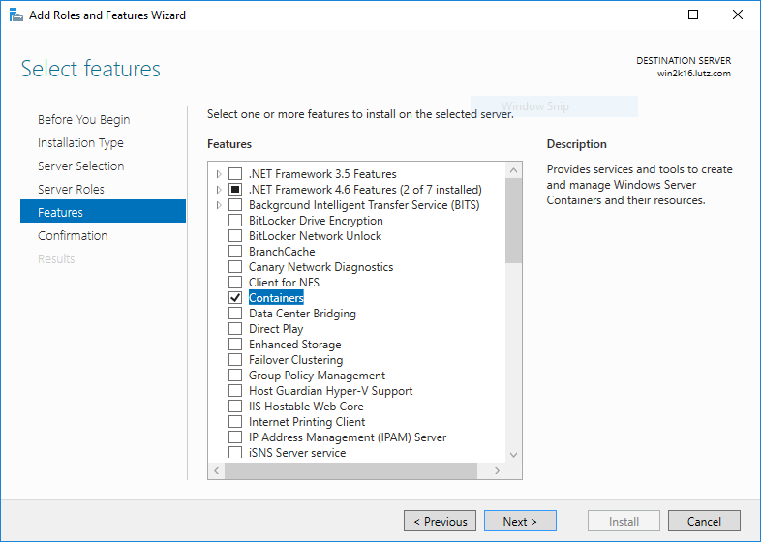
How do I get Docker?

Slide 14
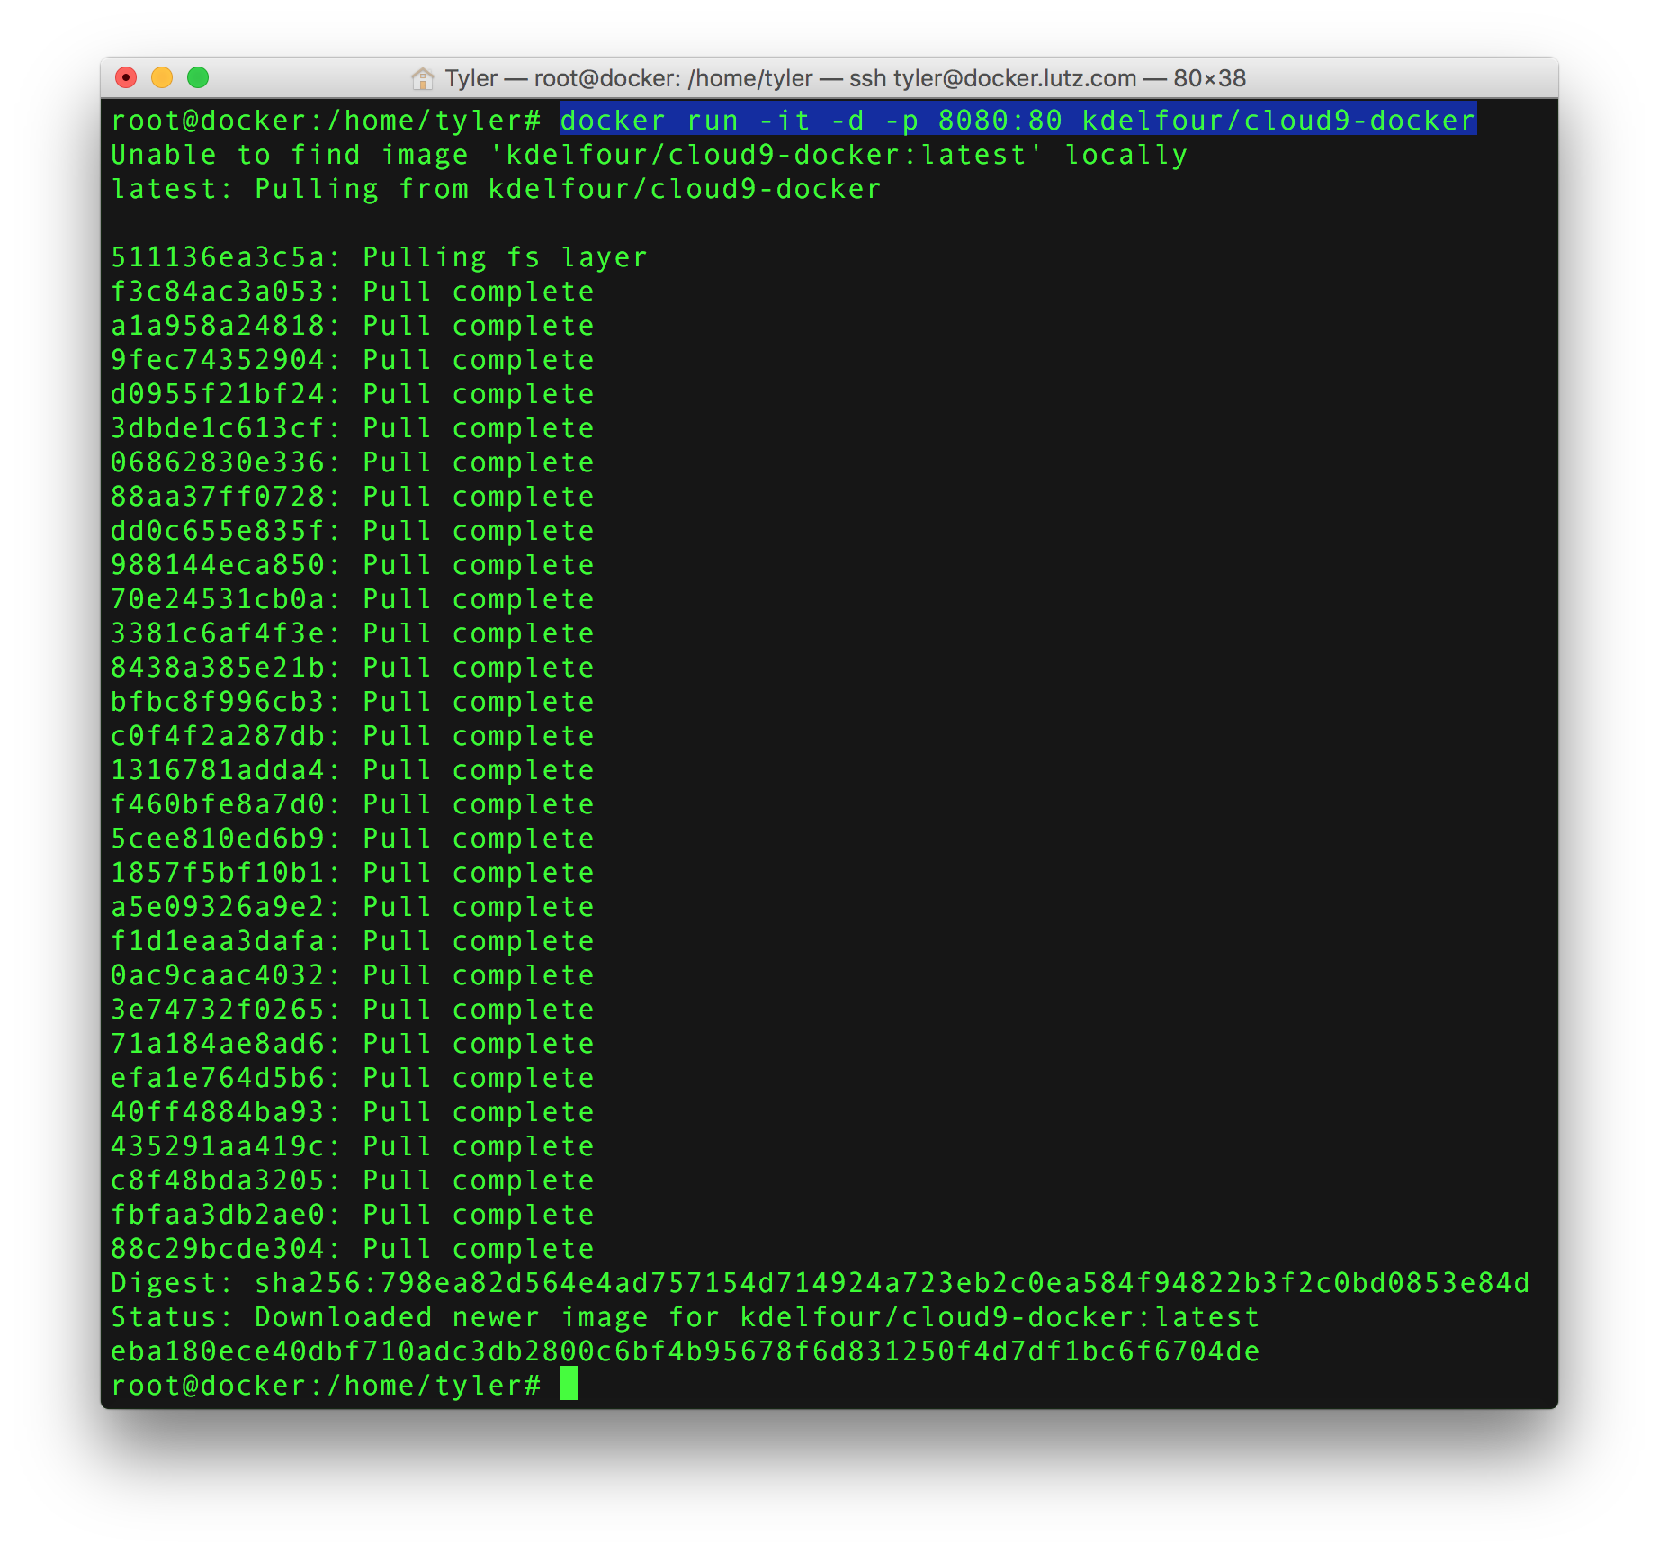
Getting My Container

Slide 15
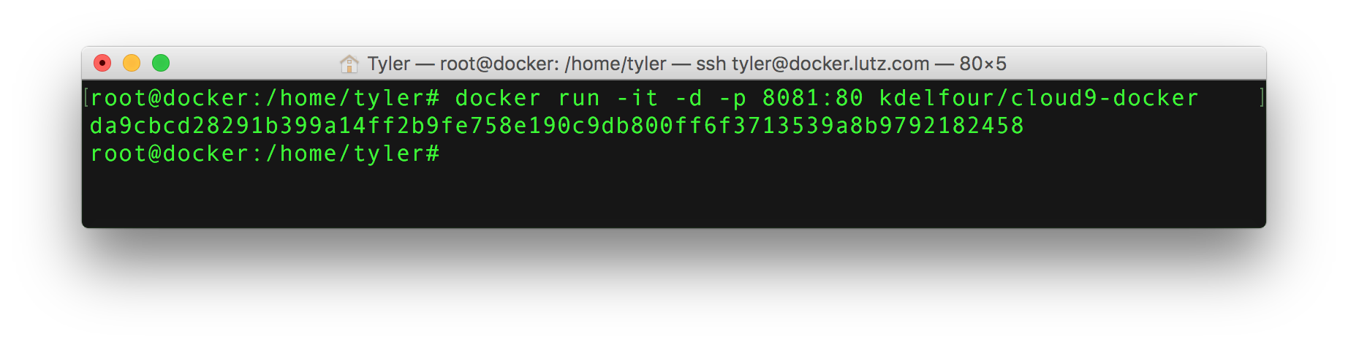
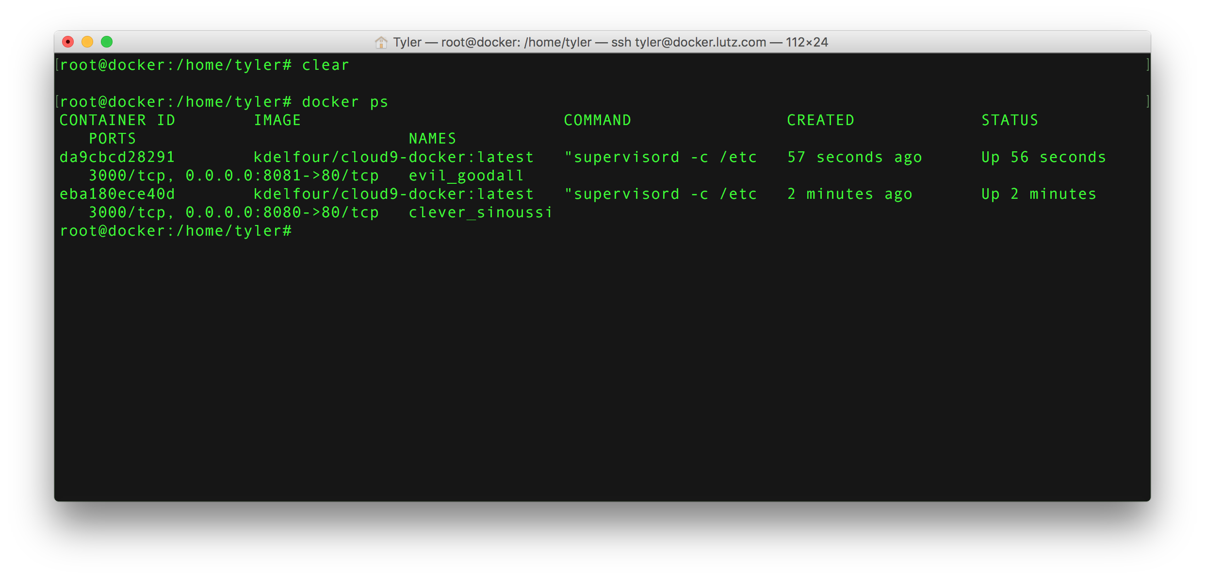
Starting My Container

Slide 16
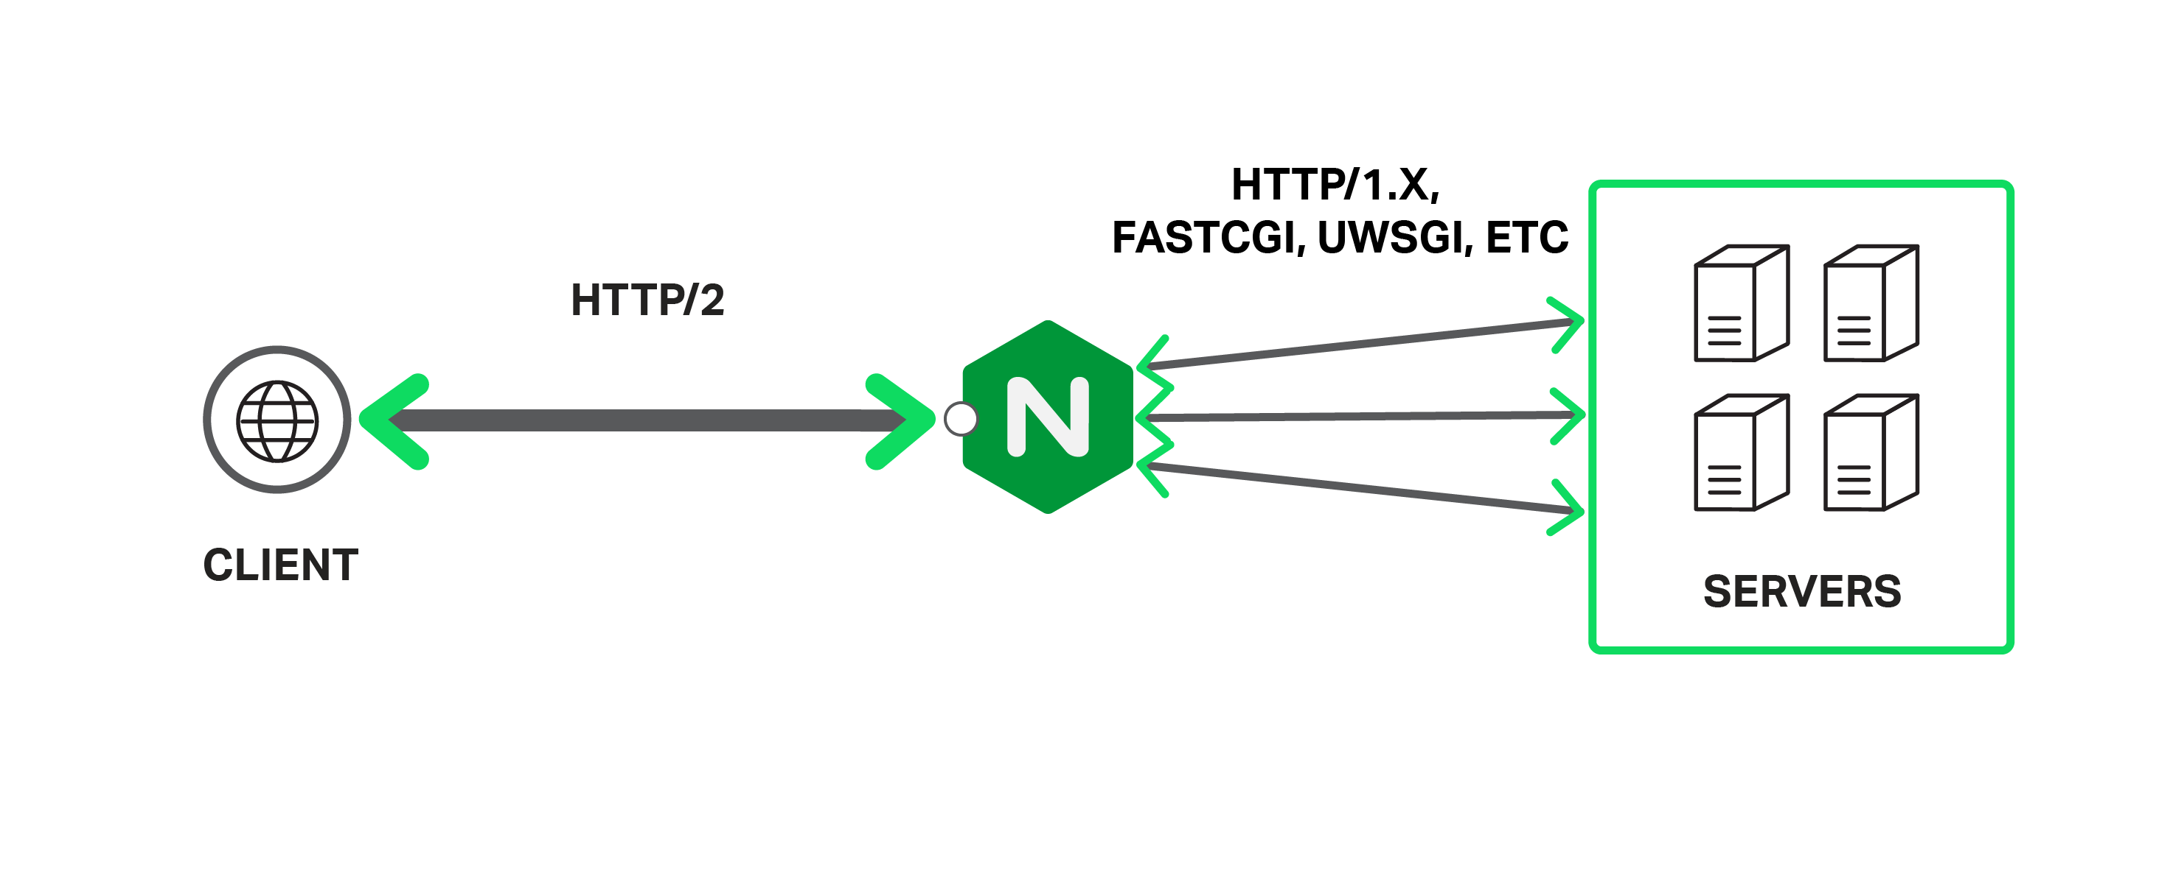
Software Load balancing

Slide 17
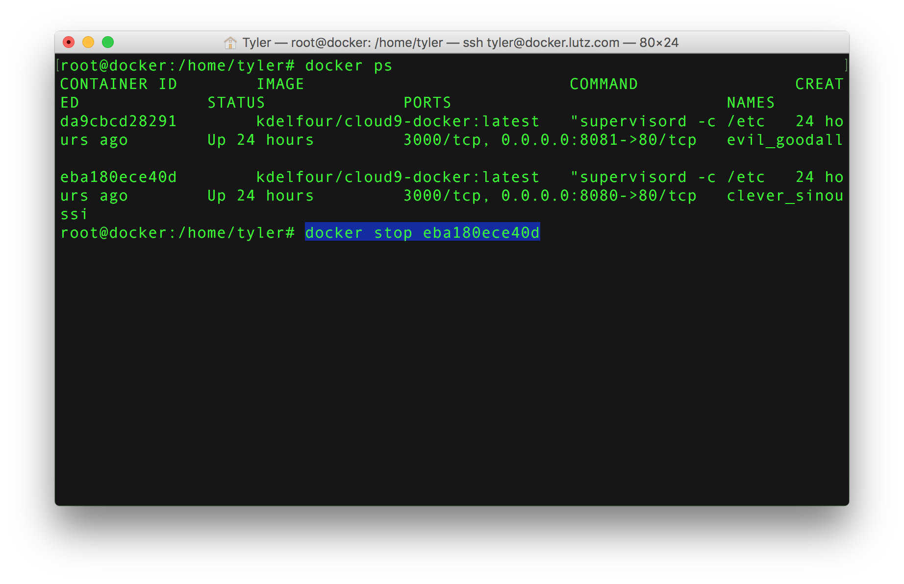
Stopping Applications

Slide 18
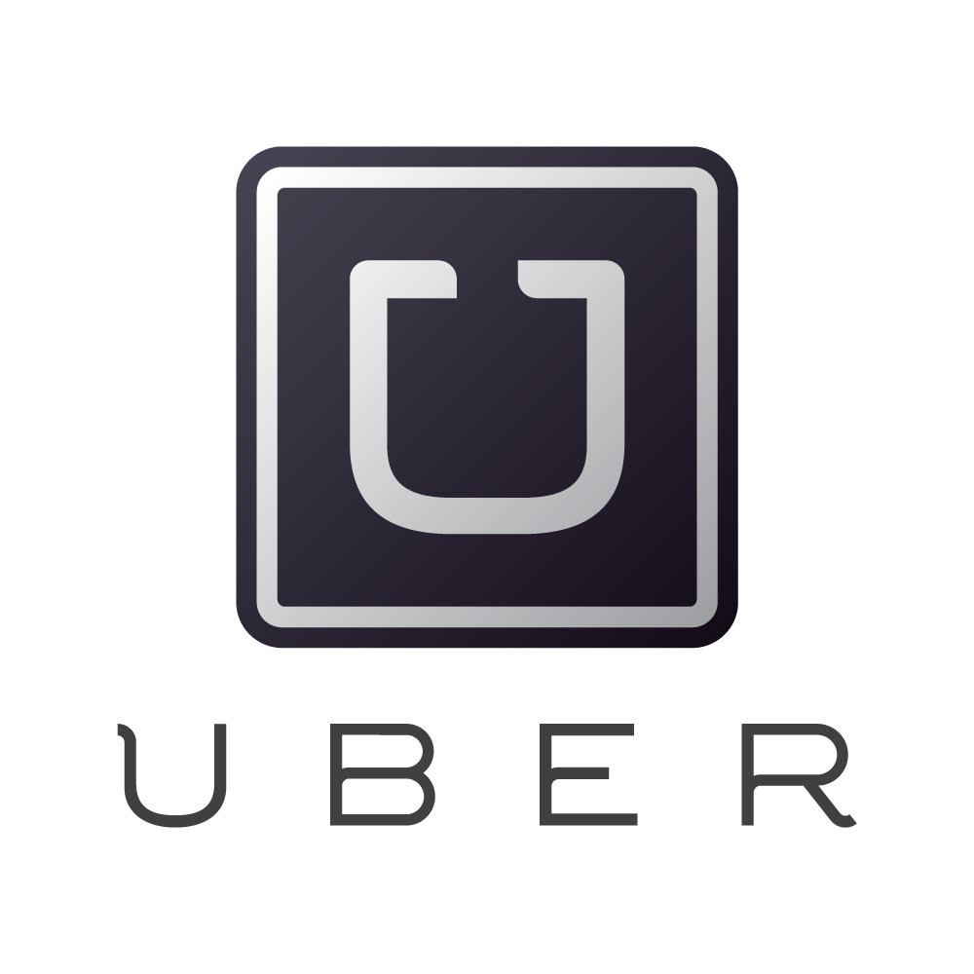
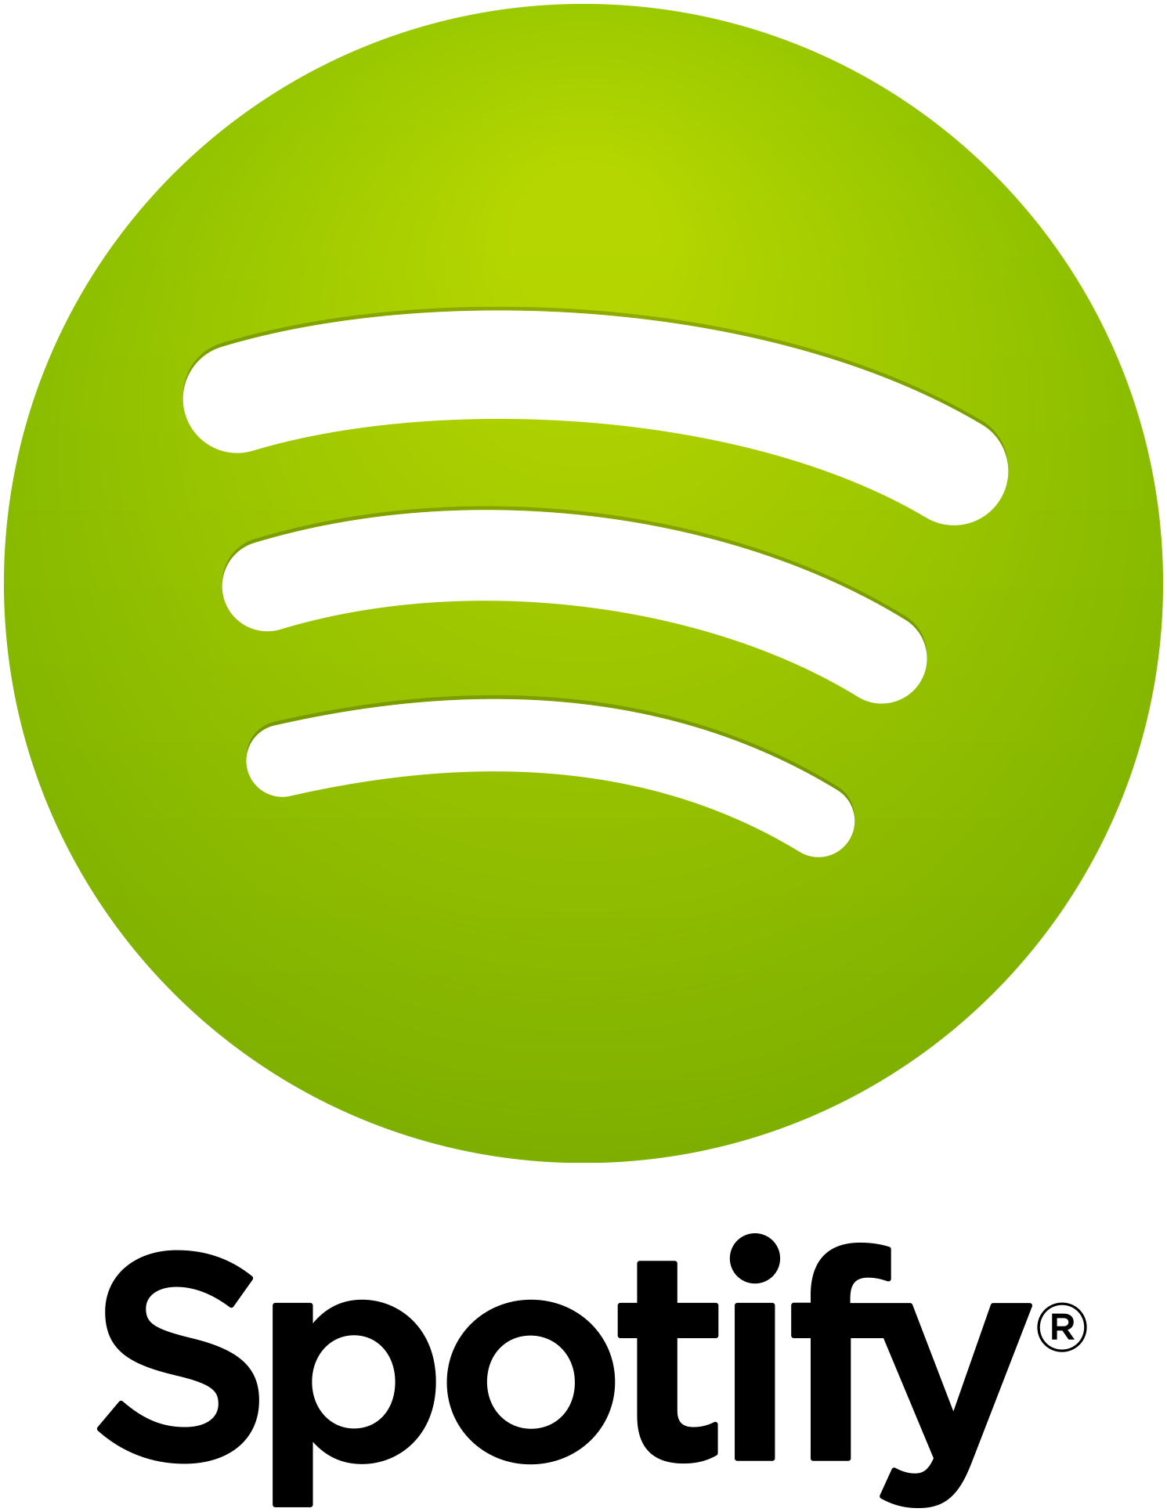



Who’s Using Docker?

Slide 19

Sources (list them)
www.docker.com
https://www.docker.com/customers
https://www.youtube.com/watch?v=Q5POuMHxW-0
https://www.youtube.com/watch?v=aLipr7tTuA4
https://www.docker.com/microsoft

