Slide 1
Foundation: CSS Framework
Javoni Faucette

Slide 2
What is Foundation?
“The most advanced responsive front-end framework in the world”
“Easy to use HTML, CSS and JavaScript to help create all kinds of awesome.”
“It’s the first front-end framework created for developing fully responsive web apps.”
Notes:
Foundation is a responsive front-end framework. Foundation provides a responsive grid and HTML and CSS UI components, templates, and code snippets, including typography, forms, buttons, navigation and other interface components, as well as optional JavaScript extensions.

Slide 3

What is Foundation? (cont.)
“Foundation is made by Zurb, a product design company in Cambell, California. We’ve put more than 15 years of experience building web products, services and websites into this framework.”
Notes:
The company behind Foundation, ZURB, have created a tightly regimented toolset for developers and designers. Every module has its part to play in the framework as a whole, but at the same time can work completely independently of central leadership. What this means then, is that you can mix and match features in your current project, or take a single feature and add it into an older project. You can even add it as a feature to a different framework.

Slide 4
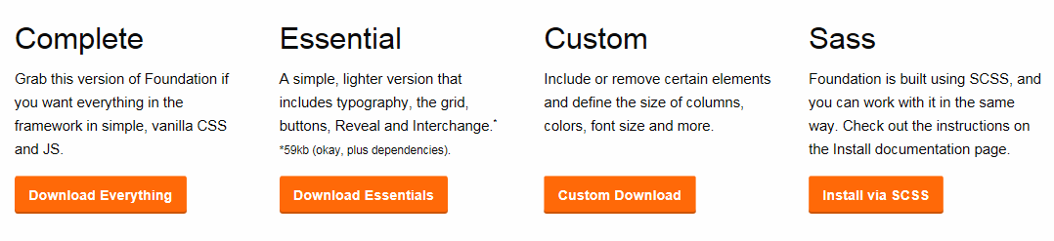




How to Download
Notes:
Looking through their docs, there are three different packages we can go into:
CSS, SASS, and Building an App. For more advanced uses, Foundation comes with a CLI that you can download and install so that you get Foundation commands from the command line. We won’t be messing with that stuff today, just the CSS. Downloading the Foundation CSS is all we have to do. We’ll get a sample site in index.html where we can test out CSS and JS features.

Slide 5
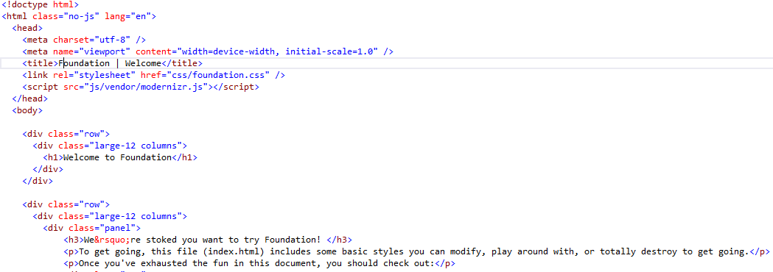

How to Download (cont.)
Notes:
To get the JavaScript going, we’ll need three things:
jquery.js, foundation.min.js, and we’ll need to initialize Foundation like so:
By adding that
$(document).foundation(); line, we’ll be able to define our JavaScript elements just by using HTML5 data-attributes. Here’s an example of the dropdown split button and the tabs:

Slide 6
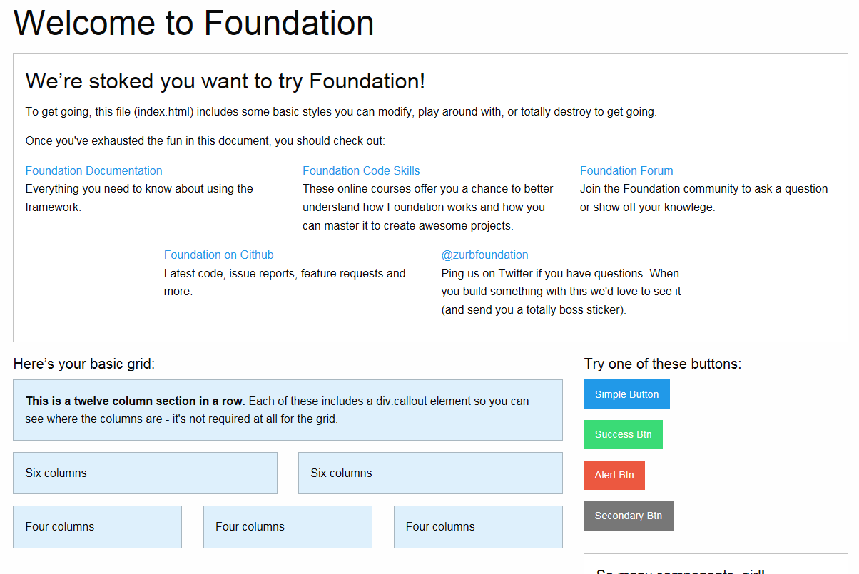
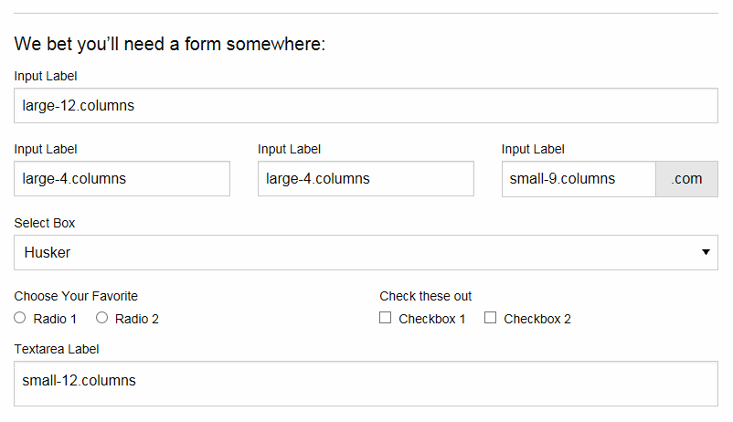
Preloaded Index.html

Slide 7
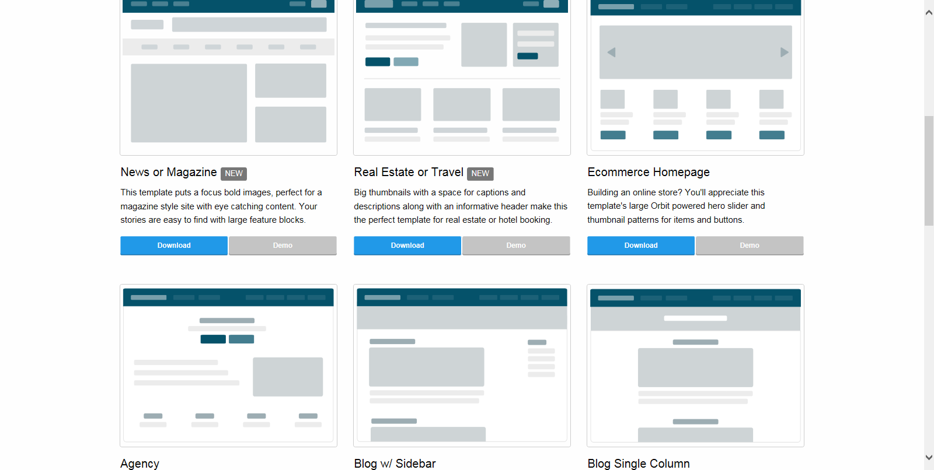
Templates
Notes:
Responsive templates to kick off your projects. You can build tons of layouts with the Foundation grid. Without using a single line of CSS outside of what comes with Foundation, we've created eighteen layouts for you to start from and build on.

Slide 8
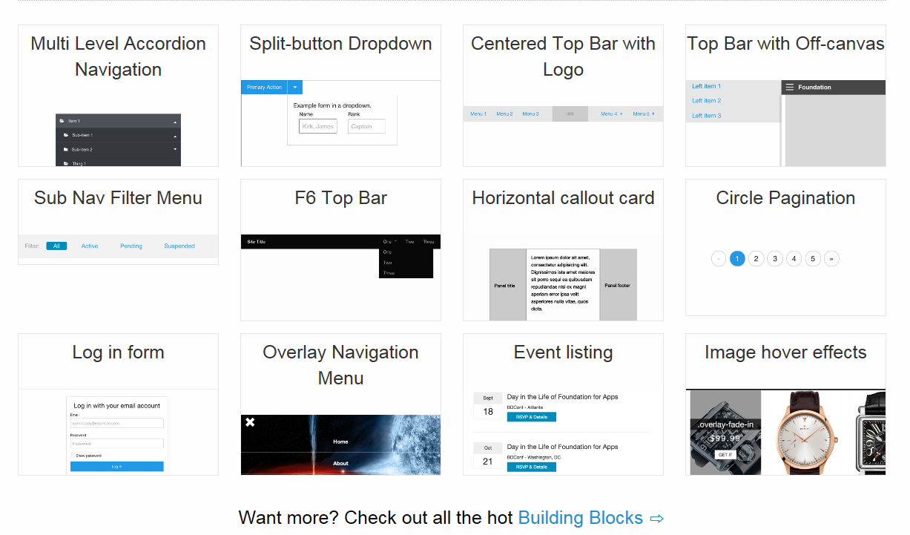
Building Blocks
Notes:
Building blocks are code bits and patterns that you can easily drop into any Foundation project. You’ll find the code to easily create panels, product cards, timelines, forms and all the things you can think off.

Slide 9
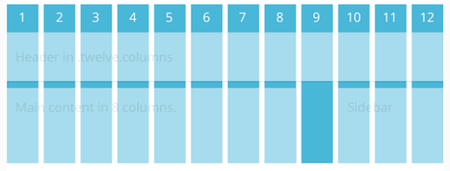
The Grid
12 columns across.
Each major horizontal section of the site is a row.
A series of columns is nested inside the rows.
Each group of columns inside a row should generally add up to a total of 12.
Notes:
The grid in Foundation is 12 columns across. Each major horizontal section of the site is a row. Then, a series of columns is nested inside the rows. Each group of columns inside a row should generally add up to a total of 12, but there are more advanced features that allow you to bend this rule.

Slide 10
Basic Grid Classes
Row
  horizontal container for vertical columns, and never the other way around.
  As you add content to a web page, each new row will span the width of the page.
Columns
  Inside each row, you can add the class columns to any element that should occupy some of the 12-column space
  you can use either the class columns or column and they will work exactly the same.
  Any element marked with columns should also have classes to specify their width.
Notes:
Foundation has several classes to specify the width of columns at different responsive sizes, and each one is followed by a number that specifies how many columns it should occupy. Row A row is a horizontal container for vertical columns, and never the other way around. As you add content to a web page, each new row will span the width of the page. For example, the header, content, and footer of a website might each have a row class with columns nested inside.
columns – Inside each row, you can add the class columns to any element that should occupy some of the 12-column space. For convenience, you can use either the class columns or column and they will work exactly the same. Any element marked with columns should also have classes to specify their width.

Slide 11
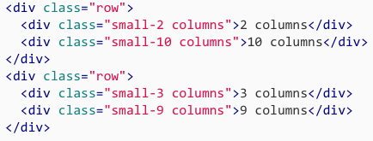
Small-# Grid Class
Mobile first
If no other responsive sizes are specified, such as medium-# or large-#, then the styling will be inherited by those larger screen sizes.

Slide 12
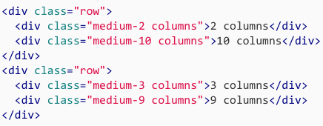
Medium-# Grid Class
Medium is new in Foundation 5, and it’s meant for tablet resolutions.
If an element has a small-# class and a medium-# class,
then the small
column
size will be
used for
mobile phones and
the medium column size will be used for tablets and anything larger.
Notes:
Medium is new in Foundation 5, and it’s meant for tablet resolutions. If an element has a small-# class and a medium-# class, then the small column size will be used for mobile phones and the medium column size will be used for tablets and anything larger. For example, you could have an element with the class small-4 and then medium-8 if you wanted it to take up four columns on mobile phones, but expand to eight columns on tablets.

Slide 13
Large-# Grid Class
The large-# column sizes are for laptop and desktop screen sizes.
If you only specify a large size without adding the small-# or medium-# classes, then the columns will stack.
  This can be very useful if you want a multicolumn desktop layout to collapse to a single column on tablets and phones.
Notes:
As you may have guessed, the large-# column sizes are for laptop and desktop screen sizes. However, if you only specify a large size without adding the small-# or medium-# classes, then the columns will stack. This can be very useful if you want a multicolumn desktop layout to collapse to a single column on tablets and phones. In the example template above, you’ll notice that all of the sizes are large. If you navigate to the template again and resize the browser, you’ll notice that all of the elements with a large-# class collapse to a single column at smaller sizes, because no small grid sizes are specified.

Slide 14
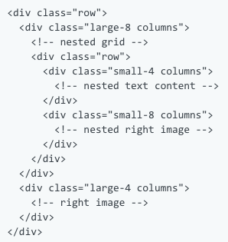

Nested Grid
Notes:
It’s possible to include rows inside of columns, which are, in turn, inside of rows of their own. This is known as nested grids, and while it is technically possible, it can be a bit confusing if you’re not careful. Use responsibly.

Slide 15
Foundation VS Bootstrap
Foundation was created by Zurb, not Twitter
  Zurb has a client list of eBay, Facebook, and NYSE
Foundation was the first to go responsive
Foundation was the first to be mobile first

Slide 16
Foundation VS Bootstrap (cont.)
Slightly different syntaxes
Foundation uses rems, while Bootstrap uses pixels
Foundation has Abide and Interchange features
Foundation has slightly different themes
  Goes away from the default Bootstrap look

Slide 17
Foundation VS Bootstrap (cont.)
Mobile design
  Foundation: “Anything not under a media query is going to be considered as mobile
  Bootstrap: “Should designers want to design for mobile, they’ll have to specify the media query for it”
Bootstrap has a bigger community
Can’t go wrong with either one

Slide 18



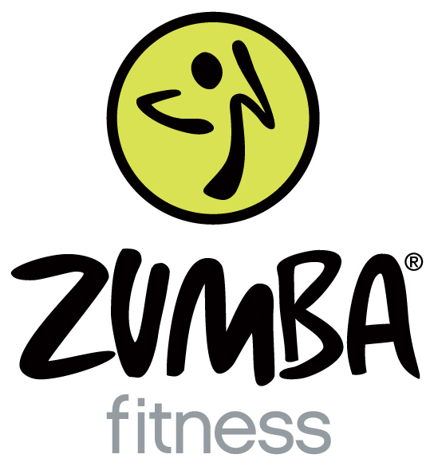
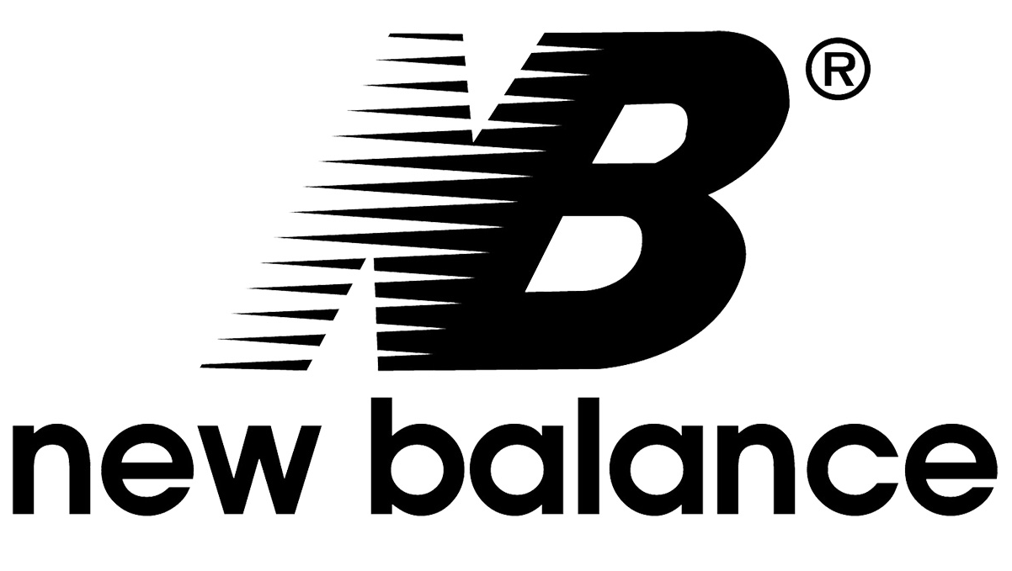

Sites Using Foundation
Stance, Toms, National Geographic, The Pressed Juicery, New Balance, Zumba

Slide 19

Sources (list them)
http://www.google.com
http://foundation.zurb.com/
http://foundation.zurb.com/sites/docs/v/5.5.3/
https://bootstrapbay.com/blog/bootstrap-vs-foundation/
http://stackoverflow.com/questions/11799236/should-i-use-px-or-rem-value-units-in-my-css
https://www.youtube.com/watch?v=kAAhtJtNq_M

