Slide 1
IoC and Dependency Injection
Joshua Grimaud

Slide 2
Inversion of Control (IoC)
“A design principle in which custom-written portions of a computer program receive the flow of control from a generic, reusable library.”

Slide 3
Dependency Injection (DI)
“A software design pattern that allows removing hard-coded dependencies and making it possible to change them, whether at run-time or compile-time.”
Recap – IoC is the principle, DI is the implementation

Slide 4


What is a dependency?
A dependency is an object that a class needs to function
Or

Slide 5

Example
You design a robot to build a house…
Framing walls, it gets to a point where a door needs to be installed…

Slide 6


What does the robot do?
Build a door from scratch?
Use a pre-fabricated door?

Slide 7
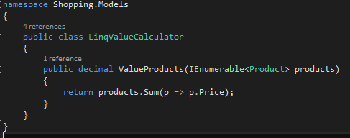
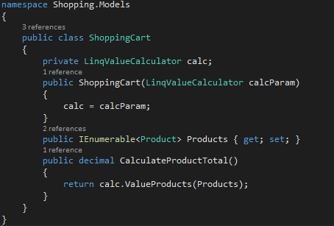
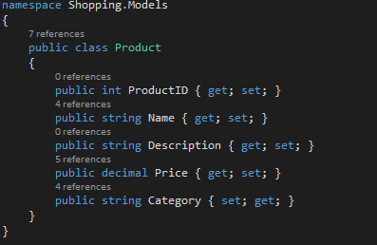
Code Example:
Shopping Cart
Three interdependent classes

Slide 8
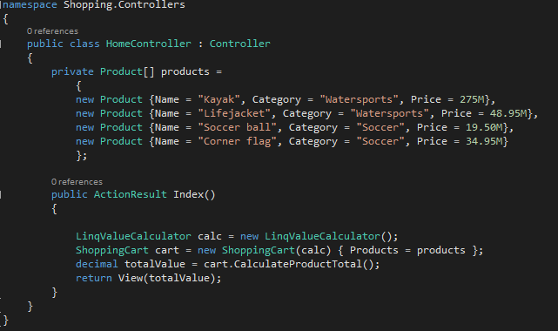
Code Example: Dependency
Do you see the dependency issues?

Slide 9
What’s the big deal?
Our classes are tightly coupled
  Shopping cart -> Calculator
  Home Controller -> Calculator and Shopping Cart
Difficult to make changes
  Hunt down references
  Matters on large projects!
How do we fix it?

Slide 10
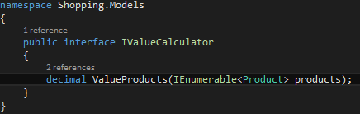
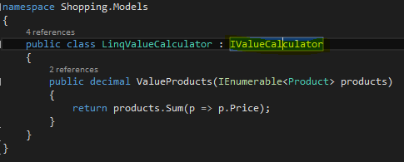
Create an Interface
Add an interface for the calculator
Do some polymorphism
We have broken the tight coupling!

Slide 11
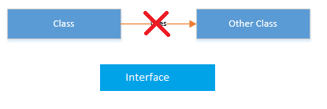
Dependency Inversion Principle
Dependency1
Dependency
Implements
Dependency2

Slide 12
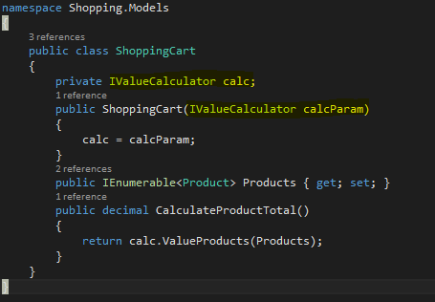
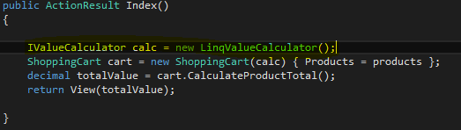
Did we fix it?
Not yet…
While we can replace the interface where we would instantiate the Calculator we have created an abstraction. Which is good, but just part of the recipe.

Slide 13
Problem / Solution
Implementing multiple interfaces gets messy, especially if an interface has multiple dependencies.
Enter Ninject
  Dependency Injection Container
  One of several DICs
    Microsoft has Unity
    Java has Spring

Slide 14
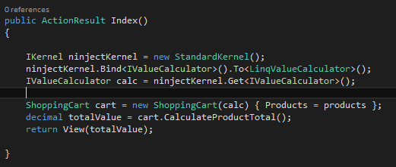
Ninject
Ninject uses C# type parameters to create relationships.
Bind<>(this interface).To<this implementation class>()

Slide 15
Is our project fixed?
Not yet, the Home controller is still tightly-coupled with the LinqValueCalculator class.
We need to create a Dependency Resolver.

Slide 16
But…
That would take more time than I have.
These aren’t the slides you are looking for (Jedi Mind Trick..?)

Slide 17
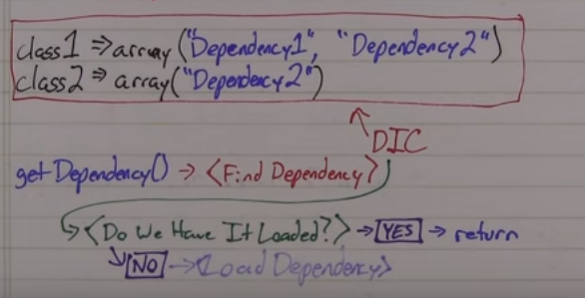
Okay… What is it?
If interested check out the MVC book in the references for more information

Slide 18
!!???!!!
Yeah, I’m probably dragging, or staring at the screen in horror.
Have mercy.

Slide 19

Sources (list them)
Ircmaxell. "Dependency Injection." YouTube. YouTube, 09 Jan. 2013. Web. 06 Apr. 2016.
Codespread. "Dependency Injection and Inversion of Control." YouTube. YouTube, 29 Apr. 2013. Web. 06 Apr. 2016.
Freeman, Adam. Pro ASP.NET MVC 4. N.p.: n.p., n.d. Print

