Slide 1


Do More with LESS
Trung Tran
Less of Trung is always good.

Slide 2
A Short History LESSon
What is LESS?
  It’s a CSS pre-processor
    Variables
    Functions (or Mixins)
    Operations
Caution: All examples are untested. May explode on site.

Slide 3
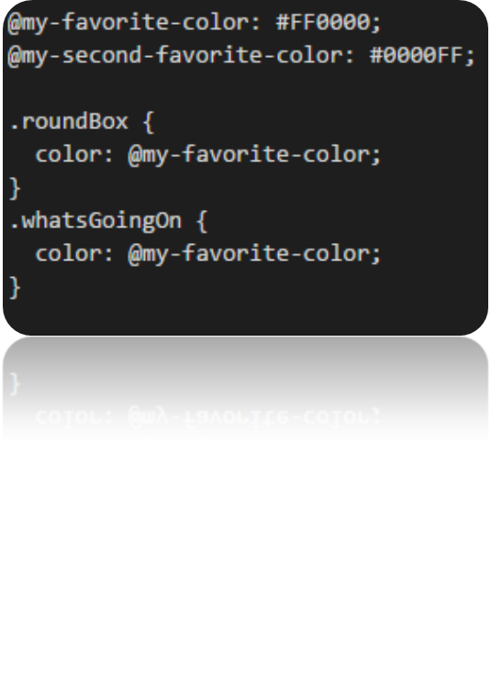
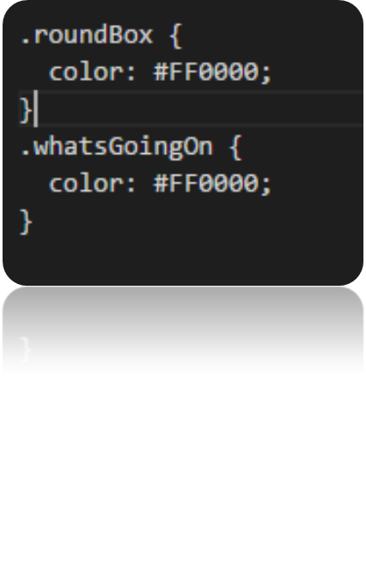
VariabLES(S)
We’ve all created a variable
@name: value;
Example:

Slide 4
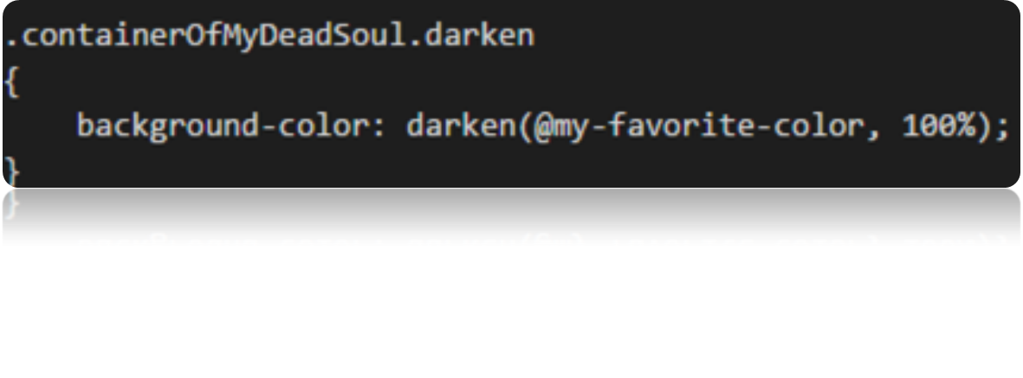
Functions (or Mixins)
A set or rules(s)
.name.nameOfFunciton{function}
Example:

Slide 5
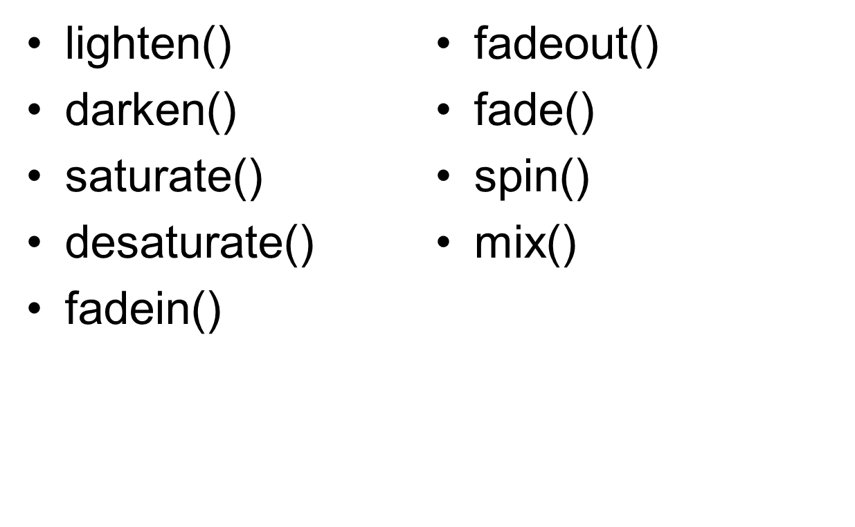
Function Examples(s) (cont)

Slide 6
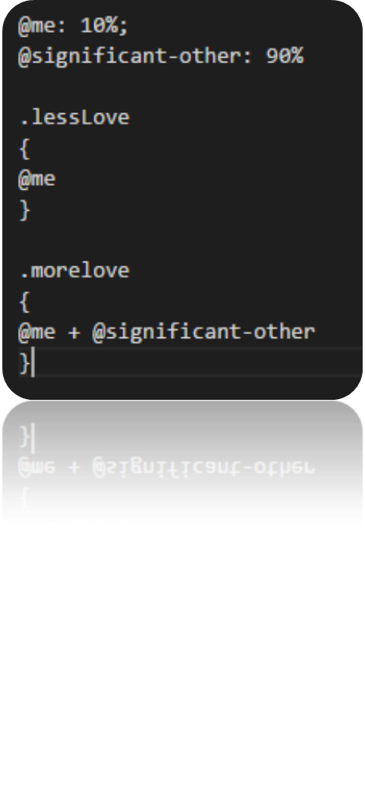

Operations
Addition, subtraction, multiplication, division.
Example:

Slide 7
The Question…
Why does LESS matter?
  It makes CSS “more maintainable, themable and extendable.”

Slide 8
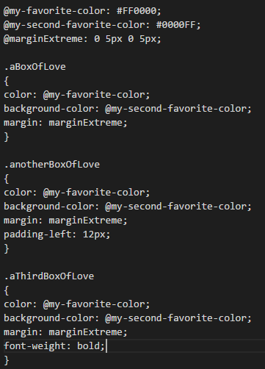
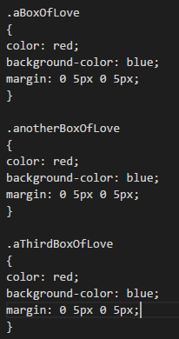
Examples(s)
Value of variables(s)

Slide 9
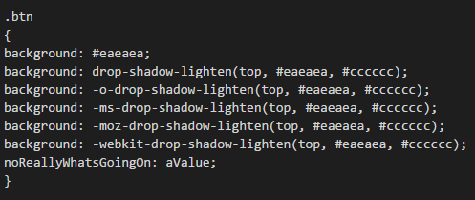
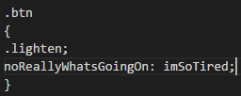
Examples(s)
Value of functions/mixins
See!? LESS is more!

Slide 10
Again, What Does LESS Do?
LESS allows one to save:
  Time
  Effort
  Stress
“How?” one might ask
  By changing the value in the variable or function when you want to make a change.

Slide 11
How Do You Use LESS?
Download the source code from GitHub
Clone or Fork from Github
Install with Bower
$ npm install -g less
CDN:<script src="//cdnjs.cloudflare.com/ajax/libs/less.js/2.6.1/less.min.js"></script>

Slide 12
What More Can LESS Do?
Nesting
Loops
Logical Operations

Slide 13
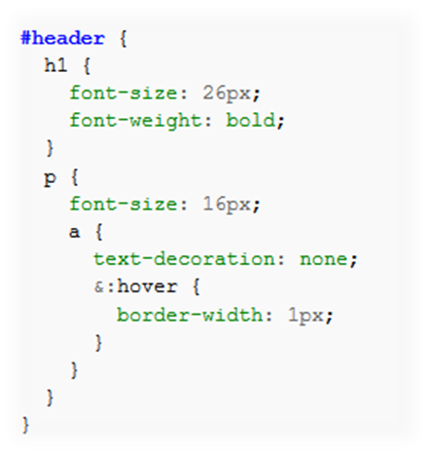
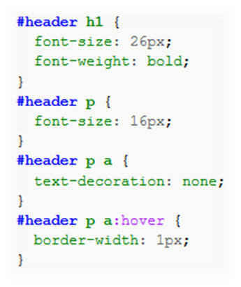
Nesting

Slide 14
Loops
I won’t embarrass myself with a loop example.
I’ll just say that you can make a container or whatever progressively… “do stuff.”

Slide 15
Logical Operations
@text-color: red;
.set-bg-color (@text-color) when (lightness(@text-color) >= 50%) {background: blue;}
.set-bg-color (@text-color) when (lightness(@text-color) >= 50%)
{background: yellow;}

Slide 16
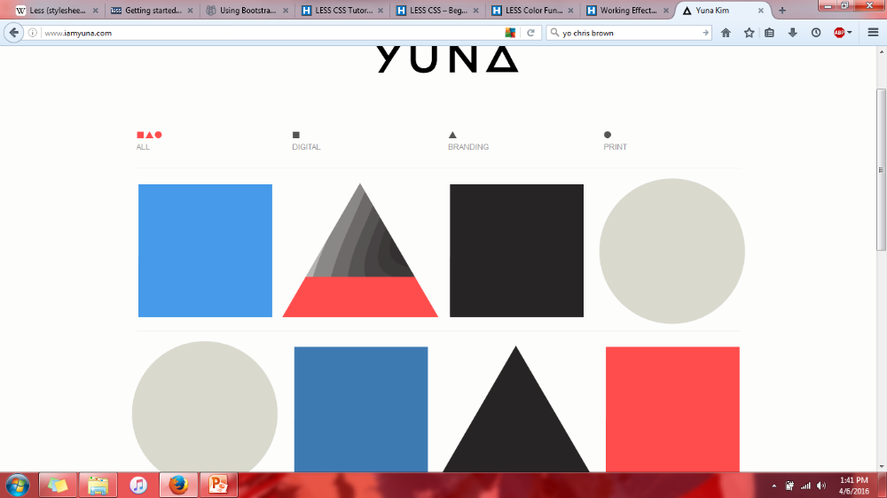
Another Question…
What can you do with LESS?

Slide 17
BLESSed
You can create a great looking website with just three colors.
LESS allows you to change gradients, shadows, and effects.

Slide 18
LOLA
My team didn’t start with WordPress
The styling was all inconsistent
  The colors
  The nav bar
  The containers
It was all a mess without LESS

Slide 19
So How Can LESS Help?
It can help save time and frustration
  You can do more by:
    Saving time and finishing a project more quickly
    Not freaking out when you have to change an attribute in each container on each page
It keeps things consistent!

Slide 20

Sources (list them)
http://www.google.com
http://www.hongkiat.com/blog/less-basic/
http://www.hongkiat.com/blog/less-color-functions/
http://lesscss.org/
https://en.wikipedia.org/wiki/Less_%28stylesheet_language%29#Functions_and_operations

