Slide 1
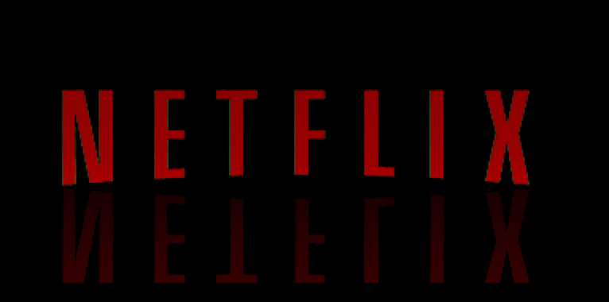
The Netflix Build
Kelly Majors

Slide 2
Agenda
The Building process
  Build
  Integrate
  Bake
  Deploy
Technologies
  GitHub
  Nebula
  Jenkins
  Gradle
  Amazon Machine Images
  Spinnaker

Slide 3
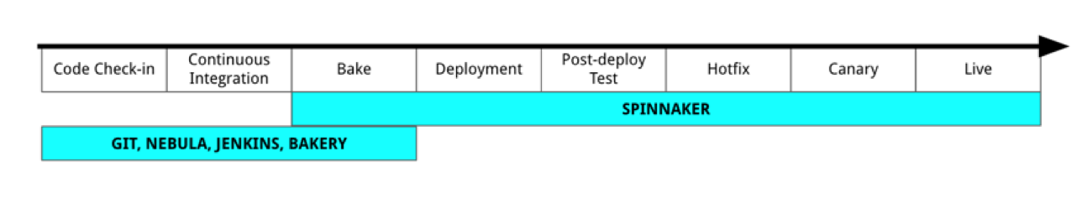
Pipeline

Slide 4
Culture, Cloud, and Microservices
Netflix culture of freedom and responsibility
Converted monolithic, datacenter-based Java applicatino to cloud-based Java microservices
Allows teams at Netflix to be loosely coupled

Slide 5
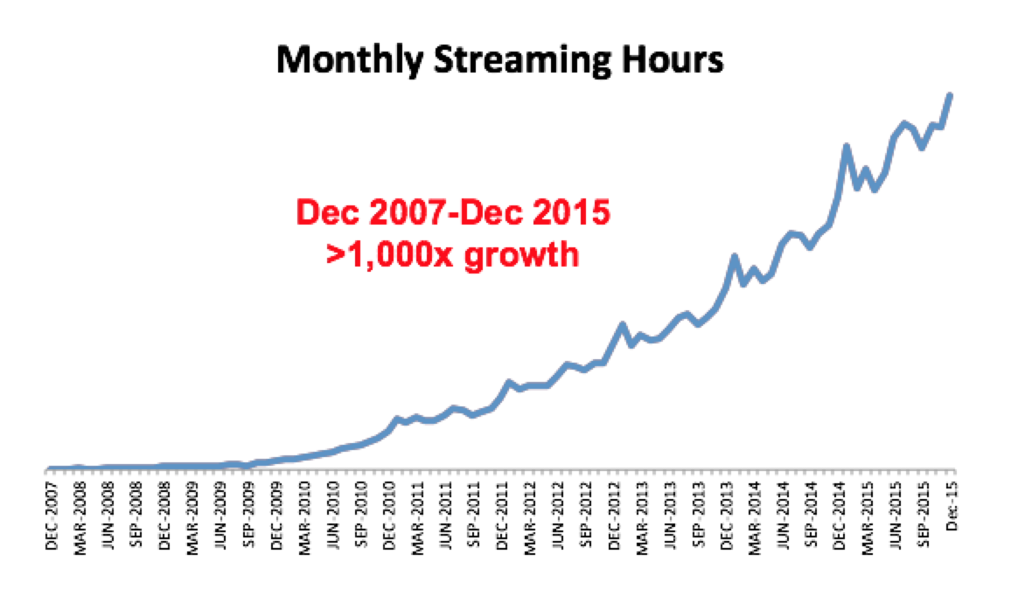
Why Netflix Changed in 2008

Slide 6
Why Netflix Changed in 2008
Had to move away from vetically scaled single points of failue
Chose Amazon Web Services
In January of 2016 completed cloud migration and shut down last remaining data center bits

Slide 7
Nebula & Gradle
Gradle
  Enterprise build tool for Java applications
  Chosen because of out-of-the-box functionality
Nebula
  Collection of Gradle plugins
  Simplify common build, testing and packaging tasks

Slide 8
Build
Simple Java Application of Netflix
  Declare Java dependencies
  Apply Nebula plugins
Reusable and consistent build functionality
Reducing boilerplate in each applications build file

Slide 9
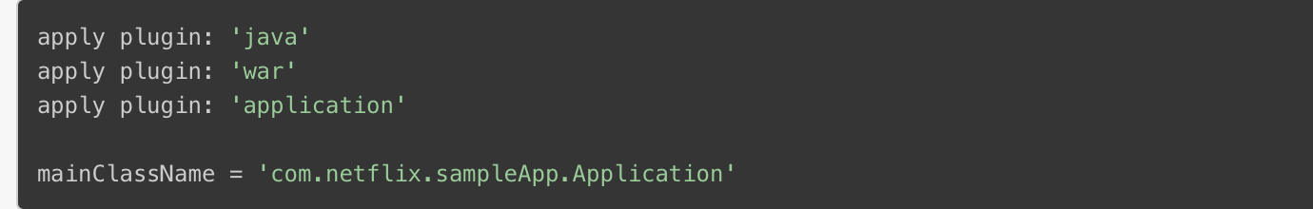
Gradle Build File

Slide 10
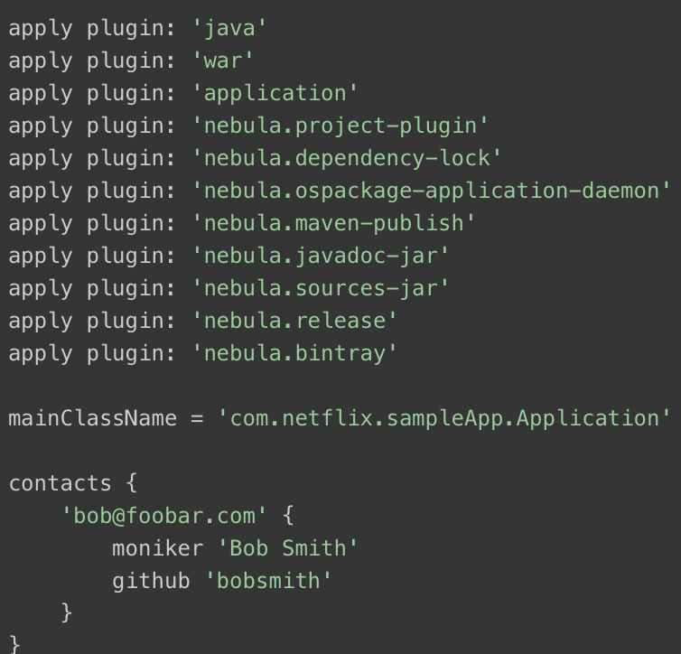
Gradle Build File with Nebula Plugins

Slide 11
Jenkins
Open source continuous integration software tool written in Java
Find and solve defects in code base rapidly
Automated testing of builds
Developer time focused on work that really matters

Slide 12
Integrate
Push the created/updated source code to a git repository
Jenkins job is triggered with ‘push’ command
A Jenkins job is configured to invoke Nebula to build, test, and package application code

Slide 13
Immutable Server
Pattern or strategy for managing services in which infrastructure is divided into “data” and “everything else”
Changes made only by modifying a versioned definition, rather than being updated in place

Slide 14
Amazon Machine Images
Master image for the creation of virtual servers in the AWS environment
AMIs include the following
  Template for root volume of the instance
  Launch permissions
  A block device mapping

Slide 15
Bake
“The Bakery”
  Used to generate AMIs from source
Bakery API service schedules bake job
To trigger a bake, user declares the package to be installed and base AMI onto which it should be installed

Slide 16
Spinnaker
Open source multi-cloud Continuous Deliver platform
Releasing software changes with high velocity and confidence
Can deploy to and manage clusters simultaneously across both AWS and Google Cloud Platform with full feature compatibility

Slide 17
Deploy
Spinnaker makes the AMI available for deployment
Next, triggers the next stage of Spinnaker pipeline , a deploy to the test environment
Specifics of an application’s deployment piepeline becomes fairly custom from this point on

Slide 18
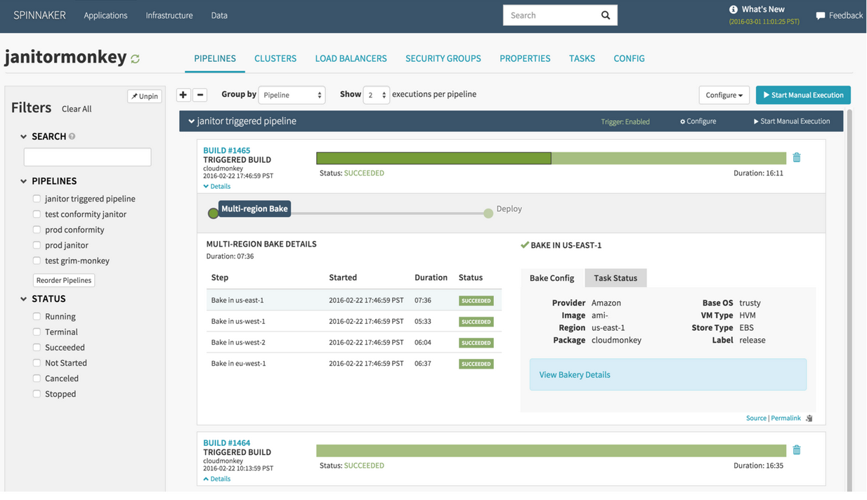
Deploy

Slide 19

Sources (list them)
http://techblog.netflix.com/2016/03/how-we-build-code-at-netflix.html
http://techblog.netflix.com/2015/11/global-continuous-delivery-with.html
http://gradle.org/why/high-performance-builds/#caching
http://nebula-plugins.github.io/documentation/introduction_to_nebula.html
http://searchsoftwarequality.techtarget.com/definition/Jenkins

