Slide 1
Rust
Mark Smith

Slide 2

What is Rust?

Slide 3

Rust

Slide 4
What is Rust?
Programming Language
  Memory Safe
  NO Garbage Collection
Ahead-of-time Compile
Focus
  Safety
  Speed
  Concurrency

Slide 5
About Rust
Mozilla Research’s Rust team
Managed by Aaron Turon
  Low-level concurrency
  Programming language design
  PhD from Northeastern University

Slide 6
Its Strengths
Embedding in other languages
Specific space & time requirements
  Compile-time safety checks
  Eliminates all data races
Low-level code writing
  Device drivers
  Operating systems

Slide 7
Variables
Type inference
  let (x,y) = (1,2);
Type declaration
let x: i32 = 5;
Slices
  let a = [0, 1, 2, 3, 4];
  let complete = &a[..]; // 0,1,2,3,4
  let middle = &a[1..4]; // 1,2,3

Slide 8
Functions
fn add_one(x: i32) -> i32{
x + 1
}
Error
fn add_one(x: i32) -> i32{
x+1;
}

Slide 9
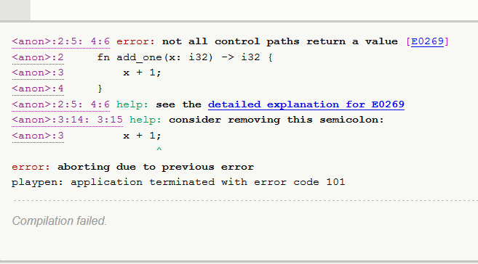
Error Helper

Slide 10
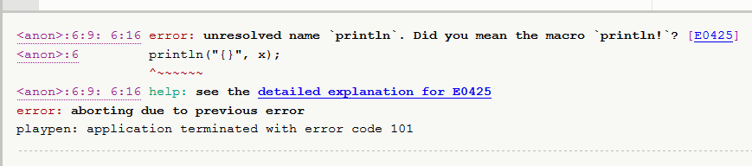
Error Helper

Slide 11
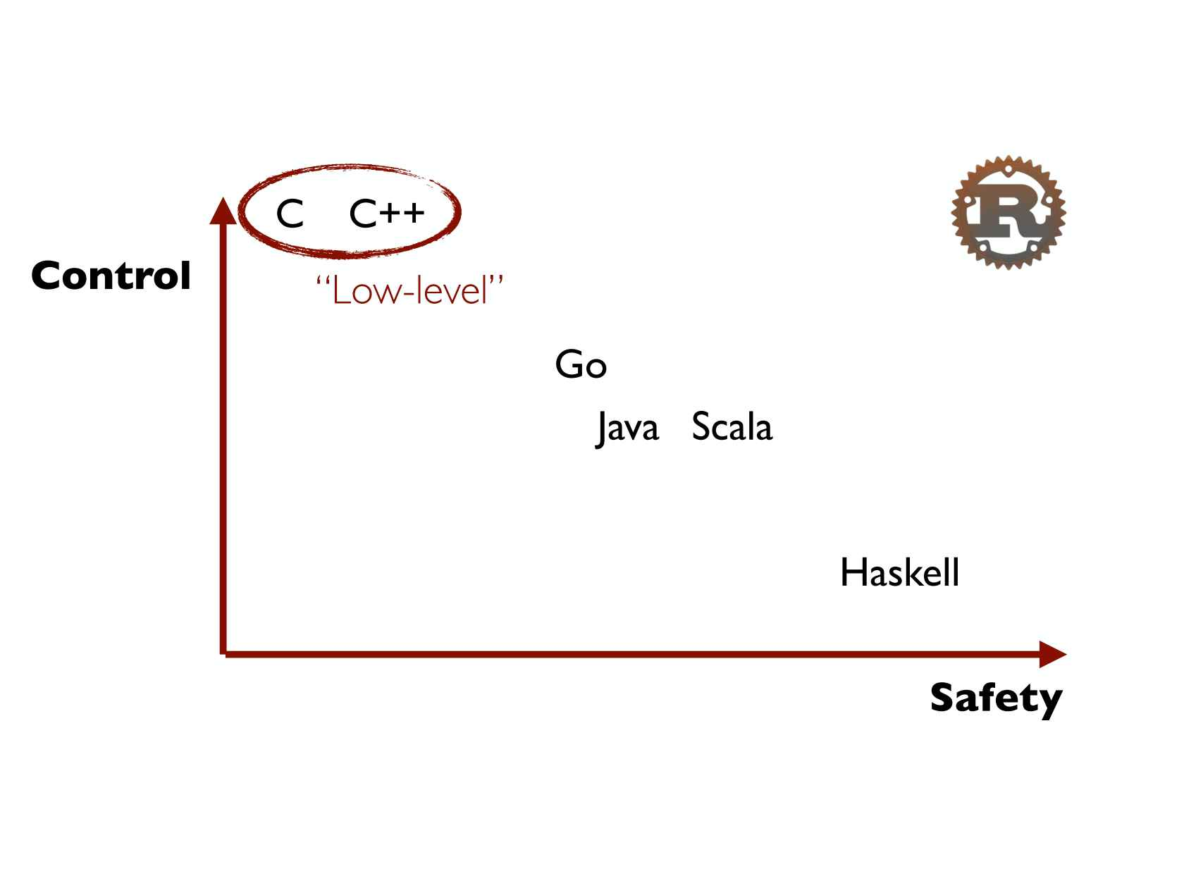
The Tradeoff

Slide 12
Secret Sauce
Ownership
  Memory safety (NO garbage collection)
  Concurrency without data races
  Abstraction without overhead

Slide 13
Ownership
Variables have “ownership” of the memory and values they are bound to
fn foo(){
let v = vec![1, 2, 3];
}
Heap space allocated
Work done
Heap unallocated

Slide 14
Embedding Rust
Java code and Go code
  Different runtime systems
  Two different garbage collectors
Every language talks with C
  Rust can be embedded in laguages
    Ruby
    Python
    JavaScript
    .Net

Slide 15
What does this mean?
You have written most of your product in a high-level language, but you have parts that need increased performance.
Rust can be written to attain that performance. Just need to set up a C interface to them.

Slide 16
Okay?
What does all this mean?
  Servo
    Better parallelism
    Security
    Modularity
    Performance

Slide 17
Servo
Highly parallel environment
Security
Modularity
Performance

Slide 18
Servo
Early development stage
  Wikipedia
  Github
Passed Acid2 test
Own CSS3 and HTML5 parser

Slide 19
References
https://github.com/rust-lang/rust
http://www.google.com
“The Book”
QCon: Aaron Turon

