Slide 1
Splice Studio
Nadir Siddiqui

Slide 2
The Problem
Plenty of musicians around the world with no means of collaborating over long distance
Local collaboration still requires trial and error along with moving large equipment
Musicians currently use media data dumps on external HDD – not efficient

Slide 3
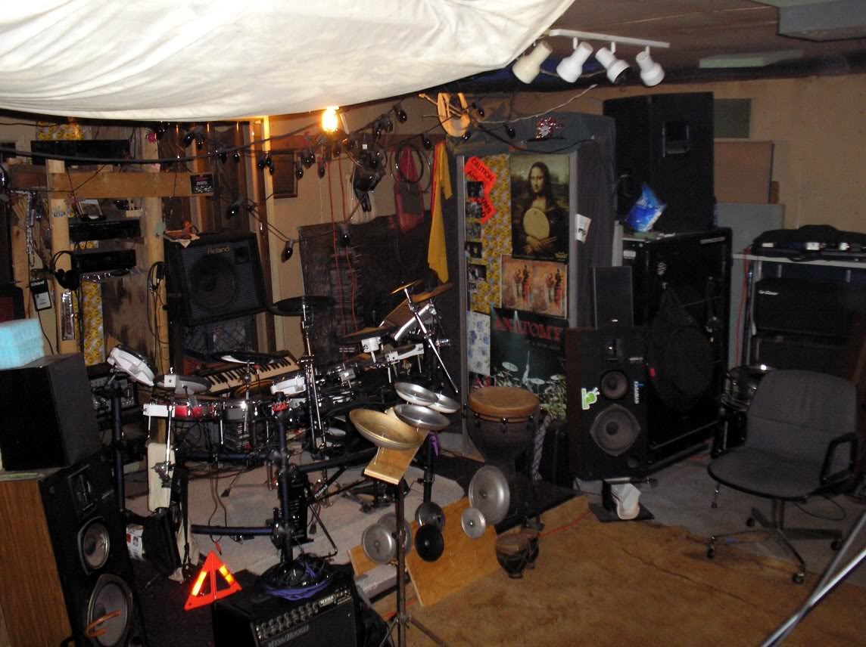
The Old Way
Mom and Dads Basement

Slide 4
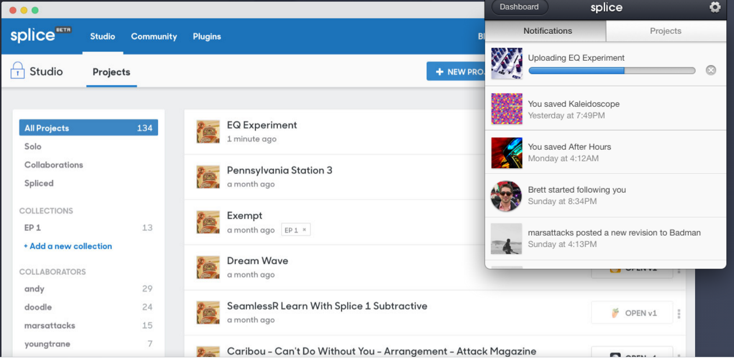
The New Way
Remote collaboration (and less back pain)

Slide 5
What does Splice do?
Think: Github for musicians
Upload tracks directly from your preferred audio workstation
Collaborate with other musicians similarly to how people collaborate with Git
Allows for version control and ability to fork or revert to previous track

Slide 6
Version Control
Always has been a major issue with musicians especially because of non-rewritable media
  Once you recorded over a track, that initial track would be gone
  With Splice you can be very specific with what you want to edit without fear of losing the original copy

Slide 7
Anonymous Collaboration
You can allow anyone to add or remove edits to your repository as they fit by forking your repository
An unlimited number of people can contribute to a single song
  Crowd-sourced music?
  Remove the problem of one band member dictating the music

Slide 8
What’s in it for me?
As a developer you can contribute to the many plugins that users can use
  Various sound effects that can be applied to a track
  Create plugins that add features which may not be present already
  New plugins could allow for the ability to integrate with preexisting devices

Slide 9
Development: new audience
Splice is currently heavily catered to electronic music and sampling of sounds
Electronic music is already digital in nature, so uploading to an online service is relatively straightforward
Developing for those who play more traditional instruments

Slide 10
Development: live stream
Currently, the ability to collaborate over the Internet with music is iterative
  One person records a track, and the next person layers on top of that track, etc
  Many argue that the essence of music can be found in “live” music

Slide 11
Development: live stream
Latency is a major hurdle when it comes to recording live
The smallest deviation in timing can result in a very negative listening experience
With high speed Internet, latency can be greatly minimized therefore making cross-country jam sessions possible

Slide 12
Development: user-friendly design
Musicians who play traditional instruments may not be “technically” inclined
Developers can enhance process of version control to be more approachable for the technology illiterate

Slide 13

Sources (list them)
http://www.google.com
http://www.splice.com

