Slide 1
LESS
Nathan Dougherty

Slide 2
What is Less?
Less is a CSS pre-compiler used to streamline CSS.
Influenced by SASS

Slide 3
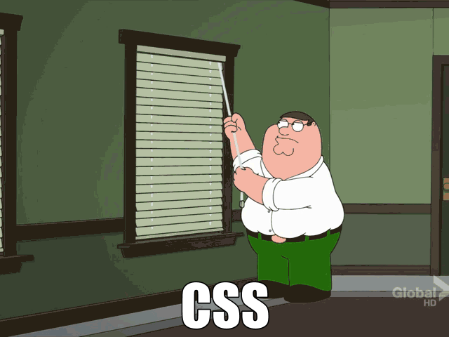
Why use Less
Some info

Slide 4
Syntax
Less intended to be as close to CSS as possible

Slide 5
Features
Its features include Mixins, Variables, and nesting

Slide 6
Variables
@color: #4D926F;
#header {
color: @color;
}
h2 {
color: @color;
}

Slide 7
Mixins
.rounded-corners (@radius: 5px) {
-webkit-border-radius: @radius;
-moz-border-radius: @radius;
border-radius: @radius;
}
#header {
.rounded-corners;
}
#footer {
.rounded-corners(10px);
}

Slide 8
Nesting
#header {
h1 {
font-size: 26px;
font-weight: bold;
}
p {
font-size: 12px;
a {
text-decoration: none;
&:hover {
border-width: 1px;
}
}
}
}

Slide 9
Arithmetic Operations
@the-border: 1px;
@base-color: #111;
@red: #842210;
#header {
color: @base-color * 3;
border-left: @the-border;
border-right: @the-border * 3;
}
#footer {
color: @base-color + #003300;
border-color: desaturate(@red, 10%);

Slide 10
Logical Operations
.set-bg-color (@text-color) when (lightness(@text-color) >= 50%) {
background: black;
}
.set-bg-color (@text-color) when (lightness(@text-color) < 50%) {
background: #ccc;
}

Slide 11
Loops and recursion
.loop (@index) when (@index > 0) {
.myclass {
z-index: @index;
}
// Call itself
.loopingClass(@index - 1);
}
// Stop loop
.loopingClass (0) {}
// Outputs stuff
.loopingClass (10);

Slide 12
Import Functions
.foo {
background: #900;
}
@import "this-is-valid.less";

Slide 13
Detached Rulesets
// declare detached ruleset
@detached-ruleset: { background: red; };
// use detached ruleset
.top {
@detached-ruleset();
}

Slide 14

In short

Slide 15
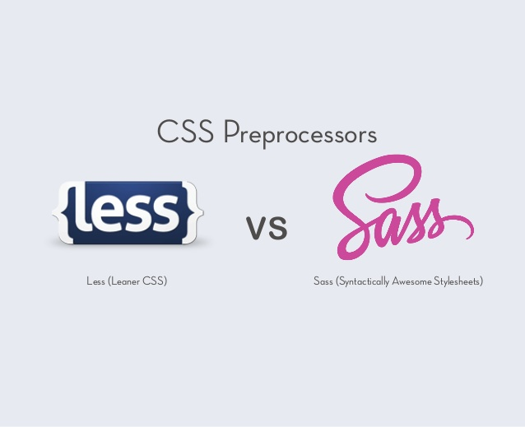
Alternatives

Slide 16
How to Use
Simply Include a less.js file in your project.
Use file extension.less for style sheet

Slide 17
Is it Really Necessary?
…no

Slide 18
WinLess | GUI Less Compiler | Apache 2.0^{[7]} | Windows | Compiler
Crunch | Less editor and compiler (requires Adobe AIR) | GPL^{[8]} | Windows, Mac OS X | Compiler Editor
less.js-windows | Simple command-line utility for Windows that will compile *.less files to CSS using less.js. | MIT_License^{[9]} | Windows | Compiler
less.app | Less Compiler | Proprietary | Mac OS X | Compiler
CodeKit | Less Compiler | Proprietary | Mac OS X | Compiler
LessEngine | Less Compiler | Free | OpenCart Plugin | Compiler
SimpLESS | Less Compiler | free but no explicit license^{[10]} | Windows Mac OS X Linux | Compiler
Chirpy | Less Compiler | Ms-PL^{[11]} | Visual Studio Plugin | Compiler
Mindscape Web Workbench | Syntax highlighting and IntelliSense for Less and Sass | Proprietary | Visual Studio Plugin | Compiler Syntax Highlighting
Eclipse Plugin for Less | Eclipse Plugin | EPL 1.0^{[12]} | Eclipse Plugin | Syntax highlighting Content assist
mod_less | Apache2 module to compile Less on the fly | Open Source | Linux | Compiler
grunt-contrib-less | Node.js Grunt task to convert Less to CSS | Open Source | Node.js | Compiler
Web Essentials

Slide 19

Sources
http://lesscss.org
https://css-tricks.com/sass-vs-less/
http://www.smashingmagazine.com/2011/09/09/an-introduction-to-less-and-comparison-to-sass/

