Slide 1
TypeScript
Hao Nguyen

Slide 2
Background
Programming language developed and maintained by Microsoft
Created because of the short-comings of JavaScript for large-scale applications

Slide 3
Background
Challenges with complex JavaScript code led to demand for custom tooling to ease development
Microsoft developed TypeScript, releasing the language in October 2012

Slide 4
What is TypeScript?
A superset of JavaScript that compiles to plain JavaScript
Adds optional static typing and class-based object-oriented programming to JavaScript

Slide 5
What is TypeScript?
Makes things in JavaScript a lot easier for a programmer to do; e.g. classes, inheritance, interfaces, generics
Any existing JavaScript programs are valid TypeScript programs

Slide 6
Language Features
Compatible with JavaScript
Type annotations to enable type checking at compile time
Type inference
Classes
Inheritance
Interfaces
Generics

Slide 7
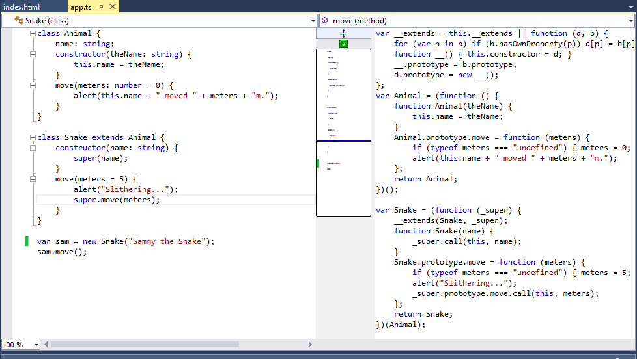
Visual Studio with TypeScript

Slide 8
Type Annotations
Enables type checking at compile time
Gives us quality Intellisense
Is optional and can be ignored to use regular dynamic typing of JavaScript

Slide 9
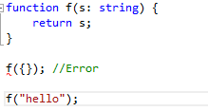
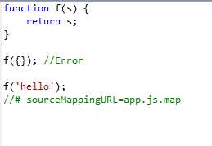
Type Annotation
TypeScript
Compiles to
JavaScript

Slide 10
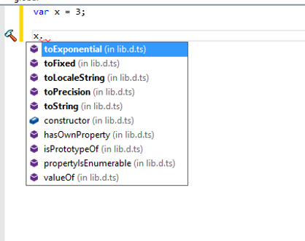
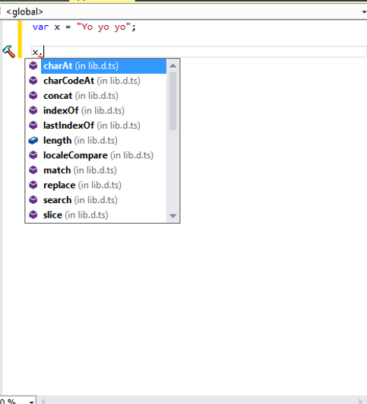
Type Inference
TypeScript can infer the type, and use the services available for that type

Slide 11
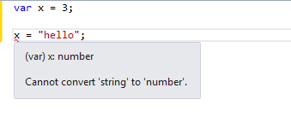




Type Inference
TypeScript will infer that x is of type “number”.
If no type is declared, it defaults to “any”

Slide 12
Classes
TypeScript makes creating classes a lot easier for a programmer to do
Syntax should look very familiar for C# and Java developers

Slide 13
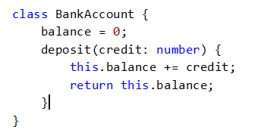
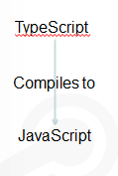
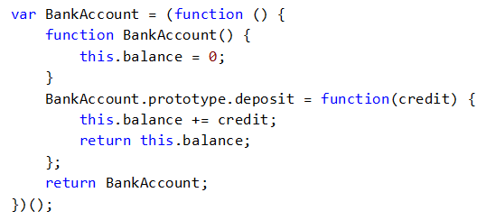
Classes
Some info

Slide 14
Inheritance
One of the most fundamental patterns in class-based programming is being able to extend existing classes
TypeScript allows the developer to extend existing classes with the “extends” keyword

Slide 15
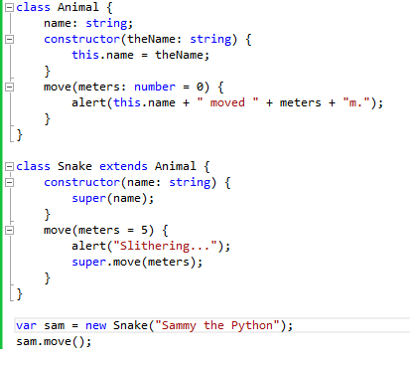
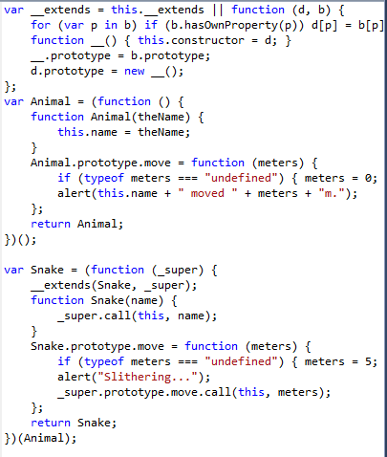
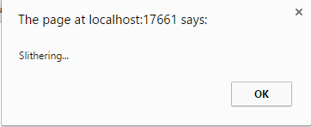

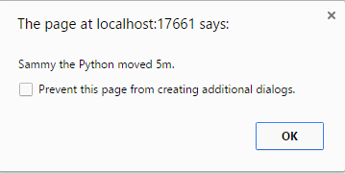
Inheritance

Slide 16
Private/Public Modifiers
TypeScript allows the programmer to declare the visibility of members
When private/public isn’t declared, it’ll be public by default

Slide 17
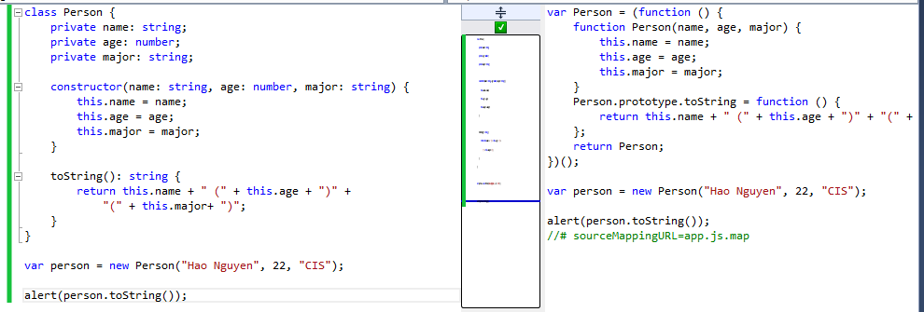
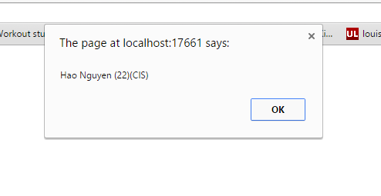
Private/Public Modifiers

Slide 18
Summary
Just a superset of JavaScript
Allows us to apply OOP to JavaScript
Any JavaScript program is already TypeScript program

Slide 19

Sources
http://en.wikipedia.org/wiki/TypeScript#Compatibility_with_JavaScript
http://weblogs.asp.net/dwahlin/getting-started-with-typescript-classes-static-types-and-interfaces
http://www.johnpapa.net/typescriptpost3/

