Slide 1
AJAX
Guy J. Stitt

Slide 2
AJAX Intro
Not a technology in itself
Jesse James Garret
  Coined term in 2005
Uses number of existing technologies together
Asynchronous JavaScript and XML

Slide 3
Why use AJAX?
Use Case
  Update the page without refresh
  Single page apps
  Dynamic components

Slide 4
AJAX with jQuery
Simple syntax
Options
  url
  type
    post or get
  data
  dataType

Slide 5
Events
Events are triggered during an AJAX request
We can manipulate data when these events are triggered
Events
  beforeSend, success, error, complete

Slide 6
Promise methods
jqXHR (jquery XMLHttpRequest)
  Wraps native XMLHttpRequest with a superset API
  jqXHR object returned by $.ajax()
Implements promise interface
  Allows use methods
    .done()
    .fail()
    .always()

Slide 7
Let’s get it
$.ajax({
url: 'Example.html',
type: 'GET',
}).done(function(data) {
$('body').append(data);
}).fail(function(data) {
alert('Why u do dis');
});

Slide 8
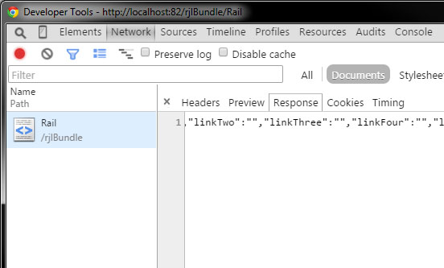
Monitoring Requests
Some info

Slide 9
Your Title
Some info

Slide 10
Your Title
Some info

Slide 11
Your Title
Some info

Slide 12
Your Title
Some info

Slide 13
Your Title
Some info

Slide 14
Your Title
Some info

Slide 15
Your Title
Some info

Slide 16
Your Title
Some info

Slide 17
Your Title
Some info

Slide 18
Your Title
Some info

Slide 19

Sources (list them)
http://www.google.com

