Slide 1
Google Charts
Dillion Patrick

Slide 2
How do I represent my data?
Population of Middle Earth by Race
Race | Population
Men | 472
Elves | 98
Half-elves | 12
Hobbits | 246
Dwarves | 52
Orcs | 20
Ainur | 37
Data from: http://lotrproject.com/statistics/

Slide 3
A Pie Chart of course
So let’s make our pie chart image and paste it into our webpage.
Done. Hurray!
… But what if the data changes?

Slide 4

Google Charts

Slide 5


Google Charts

Slide 6
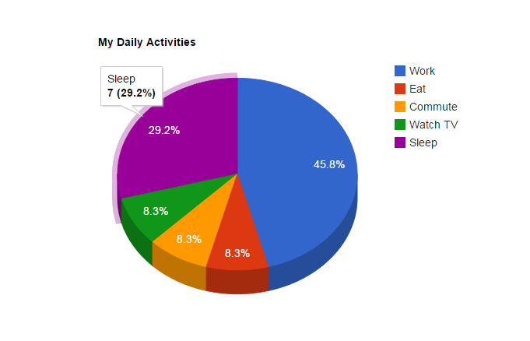
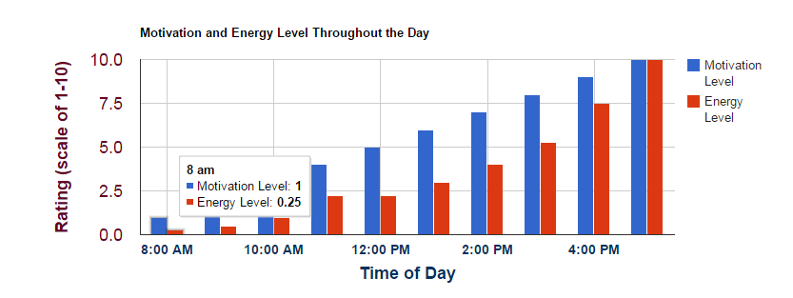

Slide 7
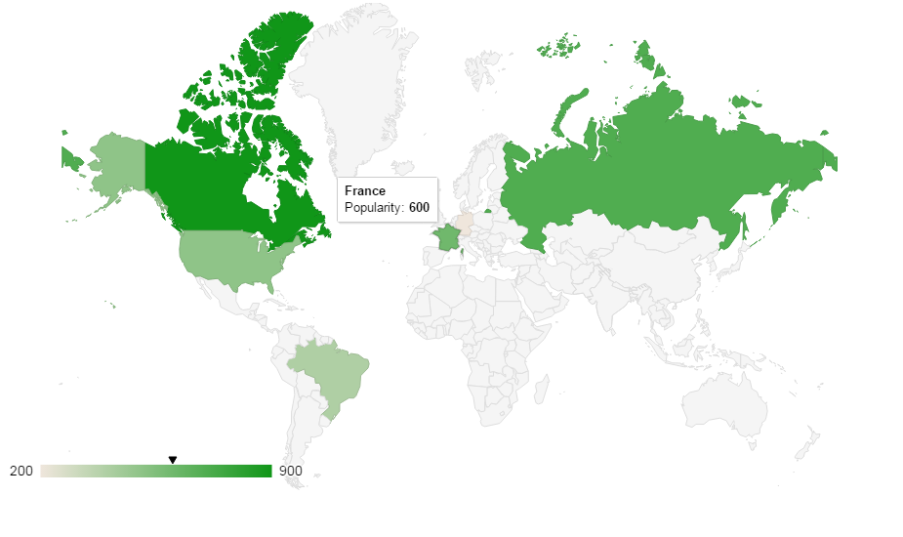
Geo Charts

Slide 8
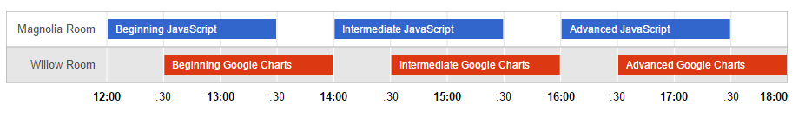
Timeline Charts

Slide 9
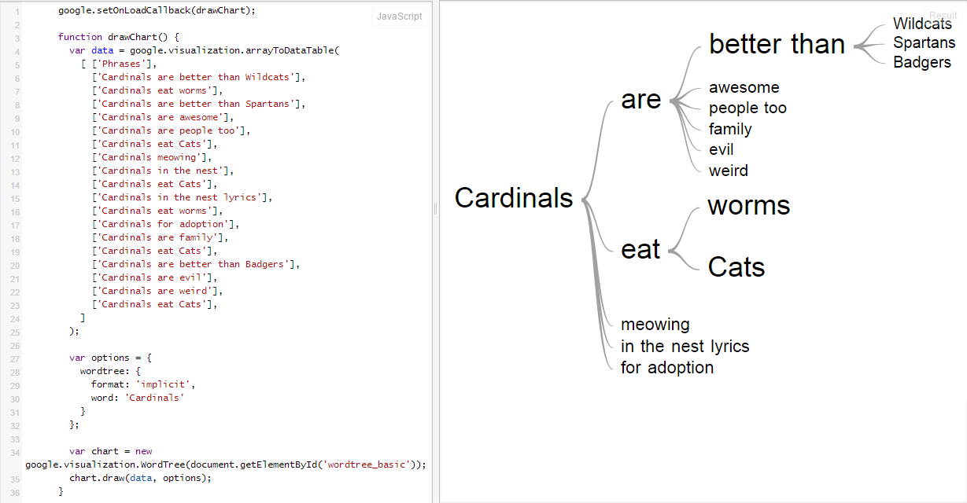
Wordtree Chart

Slide 10
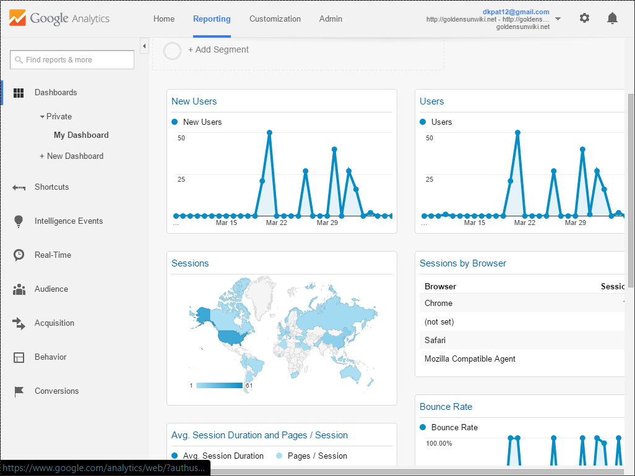
Your Title
Some info

Slide 11
Let’s Look at code
Call in the Google JS API
<script type="text/javascript" src="https://www.google.com/jsapi">
</script>
Then make a script

Slide 12
<script type="text/javascript">
// Load in the visualization package for charts
google.load('visualization', '1.0', {'packages':['corechart']});
// Set a callback to run when the Google Visualization API is loaded.
google.setOnLoadCallback(drawChart);

Slide 13
function drawChart() {
// Create the data table using our stats.
var data = new google.visualization.DataTable([
[‘Race', ‘Population'],
['Men', 472],
[‘Elves', 98],
[‘Half-Elves', 12],
[‘Hobbits', 246],
[‘Dwarves', 52],
[‘Orcs', 20],
[‘Ainur', 37]
]);

Slide 14
  // Set chart options
  var options = { title: 'Races in Middle Earth',
  pieHole: 0.4,
  };
  // Instantiate and draw our chart.
  var chart = new google.visualization.PieChart(document.getElementById(‘donutchart'));
  chart.draw(data, options);
}
</script>

Slide 15
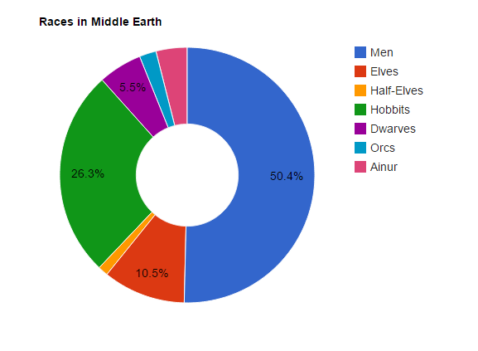
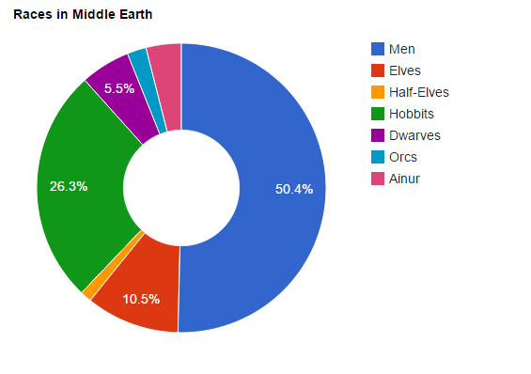
The HTML
<div id=“donutchart" style="width: 900px; height: 500px;"></div>
Done.

Slide 16
Finished!
The chart is super easy to update
Easy to customize
Doesn’t require a ton of code

Slide 17
Additional Features
Complete style control
  Change the colors, fonts, tooltips
Animate your data
  Dynamically refresh
Load data from external data sources
  JSON
  Databases

Slide 18
Google Charts
A very simple way to graphically represent your data on any website.
Live data
TONS of built in options
Cross-browser compatible (yes, IE too)
FREE!

Slide 19
Sources
http://developer.google.com/chart
http://lotrproject.com/statistics/
https://jsfiddle.net/1gktj5pn/

