Slide 1
AJAX
Guy J. Stitt

Slide 2
AJAX Intro
Not a technology in itself
Jesse James Garret
  Coined term in 2005
Uses number of existing technologies together
Asynchronous JavaScript and XML

Slide 3
Why use AJAX?
Use Case
  Update the page without refresh
  Single page apps
    Gmail
  Dynamic components
  Everybody's doing it

Slide 4
AJAX with jQuery
Simple syntax
Options
  url
  type
    post or get
  data
  dataType

Slide 5
Events
Events are triggered during an AJAX request
We can manipulate data when these events are triggered
Events
  beforeSend, success, error, complete

Slide 6
Promise methods
jqXHR (jquery XMLHttpRequest)
  Wraps native XMLHttpRequest with a superset API
  jqXHR object returned by $.ajax()
Implements promise interface
  Allows use methods
    .done()
    .fail()
    .always()

Slide 7
Let’s get it
$.ajax({
url: 'Example.html',
type: 'GET',
}).done(function(data) {
$('body').append(data);
}).fail(function(data) {
alert('Why u do dis');
});

Slide 8
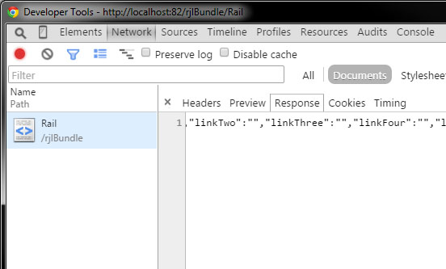
Monitoring Requests
Some info

Slide 9
Dynamic Component with AJAX
Overview
  Create a rail component that exists on right rail throughout the website
  AJAX to a controller
  Controller handles getting data and returns JSON
  JSON can then be used on the view

Slide 10
Setting up the Request
app.controller('RailController', ['$http', function($http){
var self = this;
self.items = [];
$http({
url: 'Rail/index/',
method: 'GET‘
}).done(function(data){
self.items = data;
});
}]);

Slide 11
Setting up the Controller
<?php
App::uses('AppController', 'Controller');
class RailController extends AppController {
public function index() {
$data = $this->Rail->find('all');
echo json_encode($data);
}
}
?>

Slide 12
Setting up the View
<ul ng-repeat=”RailController as rail”>
<li>{{rail.headline}}<li/>
<li>{{rail.dek}}<li/>
</ul>

Slide 13
Best Practices
You don’t want to send request on every page
Make use of session or local storage
if(!(sessionStorage.getItem('railObject'))){
do ajax….
} else {
rail.items = JSON.parse(sessionStorage.getItem('railObject'));
}

Slide 14
Debugging
Set breakpoints in the console
  after each event
Check the response from the server
  log the response
Validate your JSON
  online editors
Ask for help

Slide 15
Use the API
jQuery AJAX API
  easiest way to understand
  there are examples
Don’t rely on stack overflow
  code may be deprecated
It’s not about just getting it to work
  you need to understand

Slide 16
Can I Use?
caniuse.com
  great resource to see browser support
  some libraries have stopped support for IE8
    AngularJs
  test in all major browsers
    wiki keeps an up to date analysis

Slide 17
W3Schools<<<<
Use MDN
  Mozilla Developer Network
  Written by Developers
  Up to date
  Better Understanding
Use Treehouse
  free with library card
  learn by building apps

Slide 18
Summary
Using AJAX isn’t hard
Allows you to create dynamic websites
Single page apps are the future
If you can build dynamic websites someone will hire you

Slide 19

Sources
http://api.jquery.com/jquery.ajax/
https://developer.mozilla.org/en-US/docs/AJAX
http://caniuse.com/
https://developer.mozilla.org/en-US/docs/Web/JavaScript/Reference/Global_Objects/Promise

